Slide 1
Virginia & The Southern Colonies
Motivation – Economic Opportunity

Slide 2
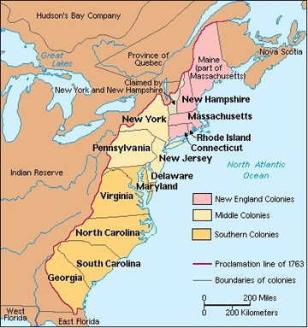

Slide 3
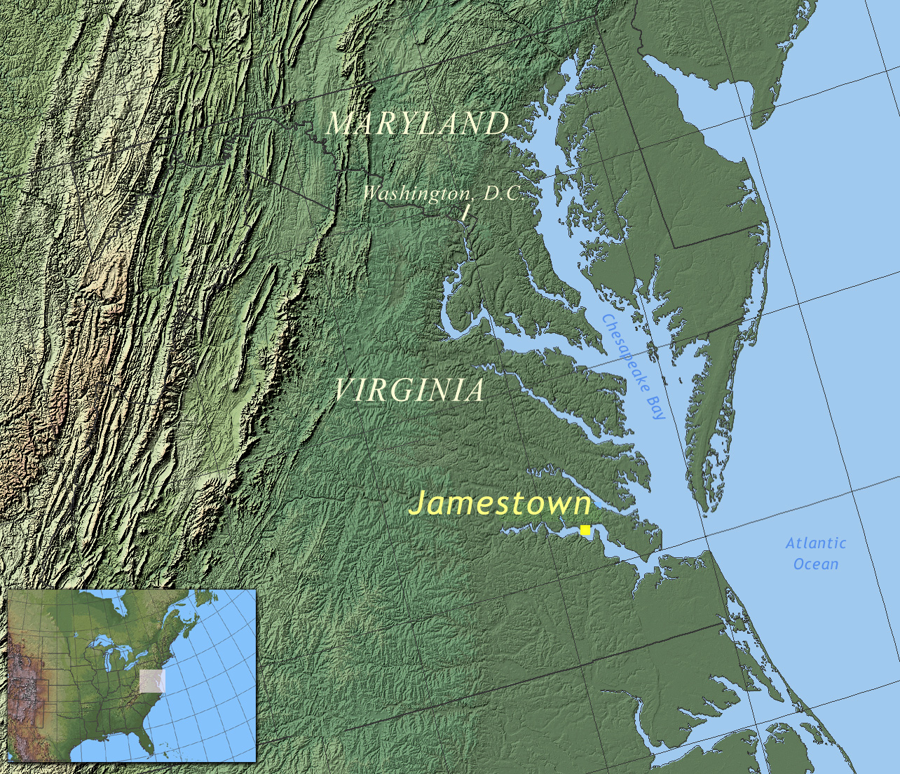

Slide 4
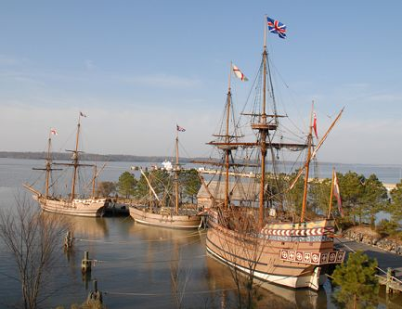

Slide 5
Jamestown (VA):
Established by the Virginia Company of London (1607)
1. Business venture - hoped to find lot of gold & silver in Virginia
Sent 105 men (goldsmiths & “gentlemen”)
Settled on a swampy site along the James River
4. First permanent English settlement in the New World

Slide 6
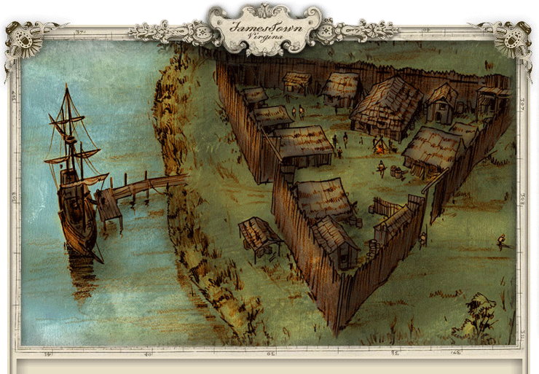

Slide 7
The Struggling Colony
1. Colony barely survived
2. Capt. Smith provided leadership
Rolfe (1612) planted Caribbean tobacco seeds ($$$) and married Pocahontas
3. Tobacco saved Jamestown

Slide 8
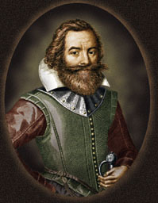
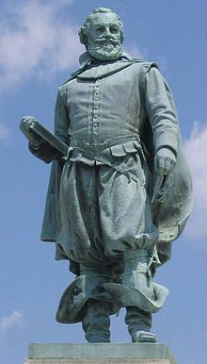

Slide 9
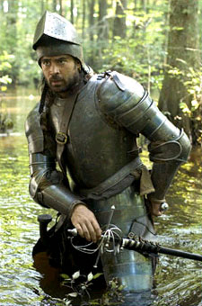

Slide 10
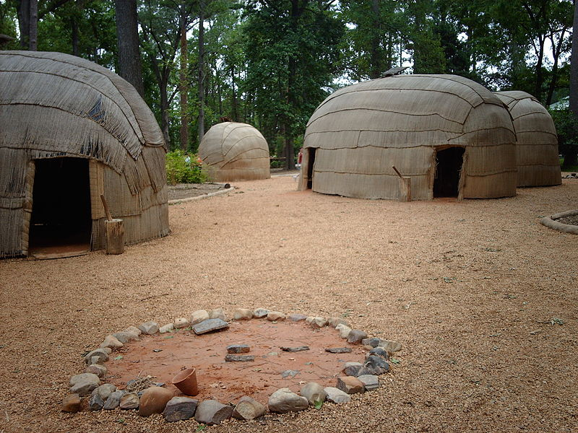

Slide 11
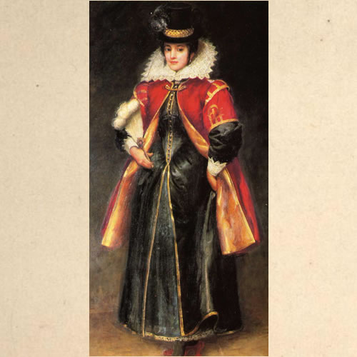

Slide 12
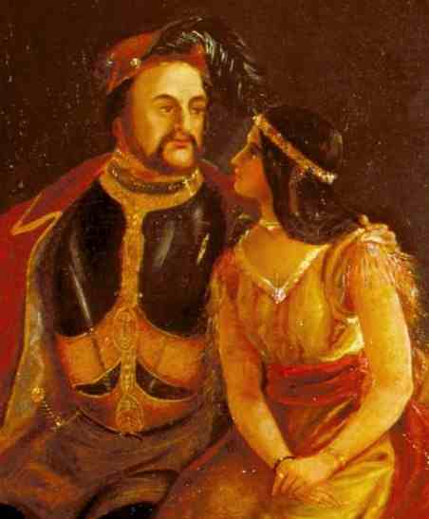

Slide 13
5. Growing tobacco required cheap labor.
A. Indentured servants = poor immigrants from England, Scotland, & Ireland who worked 4-7 yrs to pay for their passage to America.
B. 1619 – Dutch brought slaves to VA to work on tobacco plantations.

Slide 14
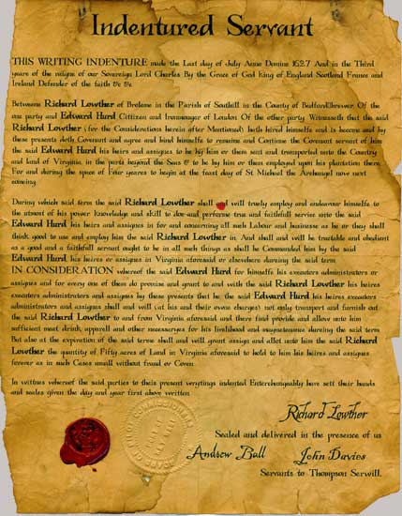

Slide 15
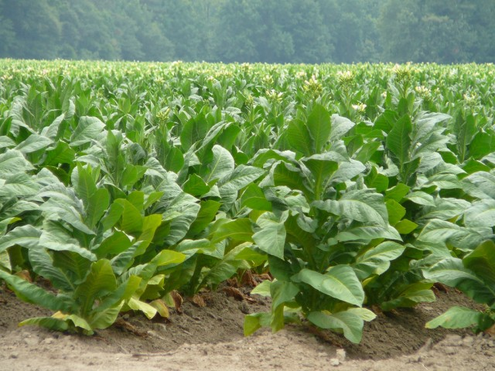

Slide 16
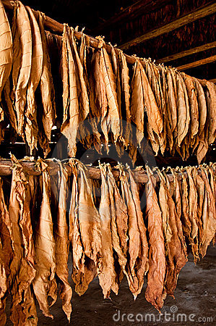

Slide 17
Early Government in Virginia
1. Cavaliers = English nobles given land grants from the King in the Tidewater region (eastern coastal lowlands)
2. These wealthy landowners dominated govt. & society
A. Society based on land ownership
B. Strong ties with Britain
C. Strong allegiance to the Church of England

Slide 18
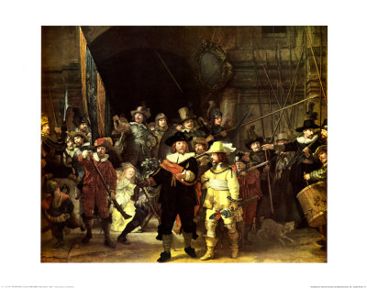

Slide 20
3. By 164o’s, the House of Burgesses (first elected assembly) was established – today it is called the General Assembly
4. Poor immigrants seeking better lives moved west into the Shenandoah Valley or Appalachian Mts.
A. Became small farmers, artisans, hunters, & traders
B. Strong belief in private ownership & free enterprise

Slide 21
Other Southern Colonies (MD, NC, SC, and GA)
1. Settled mainly by people who wanted to make money
2. Hot, humid coastal lowlands were ideal conditions for growing cash crops such as tobacco, rice and indigo. (TRI)

Slide 22
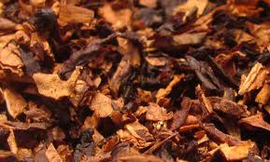
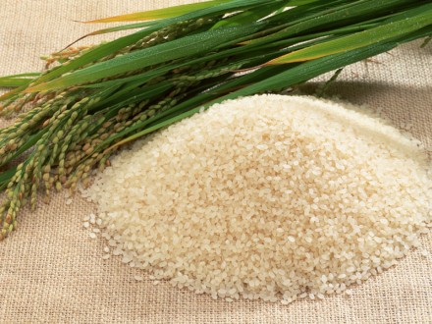
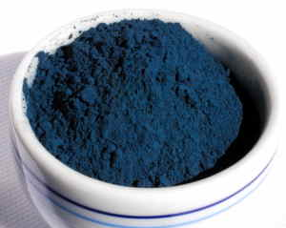

Slide 23
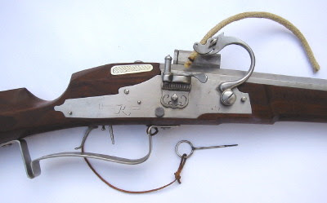

Slide 24
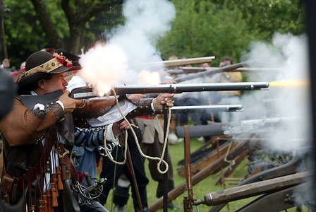

Slide 25
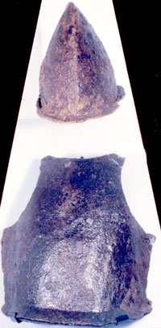

Slide 26
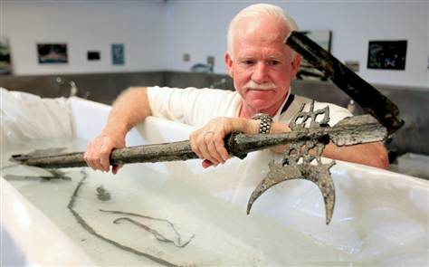

Slide 27
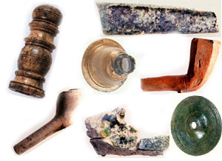

Slide 28
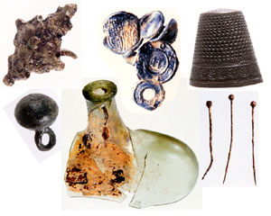

Slide 29
The New England Colonies
Motivation – Freedom to Worship

Slide 31
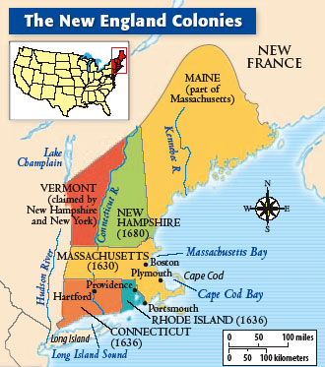

Slide 33
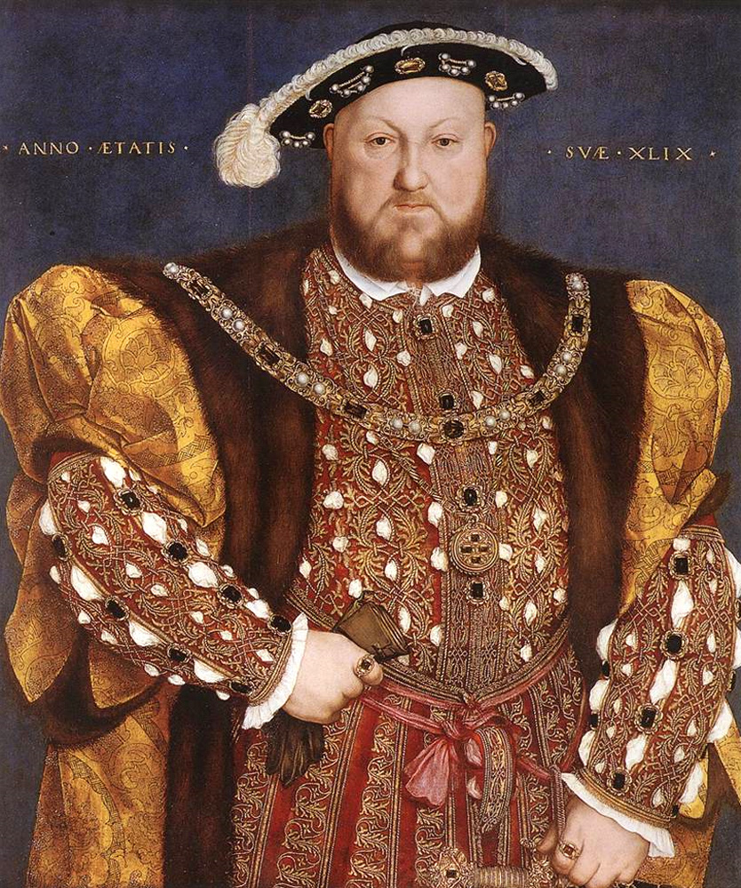

Slide 34
A. Massachusetts
Pilgrims = religious group who wanted to “separate” from the Church of England
1620: Mayflower landed in Massachusetts - formed the Plymouth Colony

Slide 35
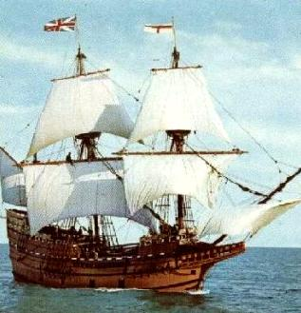

Slide 36
formed a “covenant community” based on the principles of the Mayflower Compact
Bound themselves together for religious purposes
Established notion of self-government
Celebrated 1st Thanksgiving a year later (3 day feast in 1621)

Slide 37
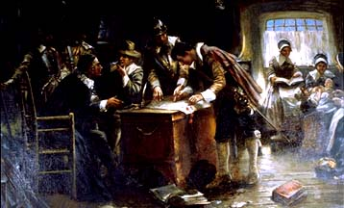

Slide 38
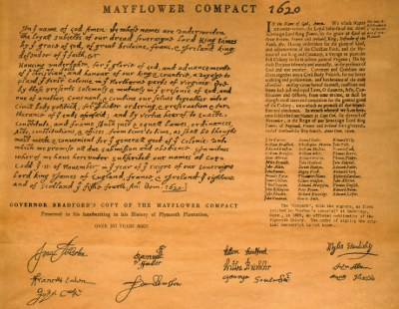

Slide 39
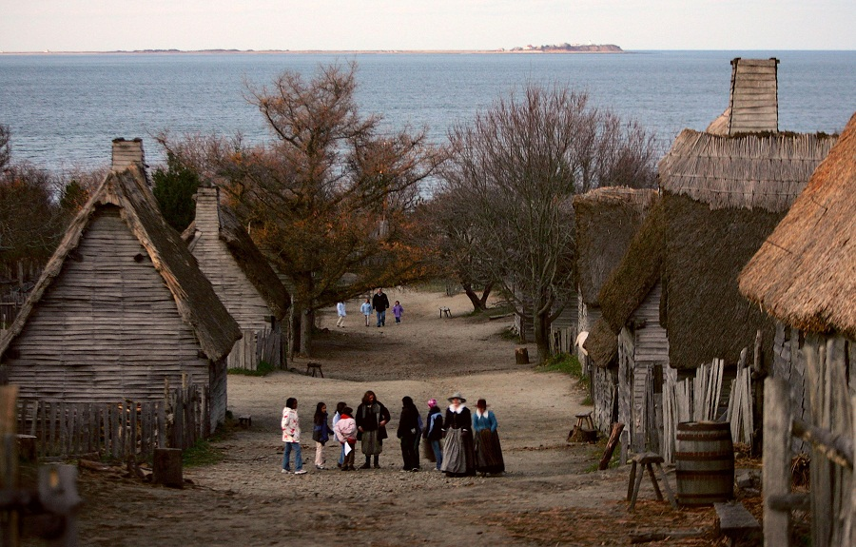

Slide 40
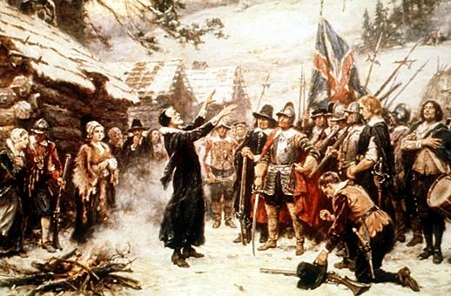

Slide 41
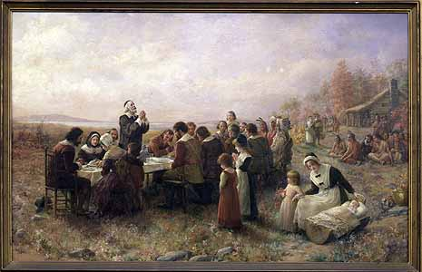

Slide 42
Puritans = unhappy – wanted to “purify” rituals of the Church of England & believed church members should elect their leaders
Town meetings = decisions made at the meeting house (church)
Adult, male church members governed the community
Form of Athenian or direct democracy (each person had a vote!)

Slide 43
Puritans were intolerant (did NOT give religious freedom to others) – all who disagreed (dissented) were banished (forced to leave the colony)
Colonial society was based on religious standing

Slide 44
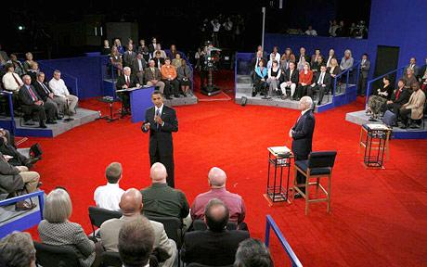

Slide 45
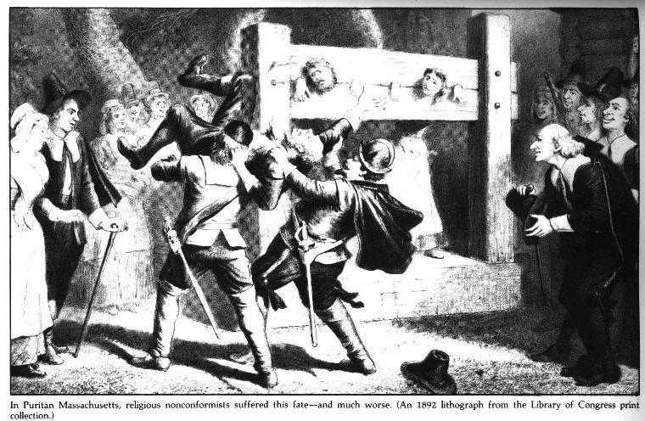

Slide 46
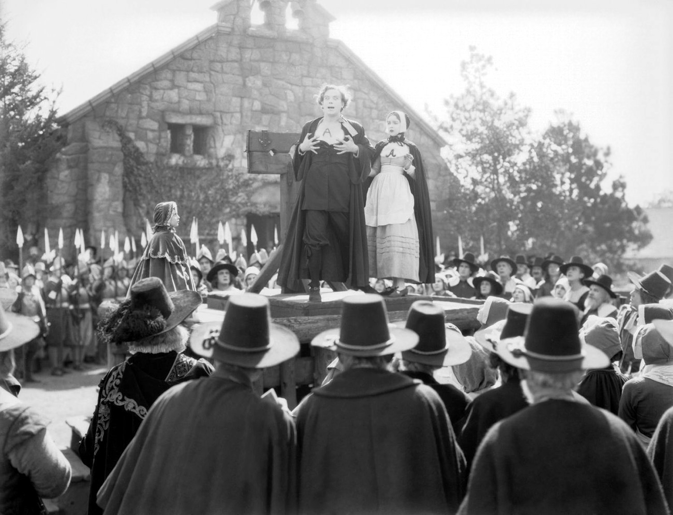

Slide 47
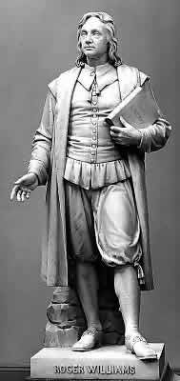
Rhode Island
Settled by Roger Williams (dissenter who was banished by the Puritans in Massachusetts)

Slide 48
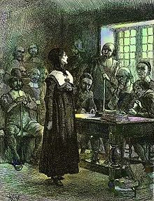
Connecticut
Anne Hutchinson – banished from Massachusetts by the Puritans for questioning the church’s authority.
- helped create the Connecticut colony

Slide 49
New England’s Economy – How they made their money?
1. Did NOT form plantations dependent on slaves because of rocky soil and cooler climate
2. Prosperity based on shipbuilding, fishing, and lumbering
3. Strong belief in the values of hard work and thrift (saving)

Slide 50
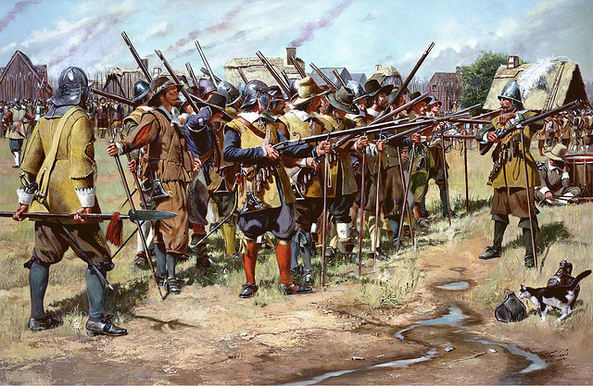

Slide 51
The Middle Colonies

Slide 52
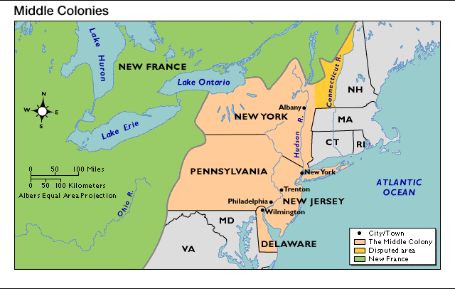

Slide 53
A. The Middle Atlantic colonies were New York, Delaware, Pennsylvania, New Jersey.
1. Settled by English, Swedish, Dutch, and German-speaking immigrants
Some came for religious freedom & economic opportunities

Slide 54
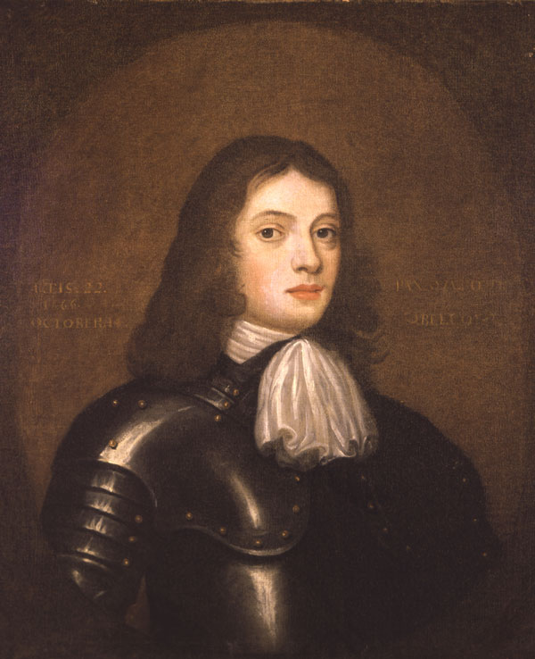

Slide 55
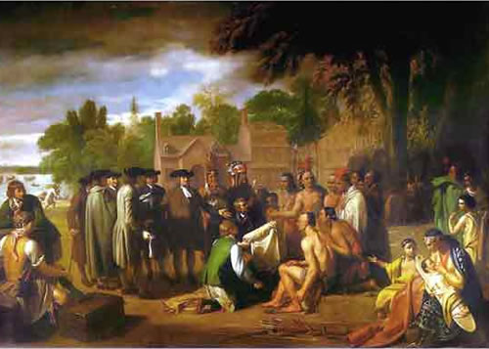

Slide 56
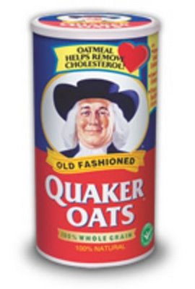

Slide 57
B. Social Characteristics
1. Home to multiple religious groups led to more religious tolerance
a. Quakers – Pennsylvania
b. Huguenots & Jews – New York
c. Presbyterians – New Jersey
(d. Catholics – Maryland)
2. More flexible social structure than other colonies

Slide 58
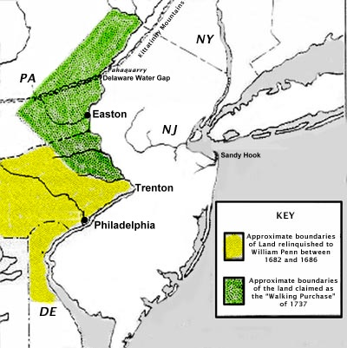

Slide 59
C. Economy
1. Based on shipbuilding, small-scale farming and trading
2. New York and Philadelphia grew into thriving seaports and commercial centers
3. Began to develop a middle class of skilled artisans (craftsmen), entrepreneurs (businessmen), and small farmers

Slide 60
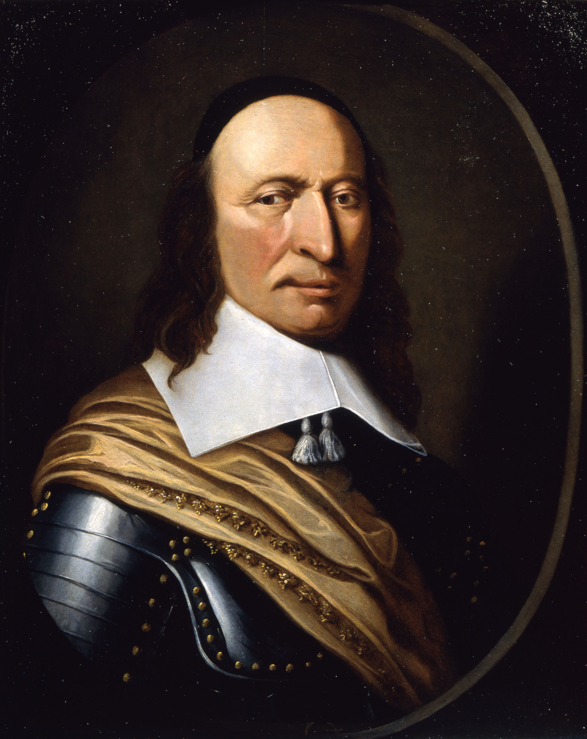

Slide 61
Growth of Slavery & Religion

Slide 62
A. Slavery
1. Economic differences will eventually lead to a Civil War
a. South = Slaves worked for life on plantations.
b. North = Poor farmland, few slaves.

Slide 63
2. Triangular Trade: 3-part colonial trade system
a. New England merchant ships carried rum across the Atlantic to West Africa. Traded rum for slaves.
b. “Middle Passage” = horrible journey for slaves shipped from Africa to West Indies (Caribbean).
c. Slaves traded in West Indies for sugar & molasses which was shipped to New England to make more rum.

Slide 64
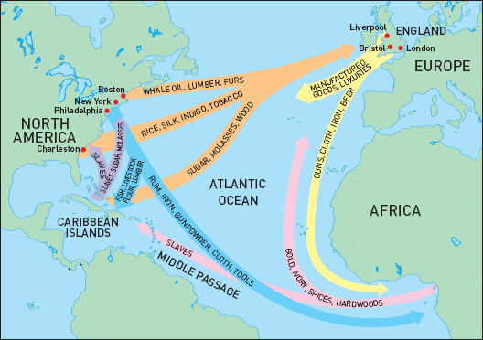

Slide 65
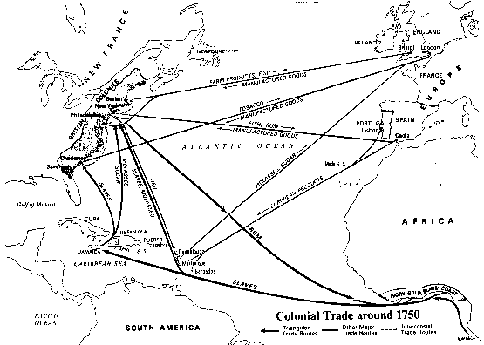

Slide 66
B. Religion
1. “Great Awakening” = mid-1700s religious movement that swept through colonies.
(Jonathan Edwards, Puritan minister – “Sinners in the Hands of an Angry God” – warned of dangers of Hell.)

Slide 67
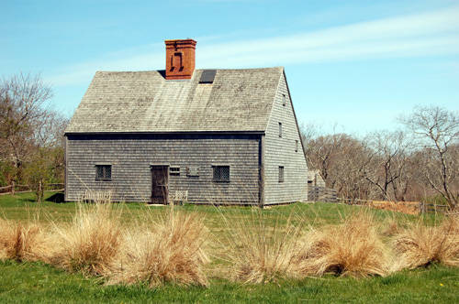

Slide 68
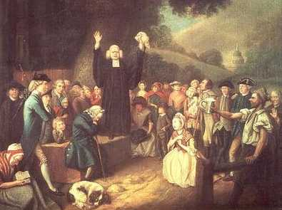

Slide 69
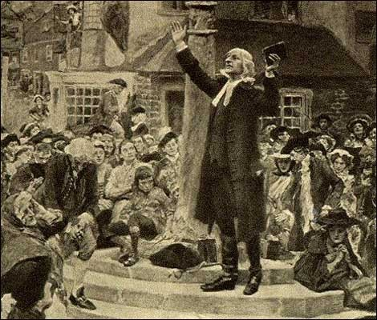

Slide 70
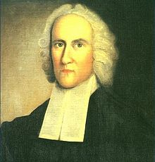

Slide 71
Effects of the Great Awakening:
a. New denominations such as Baptists & Methodists
b. New colleges to train ministers = Wm. & Mary, Princeton
d. People challenged government authority – “revolutionary”

