Slide 1
The Wild West

Slide 2
Following the Civil War, settlers streamed into the lands between the Mississippi R. and the Rockies, better known as the Great Plains. WHY?

Slide 3
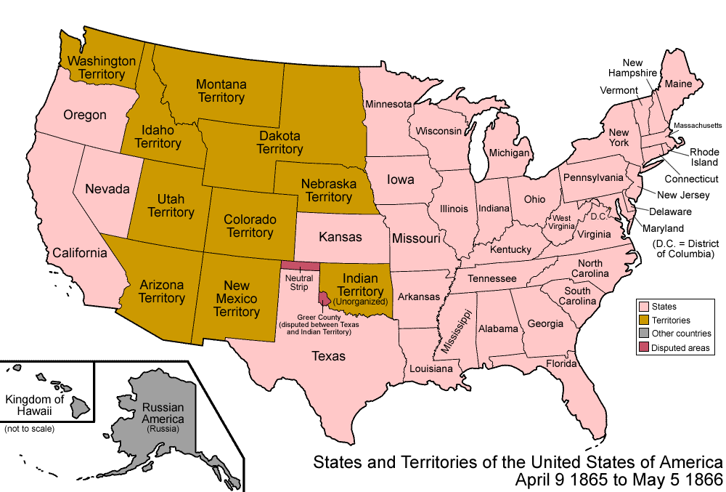

Slide 4
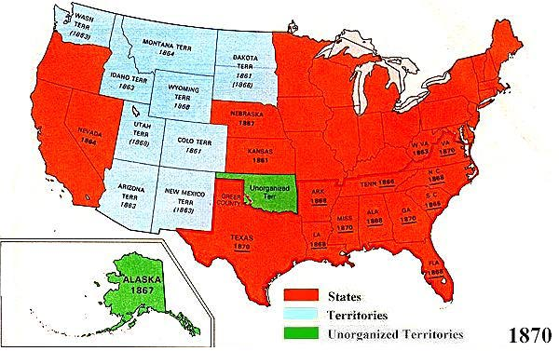

Slide 5
A. Many southerners and freedmen took advantage of the Homestead Act of 1862.
1. Federal govt offered 160 acres for free – had to live on & farm the land for 5 years.
2. Difficult life (few trees, limited water, extreme temps.)
3. Sodbusters (built houses out of chunks of Earth) often lost homesteads b/c of drought, erosion, & overuse of the land

Slide 6
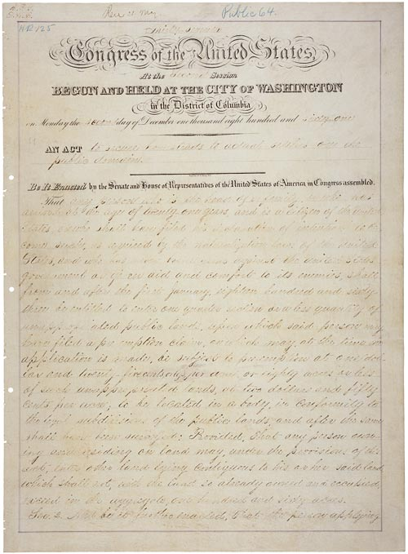

Slide 7
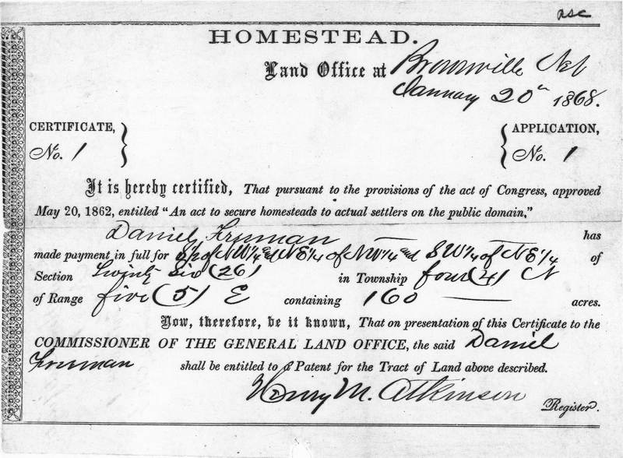

Slide 8
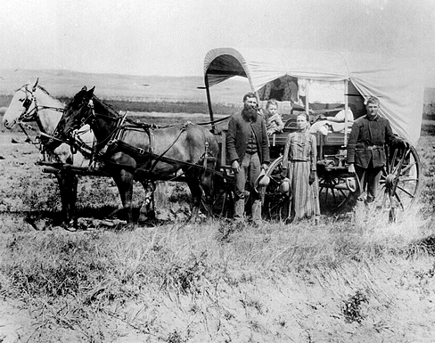

Slide 9
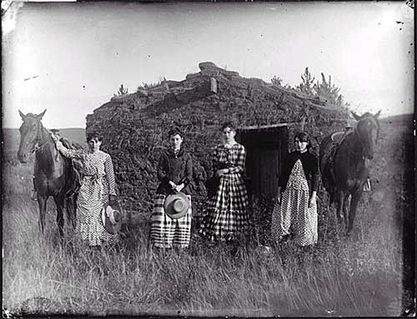

Slide 10
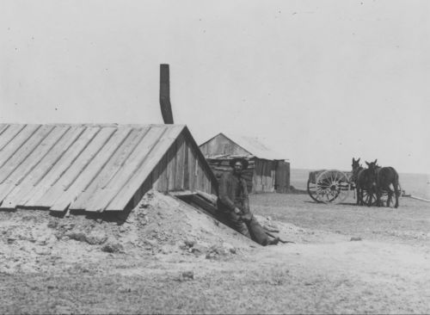

Slide 11
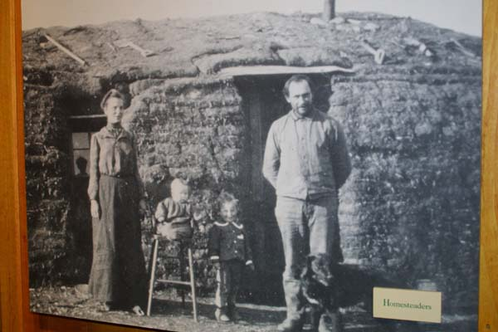

Slide 12
B. New technologies made farming on the Great Plains profitable
1. Mechanical reaper = a harvesting machine to cut wheat and corn more efficiently
Invented by Cyrus McCormick
2. Railroads linked resources and markets
- opened lands in the west & encouraged settlement.

Slide 13
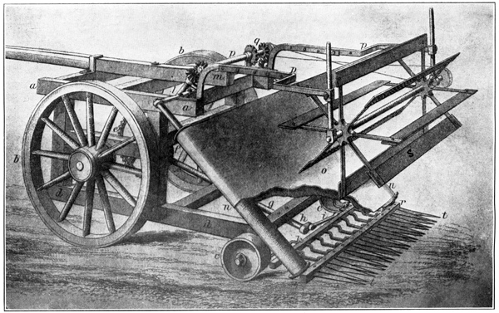

Slide 14
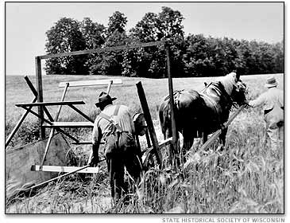

Slide 15
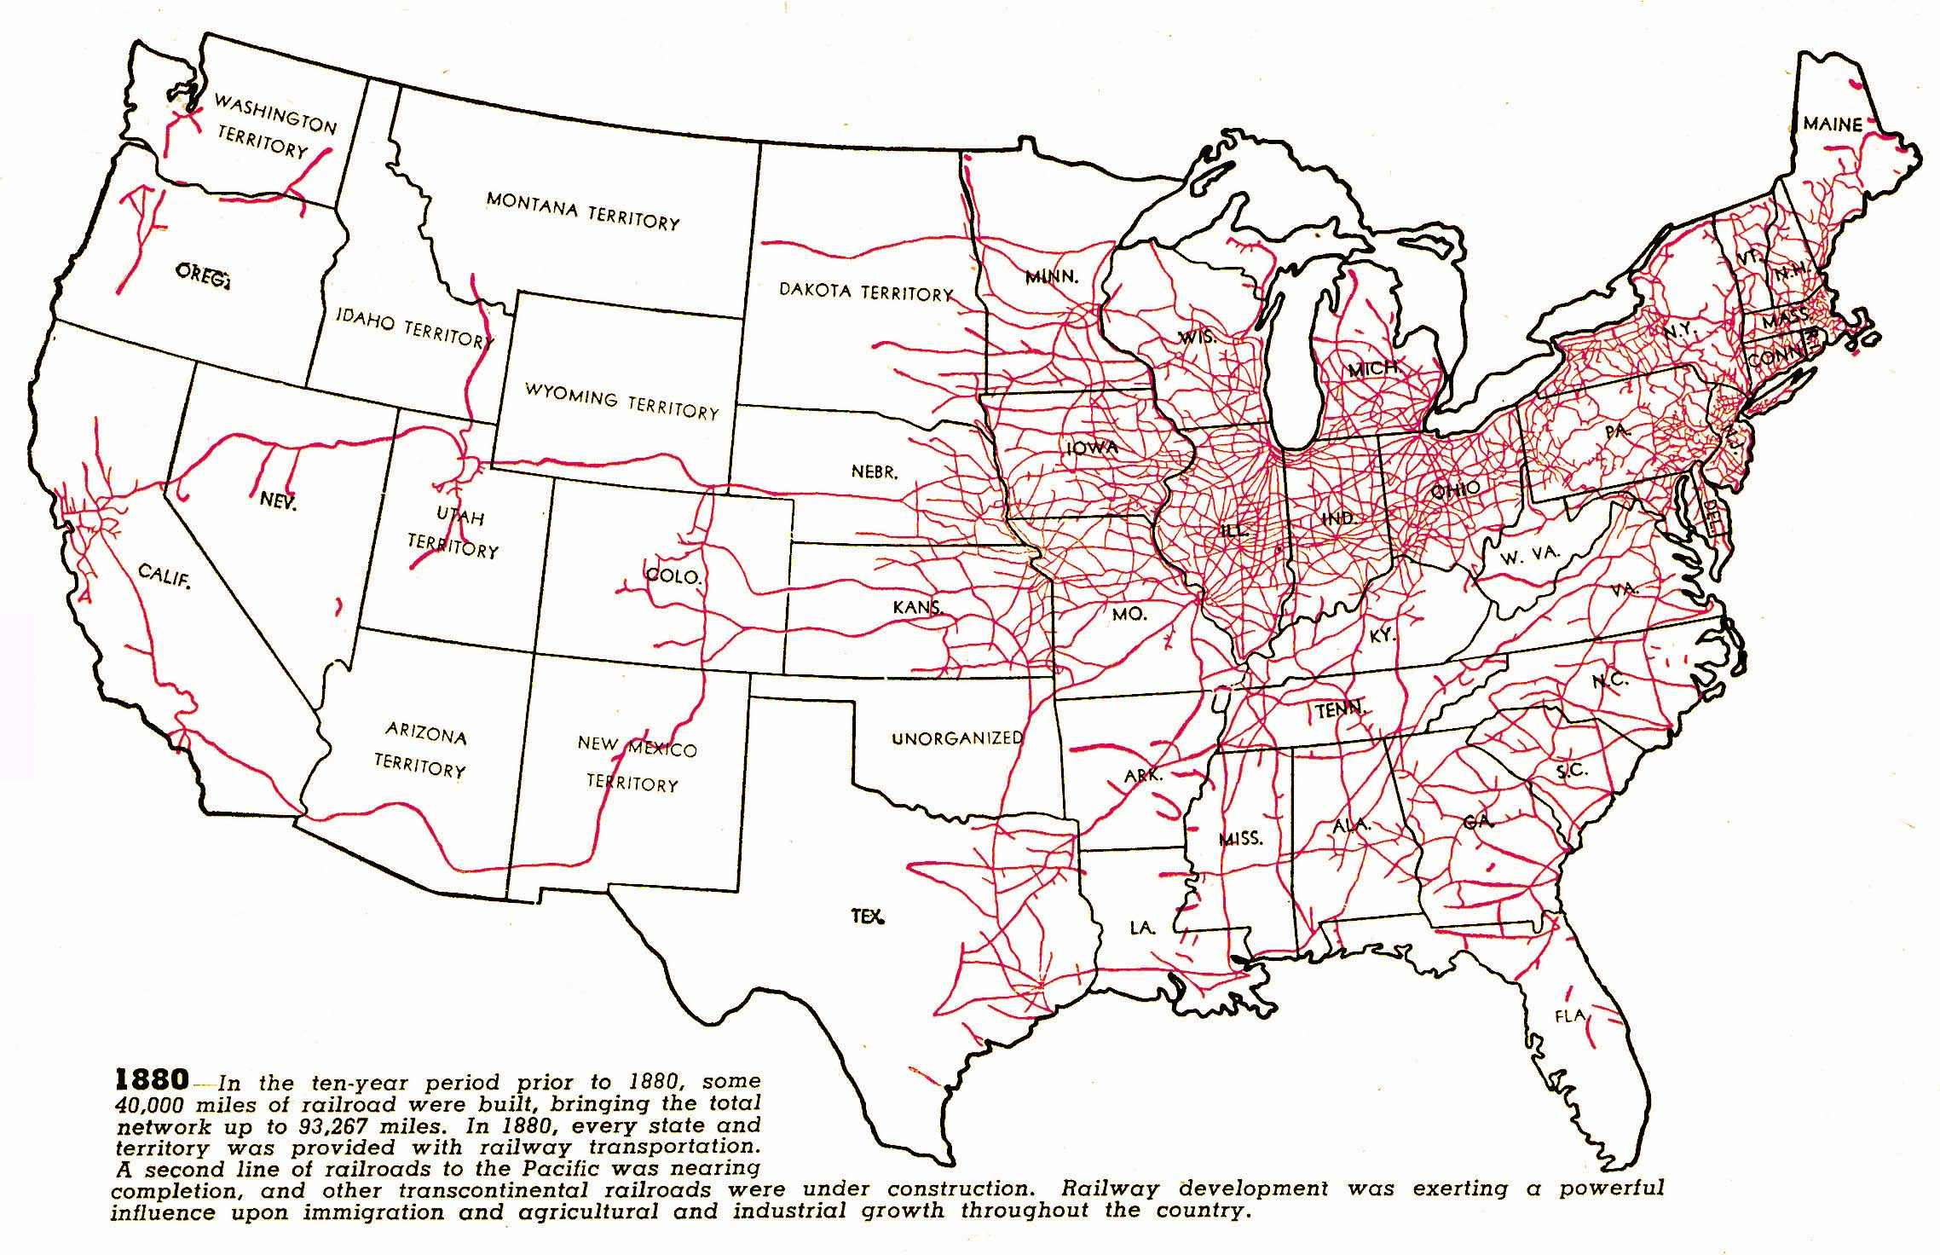

Slide 16
C. Raising cattle leads to the era of the cowboy
1. Huge demand for beef in the Civil War
2. RRs shipped the meat quickly
3. Long drive = cowboys herded Texas longhorns to RR in Kansas
4. “barbed wire” – cheap fences to protect fields from cattle herds

Slide 17
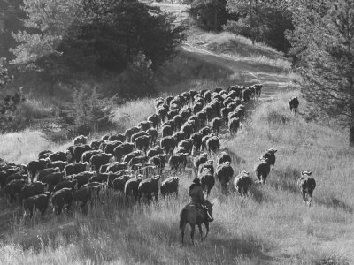

Slide 18
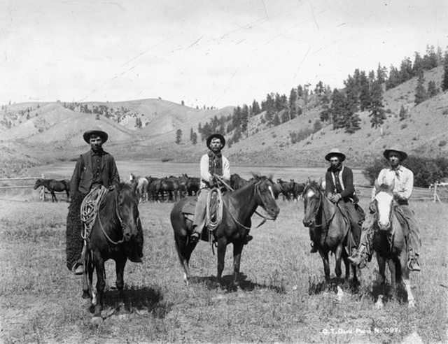

Slide 19
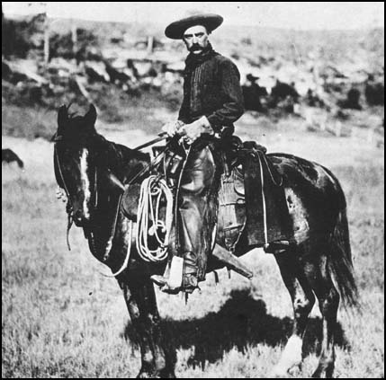

Slide 20
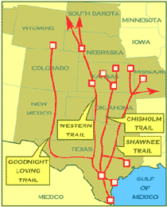

Slide 21
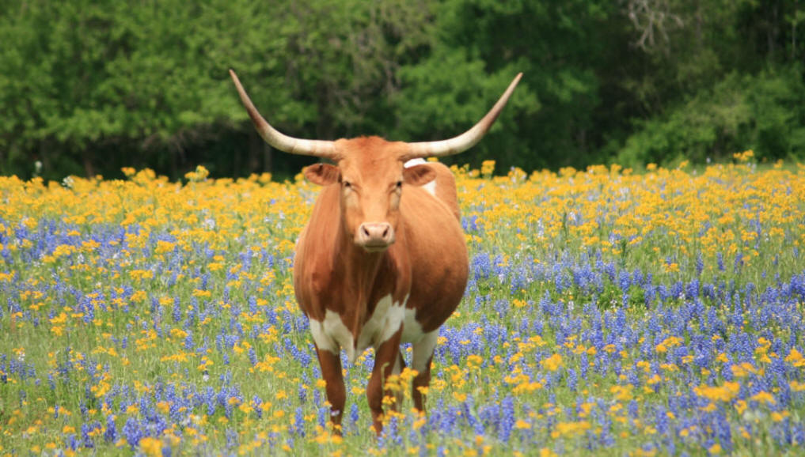

Slide 22
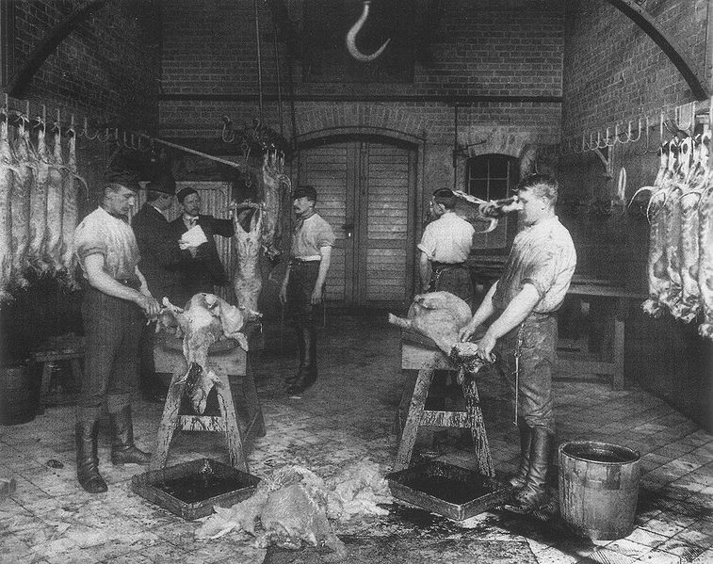

Slide 23
E. In 1890, the Census Bureau reported that there was no more frontier left

Slide 24
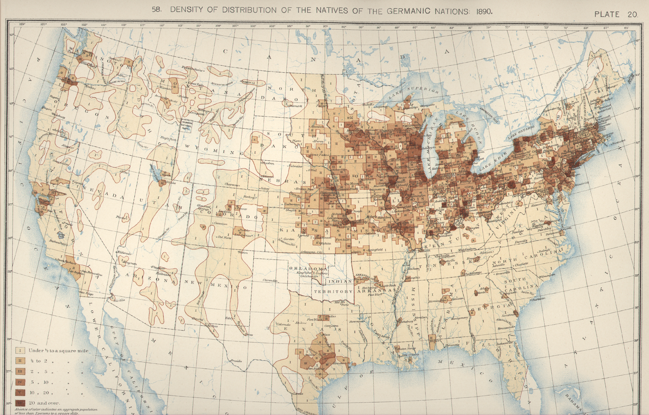

Slide 25
F. Conflict with the American Indians
1. Indians pushed onto reservations deprived of hunting grounds for buffalo
2. U.S. govt broke treaties with the Indians & had little respect for their culture
3. U.S. plan to assimilate the Indians failed!

Slide 26
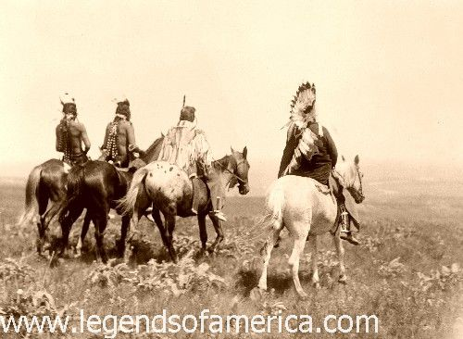

Slide 27
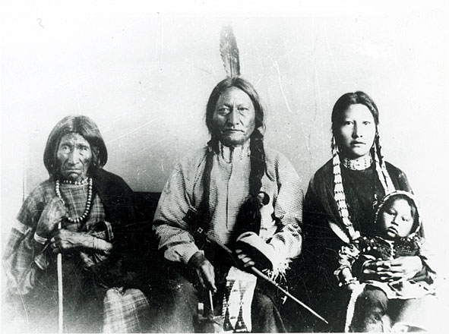

Slide 28
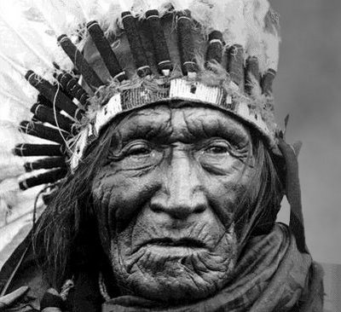

Slide 29
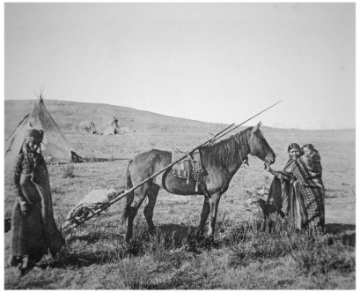

Slide 30
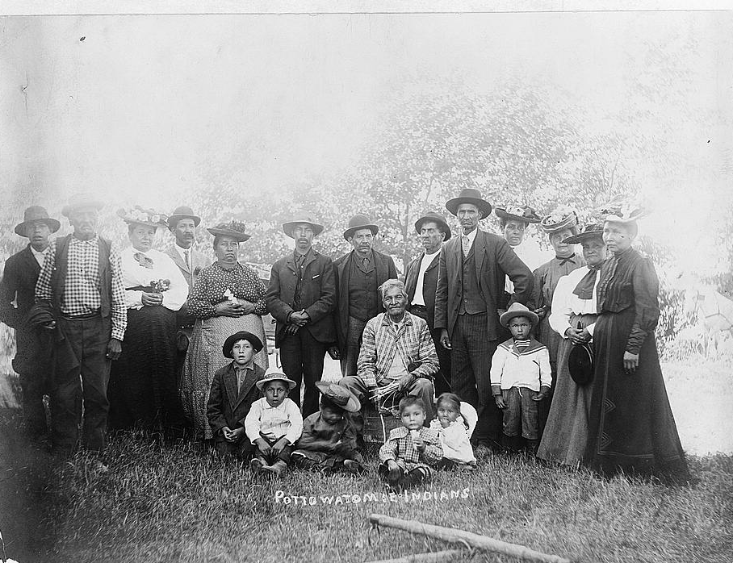

Slide 31
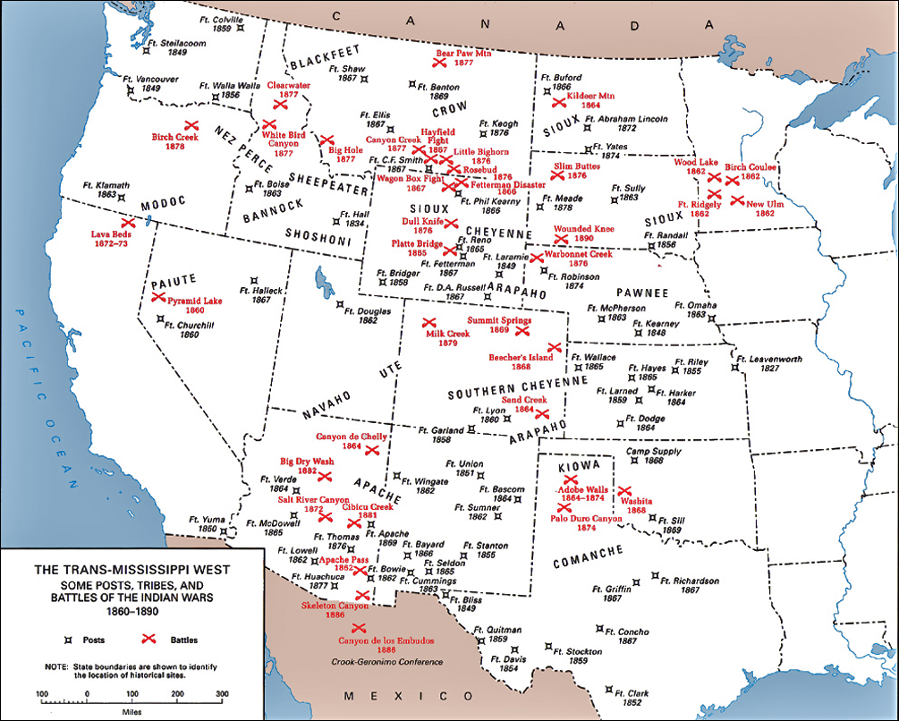

Slide 33
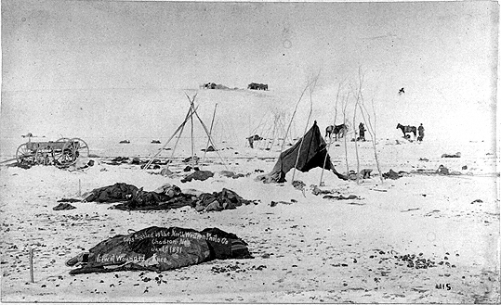

Slide 34
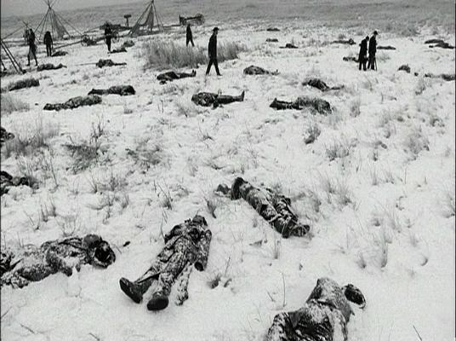

Slide 35
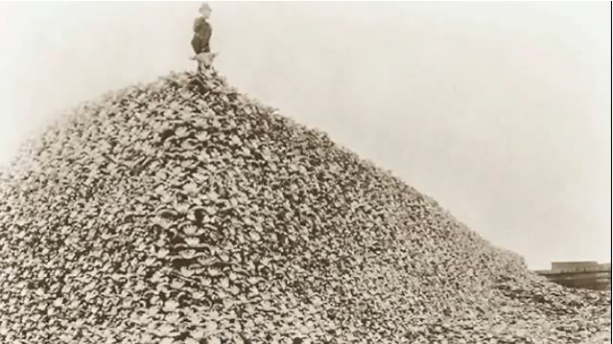

Slide 36
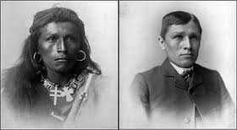

Slide 37
