Slide 1
The Supreme Court Rules!

Slide 2
A. Membership on the Supreme Court has changed in recent decades
1. Nine justices make the decisions that can have a broad impact on society
2. Until 1967, only white males served on the bench
3. Today, the court is more diverse, includes women & men
a. Clarence Thomas is the only African-American justice

Slide 3
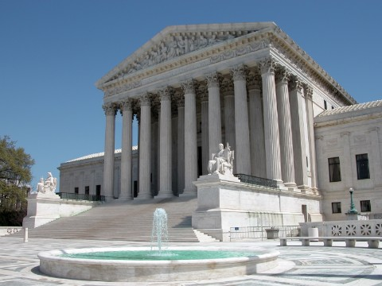

Slide 4
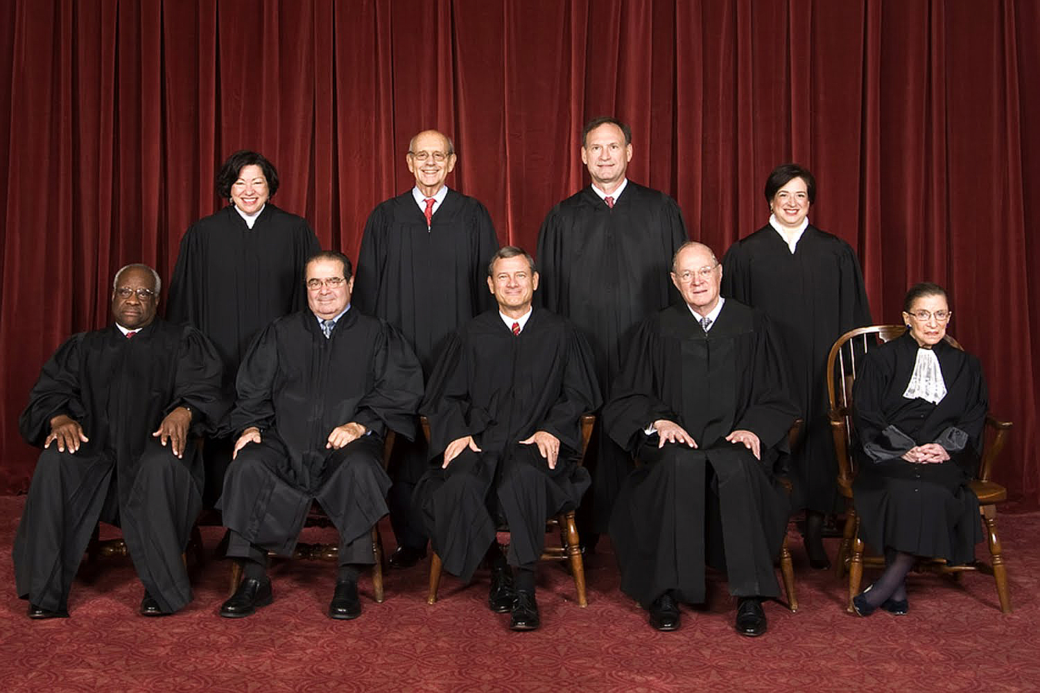

Slide 5
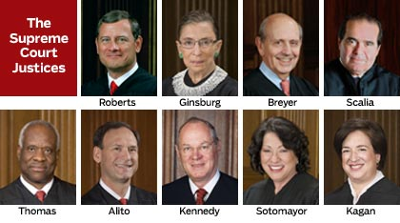

Slide 6
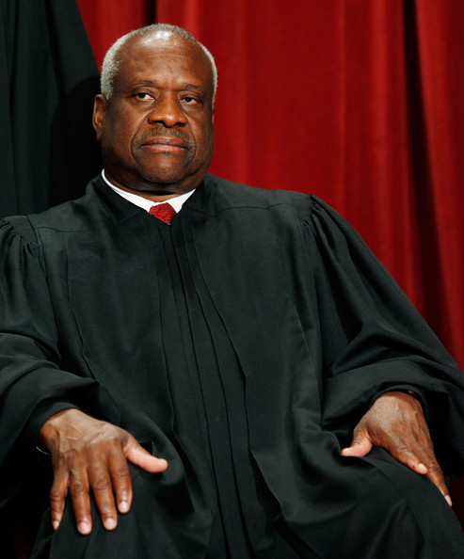

Slide 7
4. In 1981, Sandra Day O’Connor, became the 1st female
a. In 1993, Ruth Bader Ginsburg became a member
b. In 2010, Sonia Sotomayer (Hispanic) became a member

Slide 8
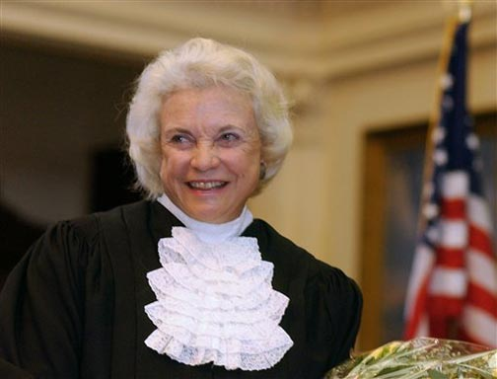

Slide 9
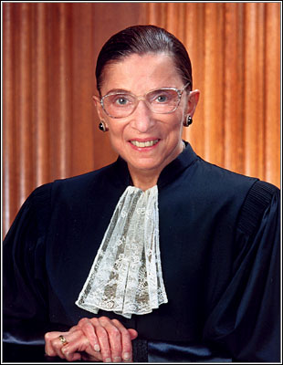

Slide 10
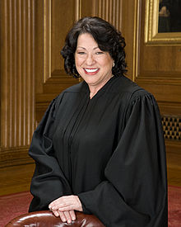

Slide 11
B. Importance of Supreme Court Decisions
1. Extending civil rights since Brown, 1954.
a. 1964 Civil Rights Act = equal employment for women & minorities

Slide 12
2. Protecting individual rights in the Constitution
a. Right to Privacy is protected
(Roe vs. Wade (1973) –woman’s right to have an abortion)
b. Freedom of speech/expression is protected
(Texas vs. Johnson (1989) – it is legal to burn the American flag)

Slide 13
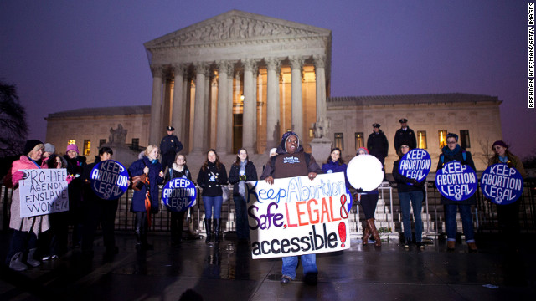

Slide 14
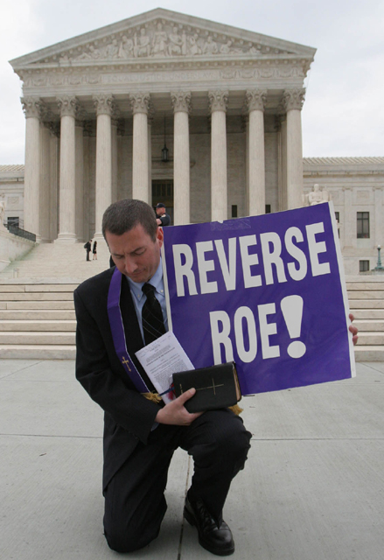

Slide 15
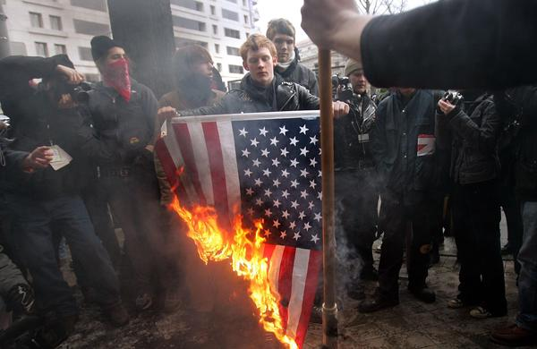

Slide 16
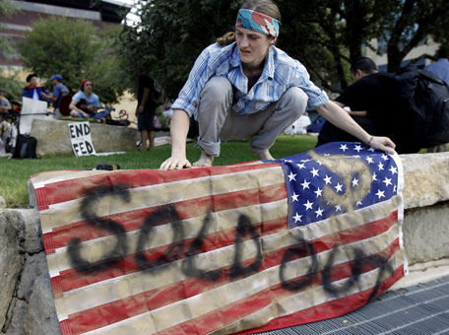

Slide 17
3. Judicial review invalidates laws that exceed their constitutional authority
(United States v. Nixon (1974) – president forced to release Watergate tapes)

Slide 18
