Slide 1
The Roaring Twenties

Slide 2
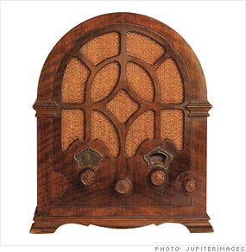
News & Entertainment
Radios

Slide 3
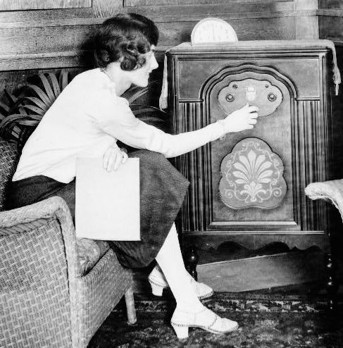

Slide 4
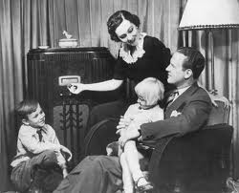

Slide 5
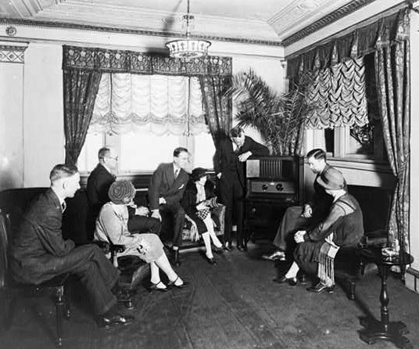

Slide 6
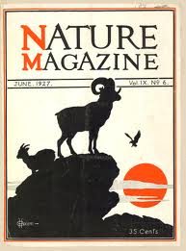
magazines

Slide 7
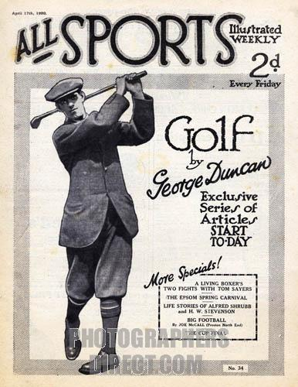

Slide 8
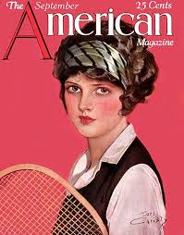

Slide 9
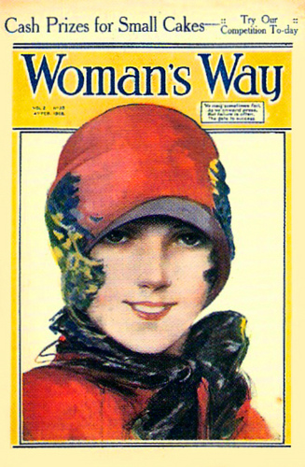

Slide 10
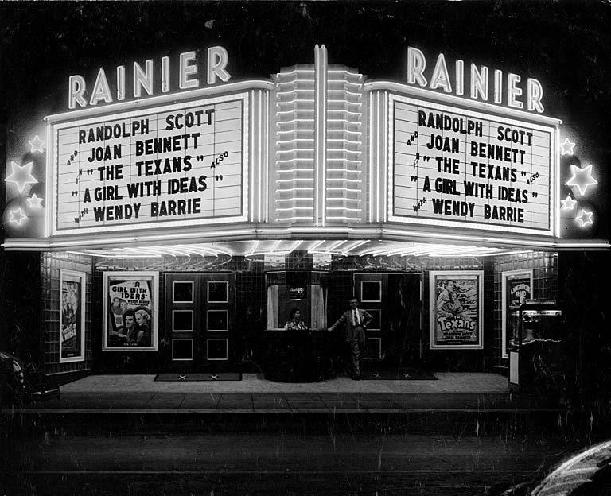
Movies

Slide 11
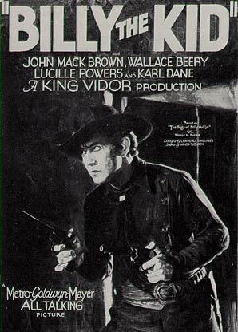

Slide 12
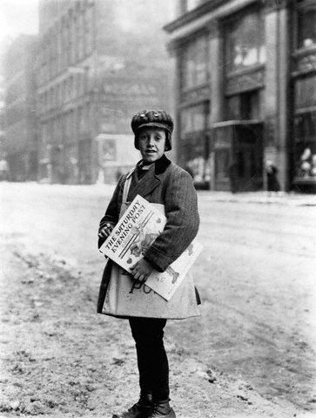
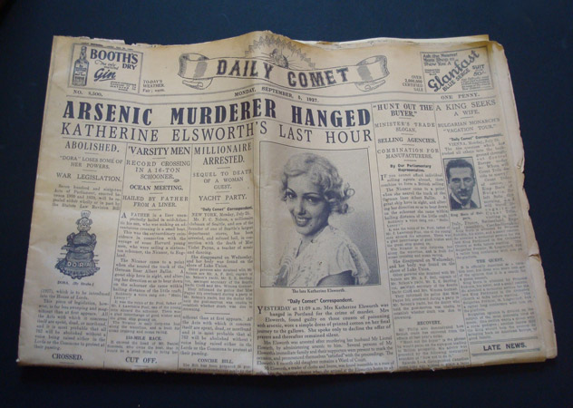
newspapers

Slide 13
Mass Media
Unified the nation and spread culture

Slide 14
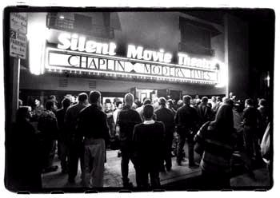
Rise of Hollywood
Early movies – no sound & relied on subtitles & lots of action

Slide 15
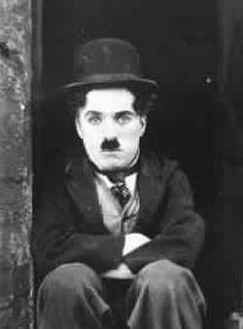
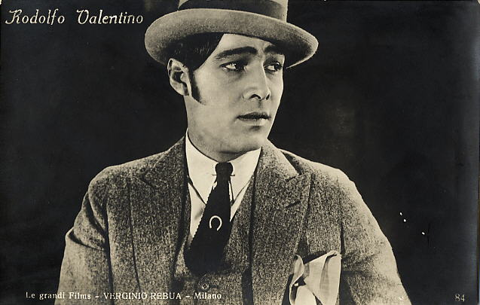
Stars of Film
Rudolph Valentino & Charlie Chaplin

Slide 16
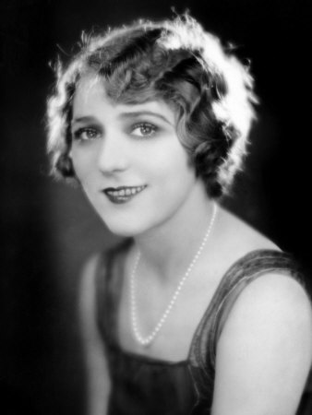
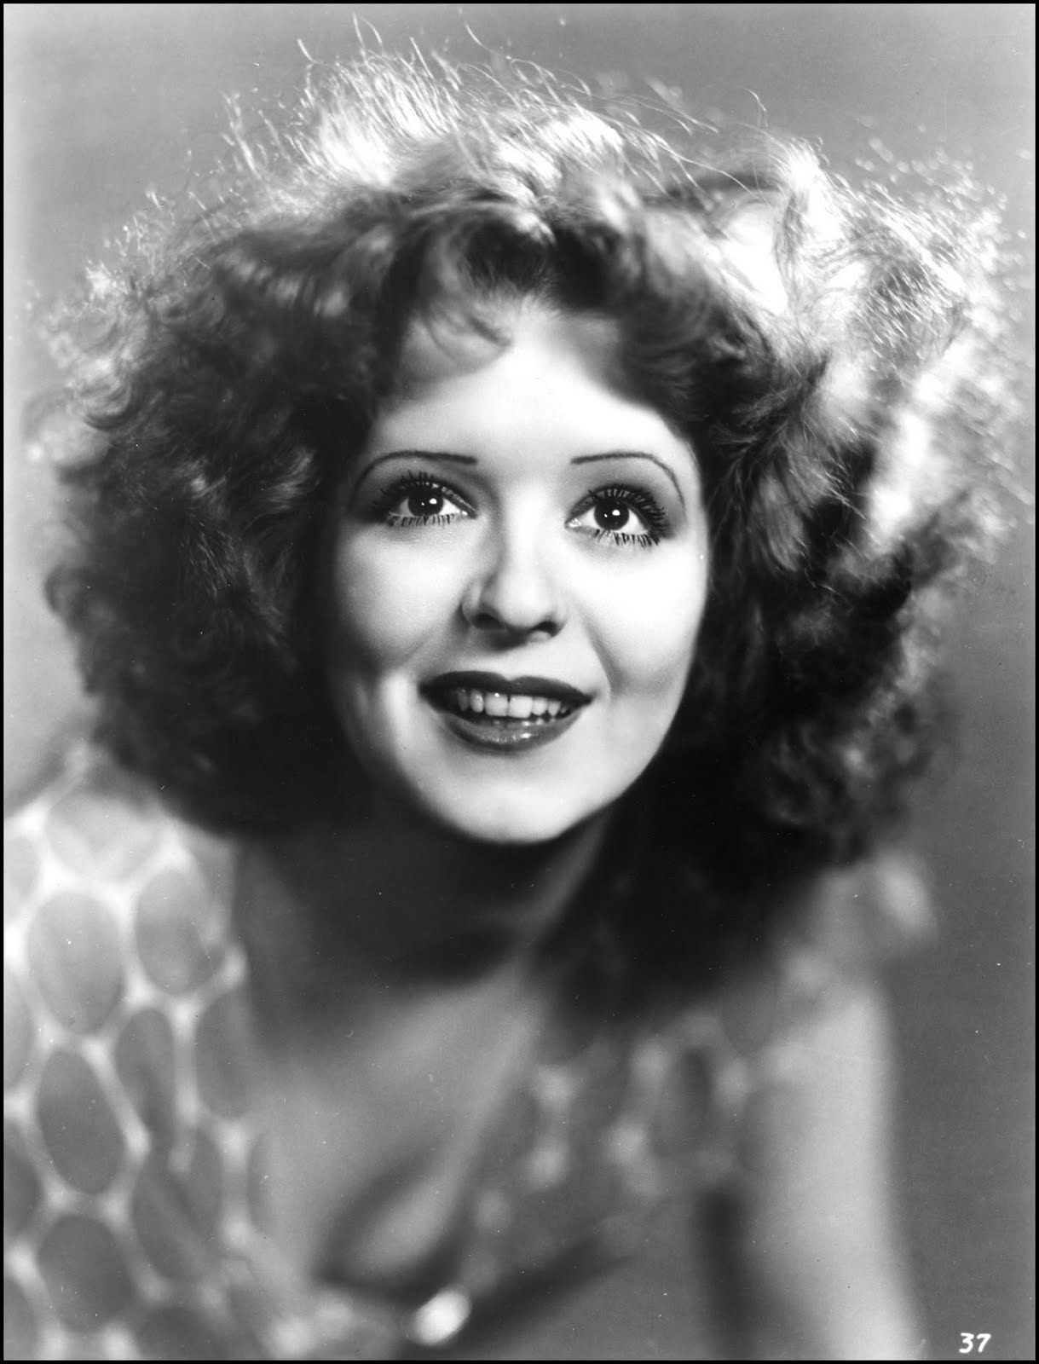
Mary Pickford & Clara Bow

Slide 17
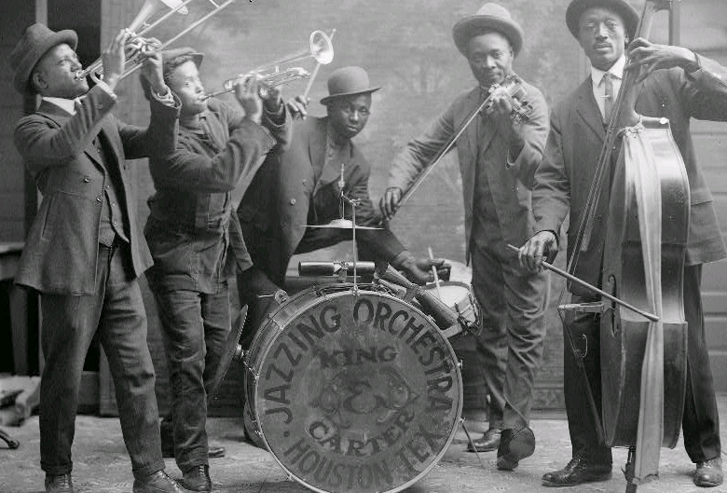
First “talkie” – the Jazz Singer

Slide 18
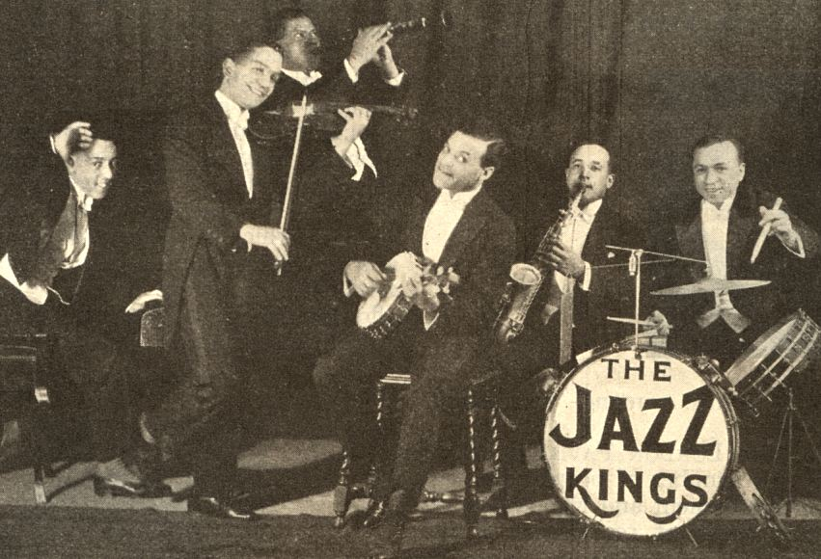

Slide 19
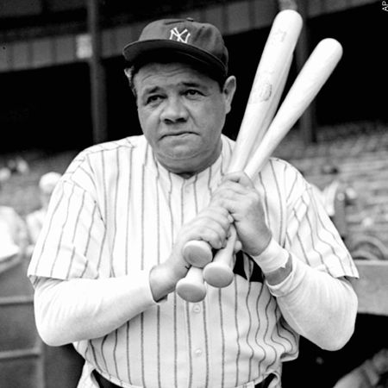
Baseball
Babe Ruth
Homerun king for NY Yankees

Slide 20
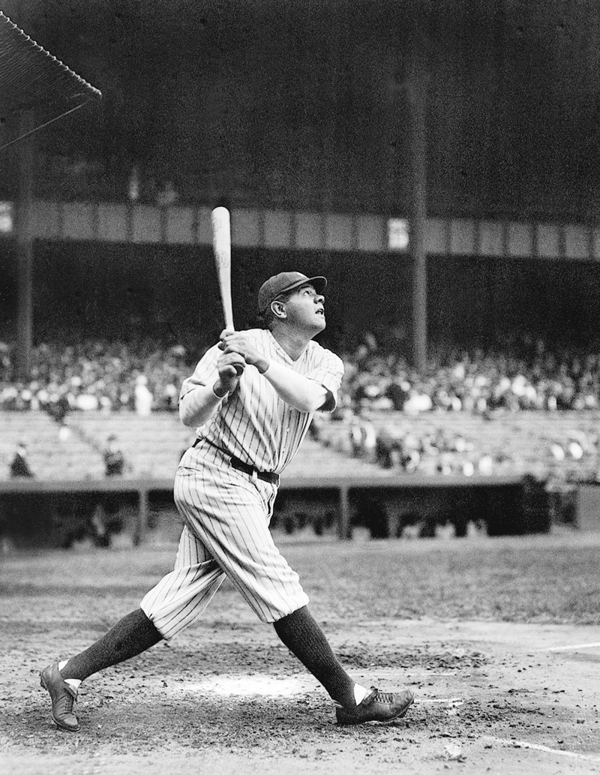

Slide 21
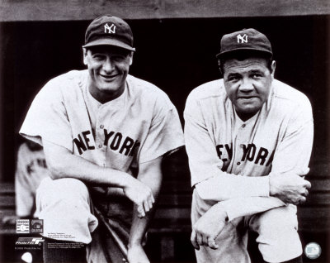

Slide 22
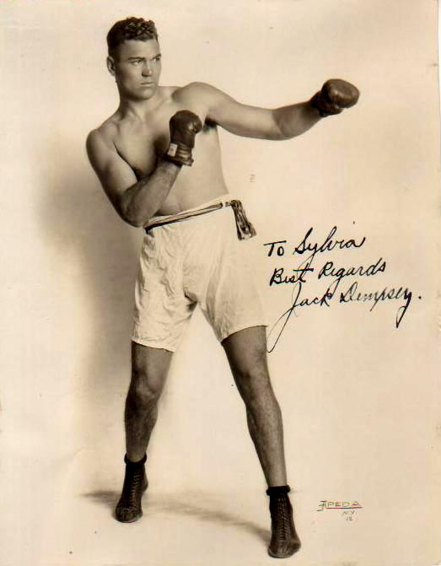
Boxing
Jack Dempsey
Heavyweight champ (1919-1926)

Slide 23
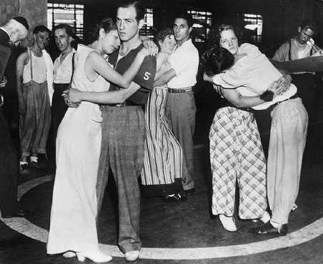
Fads
Marathon Dancing

Slide 24
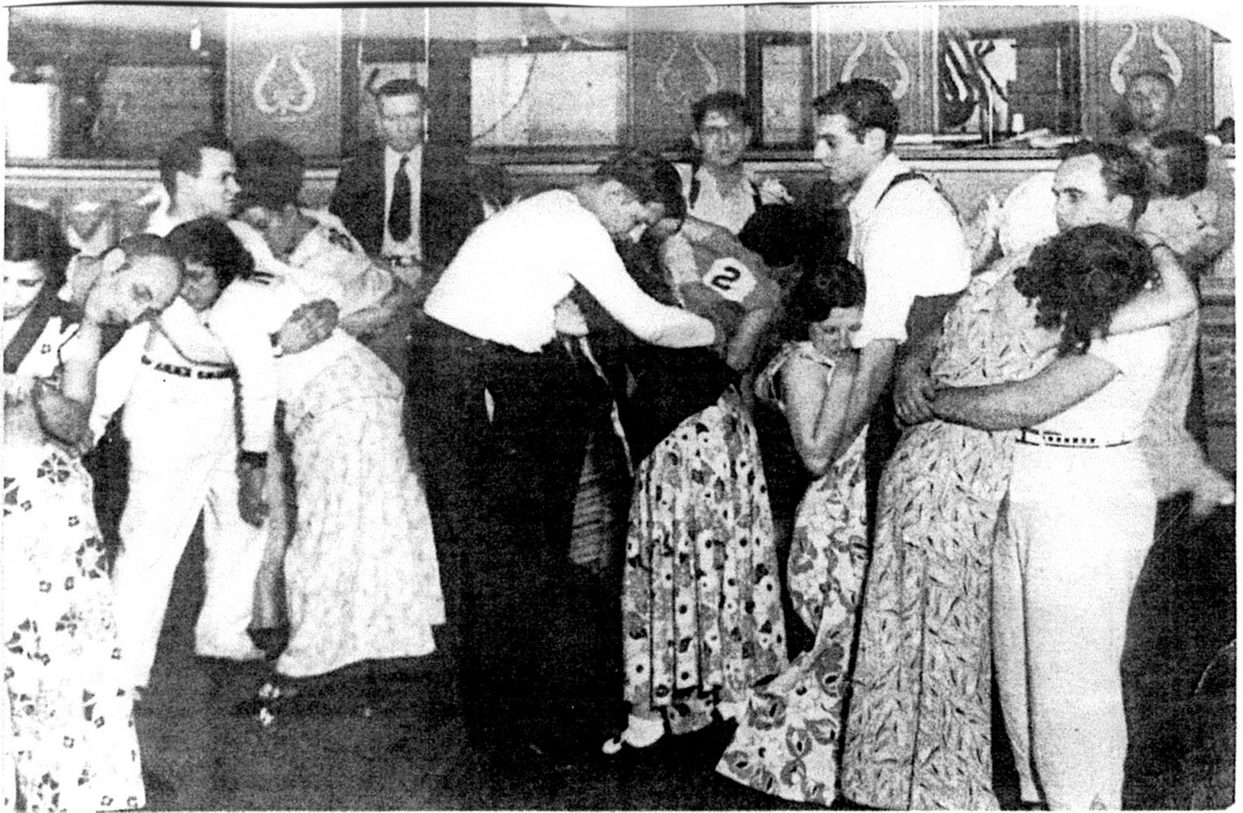

Slide 25
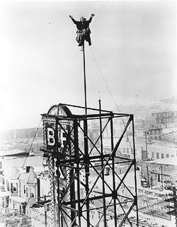
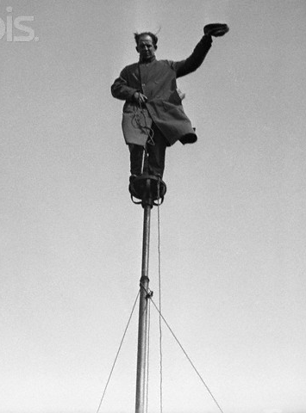
Flagpole sitting

Slide 26
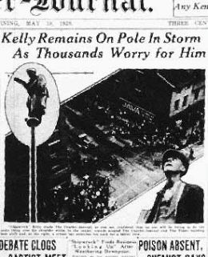

Slide 27
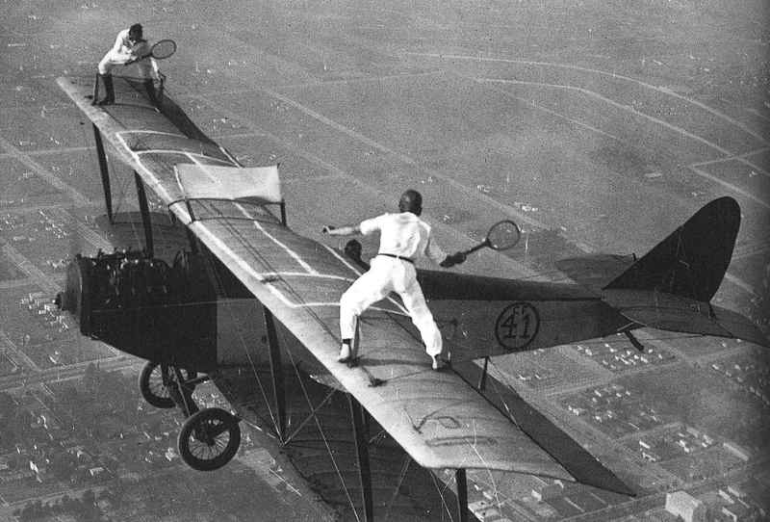
Barnstorming

Slide 28
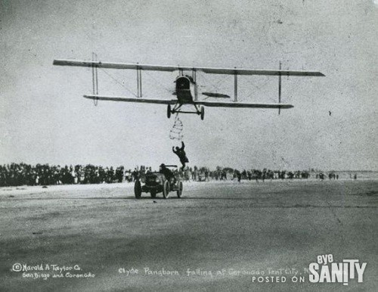

Slide 29
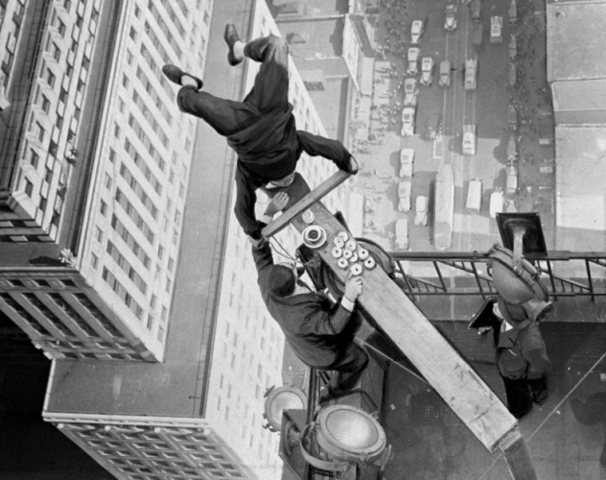

Slide 30
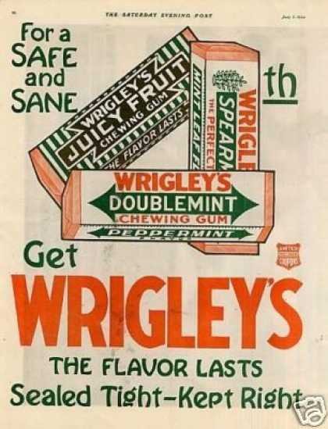
gum chewing

Slide 31
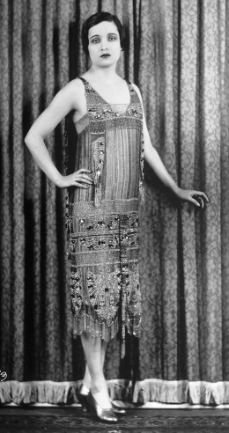
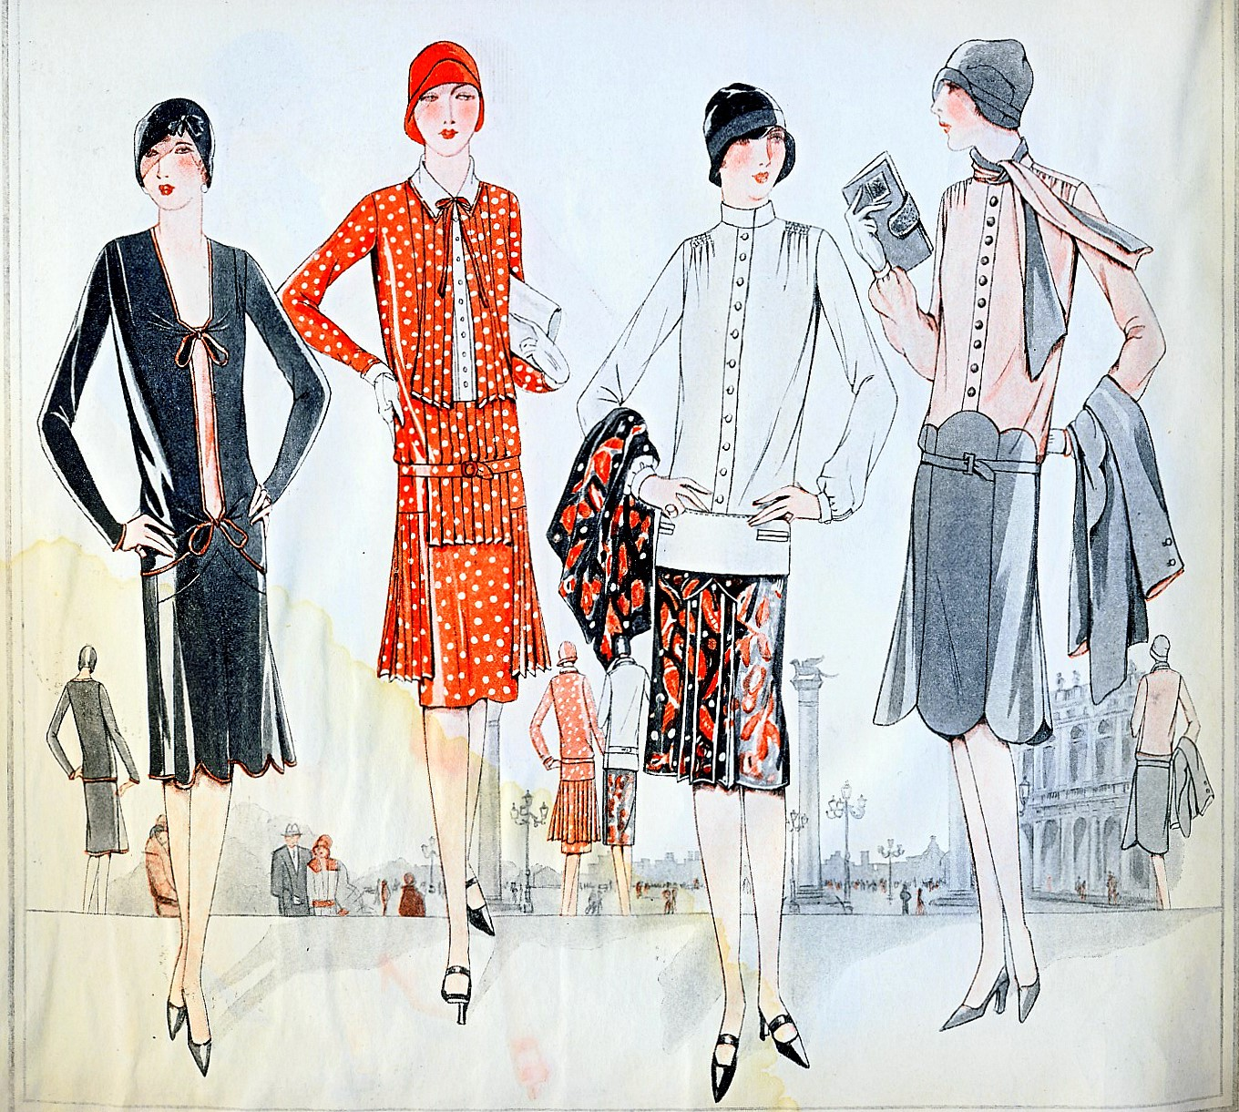
exotic Asian styles

Slide 32
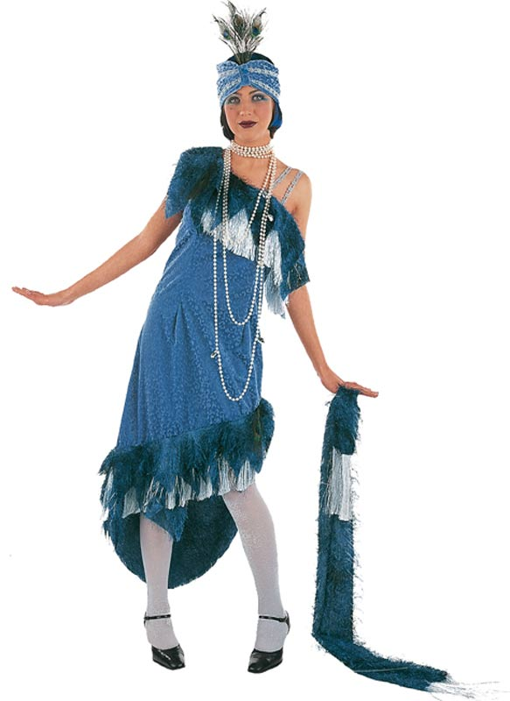

Slide 33
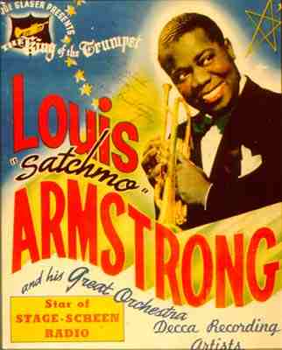
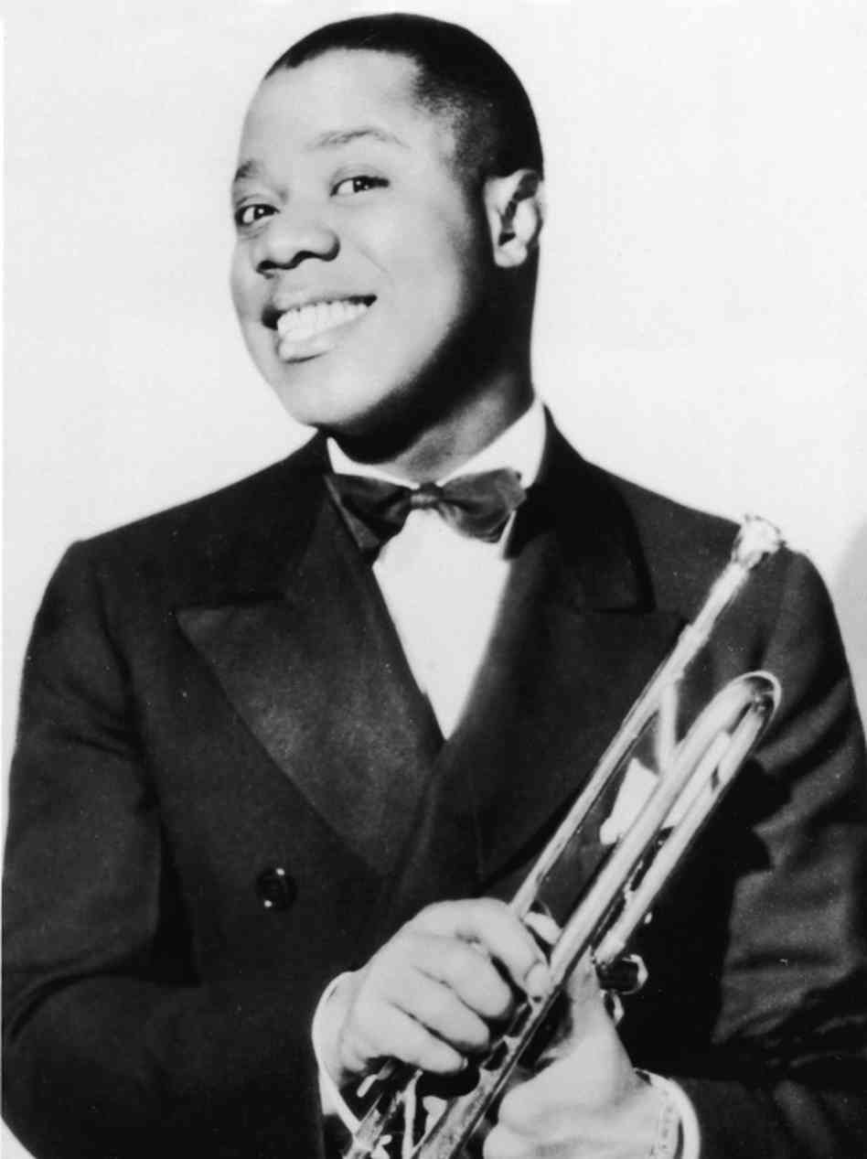
Jazz
Improvised, upbeat style of music from New Orleans
Louis Armstrong – played trumpet & cornet

Slide 34
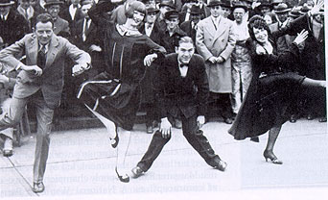
Dance – the Charleston

Slide 35
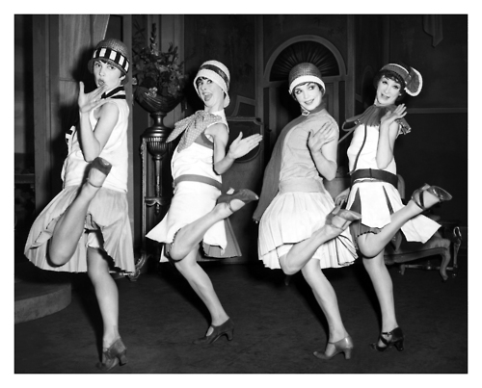

Slide 36
Traditional values
New values emerged:
Challenging authority & pursuing individual goals

Slide 37
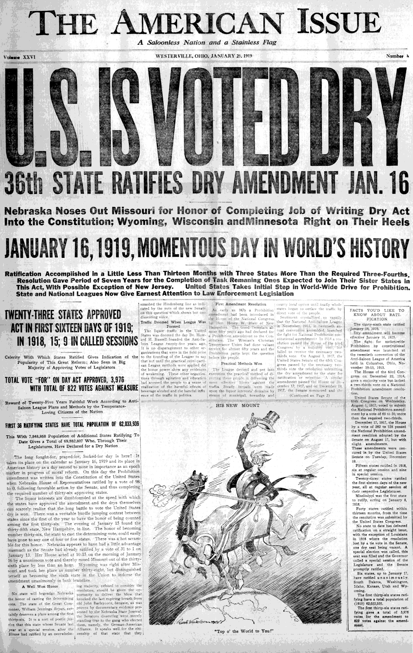
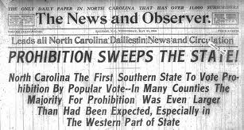
Prohibition (18th Amendment)
Banned manufacture, sale, or transport of alcohol in U.S.

Slide 38
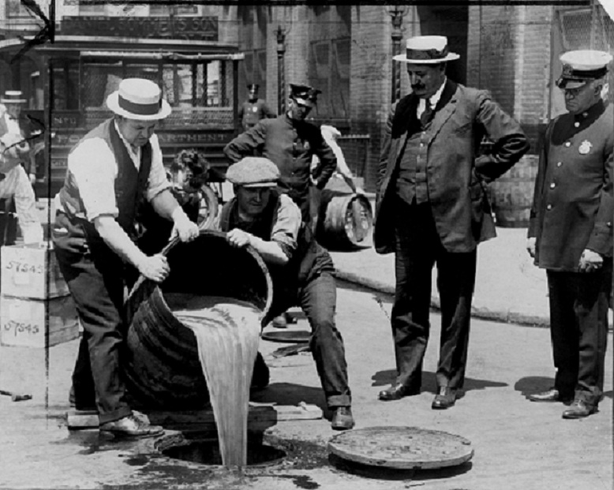

Slide 39
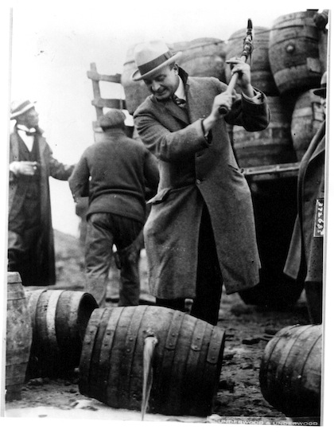

Slide 40
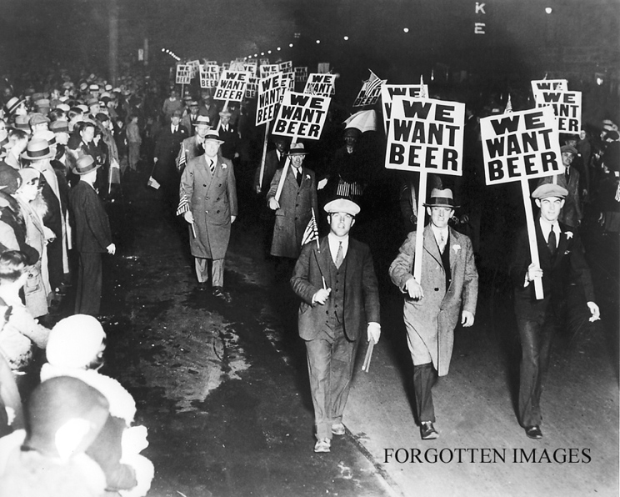

Slide 41
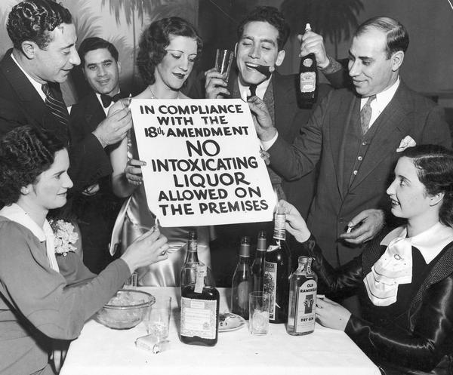

Slide 42
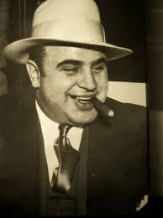
Al Capone
Gangster from Chicago who smuggled & bootlegged alcohol

Slide 43
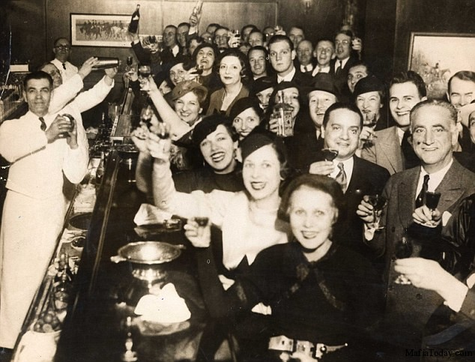
Speakeasy
Secret bar that sold alcohol illegally

Slide 44
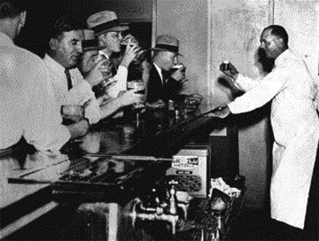

Slide 45
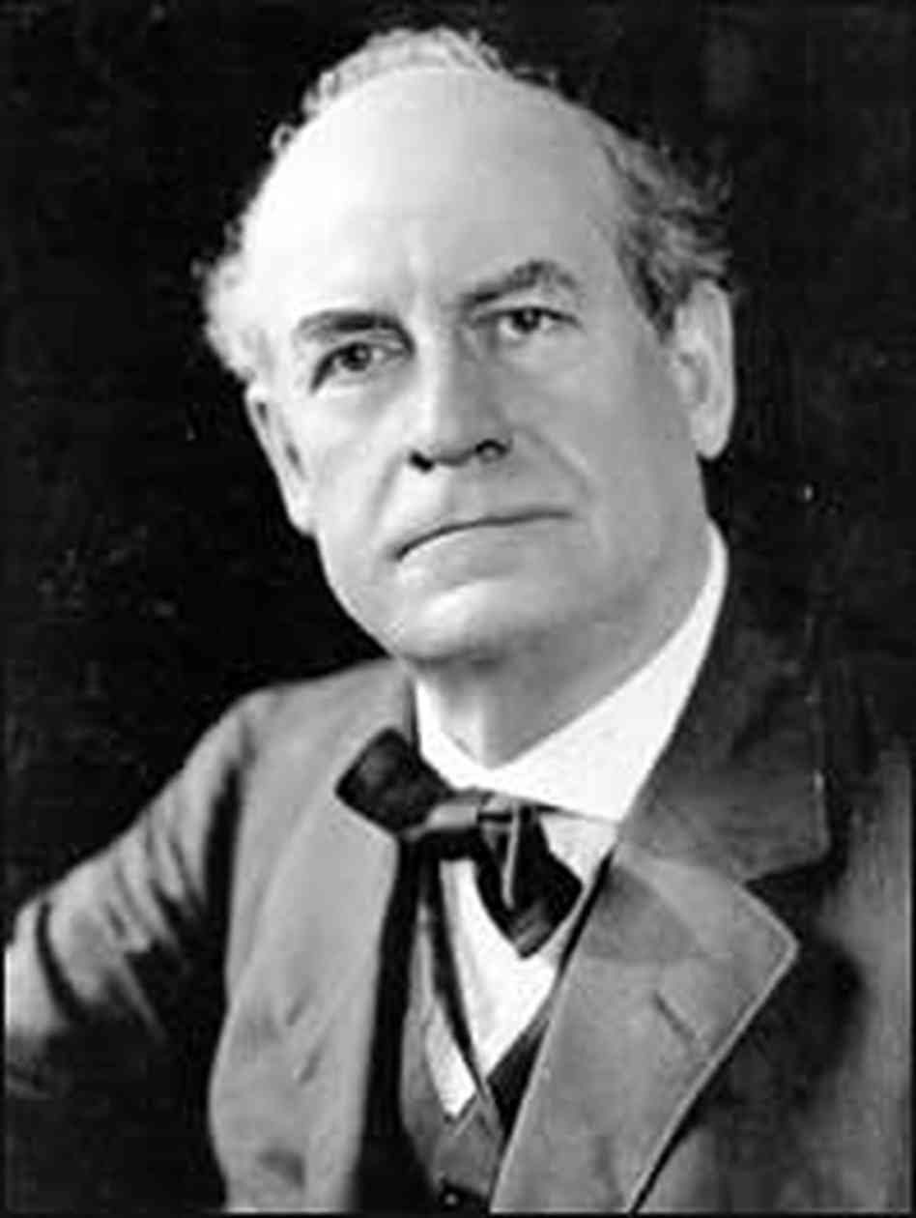
1925 – Scopes Trial
TN biology teacher, John Scopes, on trial for teaching Darwin’s theory of evolution
Conflicted with Bible’s story of creation

Slide 46
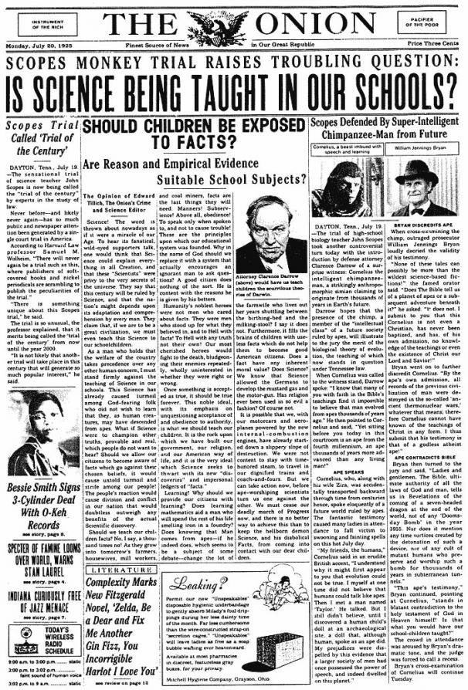

Slide 47
Resurgence of KKK
Waves of new immigrants – foreigners, Catholics, Jews, & un-American values

Slide 49
The Flappers
Young, carefree woman who smoked, drank, wore short skirts, & had a bobbed haircut

Slide 50
1920s Fashion
Men – baggy jeans & layered Shirts
Women – short skirts & low cut shirts

Slide 52
Economy of 1920s
Economy was booming & prosperous
Wages rose & luxuries became necessities
More money to spend = more time for fun

