Slide 1
The Common Man
VUS.6 D,E

Slide 2
A. Controversy in the Election of 1824
1. Jackson won the most popular votes, but NOT an electoral majority
2. John Quincy Adams became president – “Corrupt Bargain”
3. Jackson formed the “Democratic Party”

Slide 3
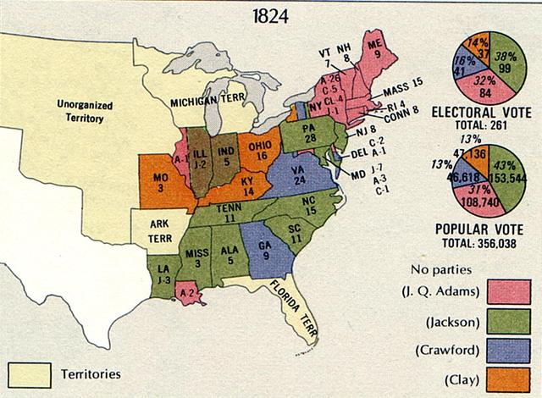

Slide 4
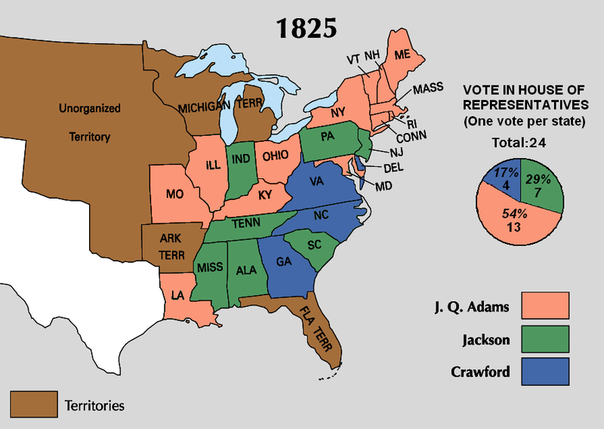

Slide 5
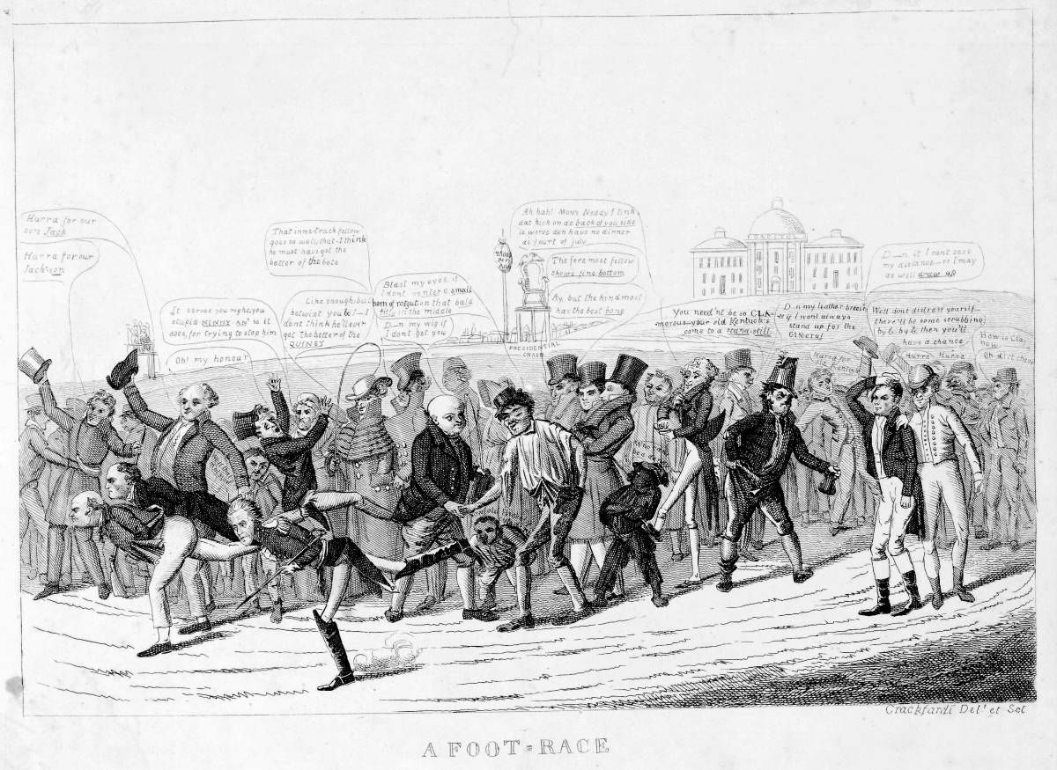

Slide 6
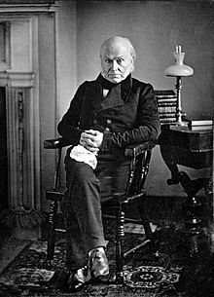

Slide 7
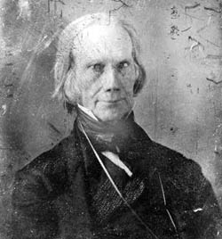

Slide 8
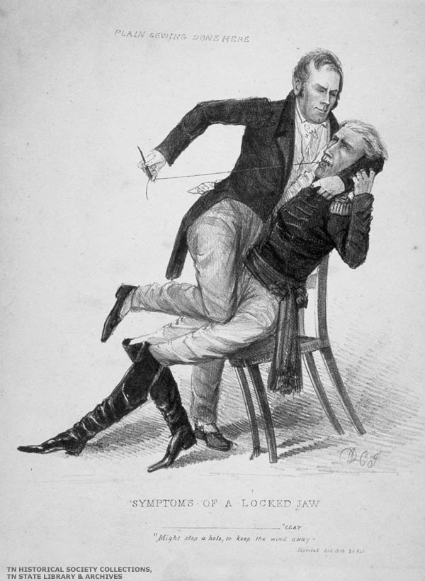

Slide 9
B. Election of 1828
1. Franchise Extended = eliminated property requirement - poor white men could vote - 3x as many votes in 1828
2. Jackson = “Common Man”
- Self-made man & a war hero
3. Jackson became the 7th President

Slide 10
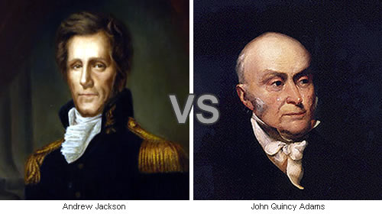

Slide 11
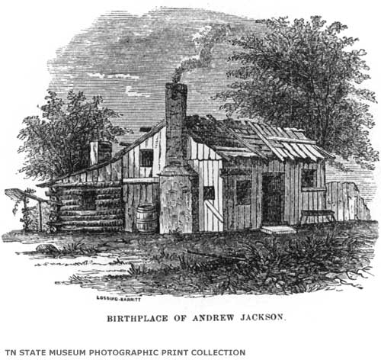

Slide 12
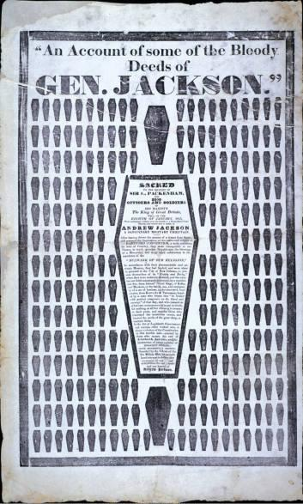

Slide 13
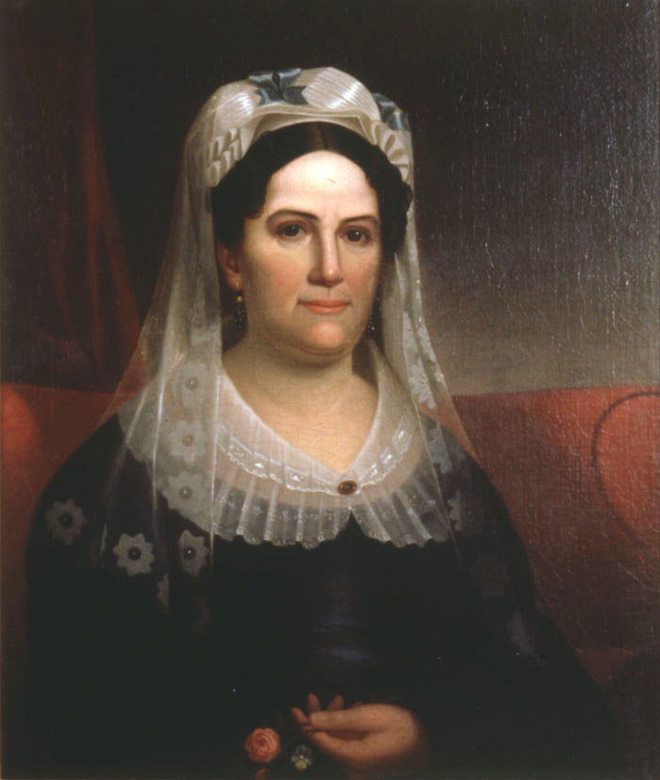

Slide 14
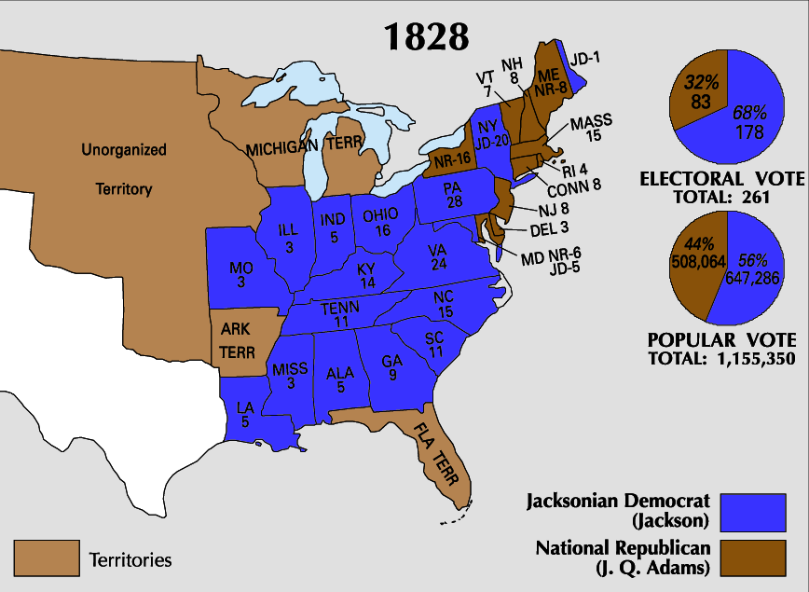

Slide 15
C. Jackson Takes Office
1. Spoils System = rewards given to campaign supporters
2. “Democratic” beliefs – every (white, male) citizen should participate in gov’t
Excluded: women, blacks, & Indians
3. “King Andrew” – criticized for using veto power too often
eliminated the Bank of the Unites States

Slide 16
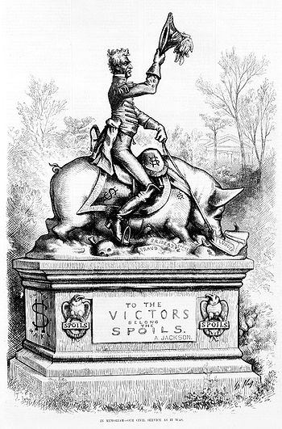

Slide 17
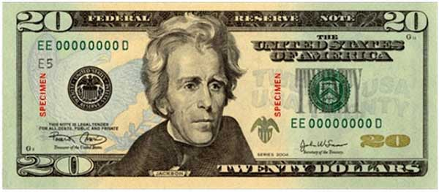

Slide 18
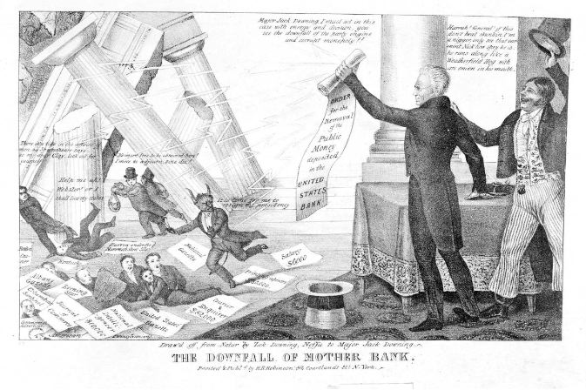

Slide 19
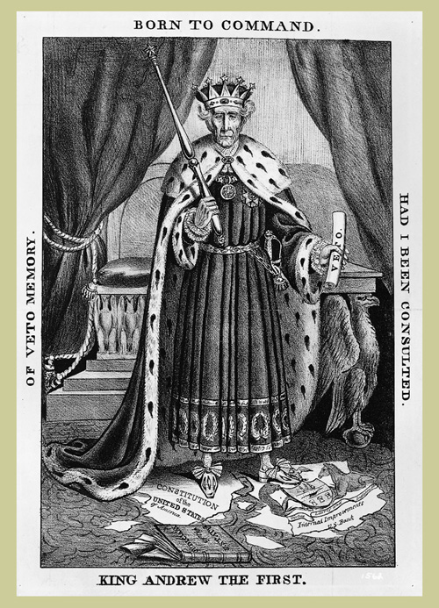

Slide 20
D. Nullification Crisis
1. SC upset by tariff
2. V.P., John Calhoun offered the idea of nullification
– states can invalidate a federal law
3. Jackson threatened to send troops to collect the tax
4. A deal was negotiated

Slide 21
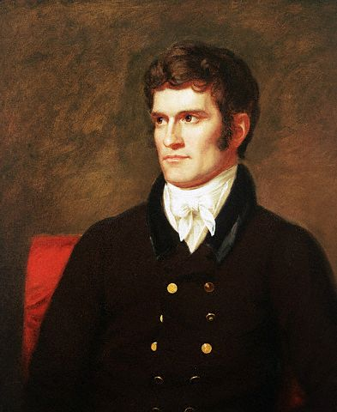

Slide 22
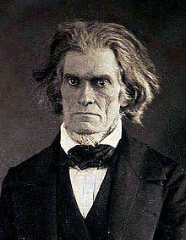

Slide 23
E. Policy Towards Indians
1. In 1830, the govt. forced tribes to relocate to Oklahoma
2. Trail of Tears (1838-1839) – about 4,000 Cherokee died during march from GA to OK
Indian Removal Act

Slide 24
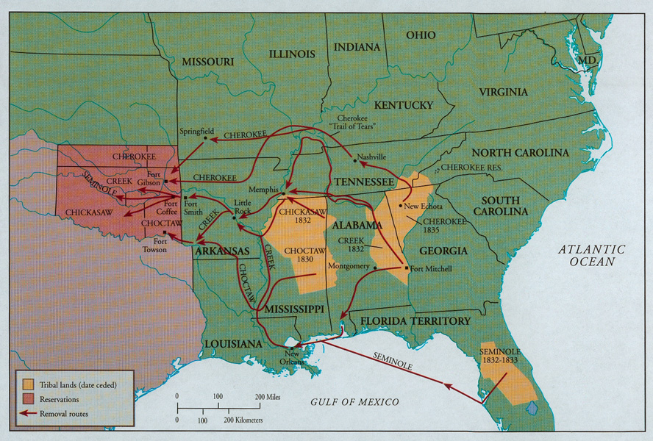

Slide 25
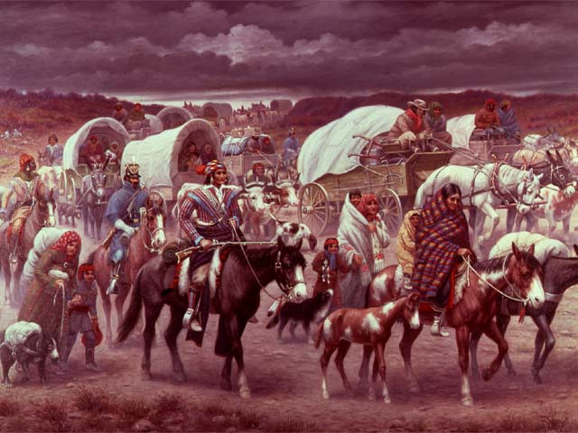

Slide 27
F. Formation of New Parties
The Federalist Party disappeared & new parties formed:
1. Whigs = favored industrial & commercial development
2. Know-Nothings = hated Catholics & immigrants

Slide 28
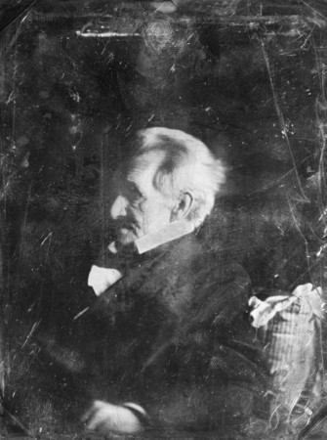

Slide 29
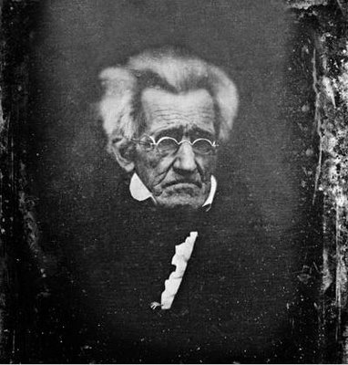

Slide 30
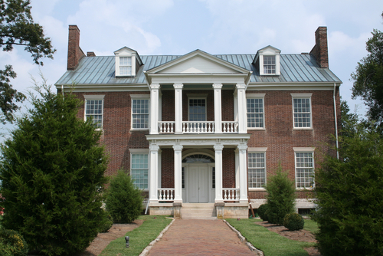

Slide 31
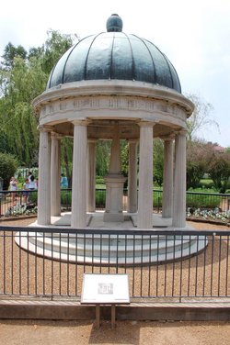

Slide 32
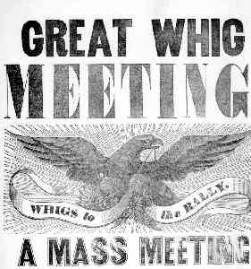

Slide 33
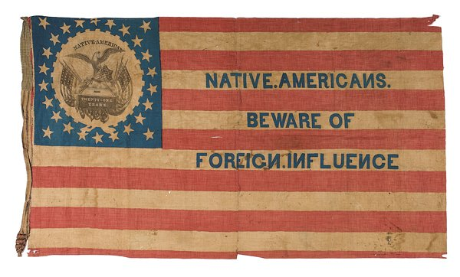

Slide 34
