Slide 1
War & Reunion

Slide 2
Life After The War

Slide 3
Reconstruction = period after the Civil War (1865-1877)
Americans struggled to restore the Union and recognize newly freed slaves and their place in society

Slide 4
Compare the Impact of the Civil War
South
Economy devastated
Farms, RR, & factories destroyed
Many cities lay in ruins
Remained backward and agricultural for decades
Southerners resented their treatment by the North

Slide 5
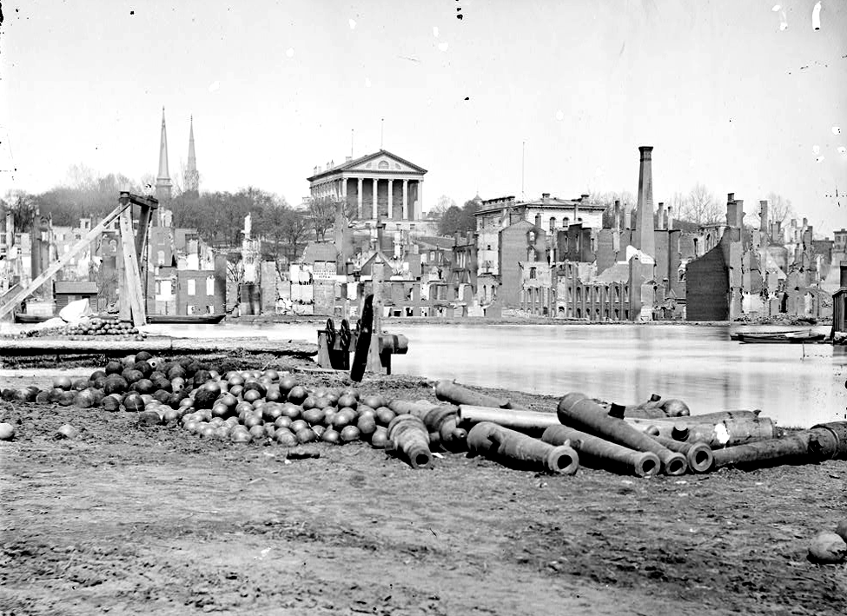

Slide 6
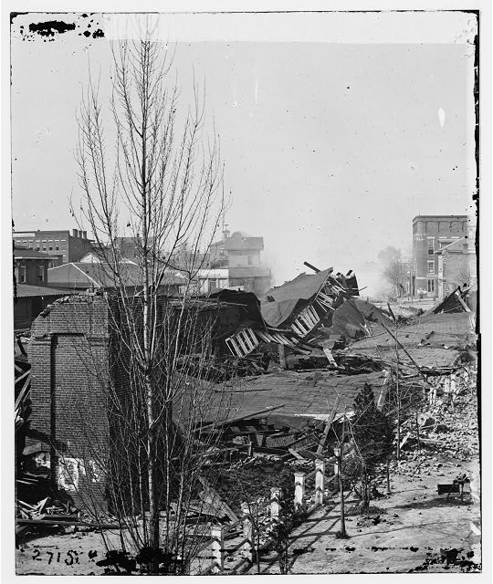

Slide 7
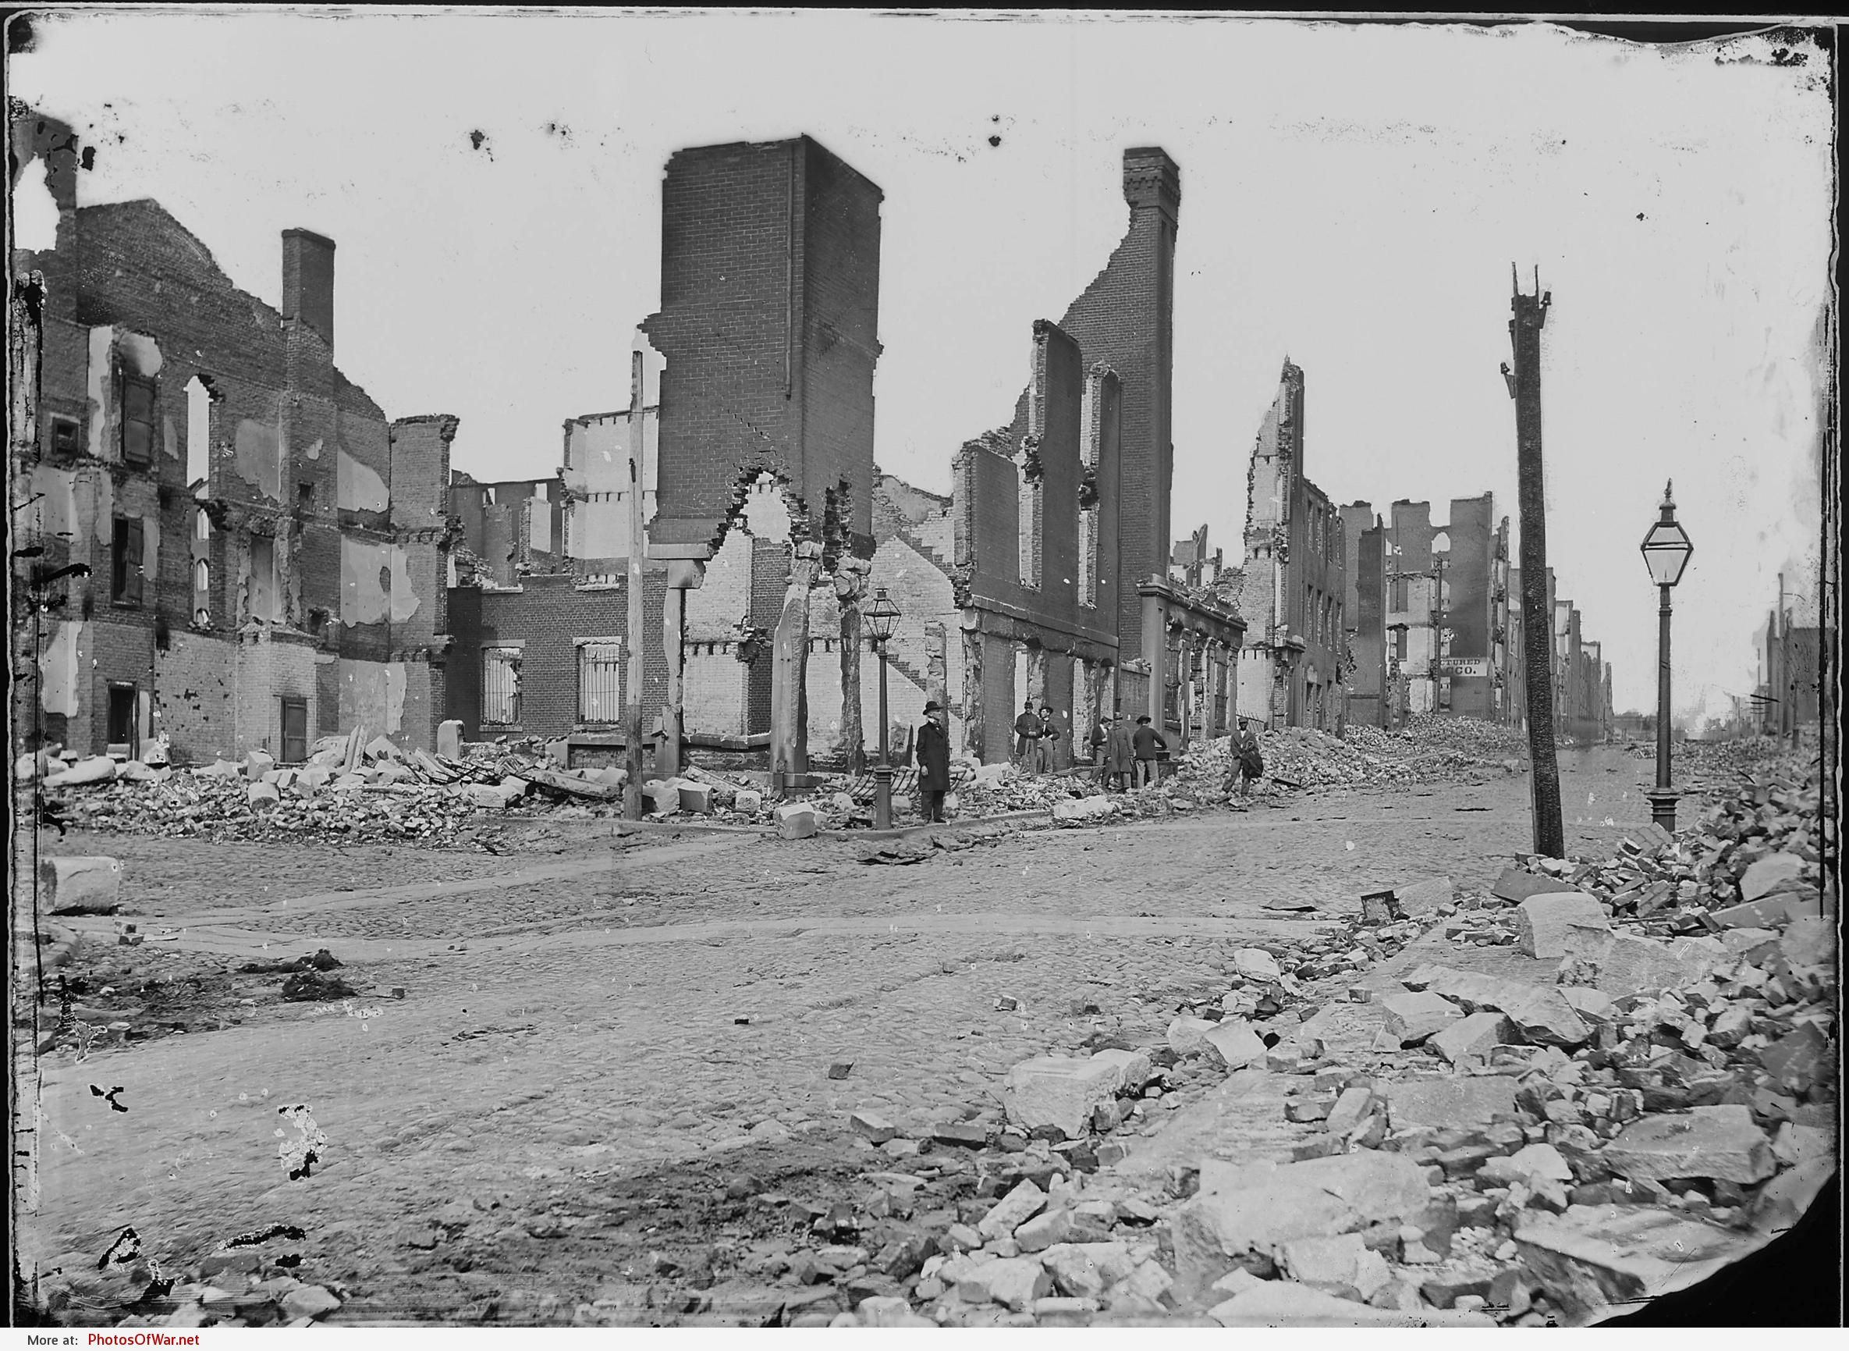

Slide 8
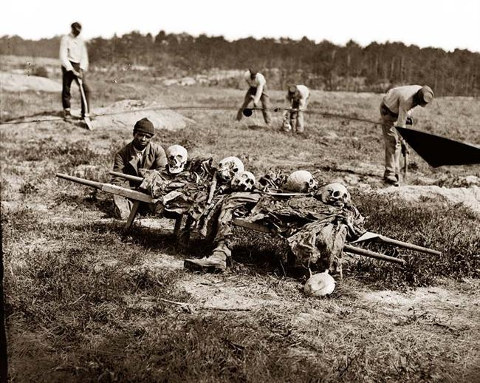

Slide 9
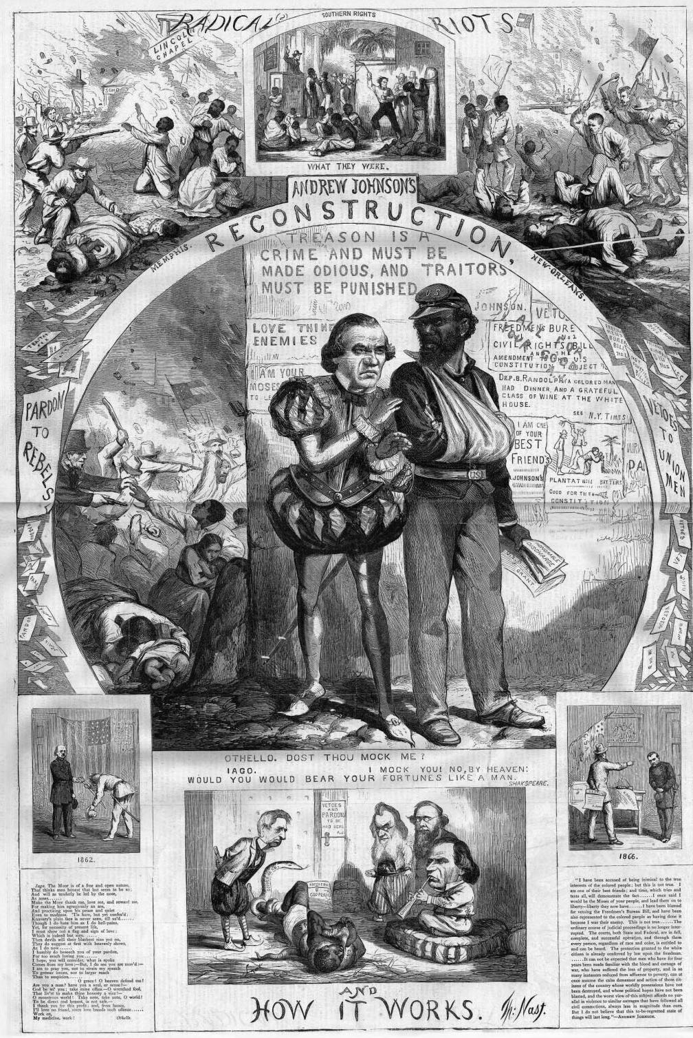

Slide 10
North
Powers of the federal gov’t increased over the power of the states
Emerged with strong and growing economy
Completed the Transcontinental Railroad which intensified westward movement

Slide 11
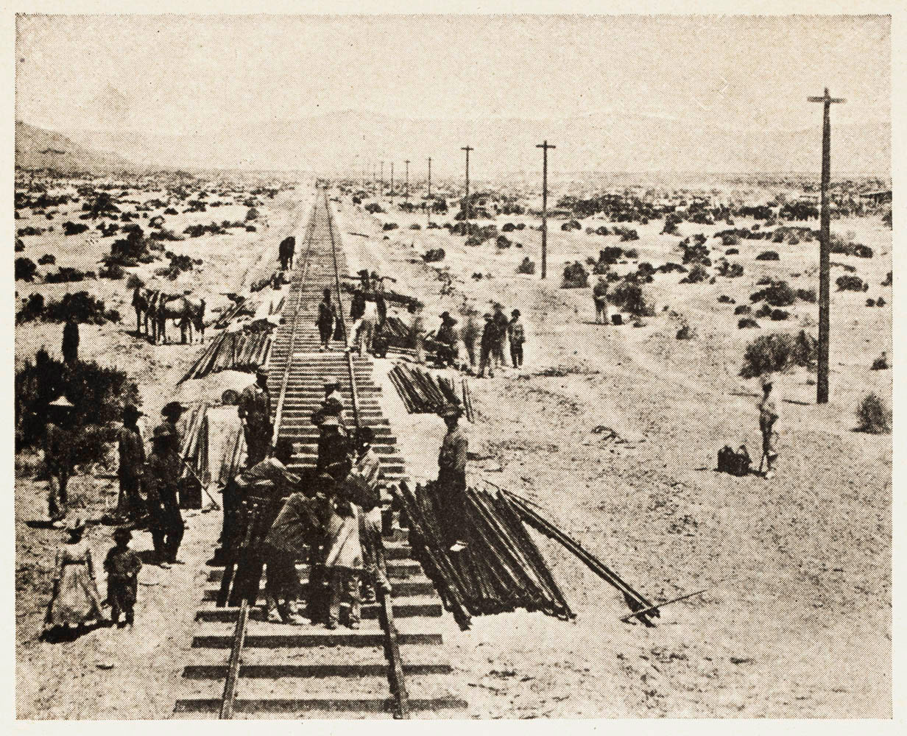

Slide 12
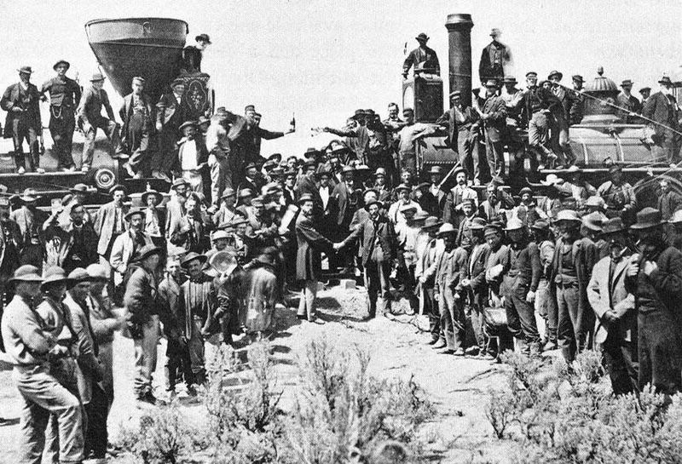

Slide 13
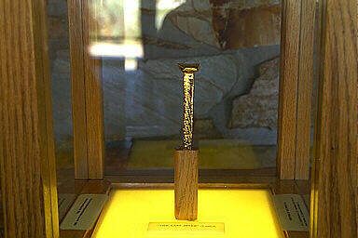

Slide 14
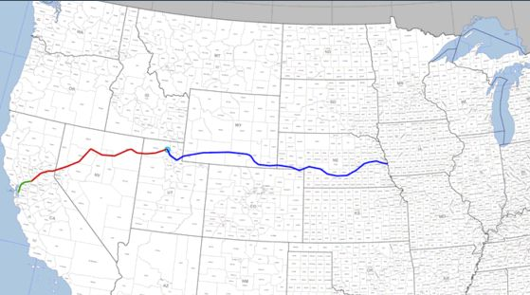

Slide 15
African-Americans after slavery was abolished
Families reunited
Sought separation & privacy
Headed to Great Plains & northern cities

Slide 16
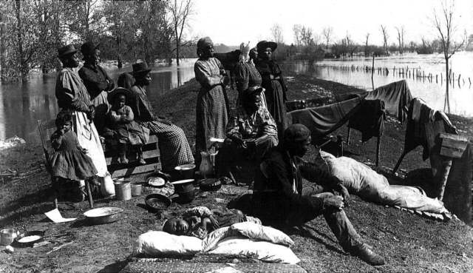

Slide 17
Role of the Freedman’s Bureau in the South (1867)
Helped freed slaves adjust to life after the Civil War
Services and accomplishments:
Gave food and clothing
Set up hospitals
Provided schools
Created colleges to train black teachers
Negotiated fair labor contracts

Slide 18
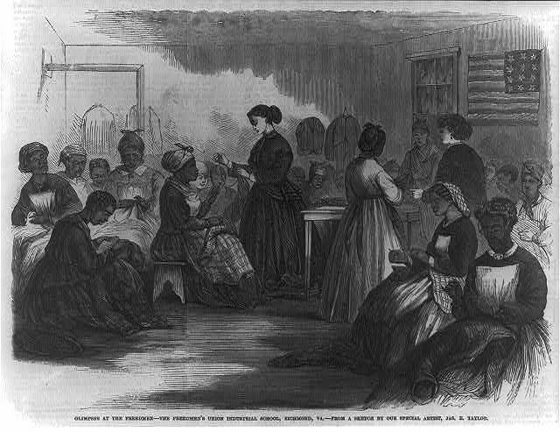

Slide 19
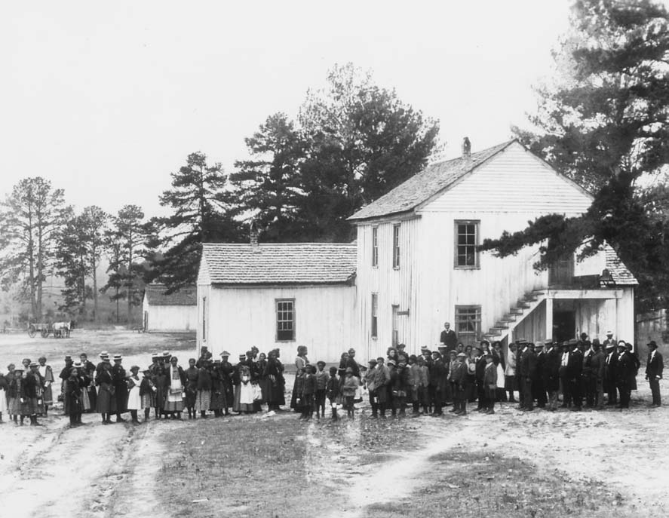

Slide 20
POST-WAR CONTRIBUTIONS:
Ulysses S. Grant – 18th President
Supported rights for freedmen and opposed harsh treatment of ex-Confederates
Robert E. Lee – Urged the South to reconcile – President of Washington College
Believed education is the key to a better future
Frederick Douglas – Advocated equality for blacks and encouraged the Federal government to protect their rights
ambassador to Haiti

Slide 21
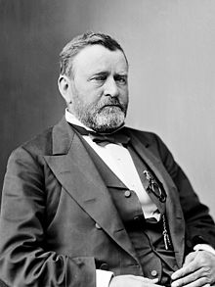

Slide 22
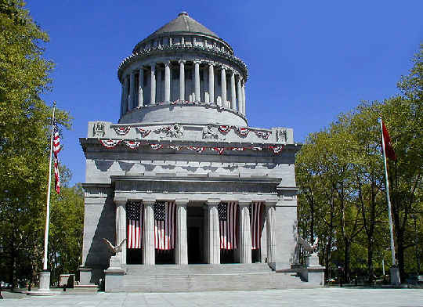

Slide 23
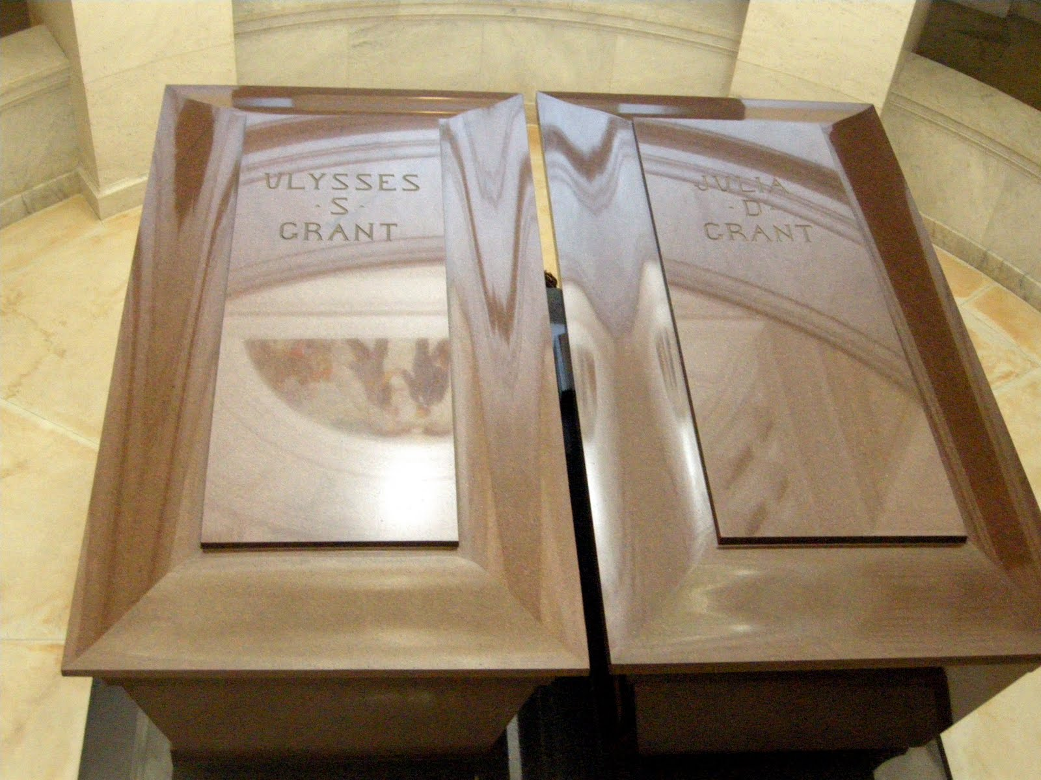

Slide 24
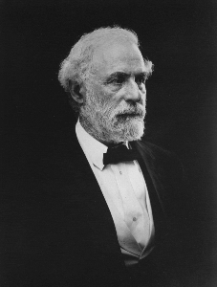

Slide 25
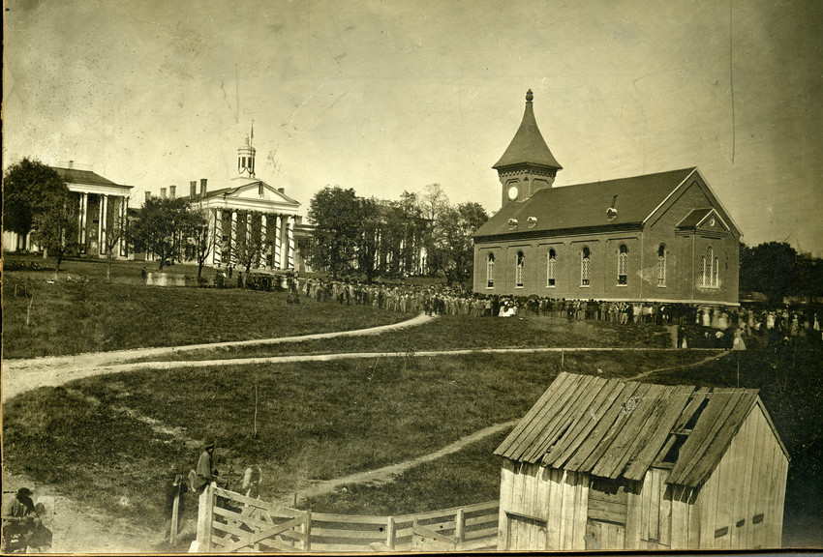

Slide 26
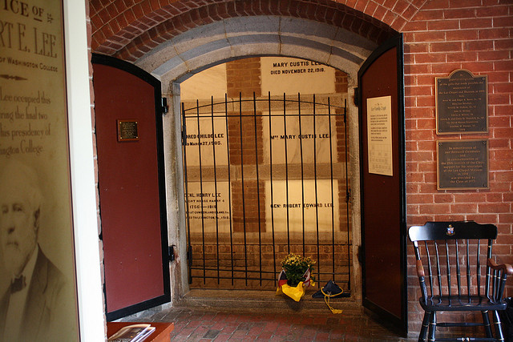

Slide 27
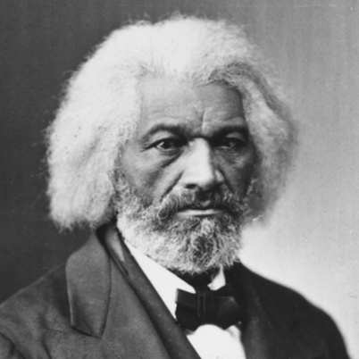

Slide 28
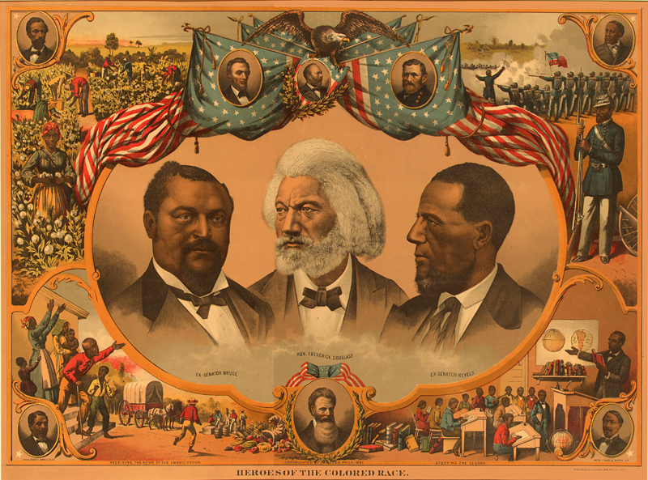

Slide 29
Plans for Reconstruction

Slide 30
Lincoln’s Reconstruction Plan – Used by Andrew Johnson
Lincoln’s goal: Restore state governments
Secession was illegal = Confederates never left the Union
10% of the voters in each state had to swear loyalty oath to the Union
States had to abolish slavery
President Andrew Johnson followed the plan

Slide 31
The Radical Republicans
believed in voting & civil rights for African Americans
Opposed lenient plan – wanted harsh punishment for the South

Slide 32
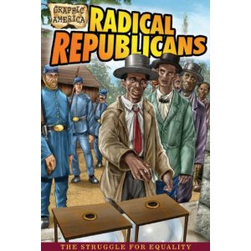

Slide 33
Radical Republicans’ Plan (1867)
Divided the South into 5 districts & put them under military rule
A majority of ex-Confederates in each state had to take oath
Each state had to give blacks the right to vote
Scalawags, carpetbaggers (N), and freedmen gained political control in the South

Slide 34
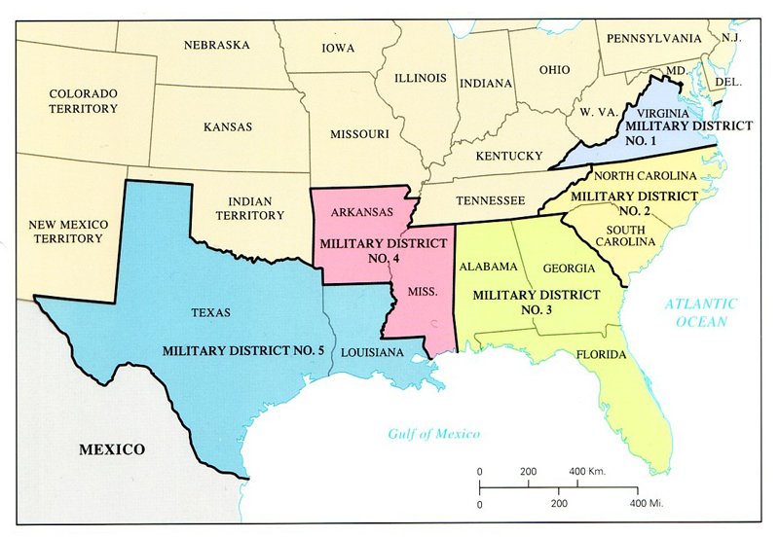

Slide 35
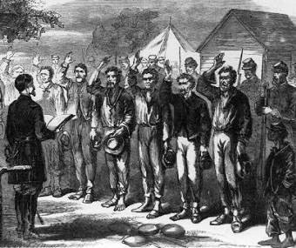

Slide 36
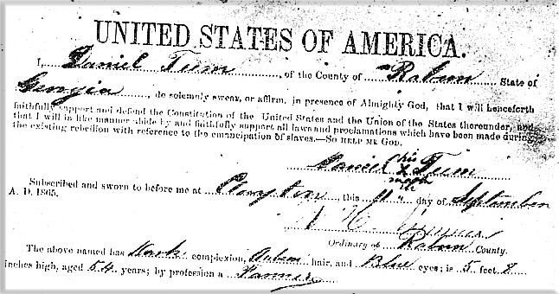

Slide 37
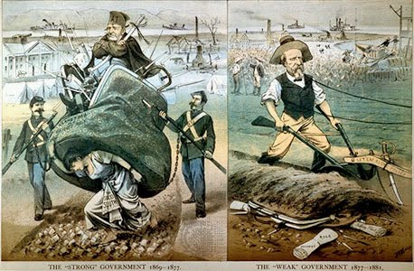

Slide 38
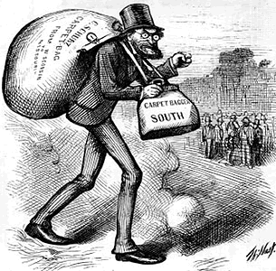

Slide 39
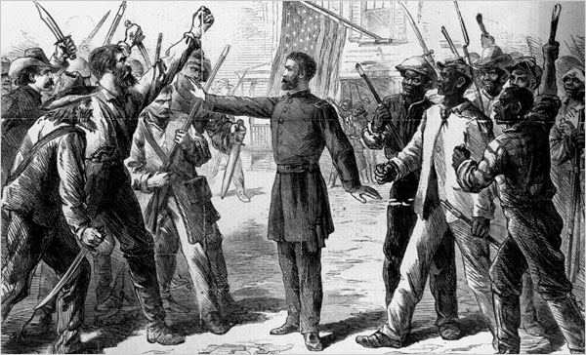

Slide 40
Radical Republicans Impeach President Andrew Johnson
1. Why didn’t the President and Radical Republicans get along?
- Had different ideas on civil rights for freed slaves
2. Who did the President fire from his Cabinet?
- Edwin Stanton, Sec. of War (Radical Republicans)
3. What law did he violate?
- Johnson fired a cabinet member w/o the Congress’ consent

Slide 41
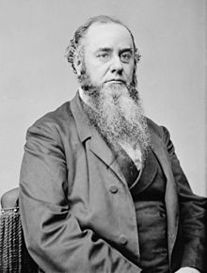

Slide 42
4. What was the outcome of his trial?
- He was impeached by the House of Representatives
- Senate was one vote shy of removing Johnson from office

Slide 43
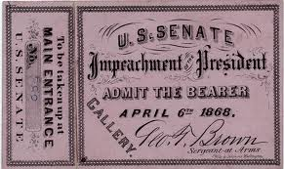

Slide 44
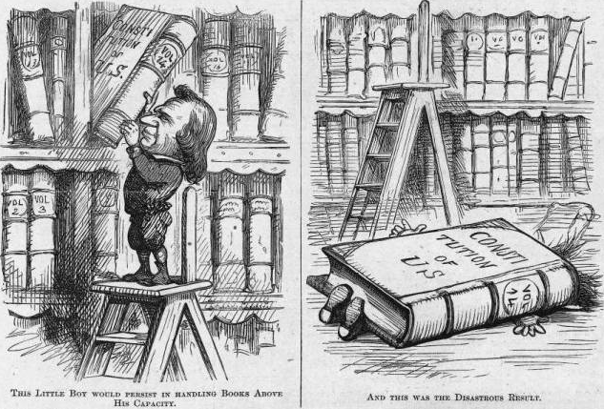

Slide 45
Civil Rights Amendments Passed During Reconstruction
13th Amend. (1865) – Freed all slaves and abolished slavery
14th Amend. (1868) – Former slaves are citizens & obligated the states to protect their rights
15th Amend. (1870) – Guaranteed voting rights

Slide 46
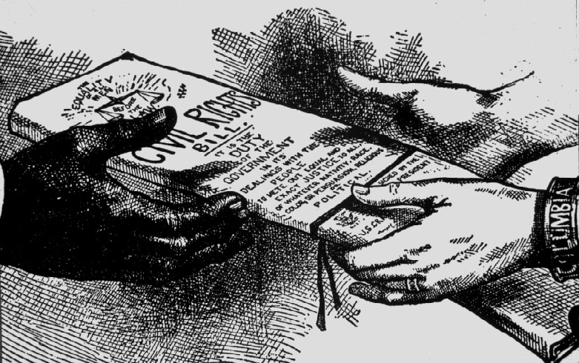

Slide 47
The End of Reconstruction

Slide 48
What political party did former Confederates join?
Democratic Party
What was the major goal of the KKK (Ku Klux Klan)?
terrorize blacks by kidnapping & hanging
prevent blacks from voting for Radical Republicans

Slide 49
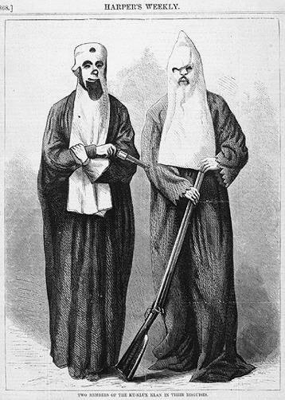

Slide 50
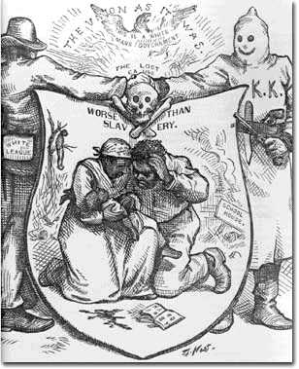

Slide 51
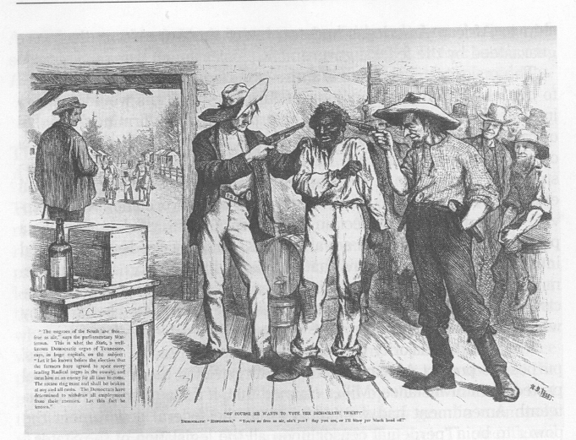

Slide 52
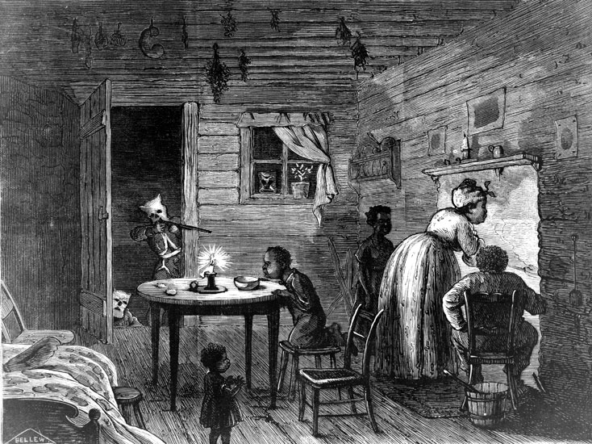

Slide 54
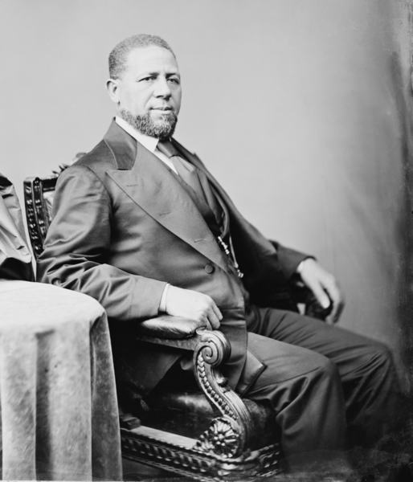

Slide 55
Election of 1876:
1. Who were the candidates? Parties?
Rutherford B. Hayes (Rep) vs. Samuel Tilden (Dem.)
2. What was disputed in the election?
electoral votes
3. Who decided the election?
A commission set up
4. What was the outcome?
Hayes got all of the disputed electoral votes
5. Who was angered by the outcome?
Southern democrats agreed to a compromise

Slide 56
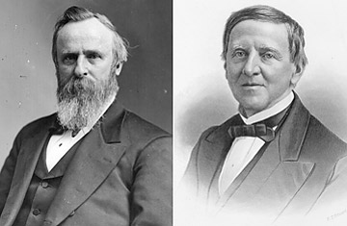

Slide 57
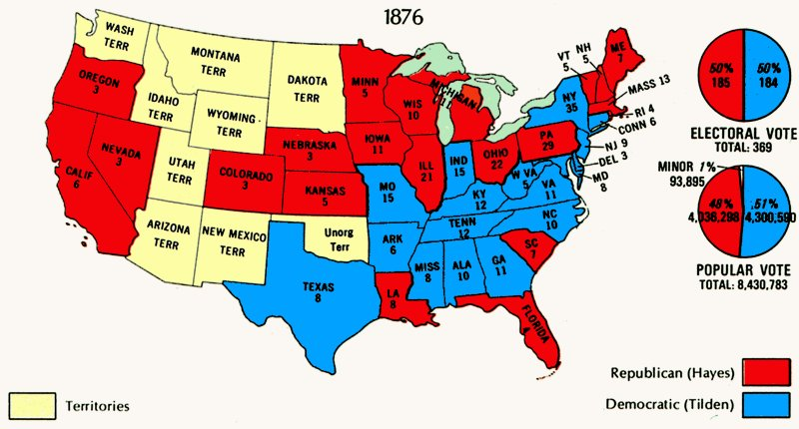

Slide 58
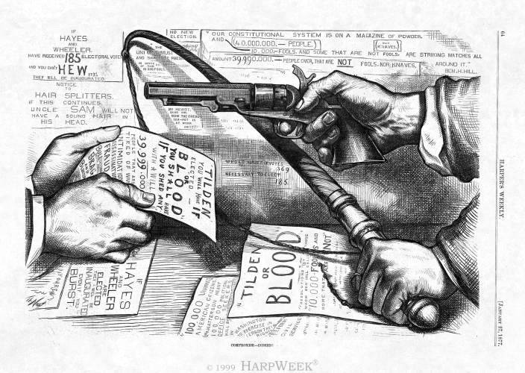

Slide 59
COMPROMISE of 1877 ended Reconstruction
Hayes would be president if military occupation of the South ended
Withdrawal federal soldiers = Reconstruction ended

Slide 60
The purpose of the Black Codes
restrict freedoms of blacks and make them 2nd class
“Jim Crow” laws legally segregated blacks from whites in daily life.
- Examples:
Schools, bathrooms, hospitals, buses, churches, cemeteries

Slide 61
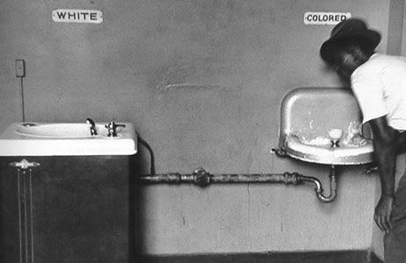

Slide 62
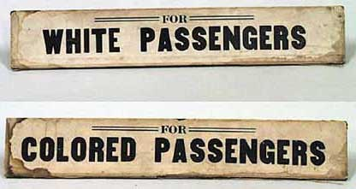

Slide 63
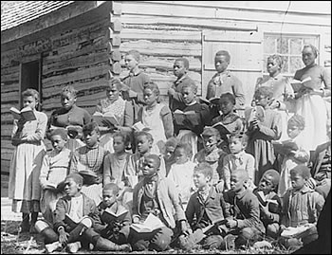

Slide 64
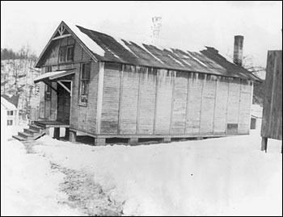

Slide 65
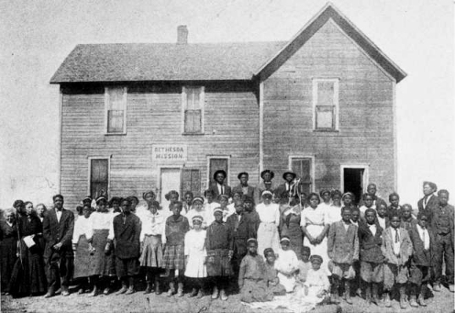

Slide 66
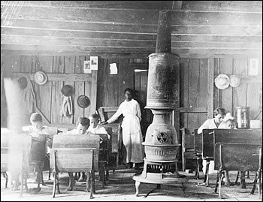

Slide 67
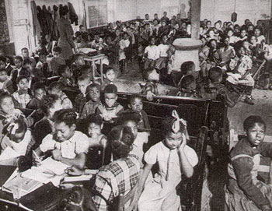

Slide 68
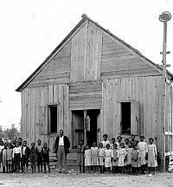

Slide 69
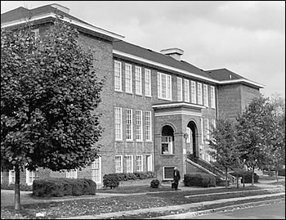

Slide 70
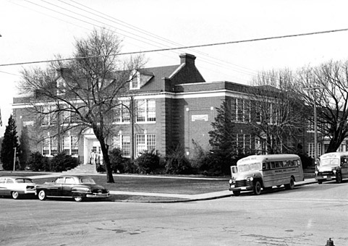

Slide 71
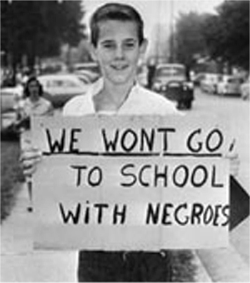

Slide 72
The case of Plessy v. Ferguson (1896):
1. Why was Plessy arrested?
He was sitting in the white first class
2. By Louisiana law, what was his race?
Black (1/8)
3. Which amendment did he use to defend himself?
14th Amendment

Slide 74
How did the Supreme Court rule in the Plessy case?
Segregation was legal as long as both races had access to equal facilities
– “Separate, but Equal” does not violate the 14th Amendment

