Slide 1
Post-Cold War Events

Slide 2
A. The Reagan Revolution
Ronald Reagan’s policies has an impact on the size and role of government and the relationship between federal and state government (federalism)

Slide 3
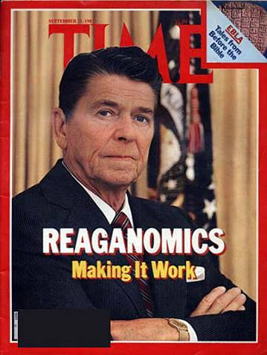

Slide 4
Reagan, a conservative republican, supported
Reagan’s influence beyond his tenure in office
Tax cuts
Transfer of responsibilities from federal to state govts.
Appointed judges who exercised “judicial restraint”
Reduced # of govt programs and regulation
Strengthened the military
His Vice-President George H.W. Bush was elected
Election of centrist Democrat, Bill Clinton
Republicans swept Congress & statehouses in the 1990s
George W. Bush, Republican, elected

Slide 5
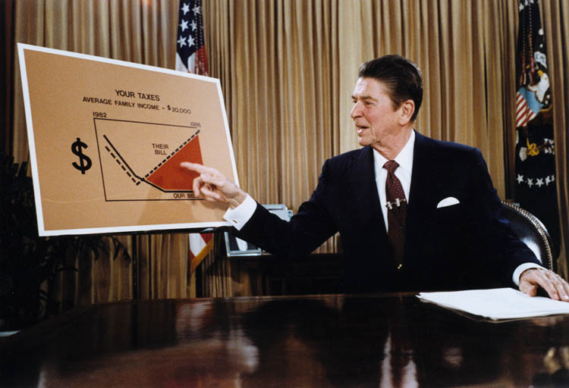

Slide 6
B. Regulating the Economy
1. The U.S. govt has the ability to influence the economy
2. Decisions based on economic indicators such as the Gross Domestic Product, exchange rates, inflation rates, & unemployment rates.

Slide 7
3. The govt promotes a healthy economy with full employment and low inflation by:
a) The Federal Reserve sets interest rates to control supply of money & credit to expand or contract the economy
b) President & Congress develop fiscal policy to determine levels of taxation and spending

Slide 8
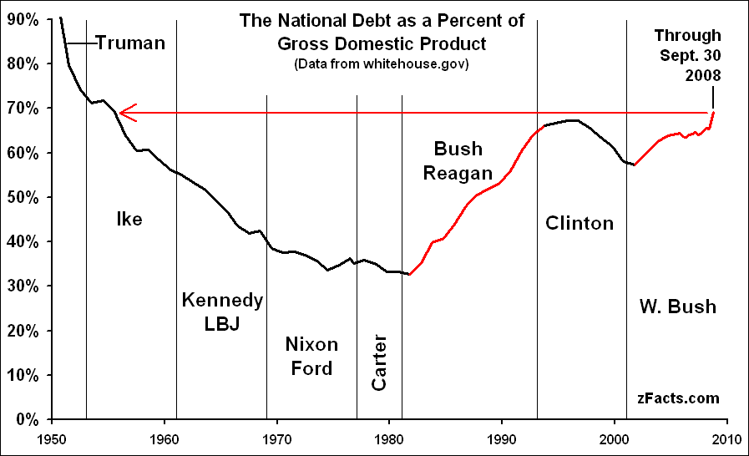

Slide 9
Goals and Policies after the Col War

Slide 10
Global involvement is an integral part of U.S. foreign policy:
1. Offer foreign aid to friendly nations
2. Provide humanitarian aid following natural disasters or epidemics
3. Support human rights

Slide 11
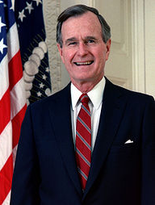
George H.W. Bush 1989-1993
Led while communism in Eastern Europe fell
Germany reunified
Collapse of Yugoslavia – civil war between different religious groups
Persian Gulf War (1990-1991)
Liberate Kuwait from Iraq’s dictator, Saddam Hussein
Operation Desert Storm lasted 5 wks.
First conflict where American women served in combat

Slide 12
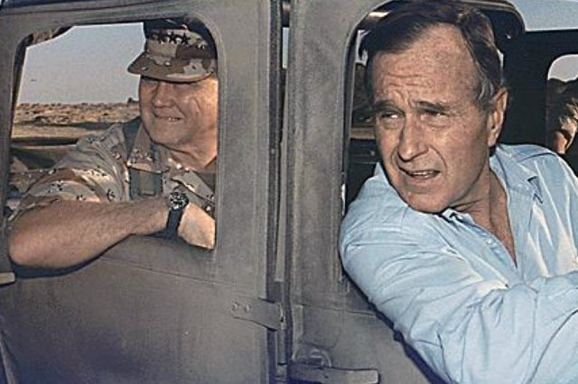

Slide 13
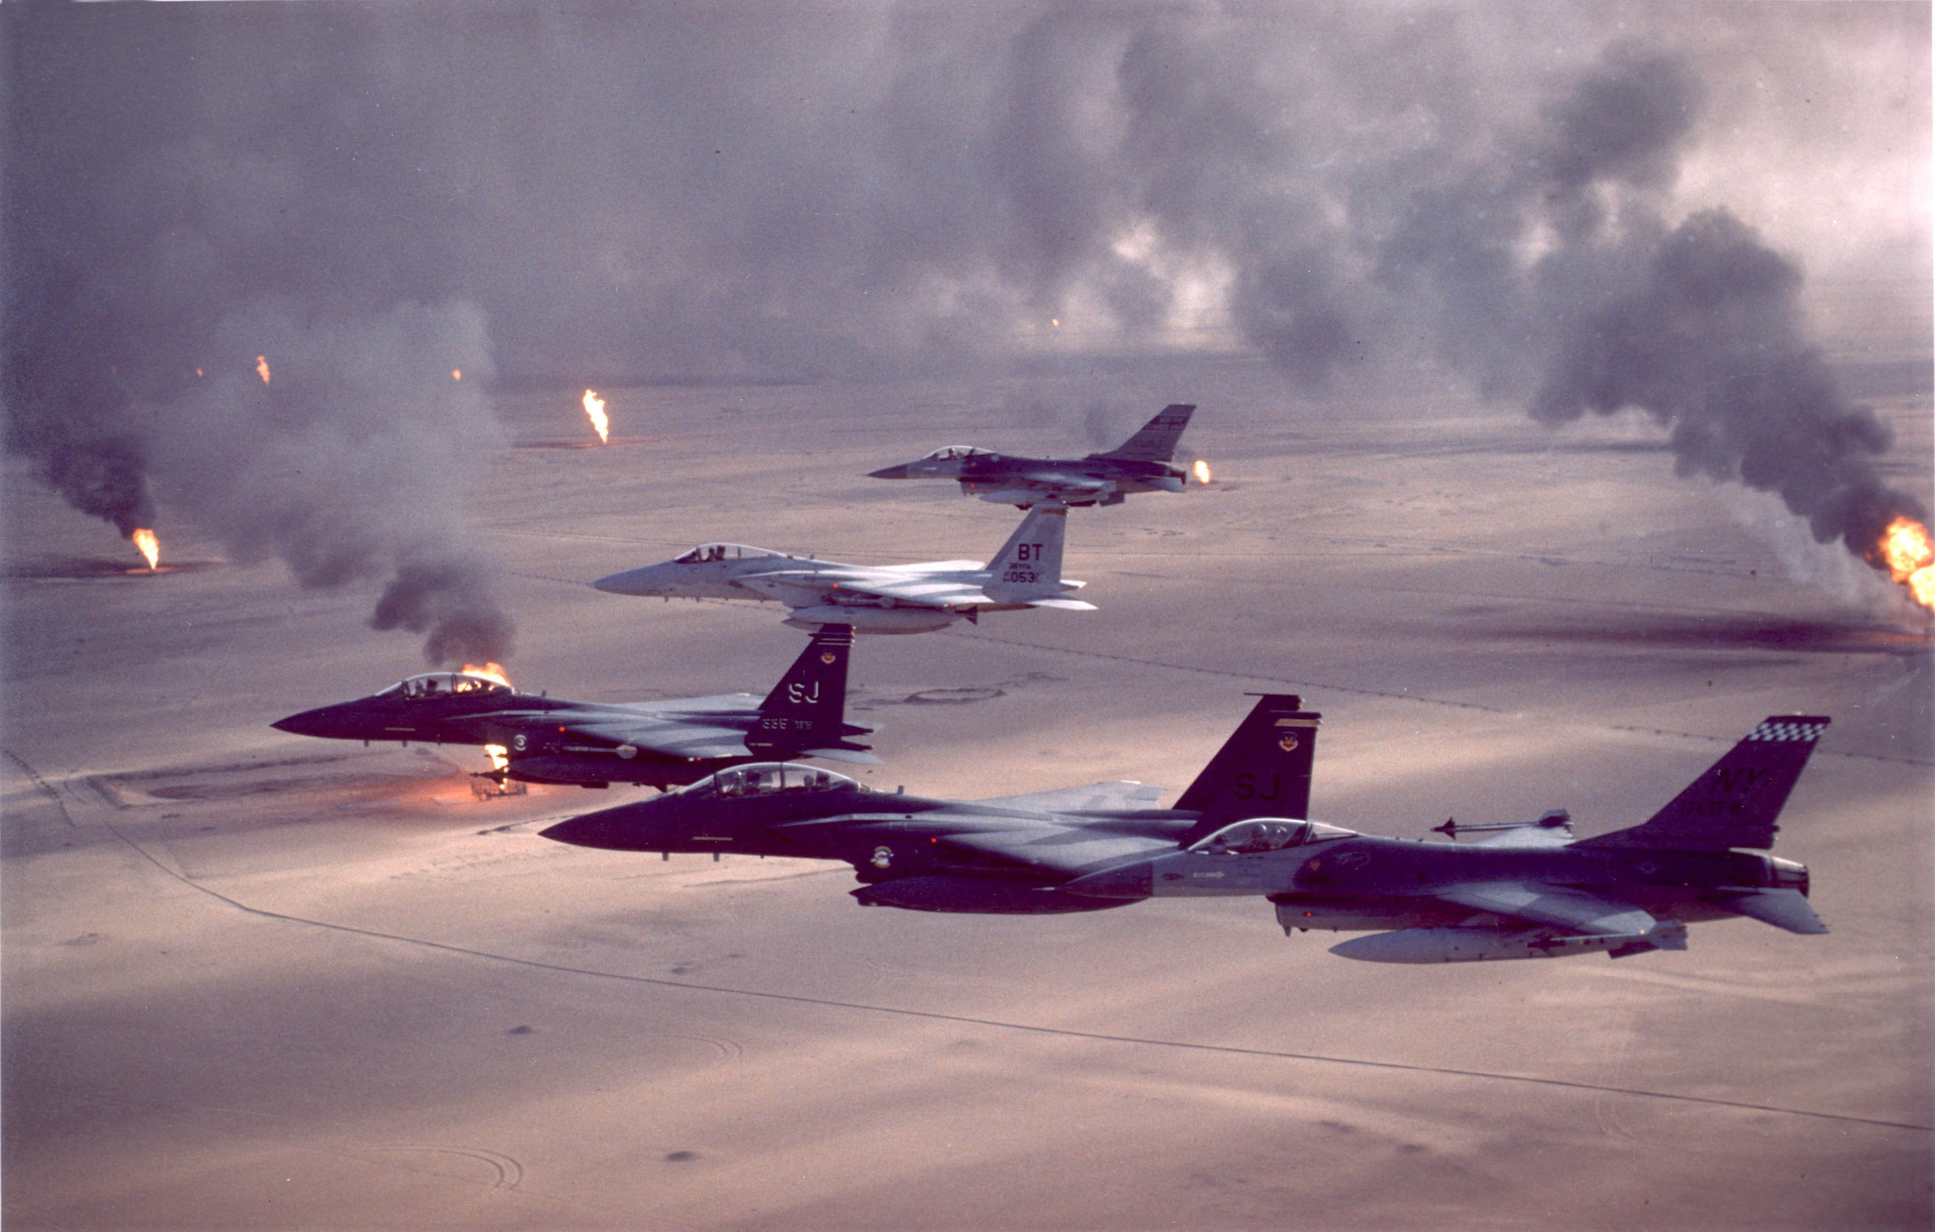

Slide 14
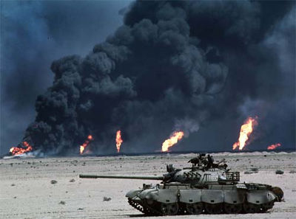

Slide 15
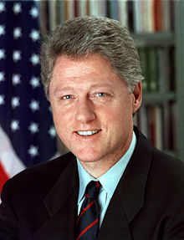
William (Bill) J. Clinton 1993-2001
Negotiated NAFTA (North American Free-Trade Agreement) between U.S., Mexico, & Canada
Worked with NATO to deal with “ethnic cleansing” in Serbia (Yugoslavia)
Restored full diplomatic relation with communist Vietnam
Removed sanctions against South Africa after they ended the brutal policy of apartheid (racial segregation)

Slide 16
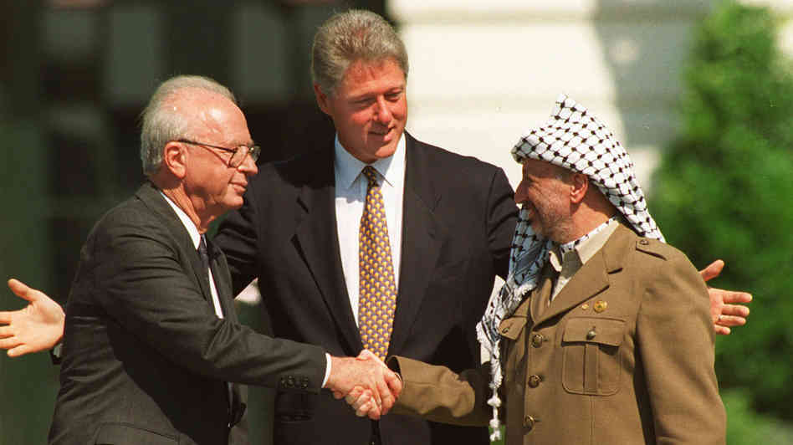

Slide 17
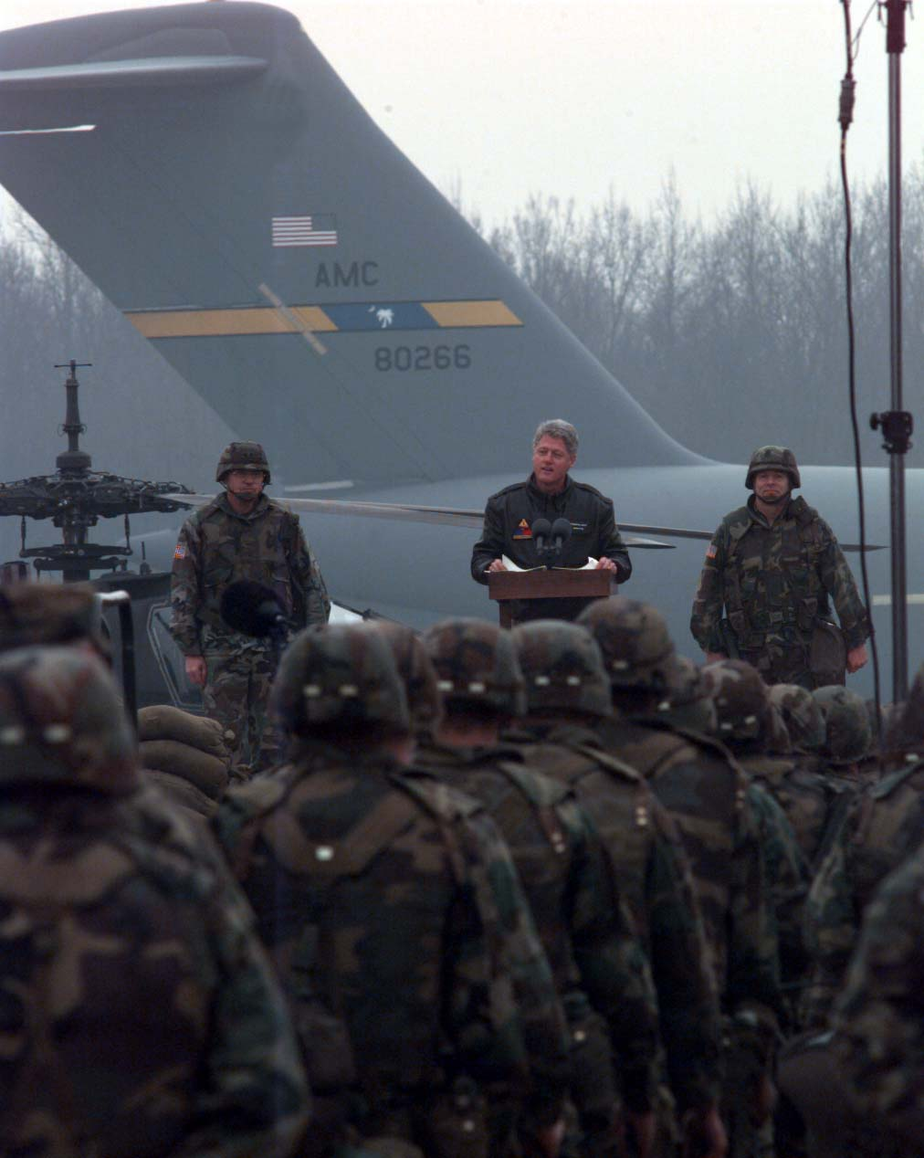

Slide 18
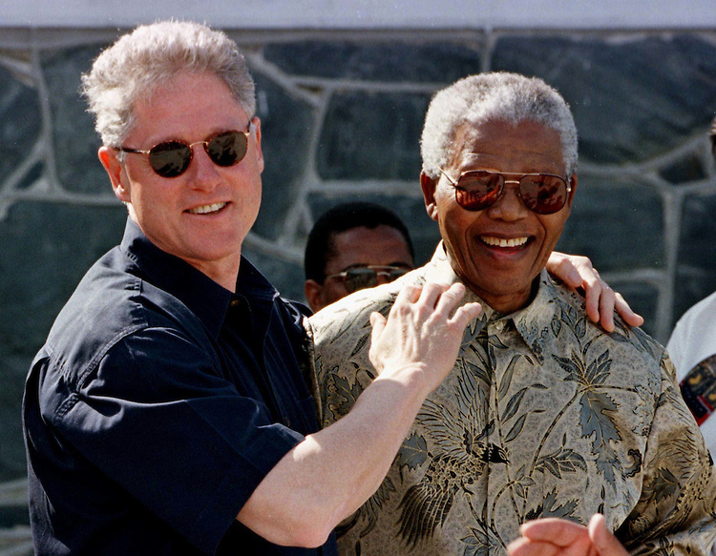

Slide 19
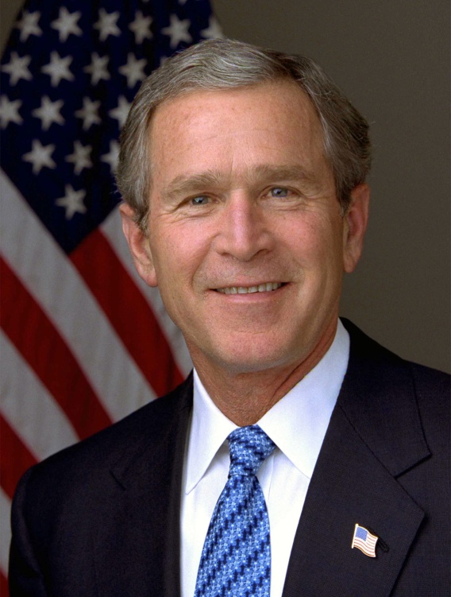
George W. Bush 2001-2009
Responds to terrorist attacks on 9/11/2001
Al-Queda, a terrorist organization led by Osama bin Laden claims responsibility
Patriot Act allowed law enforcement to wiretap, search e-mails/records, & detain suspects
Launched war in Iraq to defeat Saddam Hussein & destroyed weapons of mass destruction
Launched war in Afghanistan to defeat the Taliban, an extremist organization supported terrorism

Slide 20
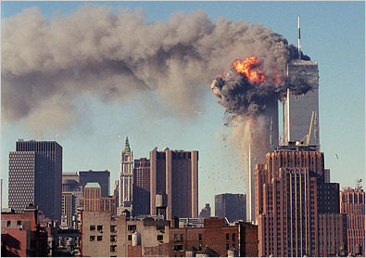

Slide 21
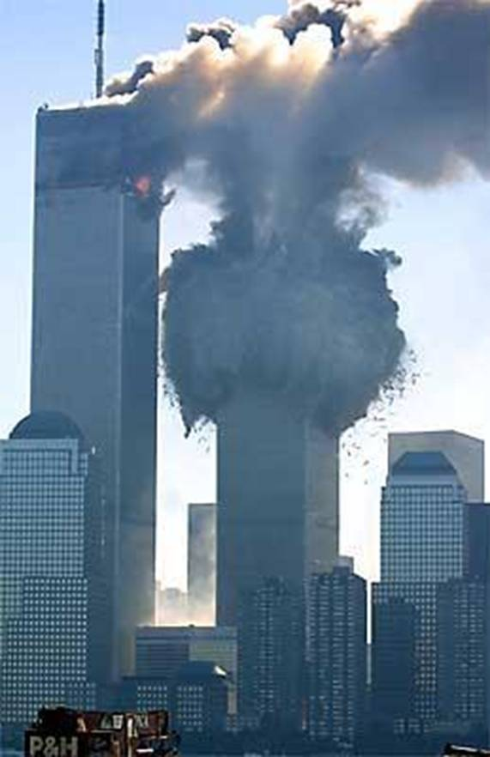

Slide 22
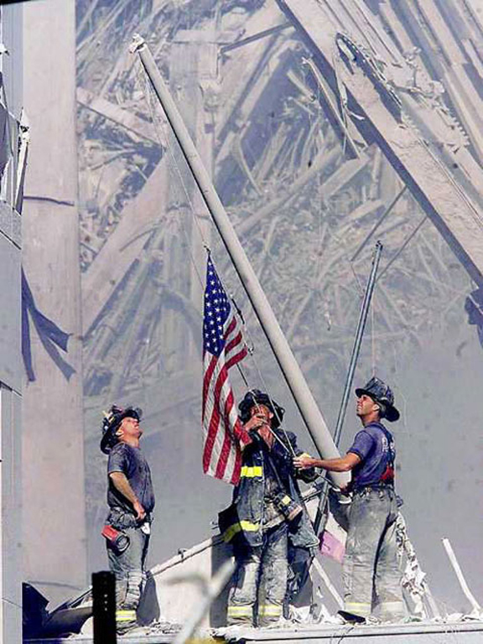

Slide 23
