Slide 1
Big Business

Slide 2
Introduction: Late 19th Century - new inventions changed rural life and influenced the growth of cities. Labor-saving devices affected both the way people lived and the roles they played in their families and at work.

Slide 3
A. By 1880s, northeastern cities had developed a modern industrial economy. How?
1. Cheap labor (immigrants and migration from farms)
2. Abundance of raw materials (coal, iron ore, & oil) & navigable rivers
3. New technologies and inventions sped production
4. Laissez-faire capitalism (gov’t keeps hands off business) and land grants to RR companies

Slide 4
B. Innovations that Improve the Standard of Living
1. Electricity = Thomas Edison –
a. Developed the light bulb
b. Built power plants to provide electricity
2. Telephone = invented by Alexander Graham Bell in 1876
3. Bessemer process = better, cheaper way to produce steel

Slide 5
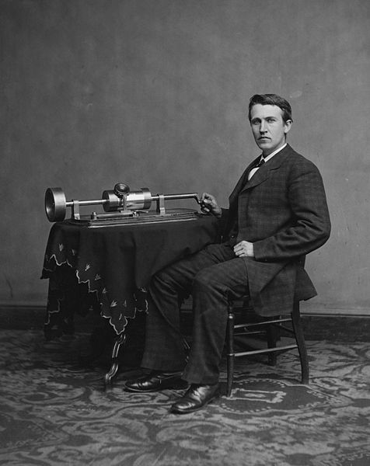

Slide 6
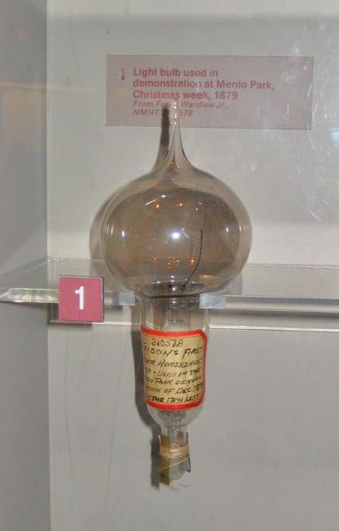

Slide 7
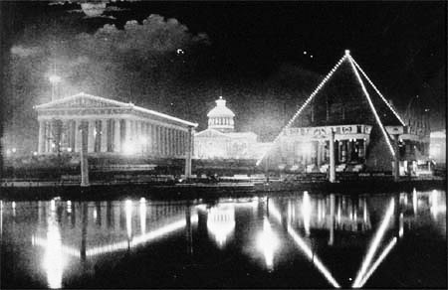

Slide 8
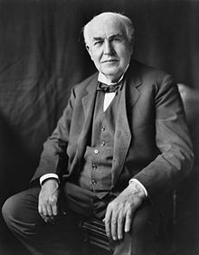

Slide 9
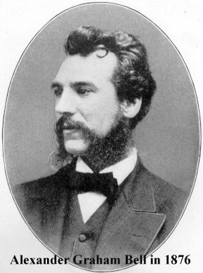

Slide 10
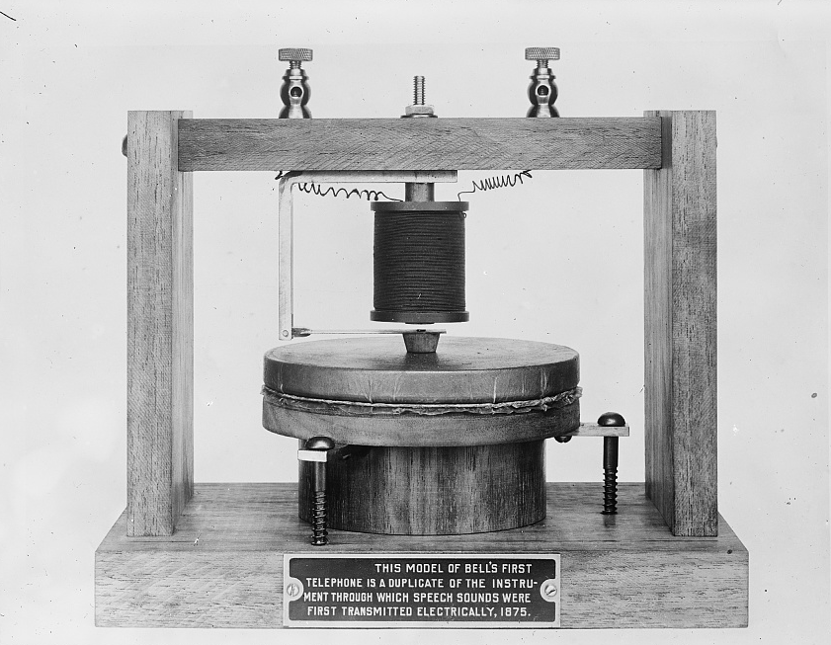

Slide 11
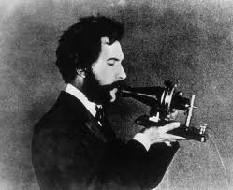

Slide 12
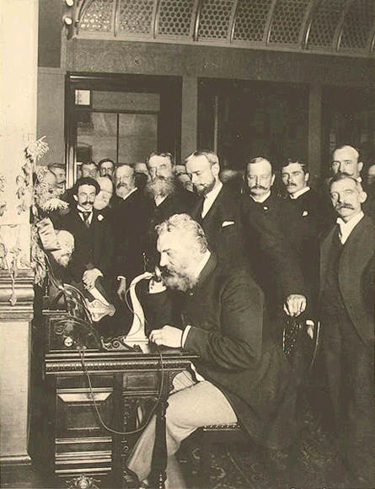

Slide 13
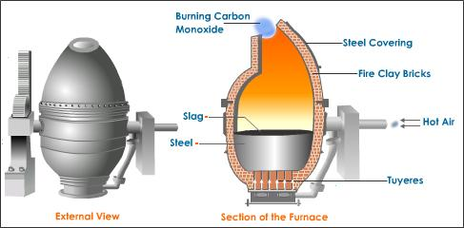

Slide 14
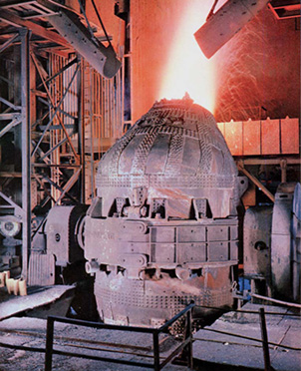

Slide 15
4. Assembly Line = developed by Henry Ford to mass-produce cars
a. made the Model-T (Tin Lizzie) cheap enough for many to own.
b. Led to suburbs and mobility
5. Wright Brothers = 1st powered airplane flight on Dec. 17, 1903 in Kitty Hawk, NC

Slide 16
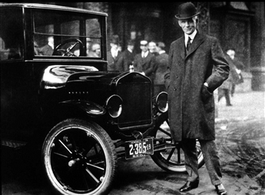

Slide 17
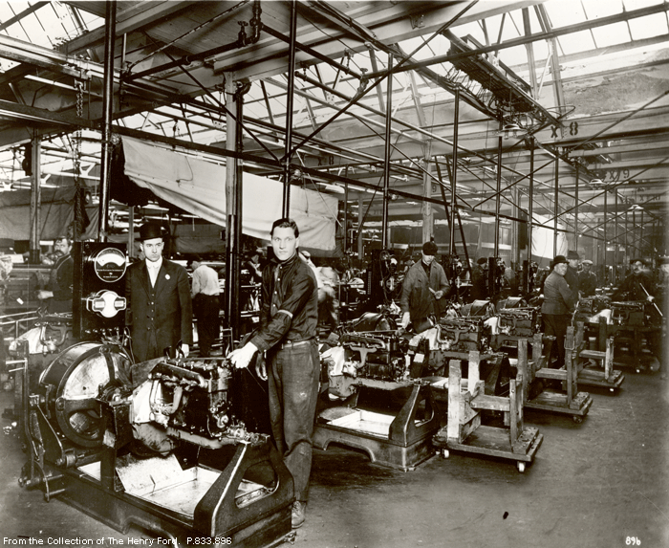

Slide 18
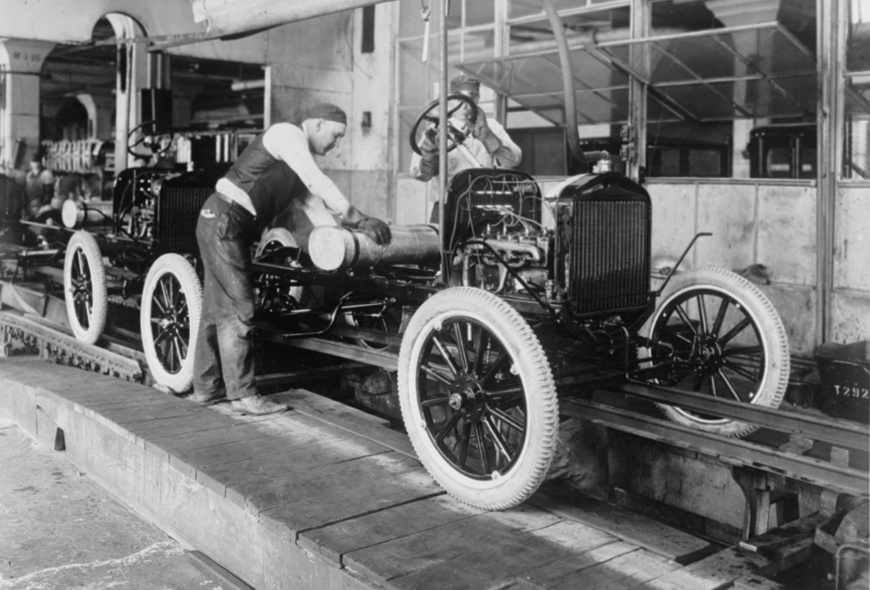

Slide 19
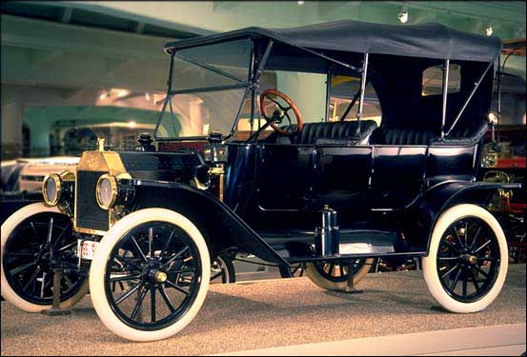

Slide 20
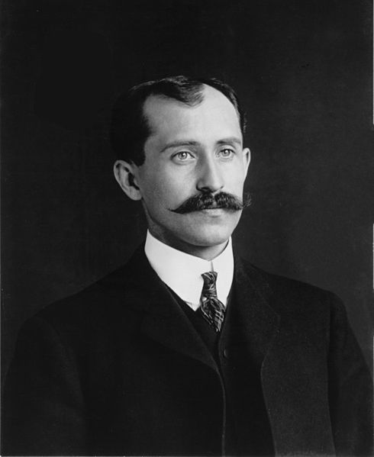
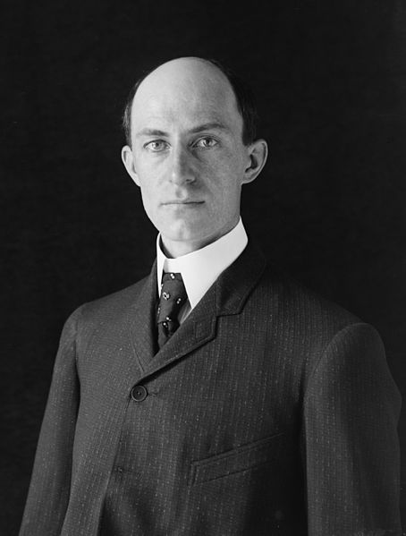

Slide 21
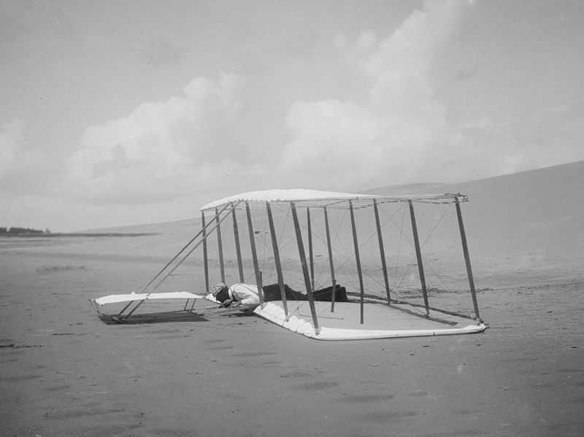

Slide 22
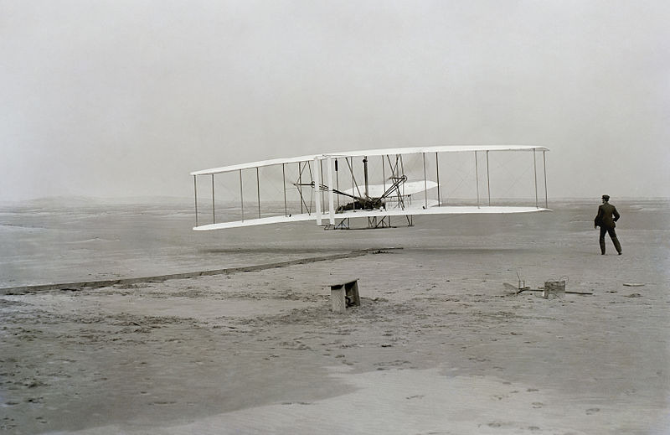

Slide 23
C. Industrial development brought great wealth to a few between 1870-1917. Why?
1. “Visionaries” – saw possibilities and opportunities
2. willing to take risks
3. Used capital ($) of others to organize companies
4. Eliminated competition & helped to create monopolies

Slide 24
D. Good Businessmen or Robber Barons?
1. Andrew Carnegie = steel business (used the Bessemer Process)
- Wrote The Gospel of Wealth – rich have a duty to help others (philanthropy)
Donated $350 million for public libraries & education.

Slide 25
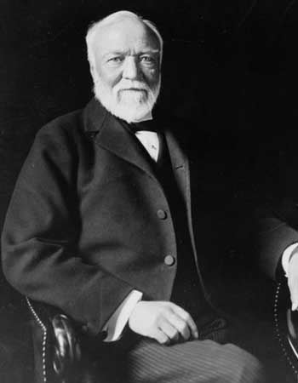

Slide 26
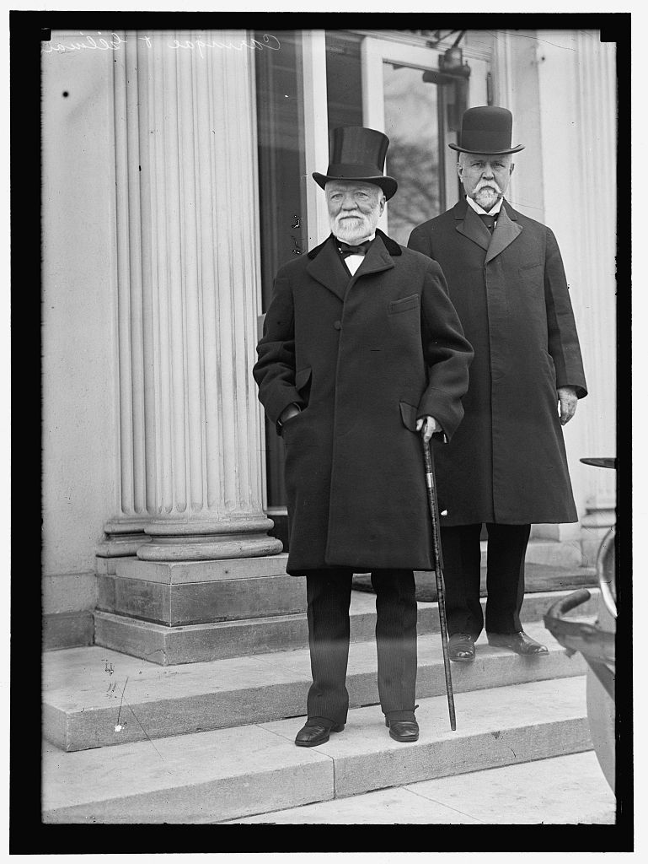

Slide 27
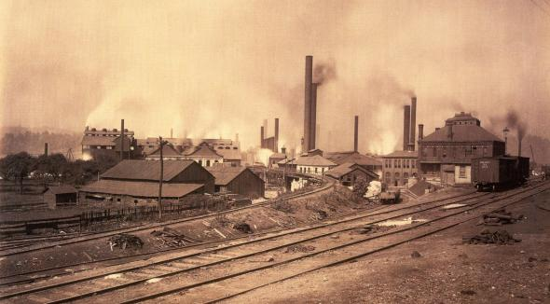

Slide 28
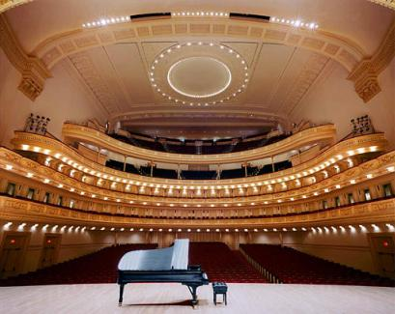

Slide 29
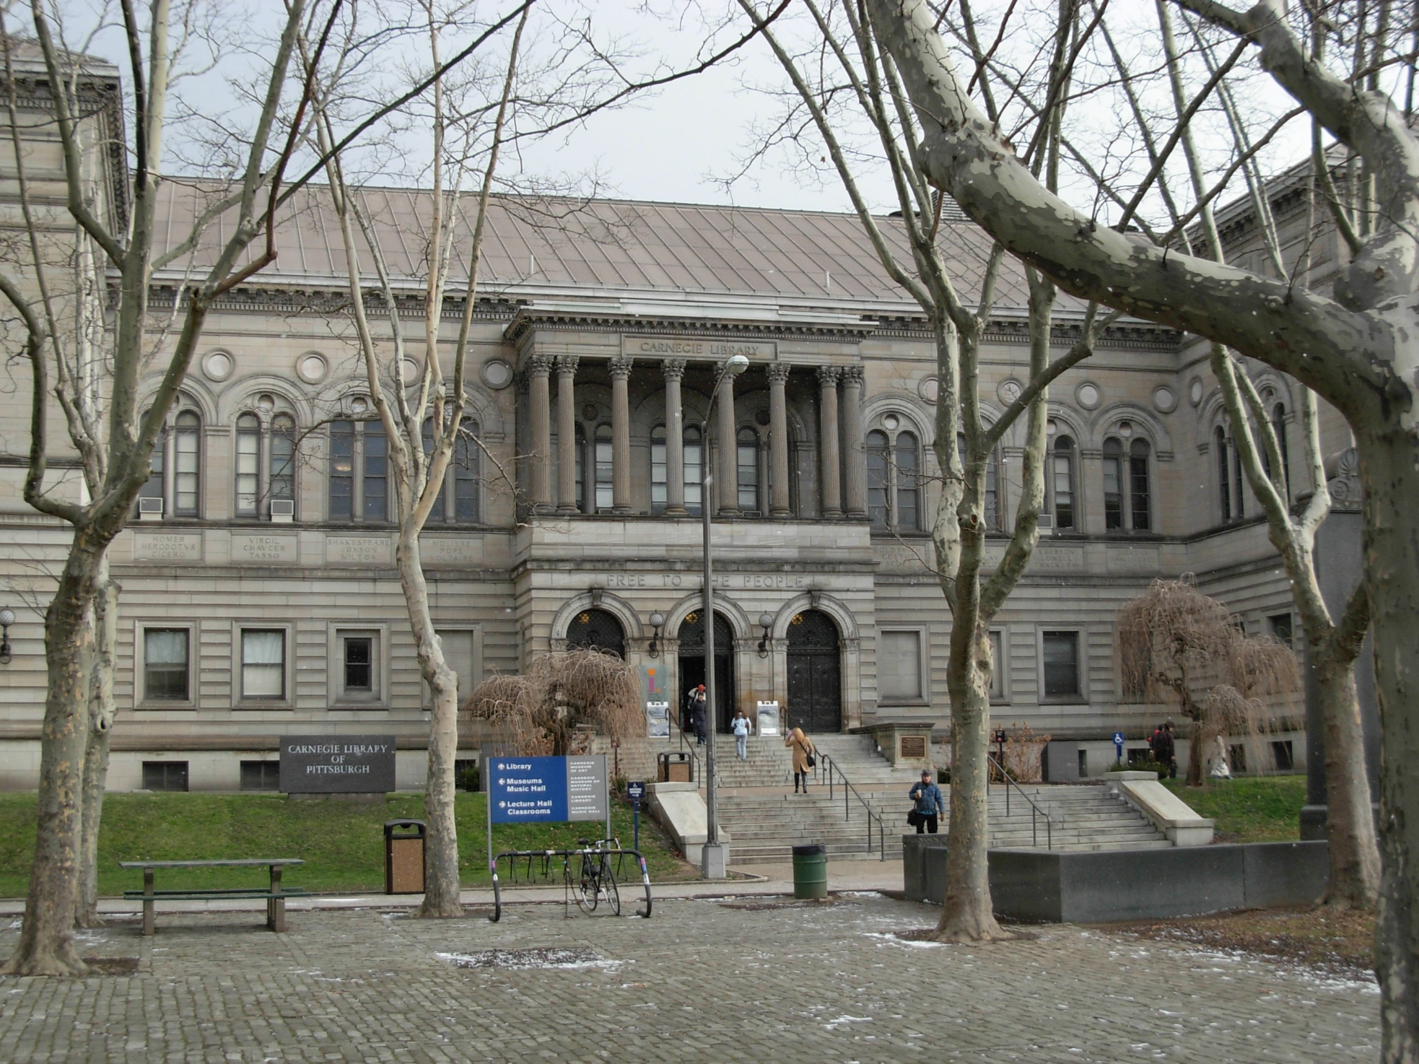

Slide 30
2. John D. Rockefeller = oil business
a. Created Standard Oil Co.
b. Ruthless business tactics (secret deals, deception)
- Donated $500 million to public

Slide 31
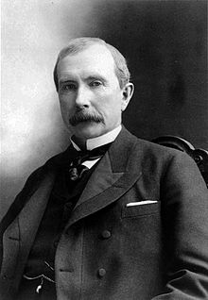

Slide 32
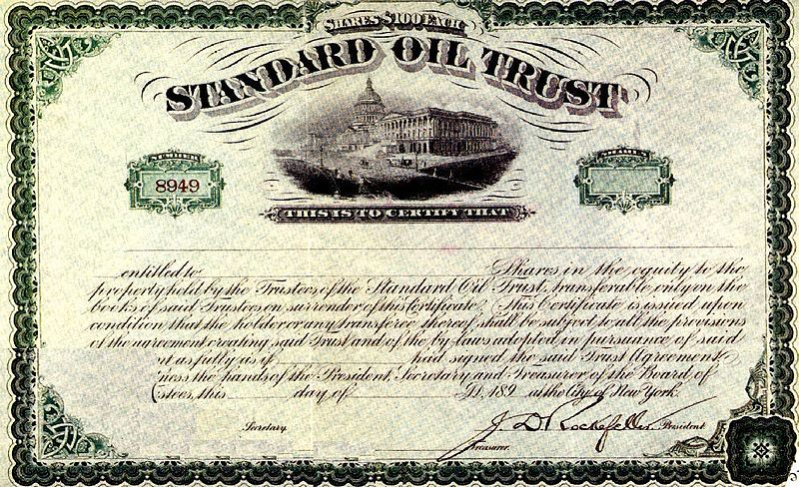

Slide 33
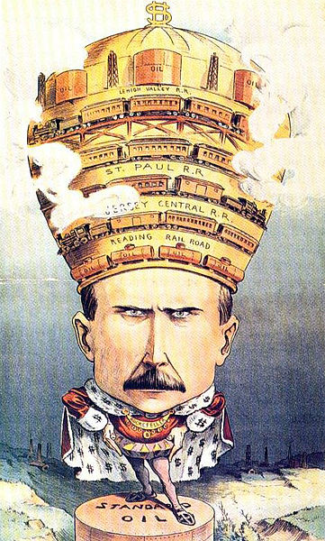

Slide 34
3. J.P. Morgan = finance
- owned banks, railroads, & bought out Carnegie
4. Cornelius Vanderbilt = railroad business

Slide 35
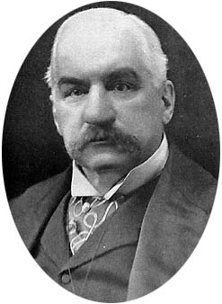

Slide 36
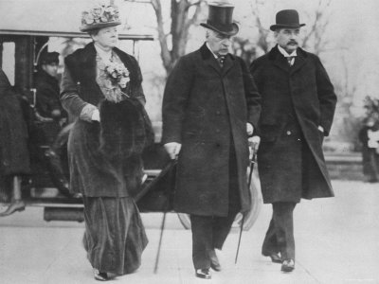

Slide 37
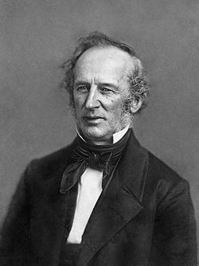

Slide 38
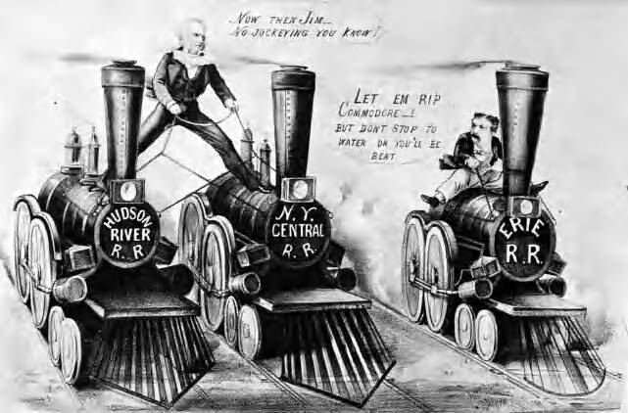

Slide 39
The Gilded Age

Slide 40
Most working class people squeezed into dark and crowded tenements, which only added to the urban problems of crime, pollution, and disease.
Many families had to send their children to work in the factories.

Slide 41
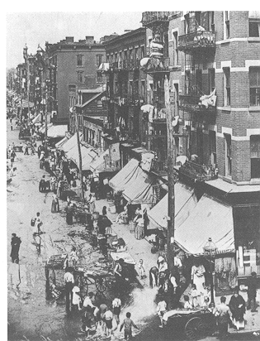

Slide 42
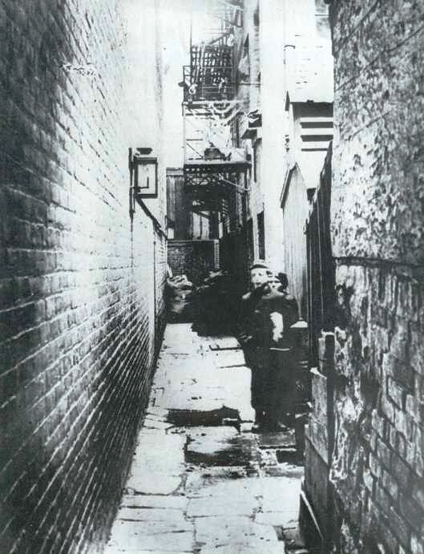

Slide 43
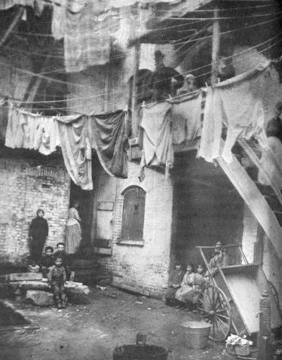

Slide 44
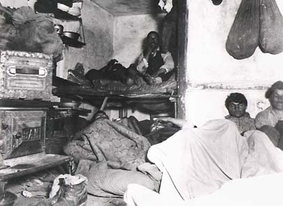

Slide 45
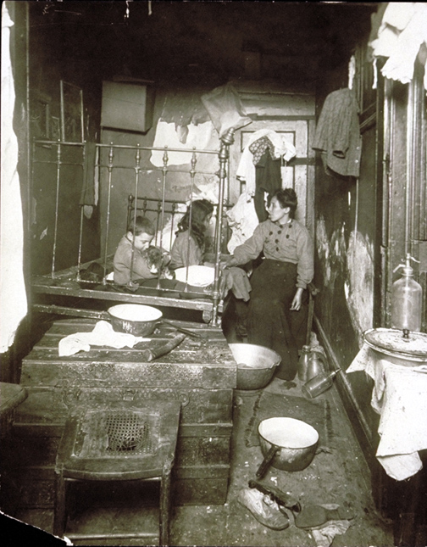

Slide 46
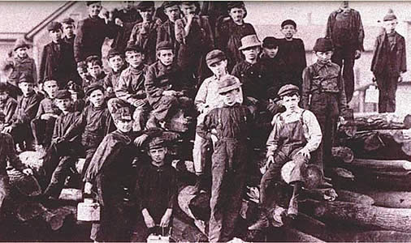

Slide 47
Working conditions
1. Dangerous factories – dust and toxic fumes; injuries from machines
2. Child labor – Kids toiled long hours in factories.
3. Average worker in 1900 – 60hr work week, low pay, no insurance, no vacations, no retirement plans
4. Women – worked in domestic-related industries for lower pay
5. Company towns – bosses owned apartments and stores
– workers forced to pay higher rents and prices.

Slide 48
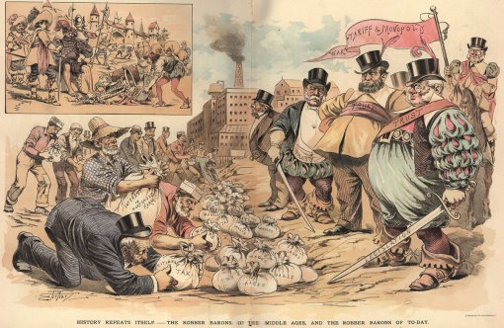

Slide 49
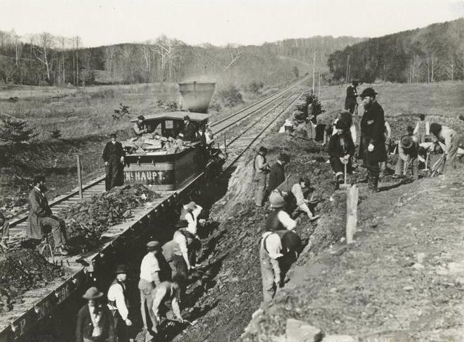

Slide 50
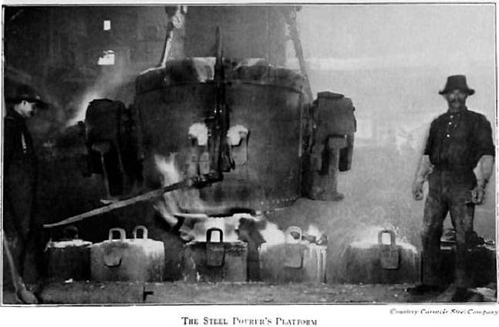

Slide 51
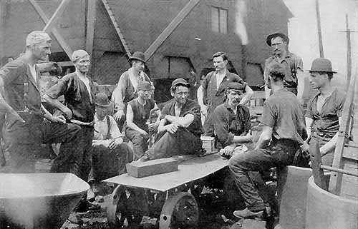

Slide 52
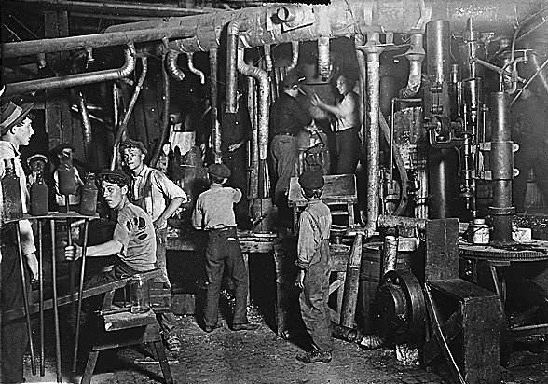

Slide 53
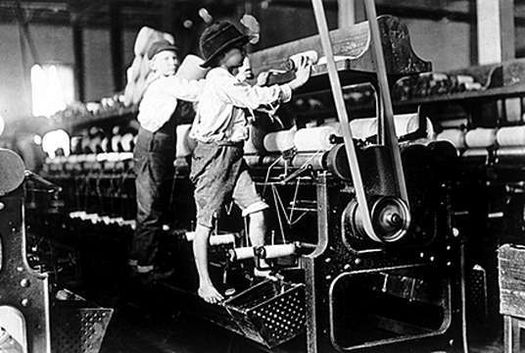

Slide 54
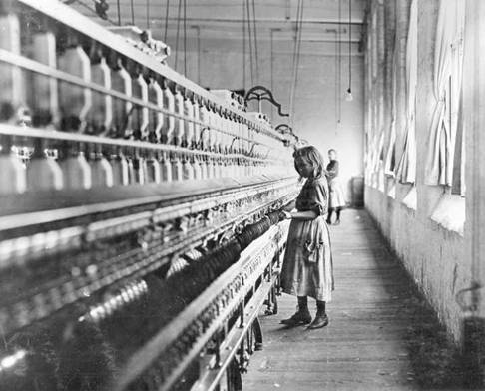

Slide 55
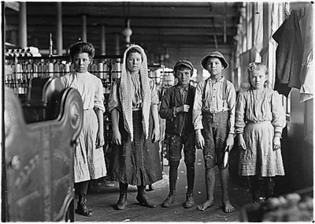

Slide 56
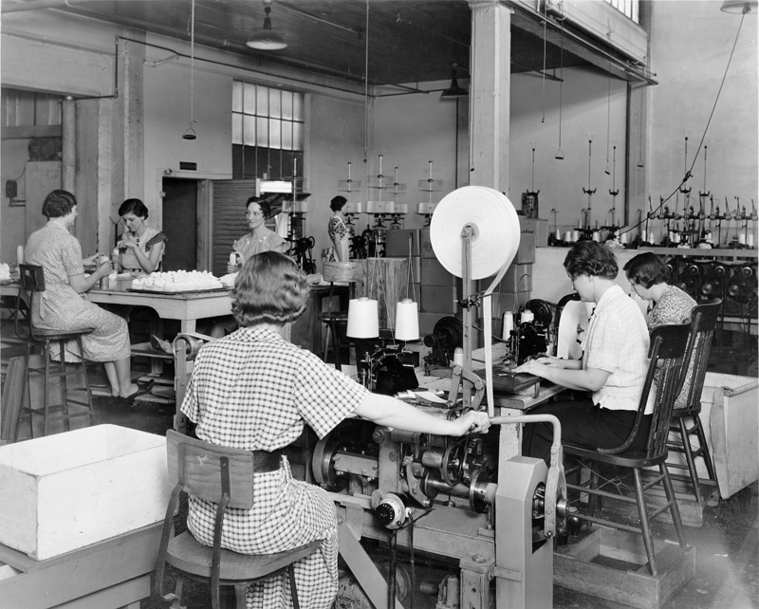

Slide 57
Rise of Unions
1. Labor union – workers organize to seek better pay and working conditions
2. Unions were difficult to organize in early 1900s.
a. surplus cheap labor gave factory owners the upper hand
b. Many different languages – hard to communicate
3. Unions used strikes to force management to listen to demands.

Slide 58
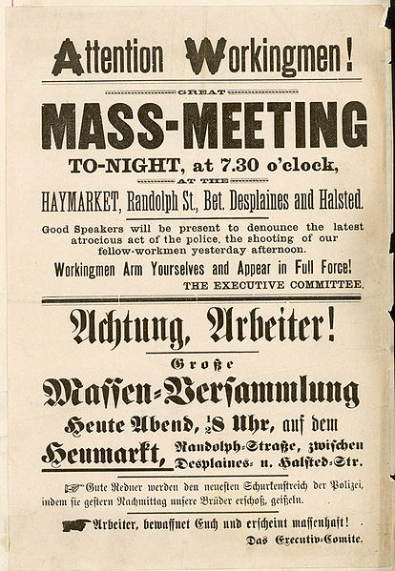

Slide 59
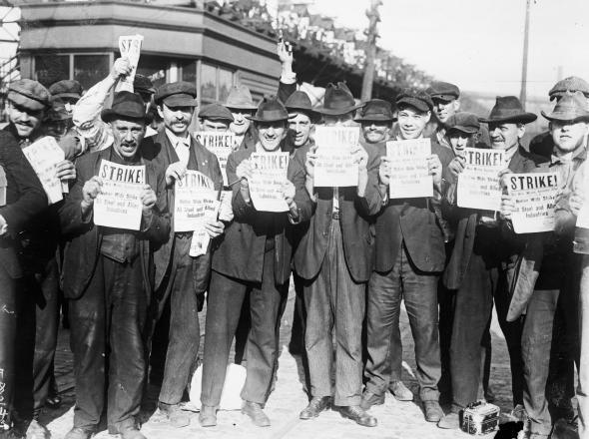

Slide 60
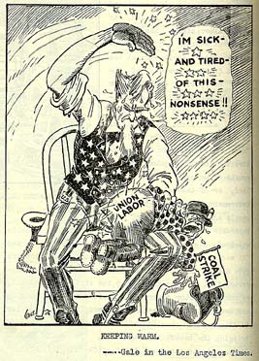

Slide 61
Early Unions
Knights of Labor (1869)
Allowed: all workers (skilled & unskilled)
Advocated: end child labor, 8 hr days, equal pay for women
- Membership declined after Haymarket Square Riot
(7 police officers killed at a labor rally → union was blamed for violence)

Slide 62
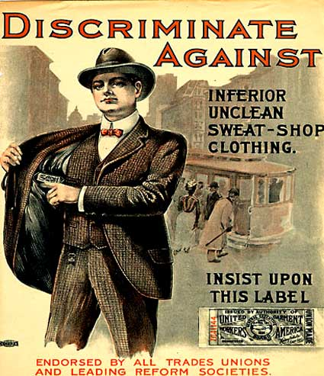

Slide 63
American Fed. Of Labor (1886)
Allowed: Only skilled workers
Fought for: higher wages and improved working conditions
Led by Samuel Gompers

Slide 64
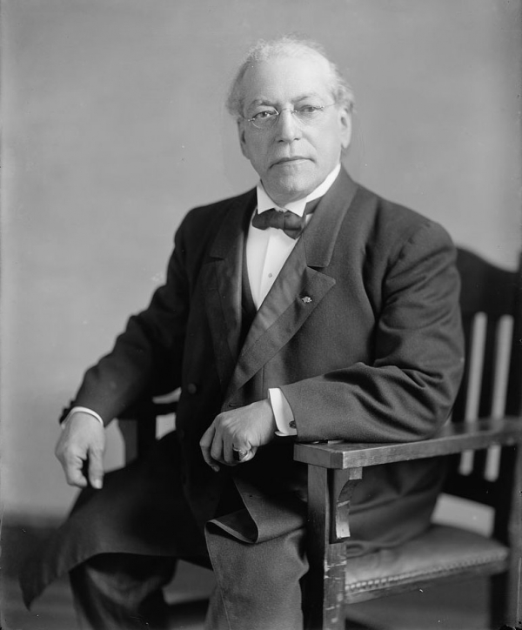

Slide 66
American railway union (1893)
Included: railroad workers
More effective - a strike could shut down the entire industry
Led by Eugene Debs

Slide 69
ILGWU – International Ladies’ Garment Workers Union
Comprised of female seamstresses

Slide 72
Famous Strikes
Homestead Strike (1892) – Pennsylvania
Steel workers - on strike after a wage cut
-Carnegie used lockouts, scabs, & a private army
Outcome: steel union lost – people afraid to join afterward

Slide 84
Pullman Strike (1896) – Illinois
ARU - wages were cut & prices increased at Pullman Co. Town
-Railroad stopped running! Mail cars were attached → rains had to run
Outcome: Pres. Cleveland sent in troops to protect the mail – union lost!

Slide 90
Outcome of labor movement
Factory owners held the upper hand → government generally taking their side.
However, the public recognized the need for a balance between the demands of employers and employees to avoid the numerous strikes and violence.

Slide 93
Antitrust Laws
Sherman Anti-Trust Act
Attempted to prevent monopolies from “restraining trade”
Clayton Ant-Trust Act
Outlawed price fixing and exempted Unions from being considered as monopolies

