Slide 1
Immigration to America

Slide 2
New Immigrants
When? – before 1871
Where? – came from Northern & Western Europe
Examples:
England – 13 colonies
Ireland – 1840s potato famine
Germany – Midwest & farms
Norway /Sweden – Scandinavians
When? – 1871 to 1921
Where? Southern & Eastern Europe as well as Asia
Examples:
Italy – Catholics
Greece
Russia – Jews
Poland, Hungary, & Yugoslavia – poor slavic ppl.
China & Japan – Hawaii & Cali.
Old Immigrants

Slide 3
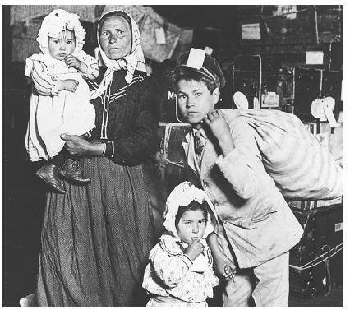

Slide 4
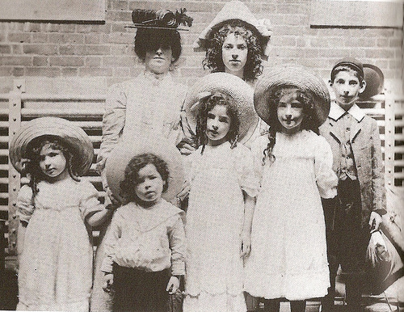

Slide 5
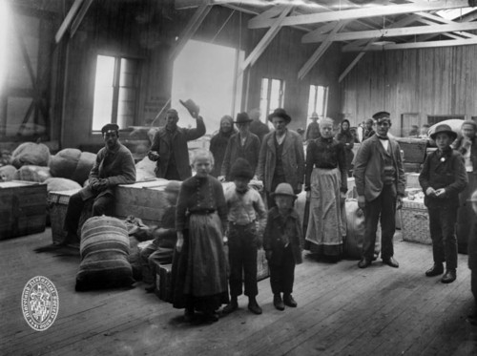

Slide 6
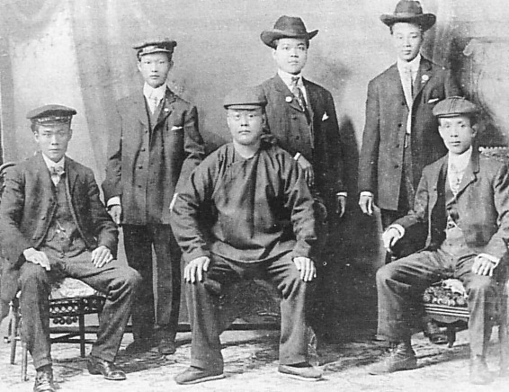

Slide 7
Reasons for migration
Why did people leave their home countries?
Religious persecution
No jobs or land
War & political persecution

Slide 8
What are some reasons why immigrants would be pulled to America?
Promise of freedom
Availability of jobs/land
Friends & family in US

Slide 9
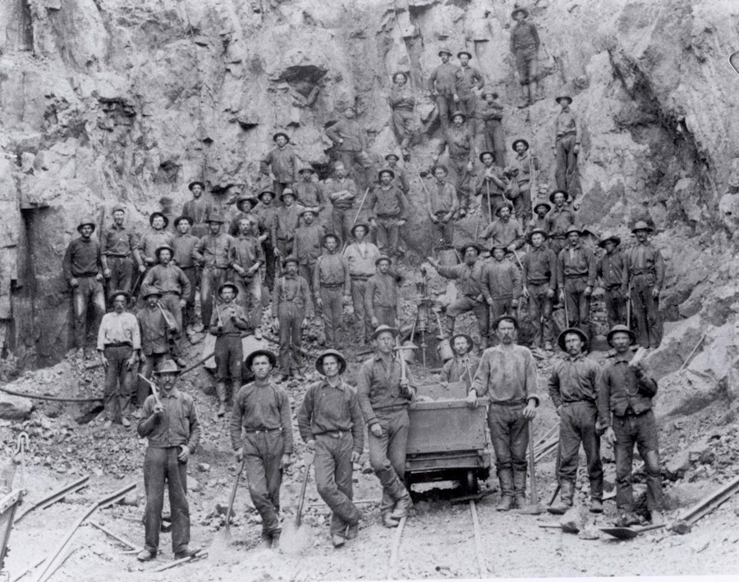

Slide 10
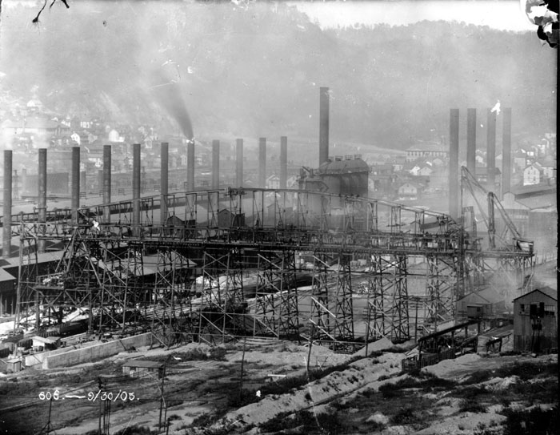

Slide 11
How did immigrants contribute to America’s industrial growth?
1. Chinese workers helped build the Transcontinental RR
2. Slavs, Italians, & Poles worked in coal mines of the East
3. Worked in the textile & steel mills of the Northeastern cities

Slide 12
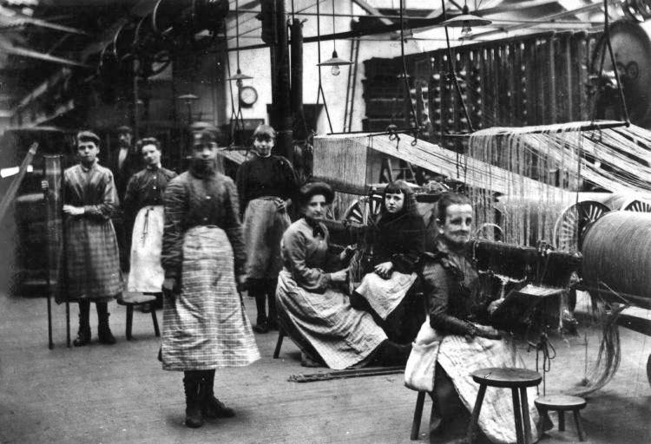

Slide 13
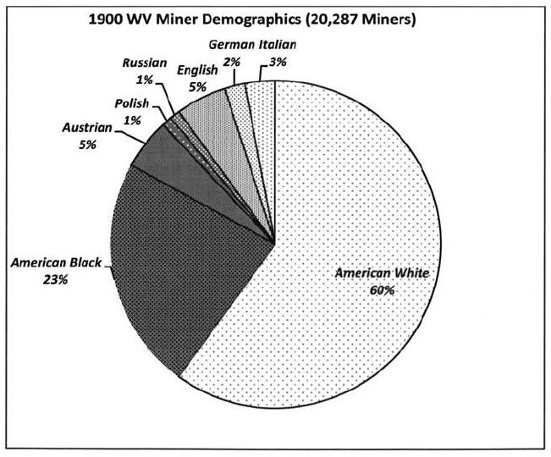

Slide 14
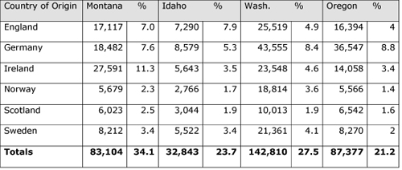

Slide 15
Immigration Concerns

Slide 16
Ellis Island
Where is it located?
Port of entry in New York Harbor
How long was it open?
1892-1954
What is its purpose?
To process and screen immigrants before they enter the US
How many immigrants entered the U.S. this way?
Over 12 million immigrants

Slide 17
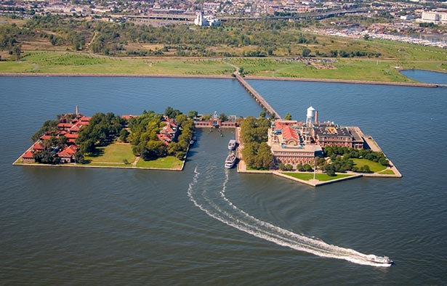

Slide 18
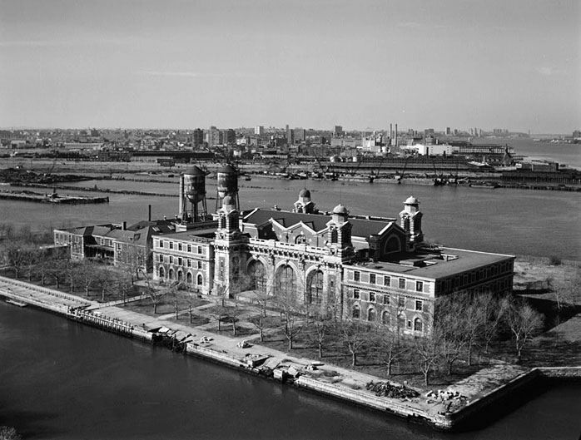

Slide 19
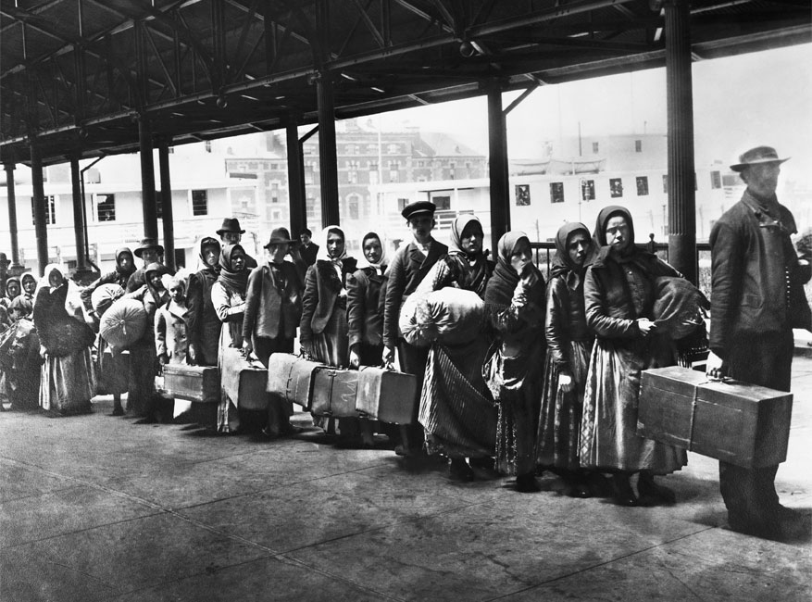

Slide 20
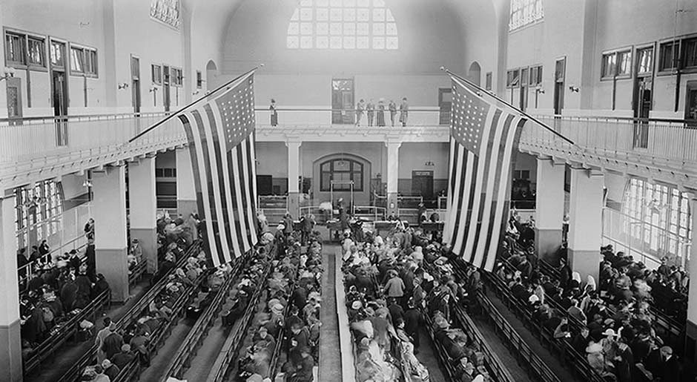

Slide 21
Why were immigrants screened before entering the U.S.?
Checked for diseases and their backgrounds
How did many immigrants get to Ellis Island?
Poor immigrants could only afford 3rd class tickets and rode beneath the decks
Arriving in the harbor, what sight would they behold?
Statue of Liberty, gift from France in 1886

Slide 22
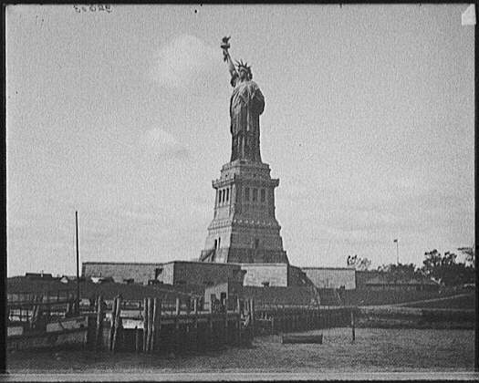

Slide 23
On the pedestal of this statue is a poem by Emma Lazarus which reads:
Give me your poor, tired your huddled masses yearning to be free…”
Explain its meaning.
It is welcoming others into the United States; freedom

Slide 24
Immigration causes problems in Cities
Which cities grew quickly?
New York
Pittsburgh
Chicago
Detroit
Cleveland

Slide 25
Why did immigrants settle in the cities?
Factories in large cities provided jobs, but living conditions were harsh
What were some of the urban problems?
Lack of housing – overcrowded tenements & slums
Lack of public services – sewage, clean water, transportation
Crime & disease was rampant

Slide 26
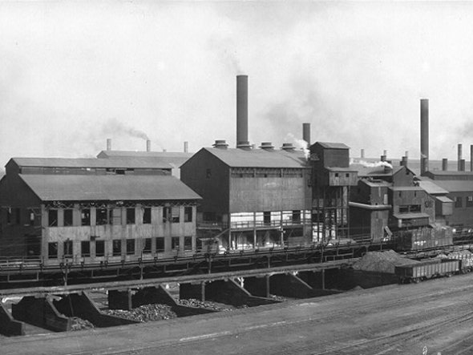

Slide 27
Which city built the nation’s first subway system?
New York City
When?
1900
Why?
Ease congestion

Slide 28
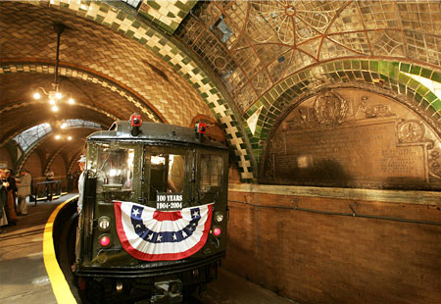

Slide 29
Adjusting to life in America
Define assimilation.
Adapt to and fit into new surroundings
Describe the melting pot theory.
Idea a diverse mix of races, cultures, & religions blend together to form American culture

Slide 30
What were ethnic neighborhoods?
City blocks made up of a certain ethnic group
Ex. China Town, Little Italy, etc.
Why were public schools essential to the process for assimilation?
Immigrants learned English, American customs, and became citizens

Slide 31
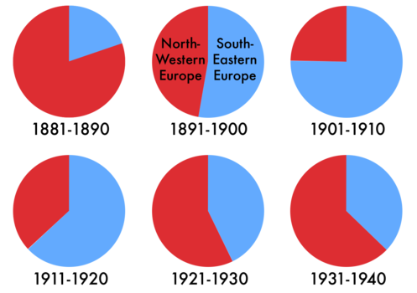

Slide 32
Nativist reactions
Immigrants often faced hostility and discrimination from nativists (people born in the United States). WHY?
Looked & sounded different (languages, foods, dress, customs)
Different beliefs (Jews, Catholics, Buddhists)
Willing to work for less pay (competition for jobs; lowered wages)

Slide 33
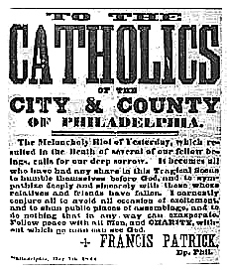

Slide 34
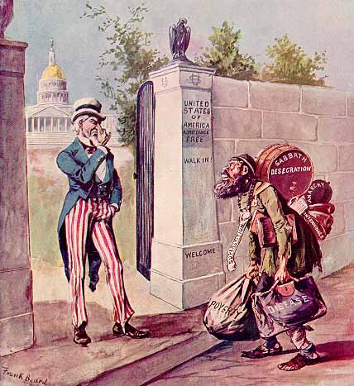

Slide 35
Laws passed to limit immigration
Chinese Exclusion Act of 1882: Chinese were banned from the country
Immigration Restriction Act of 1921: a quota law that favored the old immigrants over the new

Slide 36
