Slide 1
Growing Differences
VUS.6

Slide 2
A. The Industrial North
1. The North developed an industrial economy
a. Immigrants – cheap labor
b. Railroads & canals - ship goods & resources
2. Factories produced textiles (cloth)
3. Favored high tariffs (tax on imports)
– less competition from foreign nations
4. Did NOT rely on slaves

Slide 3
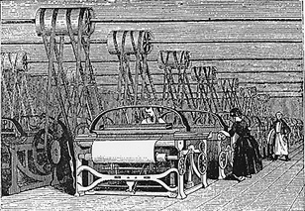

Slide 4
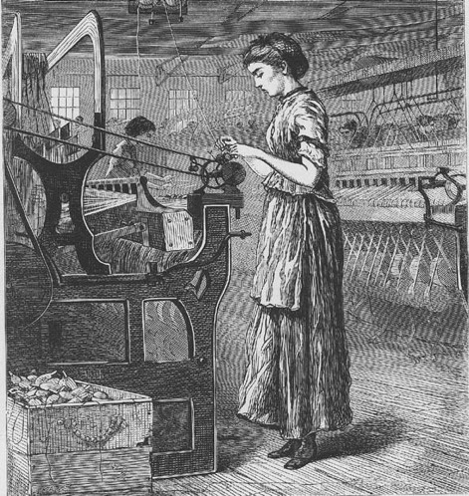

Slide 5
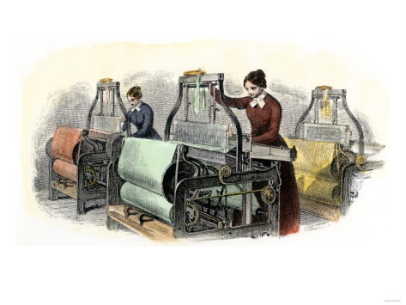

Slide 6
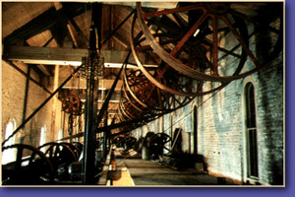

Slide 7
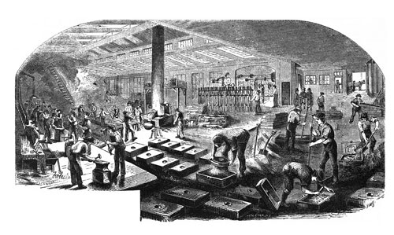

Slide 8
B. The Agricultural South
1. In 1793, Eli Whitney invented the cotton gin
a. Clean seeds from raw cotton quickly
- Before: 1 lb. by hand – After: 50 lb. by machine
b. RESULT – Slavery increased – needed to grow & harvest more cotton

Slide 9
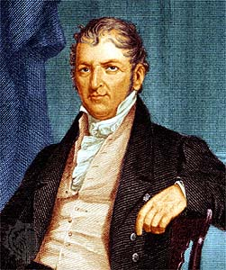

Slide 10
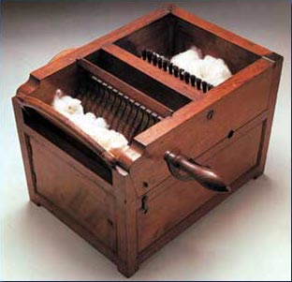

Slide 12
2. “Cotton becomes King!”
Sold to Great Britain
a. “Deep South” (MS, AL, AR, GA, & LA) = major cotton states
b. Slavery became a “necessary evil”
4. Against high tariffs – made imported goods expensive
5. Wanted to allow slavery in new states

Slide 13
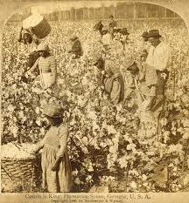

Slide 14
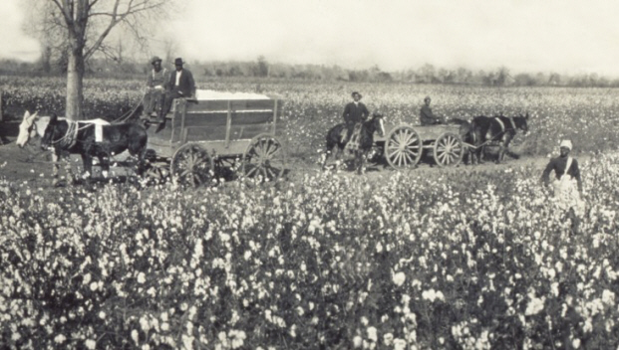

Slide 16
C. Missouri Compromise of 1820
1. Missouri wanted to enter as a slave state
- would upset the balance in the senate (11 free & 11 slave)

Slide 17
2. COMPROMISE:
a. Missouri added as a slave state
b. Maine added as a free state
c. In new territory, slavery would not be allowed above 36°, 30’ line

Slide 18
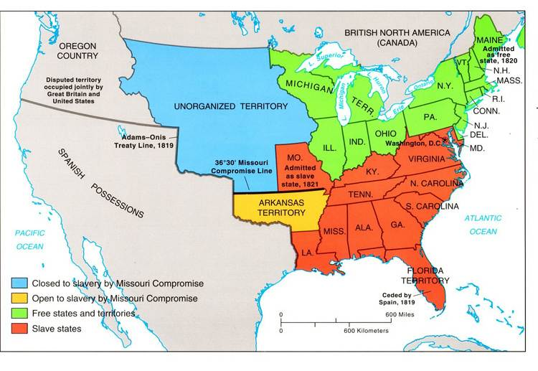

Slide 19
Reform Movements
VUS.6e

Slide 20
A. As the U.S. expanded westward, the conflict over slavery threatened to tear the country apart.
Abolitionists sought to get rid of slavery.

Slide 21
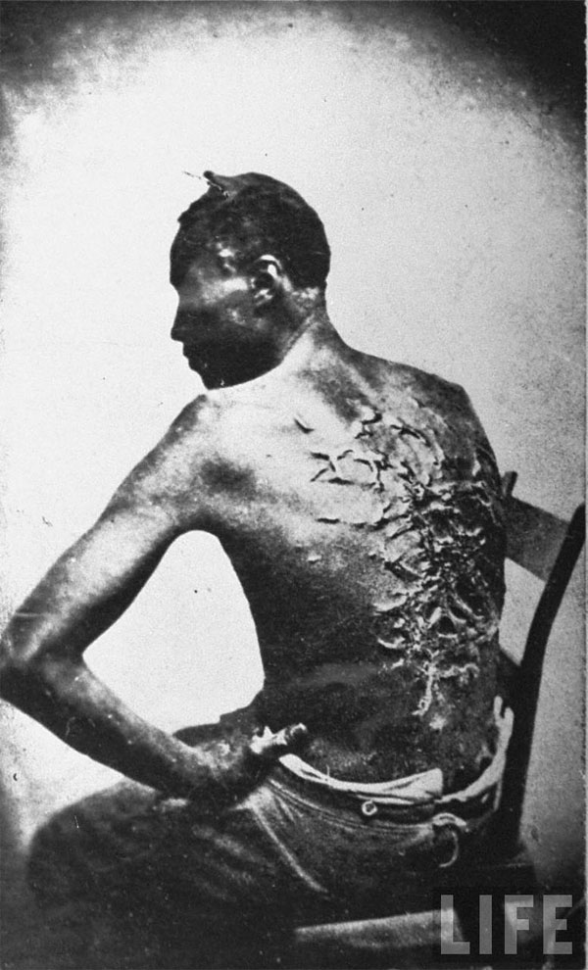

Slide 22
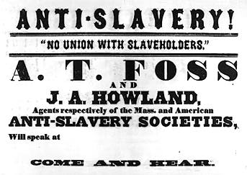

Slide 23
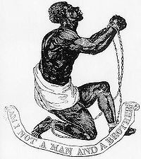

Slide 24
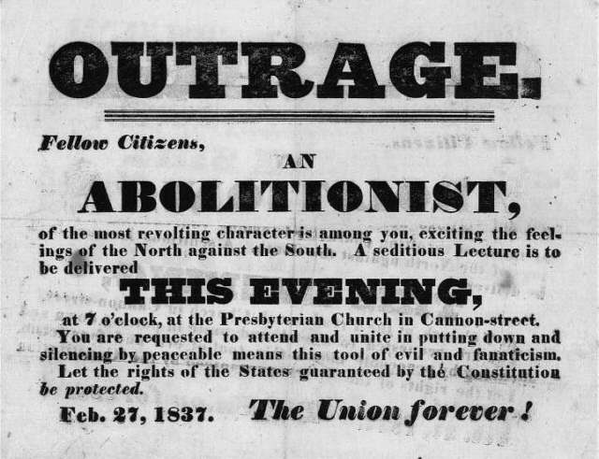

Slide 25
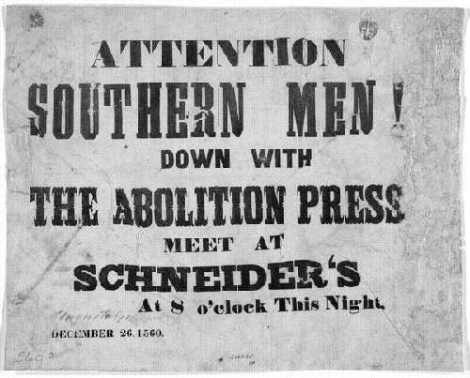

Slide 26
1. William Lloyd Garrison
Published antislavery newspaper called “The Liberator”
Slavery was against Christian principles

Slide 27
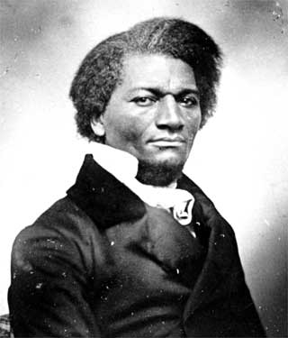
2. Frederick Douglas
a. Powerful speaker
b. spread the message that slavery was evil

Slide 28
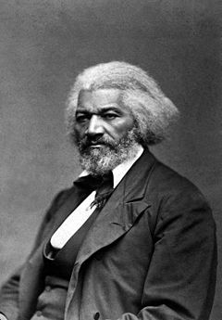

Slide 29
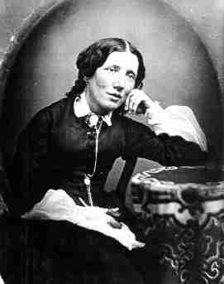

Slide 30
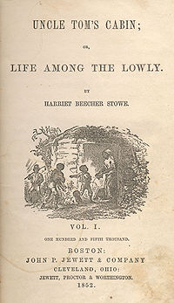

Slide 31
3. Abolitionists helped slaves escape via the Underground Railroad.
a. Network leading slaves to freedom

Slide 32
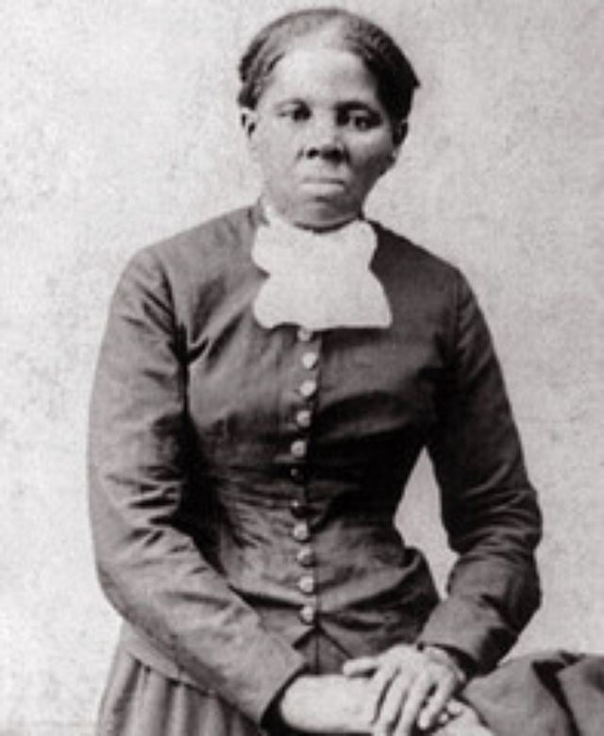

Slide 33
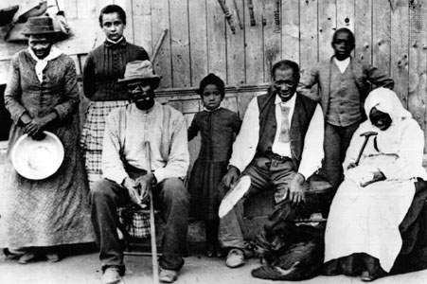

Slide 34
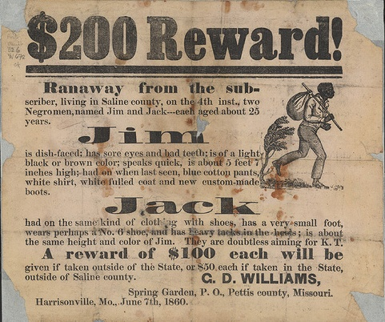
B. Southerners felt their way of life was threatened.

Slide 35
C. Slave Revolts
1. In 1800, Gabriel Prosser planned to capture an arsenal and free slaves
- plan failed!
2. In 1831, Nat Turner killed 60 whites near Hampton, VA
– captured and executed
3. RESULT: South imposed harsh fugitive slaves laws

Slide 36
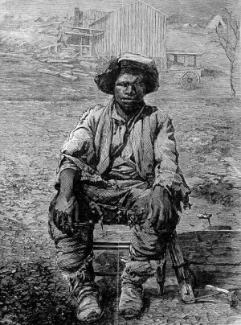

Slide 37
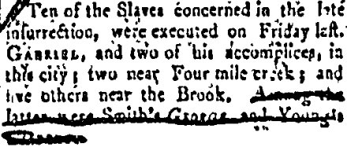

Slide 38
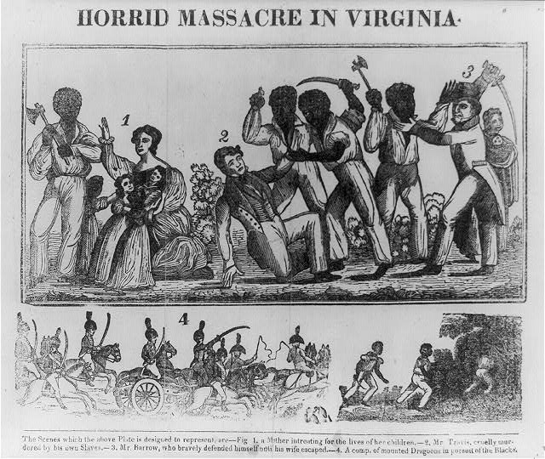

Slide 39
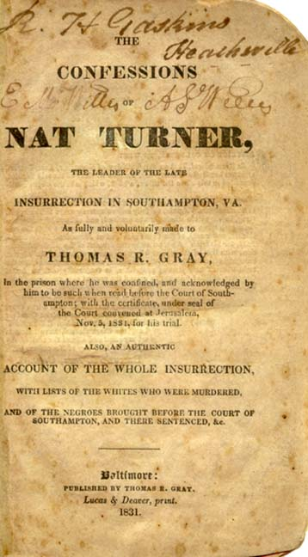

Slide 40
D. Women’s Rights
1. In 1848, women gathered at Seneca Falls Convention (NY)
a. Organized by Elizabeth Cady Stanton
b. Wrote a Declaration which stated that “All men and womenare created equal…”
-modeled after Declaration of Independence
c. Many women continued to fight for equality

Slide 41
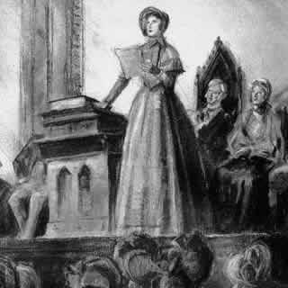

Slide 42
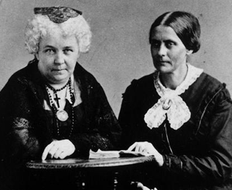

Slide 43
Territorial Expansion

Slide 44
A. Manifest Destiny
- Americans believed U.S. should stretch from Atlantic to Pacific
1. Led to conflicts with Mexico and the Indians
2. Growth of RR & Canals helped westward flow of settlers.

Slide 45
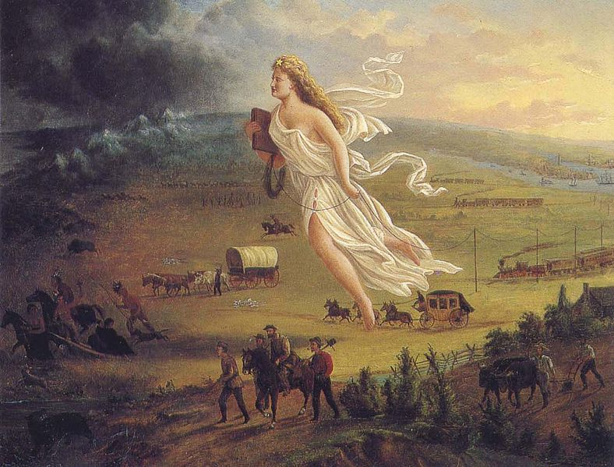

Slide 46
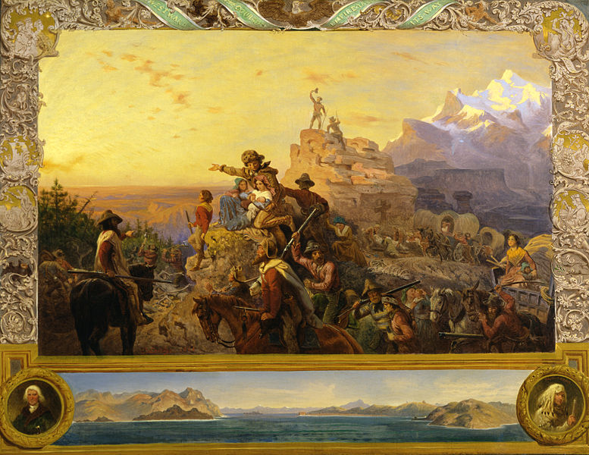

Slide 47
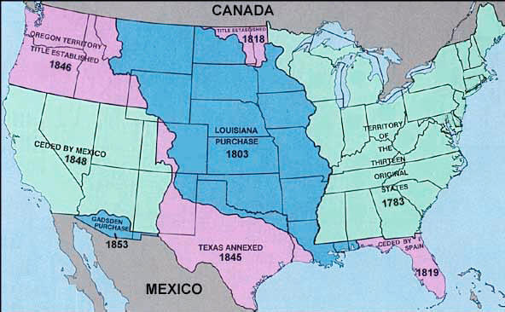

Slide 48
B. Reaching Oregon
1. Many settlers traveled west on the Oregon Trail
2. Treacherous journey – crossed the Rockies

Slide 49
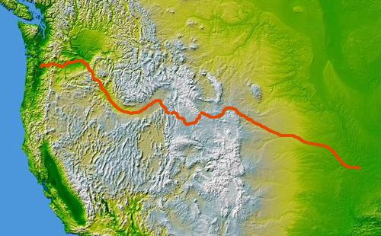

Slide 50
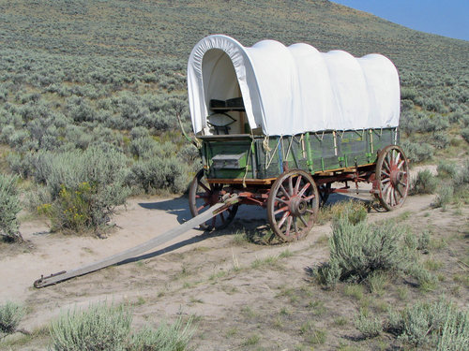

Slide 51
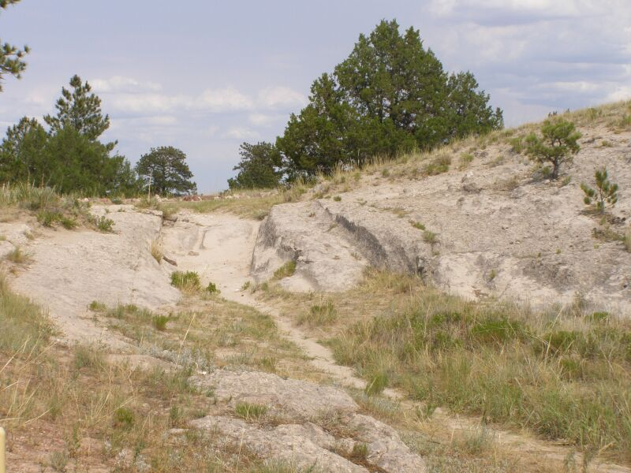

Slide 52
C. Texas (1836)
1. Mexico won its independence in 1821
- Allowed Americans into TX
2. War: Alamo - 188 Texans fought to the last man - killed by Mexican army

Slide 53
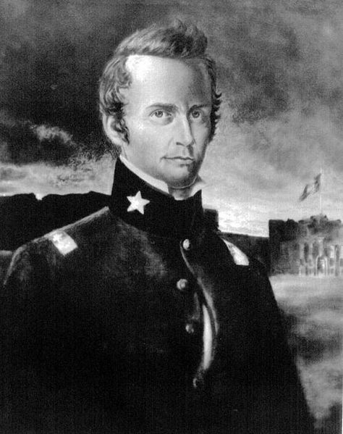

Slide 54
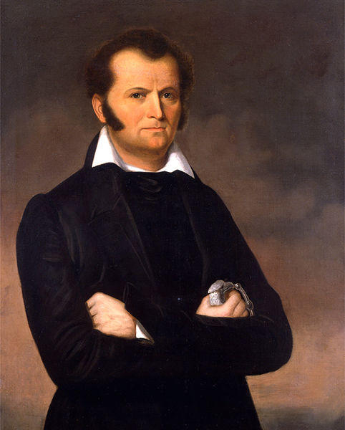

Slide 55
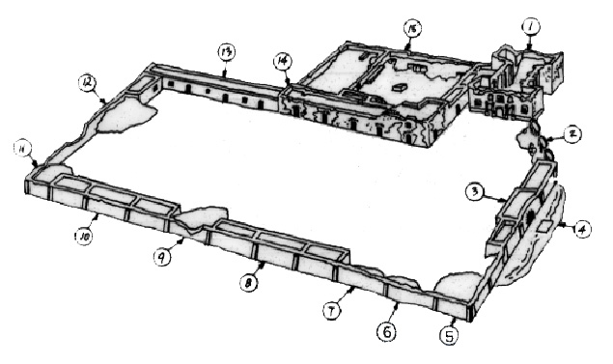

Slide 56
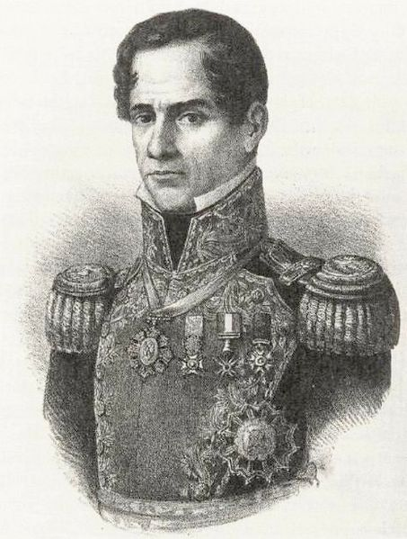

Slide 57
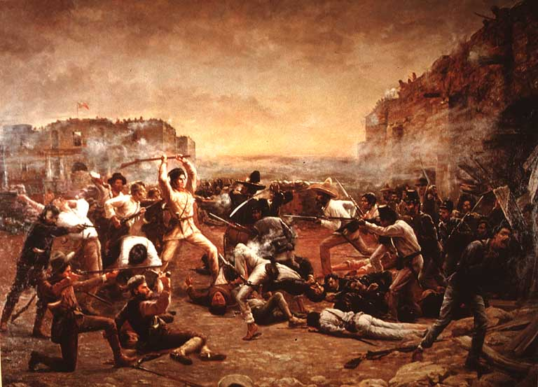

Slide 58
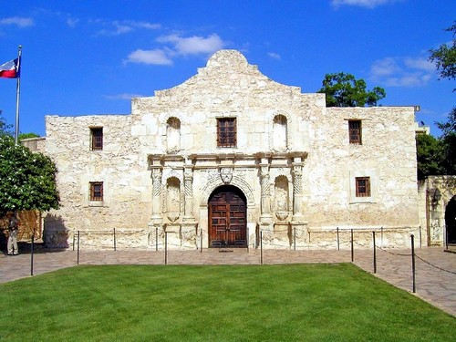

Slide 60
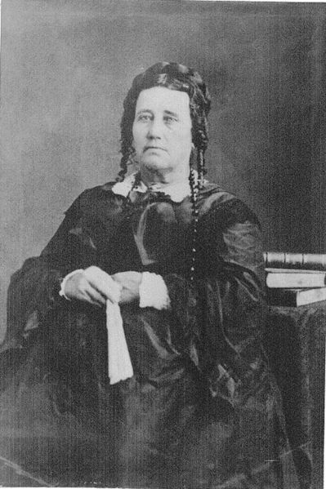

Slide 61
- Texans defeated Mexico & won independence
3. TX became the Lone Star Republic
4. 1845 – TX became a state

Slide 62
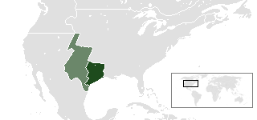

Slide 64
D. The Mexican War (1846-1848)
1. President James K. Polk wanted California
- Annexed TX in 1845 & gained Oregon in 1846
2. Fighting broke out w/ Mexico
3. Mexico surrendered

Slide 65
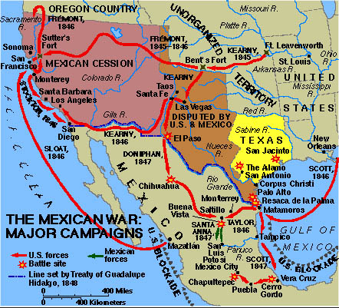

Slide 66
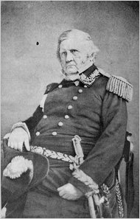

Slide 67
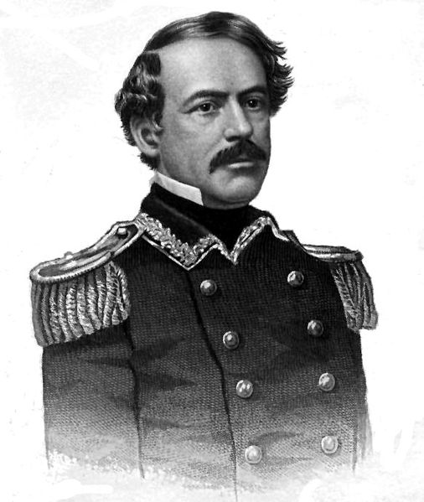

Slide 68
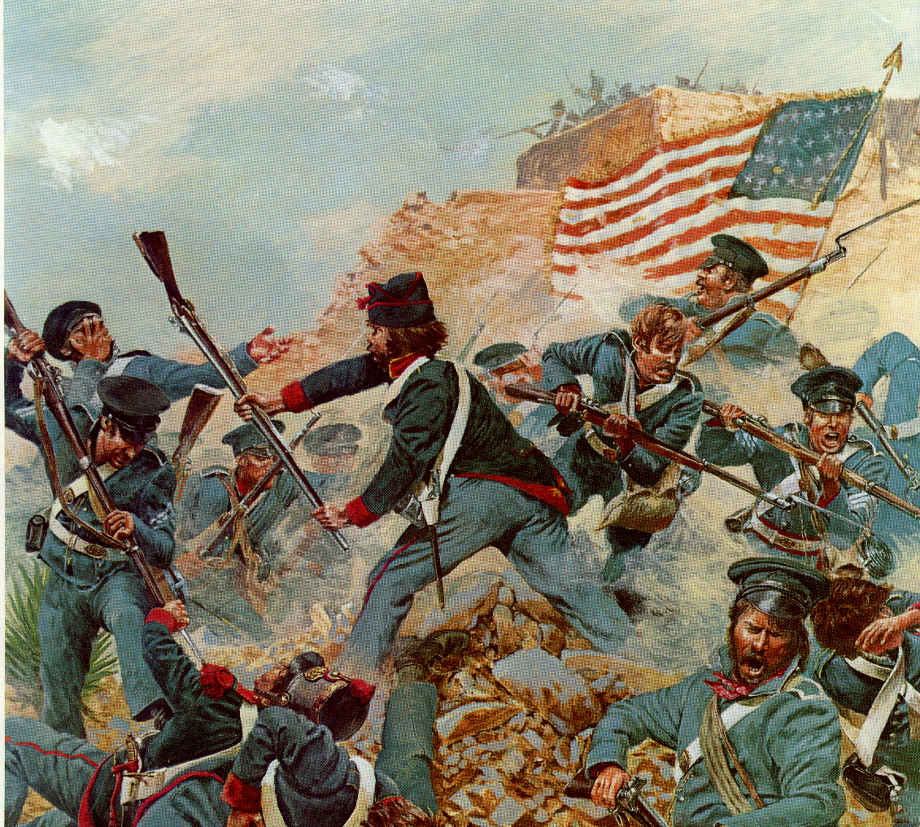

Slide 69
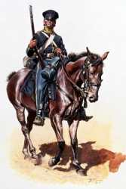
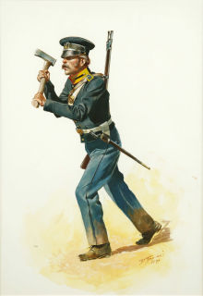

Slide 70
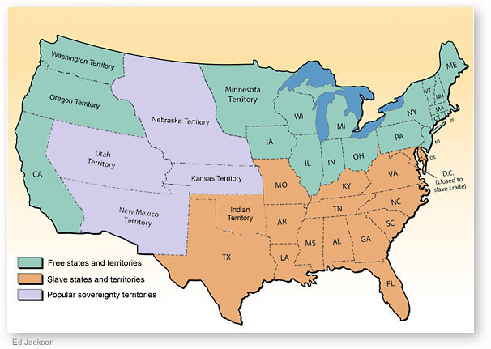
RESULT – U.S. gained all land to the Rio Grande River, California, & the New Mexico territory (AZ, UT, NV, NM, CO)

