Slide 1
The Great Depression & The New Deal

Slide 2
Great Depression
period of severe economic hardship
(1929 – 1941)

Slide 3
Over speculation
Too easy to get credit
Many bought stocks with borrowed money then hoped to pay it back after making a big profit → risky!
Banks invested customers’ savings in the stock market

Slide 4
Federal Reserve Failure
The Fed sets the interest rate to control money supply
The Fed kept interest rates high which discouraged borrowing and spending → money supply contracted

Slide 5
High Tariffs
Congress tried to help American businesses by passing the Hawley-Smoot Tariff (50% tax on imports)
Other nations retaliated by putting high tariffs on U.S. exports to their countries
RESULT – world trade was strangled

Slide 7
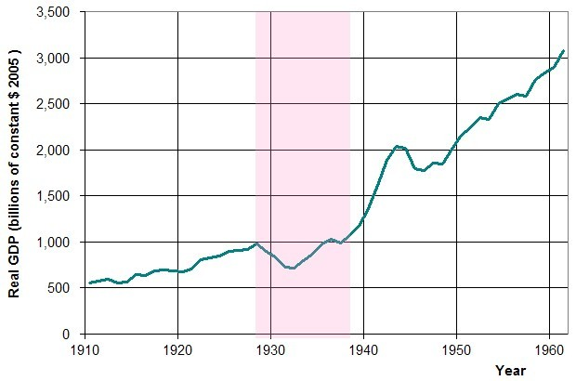

Slide 8
The Crash – Oct. 29, 1929
People panicked & sold their stocks
Stocks lost their values & businesses failed
Demand declined & production slowed
Banks had no money & collapsed

Slide 10
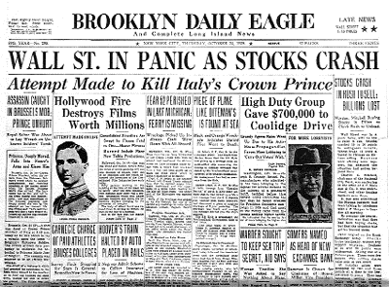

Slide 12
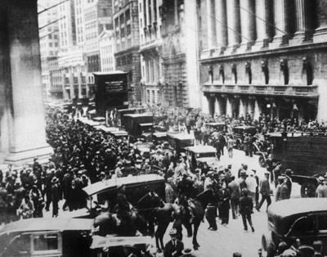

Slide 13
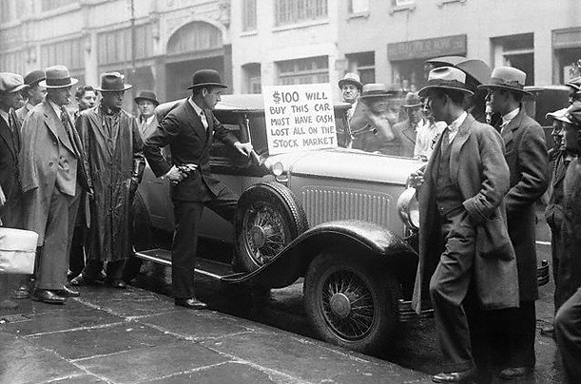

Slide 14
Impact
Unemployment (25%), bankruptcy, & homelessness
Failure of banks → no money for new investments
Unions questioned our politics/economics
Farms were foreclosed, due to heavy debts and low crop prices
“Dust Bowl”: ND to TX hit by severe droughts & erosion in 1930s
Many farm families (Okies) migrated to find work

Slide 15
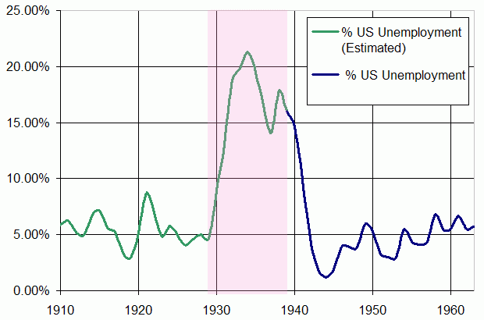

Slide 16
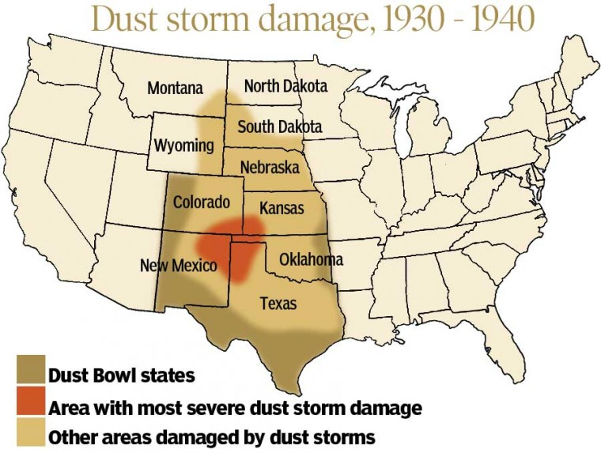

Slide 17
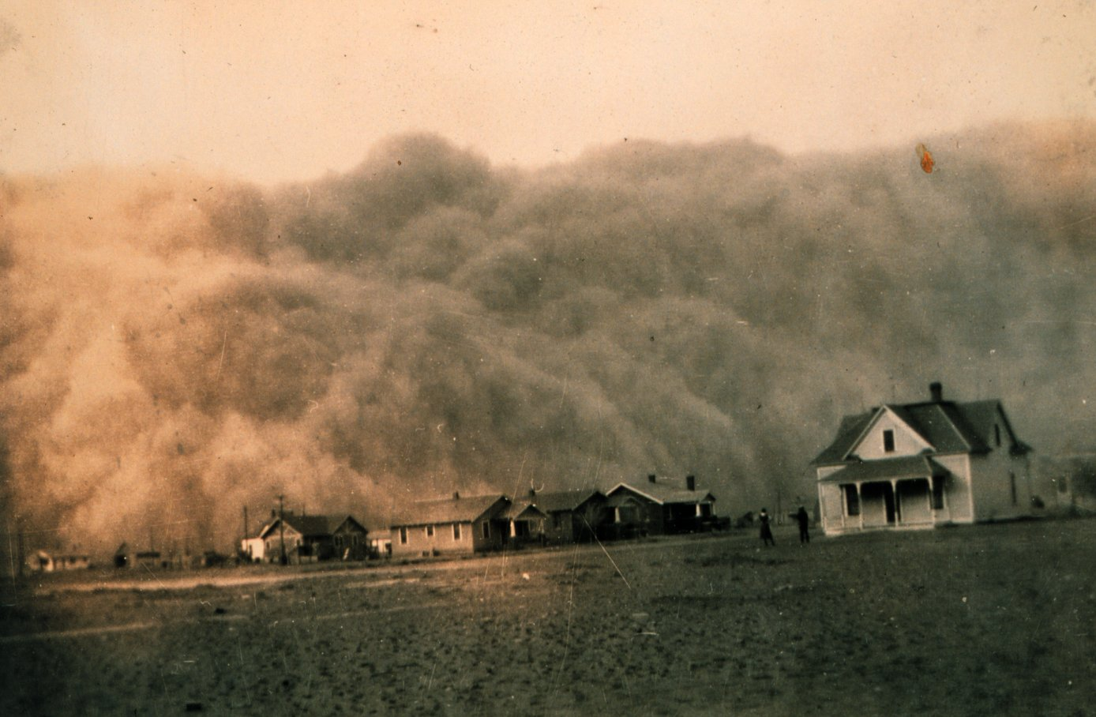

Slide 18
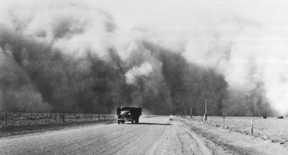

Slide 19
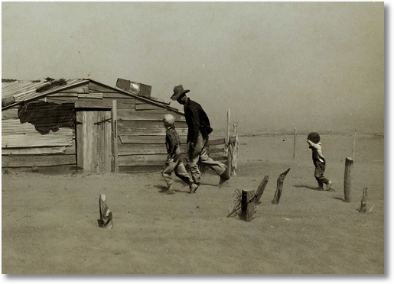

Slide 20
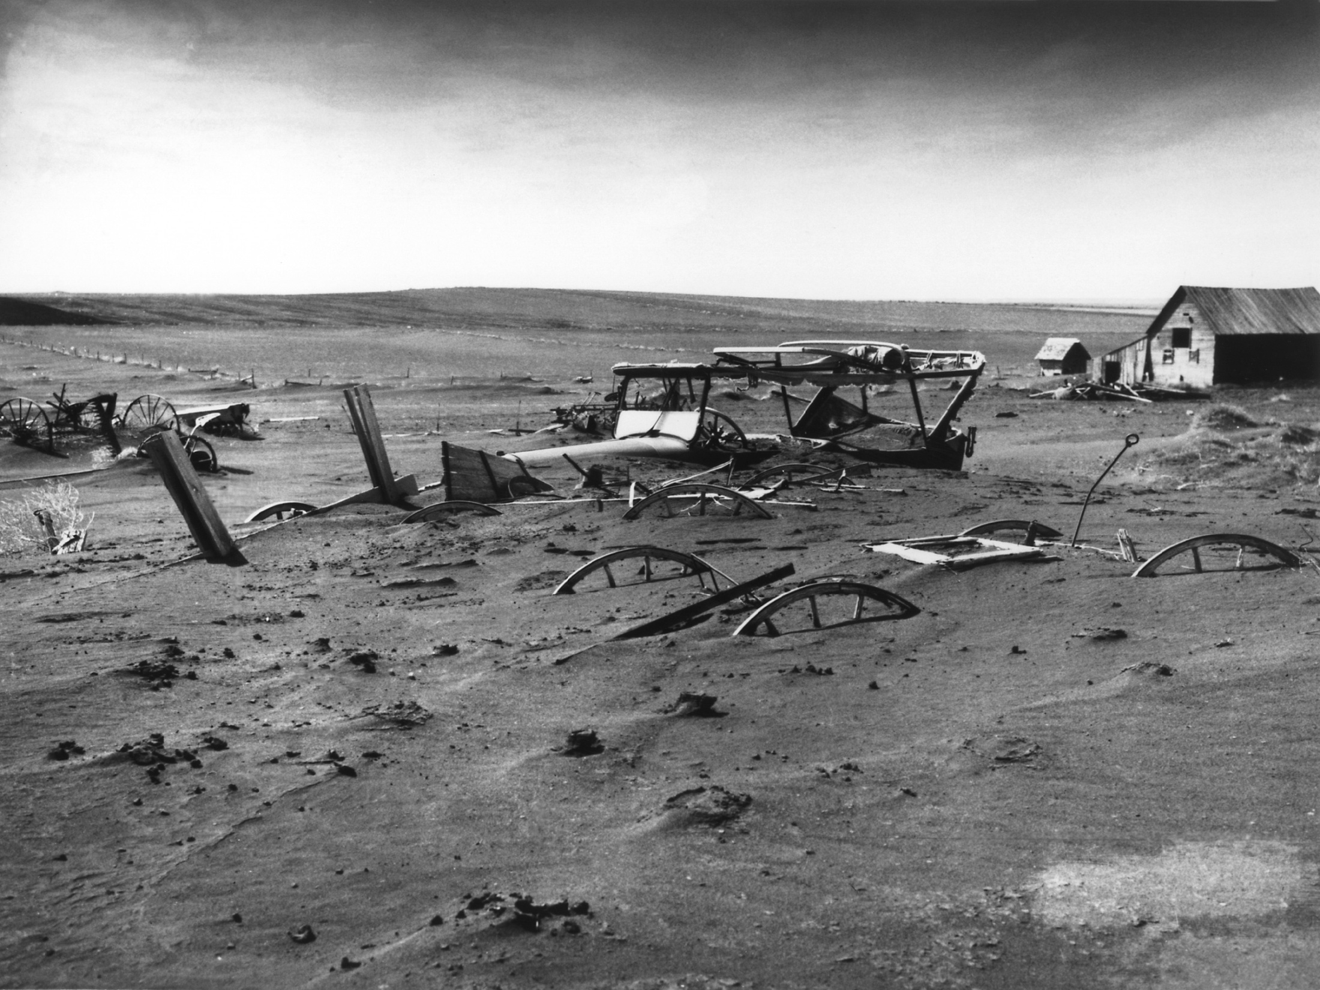

Slide 21
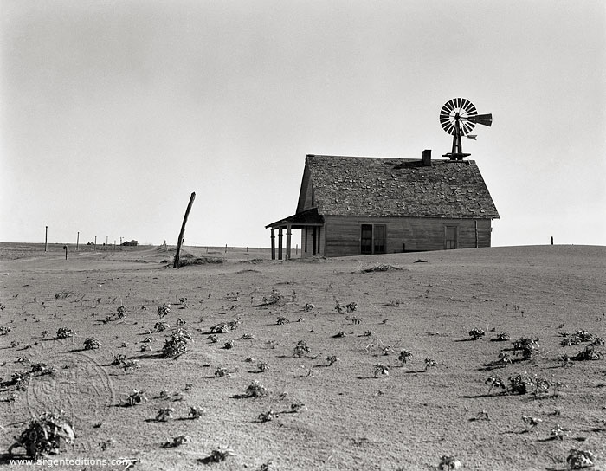

Slide 22
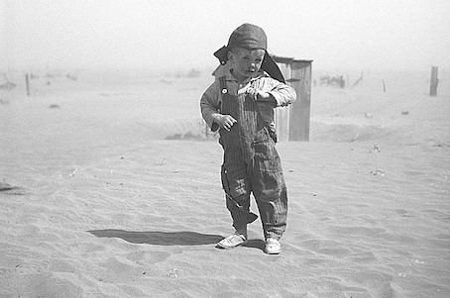

Slide 23
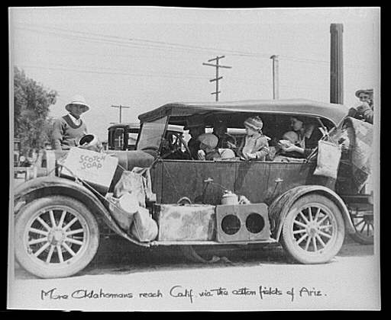

Slide 24
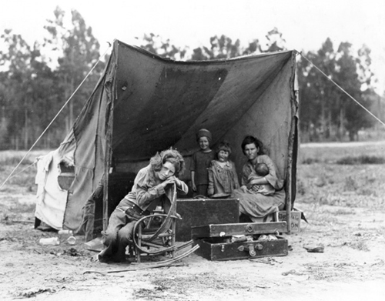

Slide 25
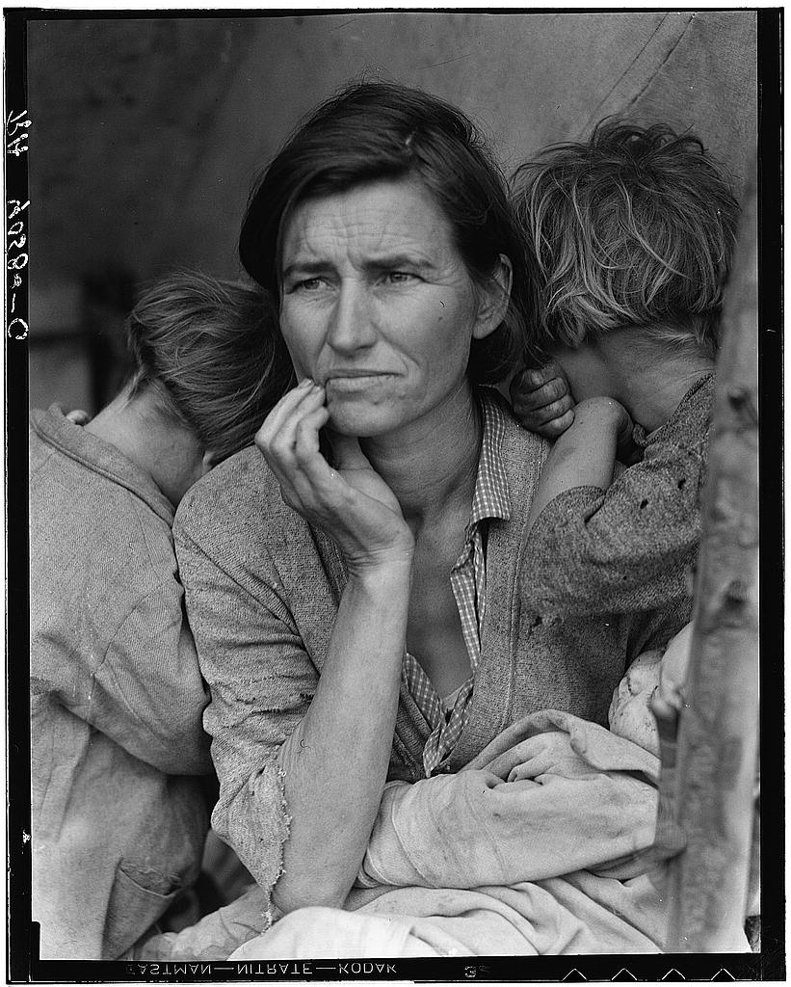

Slide 26
A Tale of Two Presidents

Slide 27
Herbert Hoover’s Reaction
1928 – he promised “two cars in every garage and a chicken in every pot”
After the crash, he didn’t give direct handouts to poor, instead tried to assist industries
People blamed him for the depression
“Hoovervilles”: homeless villages on outskirts of cities
Lost Election of 1932 to Franklin D. Roosevelt (Democrat)

Slide 28
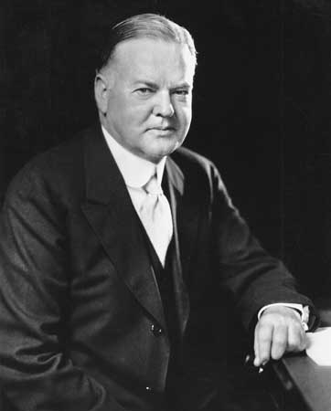

Slide 29
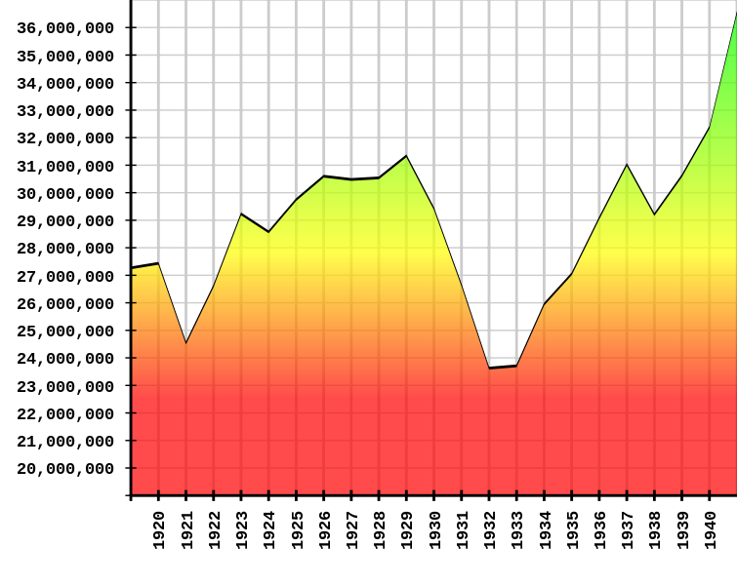

Slide 30
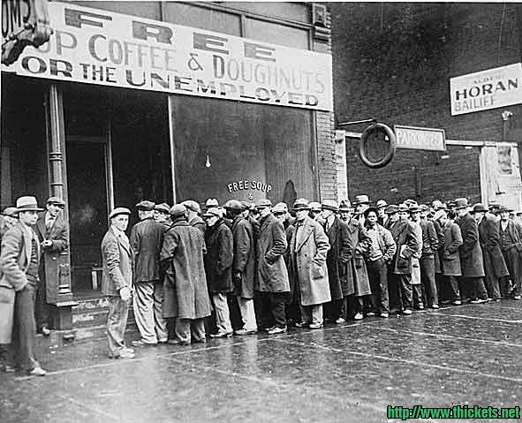

Slide 31
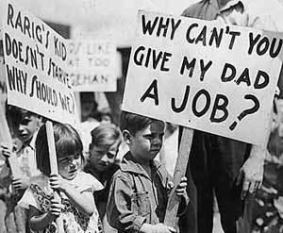

Slide 32
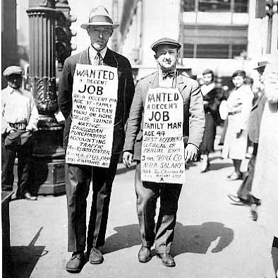

Slide 33
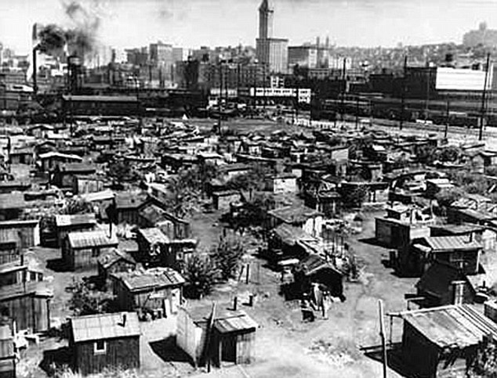

Slide 34
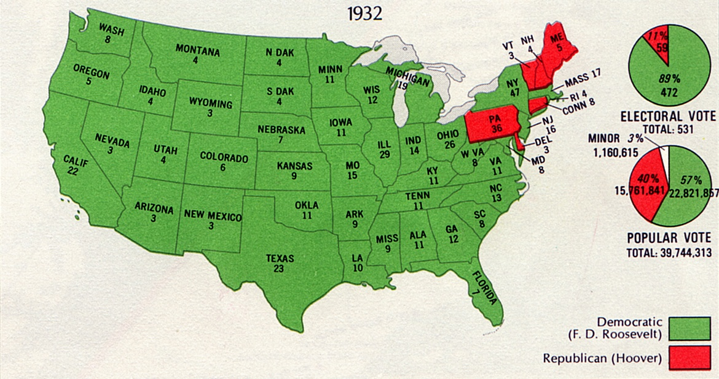

Slide 35
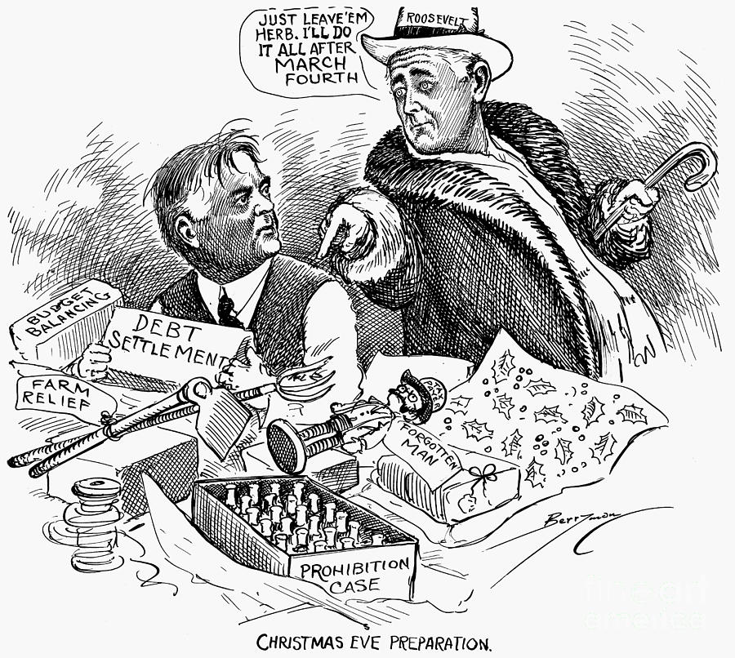

Slide 36
FDR’s Response – The New Deal
At his inauguration, FDR said, “This great nation will endure as it has endured, will revive and will prosper. So first of all let me assert firm belief that the only thing we have to fear is fear itself.”
“Fireside chats” = FDR talked on the radio & assured them things would get better

Slide 37
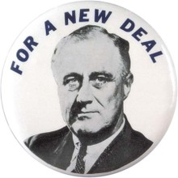

Slide 38
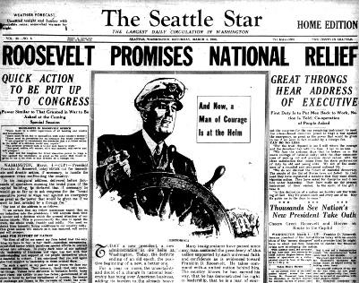

Slide 39
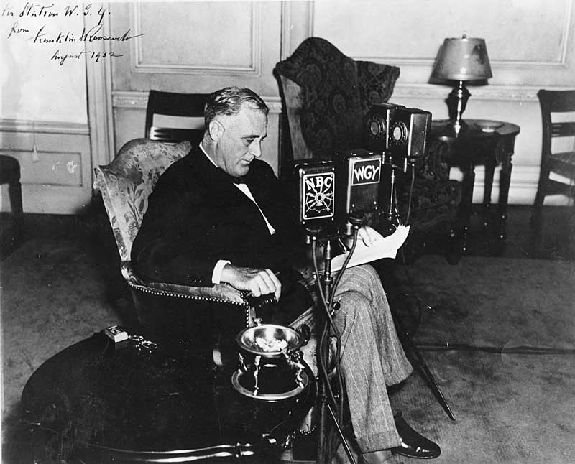

Slide 40
New Deal: FDR’s plan to get the U.S. out of depression
3 R’s of the New Deal
Recovery > create jobs to lower unemployment
Relief > provide direct payment to people for immediate help
Reform > correct banking & investment practices
Deficit spending > spend more money than gov’t took in (national debt)

Slide 41
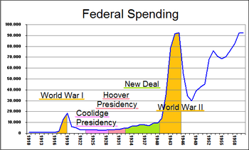

Slide 42
New Deal Organizations: provided relief & created jobs for public works
AAA (Agricultural Adjustment Act) = paid farmers to cut production of crops
FDIC (Federal Deposit Insurance Corp.) = protected bank deposits up to $5,000
CCC (Civilian Conservation Corps) = single men worked on parks, soil conservation, projects, & forests → built Westmoreland State Park

Slide 43
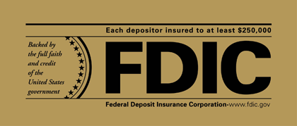

Slide 45
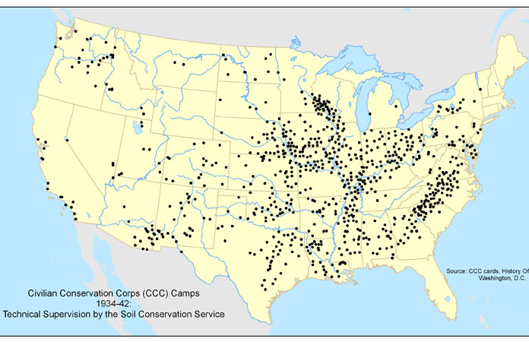

Slide 46
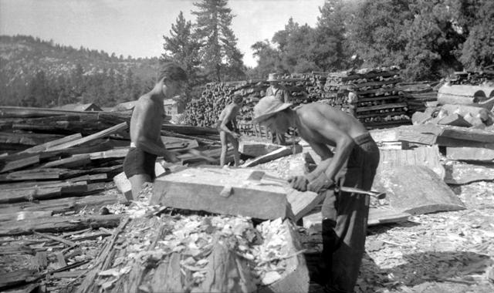

Slide 47
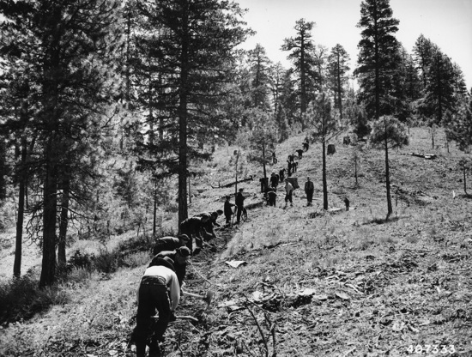

Slide 48
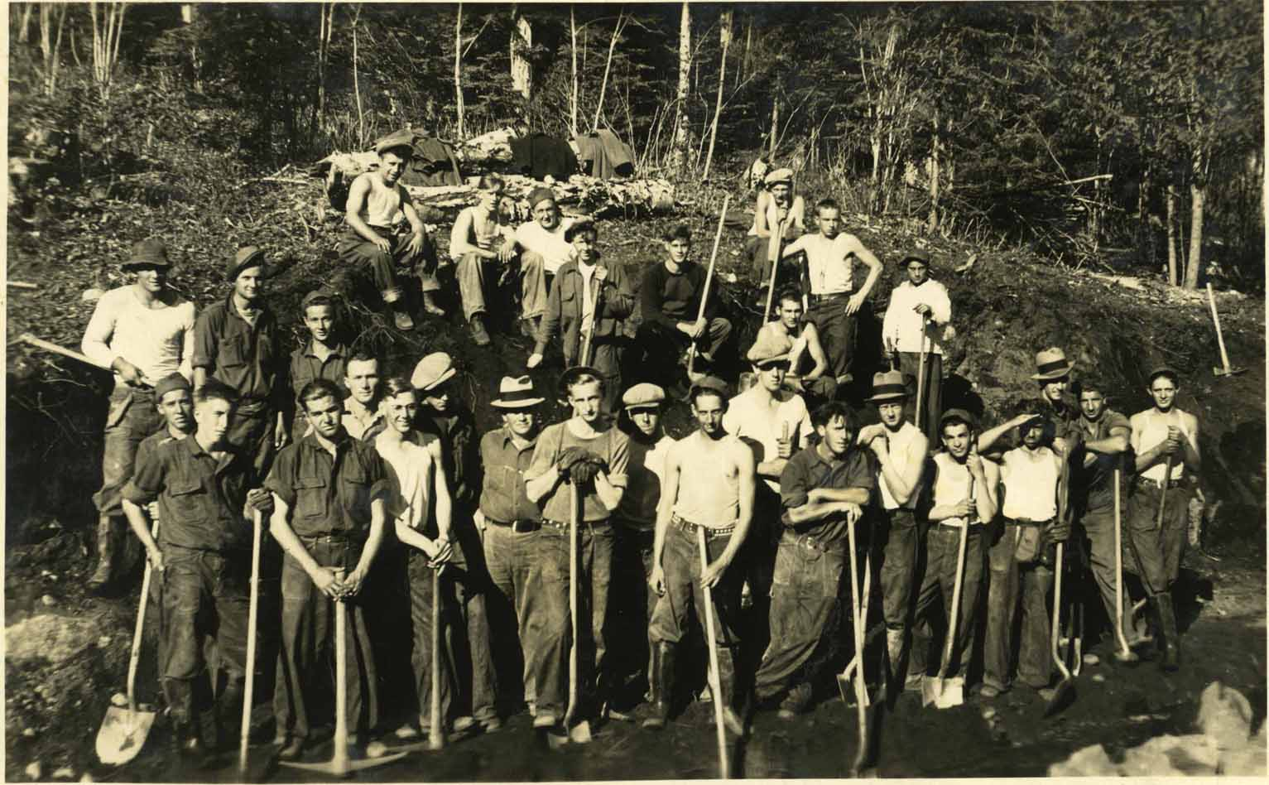

Slide 49
WPA (Works Progress Admin.) = build monuments, bridges, roads, airplanes, schools, writers, artists, etc.
Social Security Act = offered safeguard for the elderly & workers
Provided hope for Americans; however, the Great Depression did not end until WWII

Slide 50
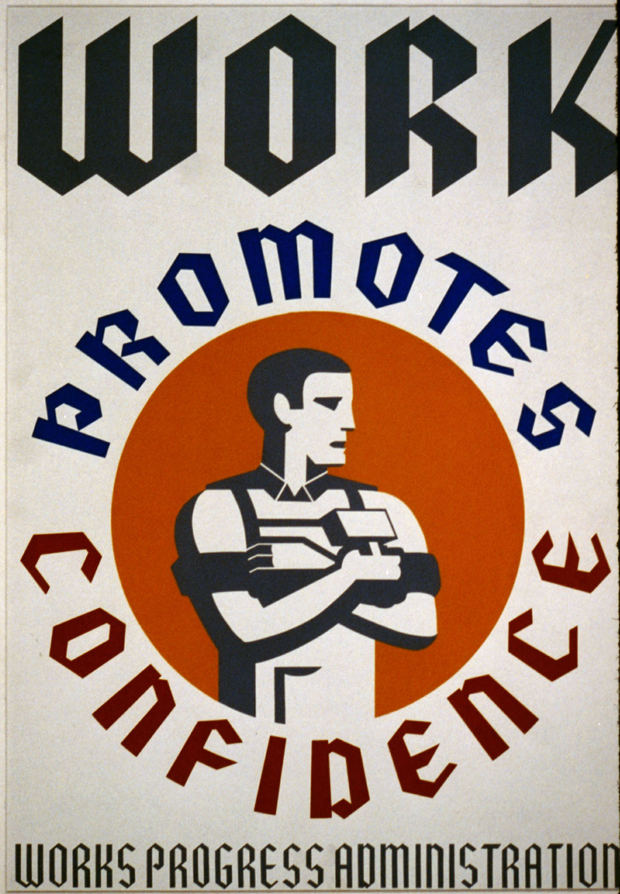

Slide 51
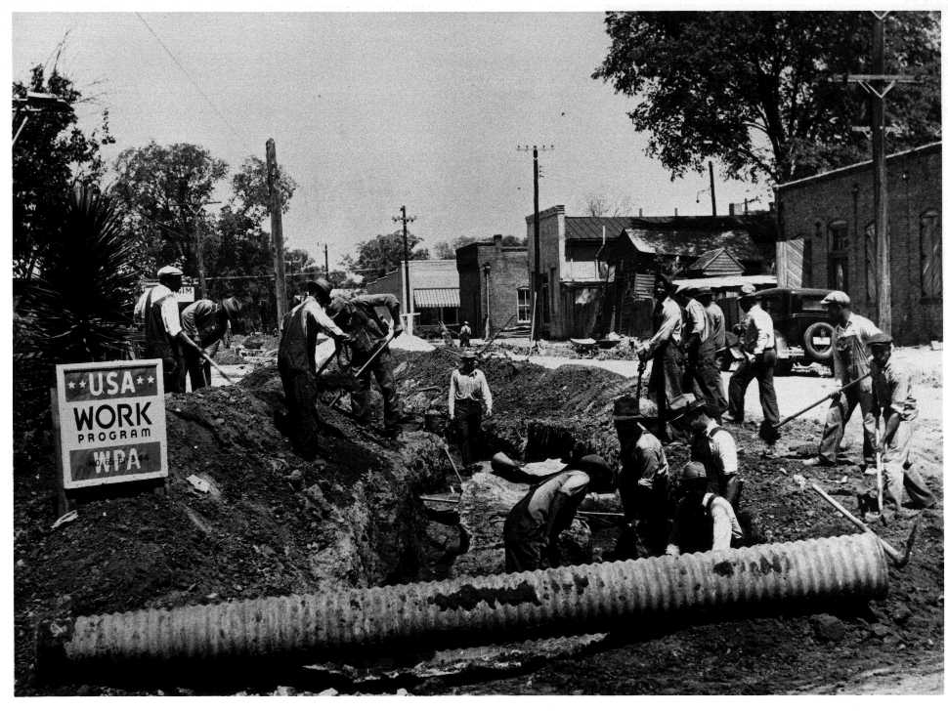

Slide 52
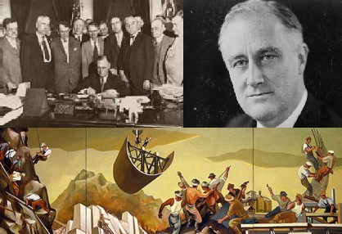

Slide 53
Effects of the New Deal
Americans believe federal gov’t is responsible for solving problems & providing aid
Federal gov’t & president became more powerful
Labor unions acquired new rights to form unions and to strike
The gov’t. more closely regulates the economy (no laissez-faire)

