Slide 1
The Rise of Politics
VUS.6a

Slide 2
A. 1st President Ever (1789: NYC)
1. Washington was the unanimous choice – hero of the Revolution
Created a cabinet (group of advisors)

Slide 3
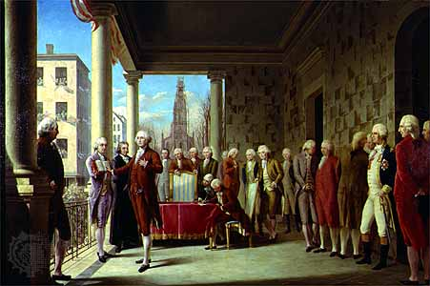

Slide 4
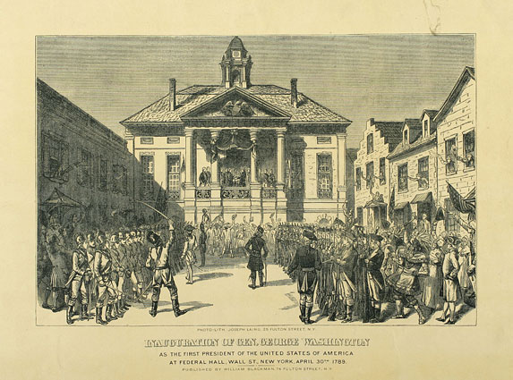

Slide 5
B. Big Problems
U.S. owed $54 million(war debt)
2. Alexander Hamilton (Treasury) believed the U.S. should:
a. Establish a Bank of the United States (BUS)
b. Help the states pay off their debts

Slide 6
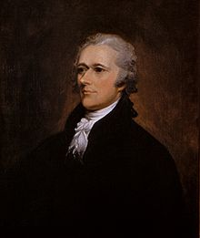

Slide 7
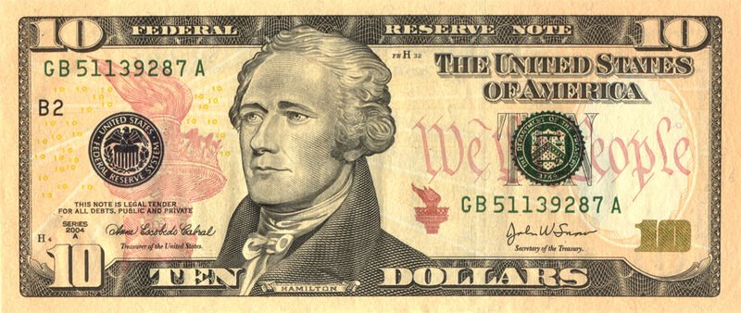

Slide 8
C. Jefferson Opposed Federalist Policies
Objected to helping to pay states’ debts
a. Southern states had paid off their debts
b. Compromise – capital was moved further South (DC)

Slide 9
- Constitution does NOT give the power to create a bank
a. Hamilton justified the BUS with the “Elastic Clause” (I.8.18)
b. Jefferson resigned
- led to the birth of the first political parties

Slide 10
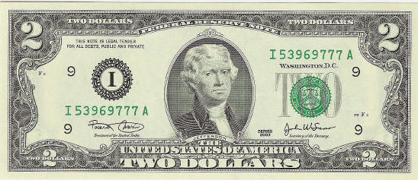

Slide 11
D. Foreign Policy – Neutrality
1. In 1793, England & France started another war
2. U.S. tried to remain neutral
3. Jay Treaty = U.S. was given trading rights w/ Britain
Very unpopular, but it prevented war!

Slide 12
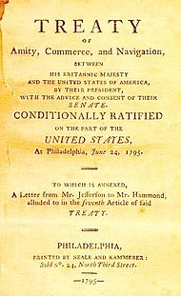

Slide 13
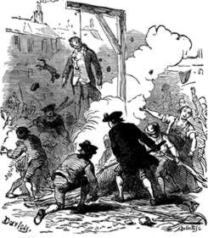

Slide 14
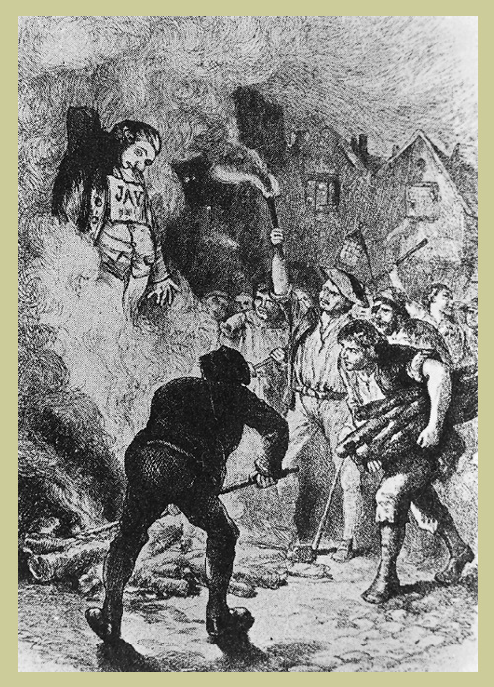

Slide 15
E. Washington Steps Down
In his Farewell Address (1796), he offered the following advice:
1. NO involvement in Europe’s affairs
2. NO “permanent alliances”
3. NO political parties
4. NO sectionalism (East vs. West, North vs. South)

Slide 16
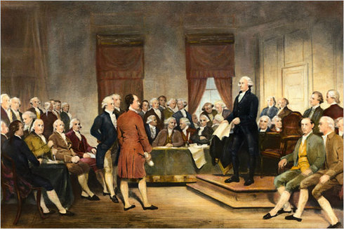

Slide 17
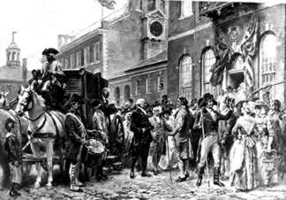

Slide 18
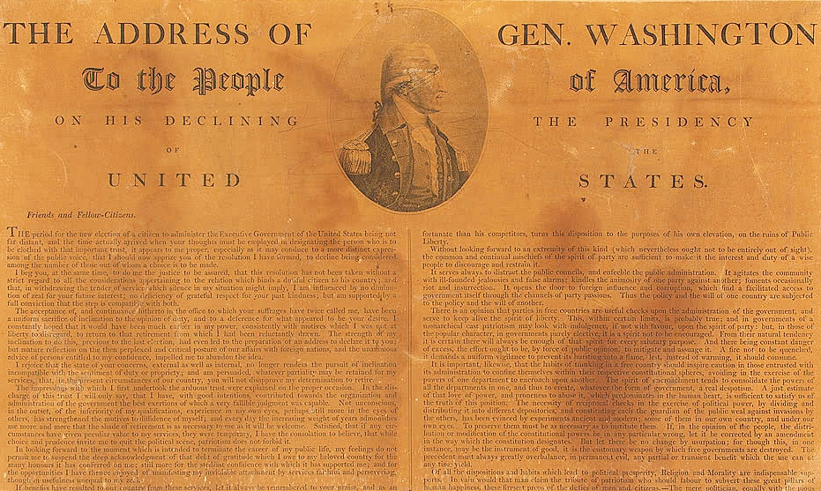

Slide 19
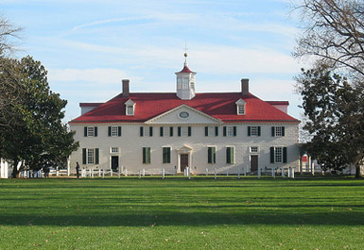

Slide 20
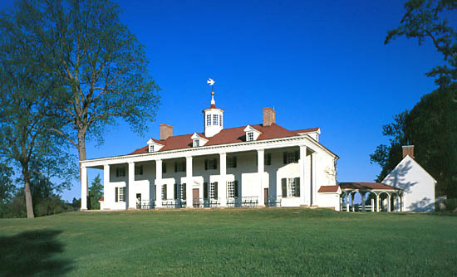

Slide 21
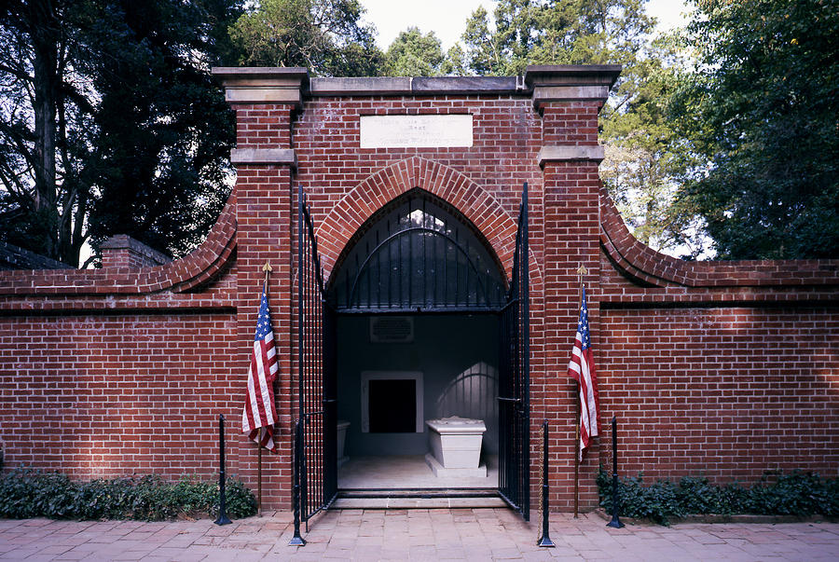

Slide 22
The First Political Parties | Federalists | Democratic-Republicans
Leaders | -John Adams -Alex Hamilton | -Thomas Jefferson -James Madison
Beliefs | -Strong national gov’t -Stimulate the growth of business & industry | -Weak national gov’t -States need more power -Growth of agriculture
Supporters | -Bankers and Businessmen in the Northeast | -Farmers, Artisans, and Frontiersmen from the South

Slide 23
G. Election of 1796 (First partisan election)
1. Constitution did not anticipate political parties.
2. John Adams vs. Thomas Jefferson
3. Adams won (71 – 68)
4. Jefferson became Vice President

Slide 24
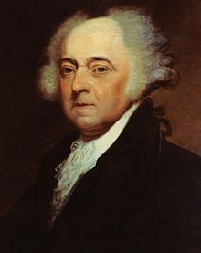

Slide 25
H. Adams’ Troubles
Upset by the Jay Treaty, France began seizing goods from U.S. ships
Sent delegates to negotiate w/ France

Slide 26
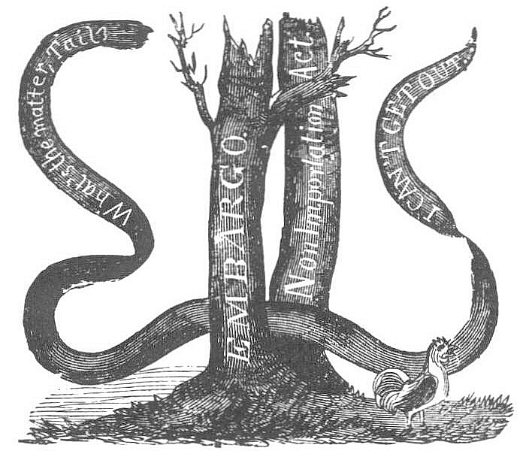

Slide 27
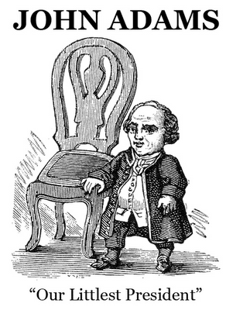

Slide 28
- French agents (XYZ) wanted bribes from the American delegates
(Delegates refused – “Millions for defense, but not a cent for tribute!”)
a. An undeclared naval war erupted w/ France
b. Stirred Democratic-Republican criticism of Federalist foreign policies

Slide 29
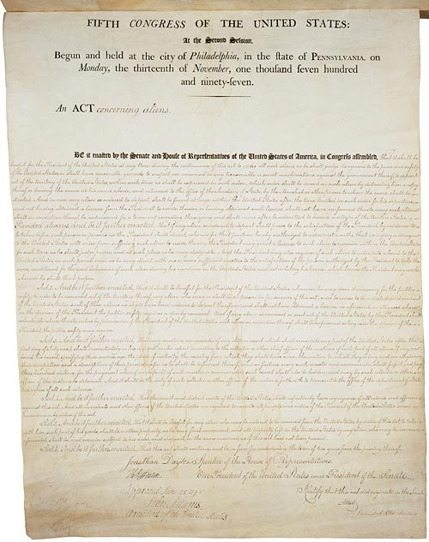

Slide 30
I. Election of 1800:
Rematch – Jefferson defeated Adams (73-65)
1. 1st peaceful transfer of power from one party to another
Could a two-party system work?

Slide 31
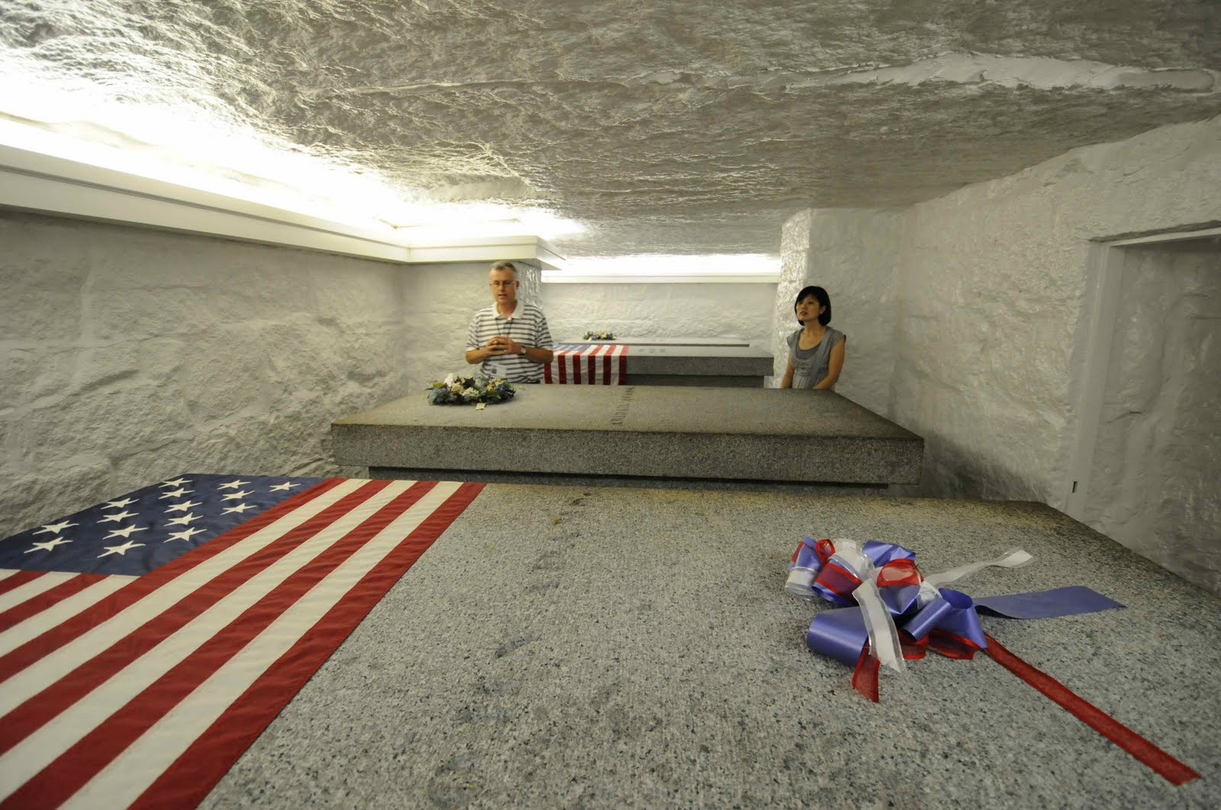

Slide 32
Democratic-Republicans
VUS.5E, 6A-D

Slide 33
A. Thomas Jefferson: 3rd President (1801 – 1809)
1. Renaissance Man – a man of many talents
Founded UVA (public university)
2. Goals: reduce spending & size of gov’t

Slide 34
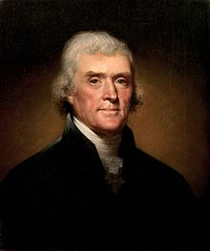

Slide 35
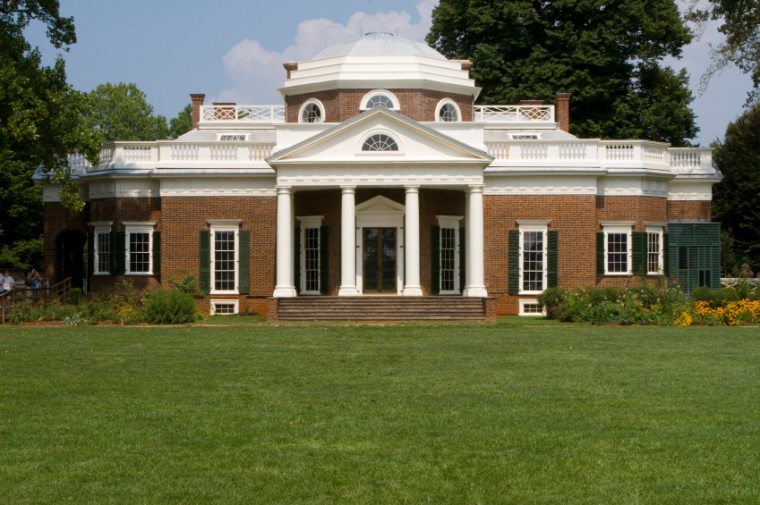

Slide 36
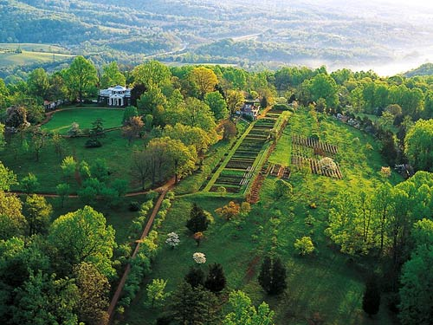

Slide 37
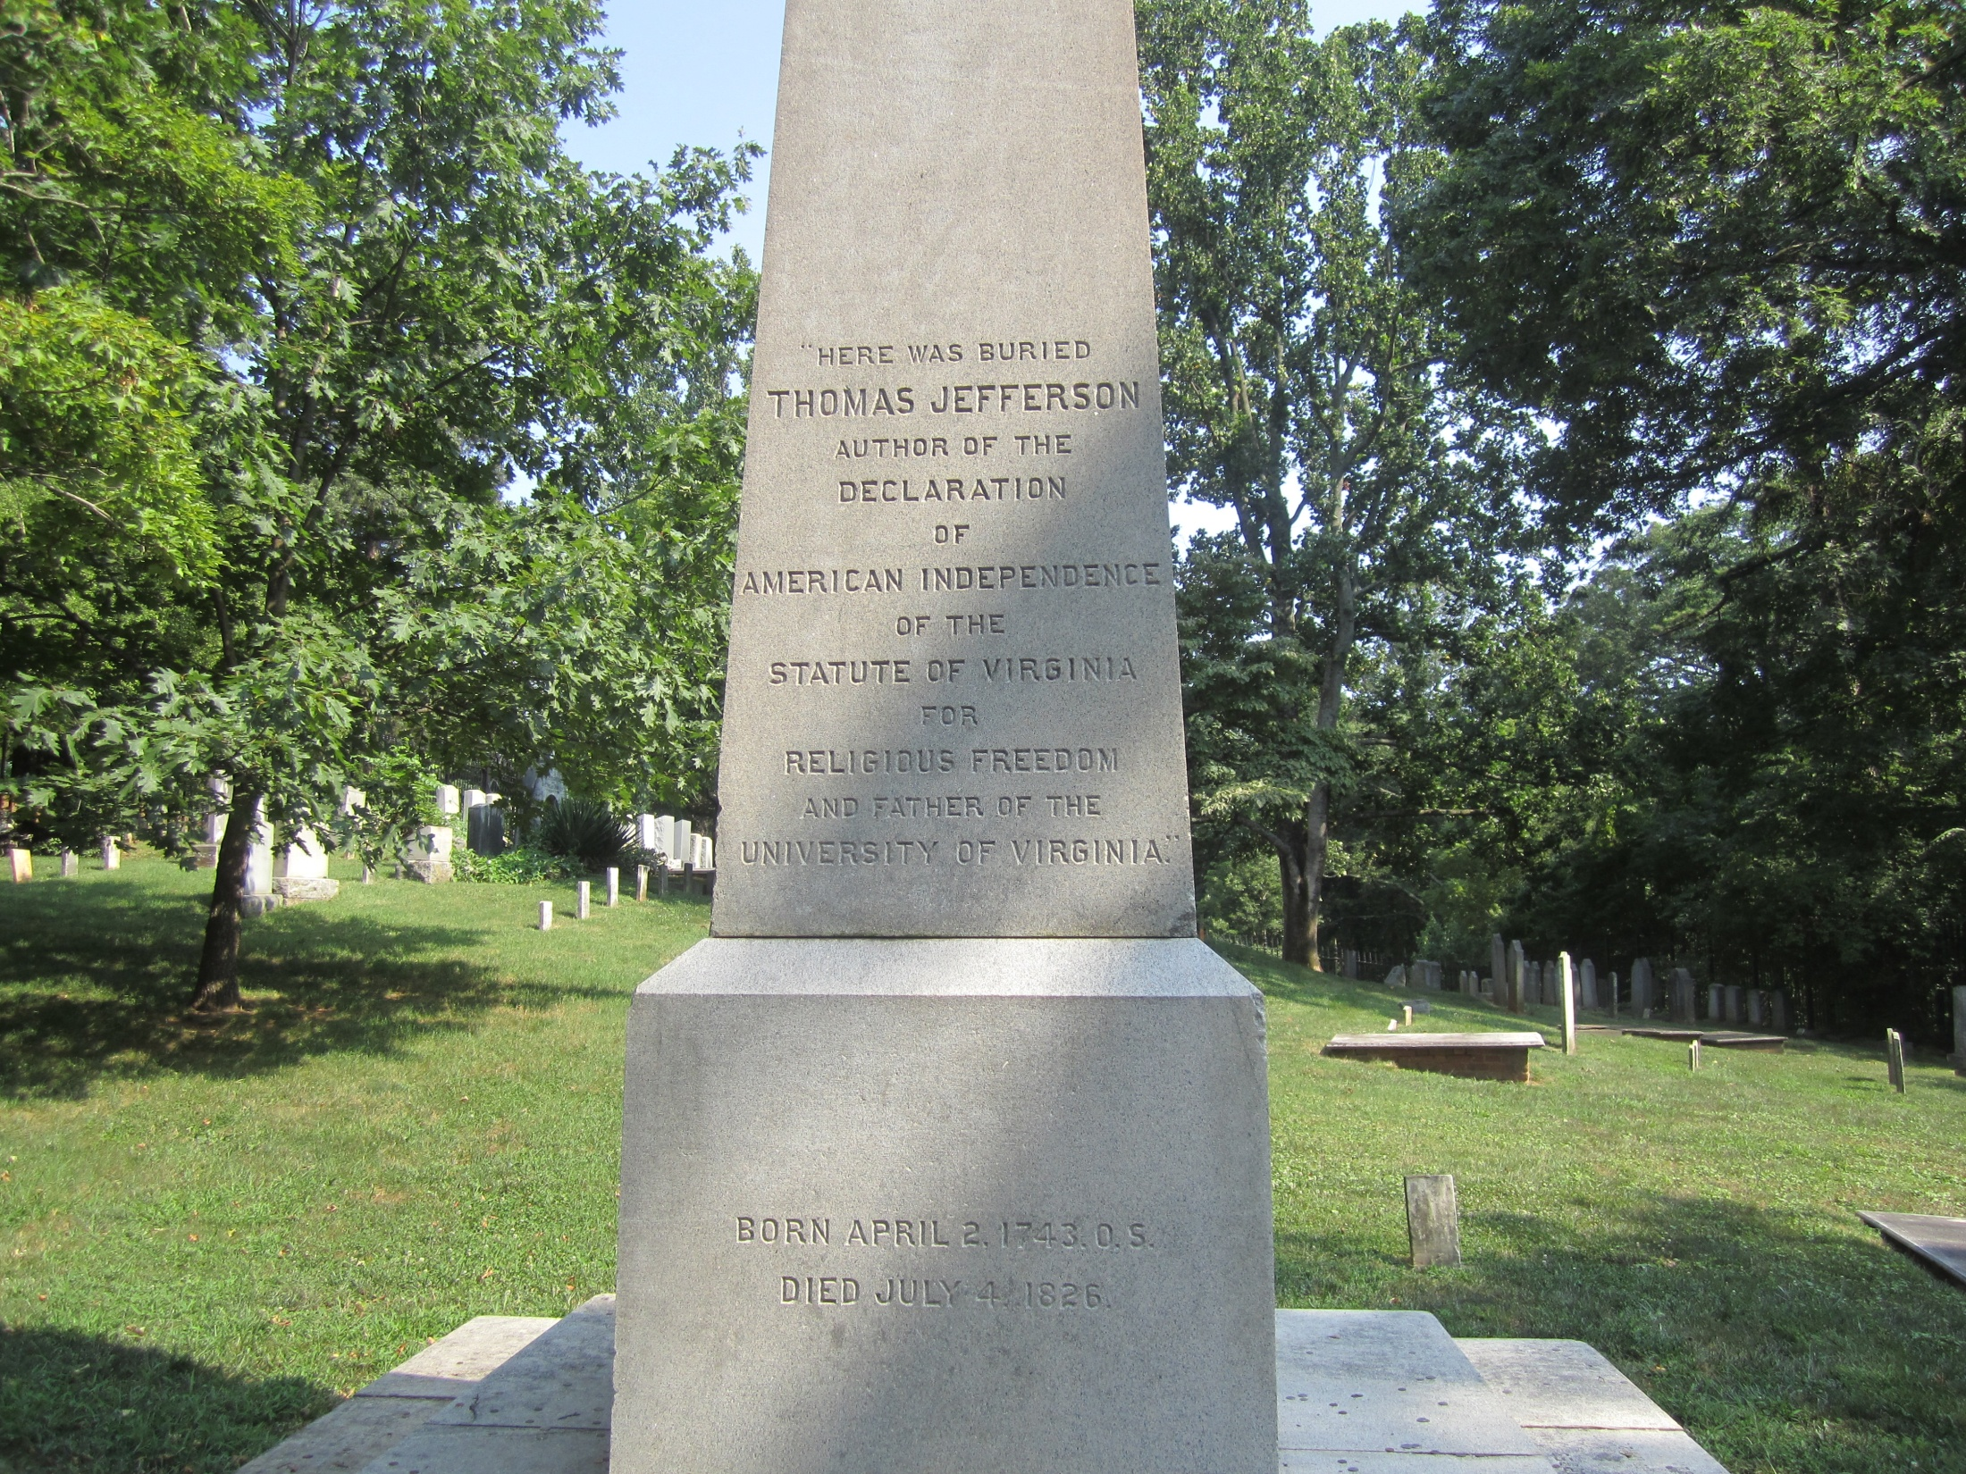

Slide 38
B. Louisiana Purchase(1803)
1. France sold Louisiana Territory for $15 million
2. Doubled the size of the U.S. and its natural resources

Slide 39
C. Lewis and Clark (1804-1806):
Explored the Louisiana Territory
Sacajawea = Indian woman; guide & translator (& mom)
1. Searched for a waterway to the Pacific
2. Observed customs of the American Indians
3. Took notes of the land, weather, plants, & animals
4. Claimed Oregon Territory for the U.S.

Slide 40
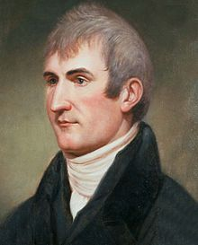
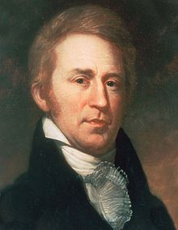

Slide 41
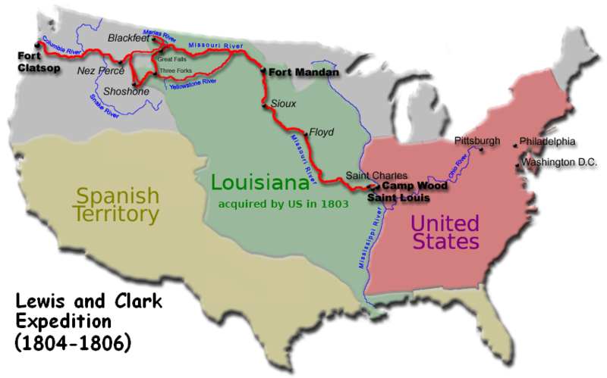

Slide 42
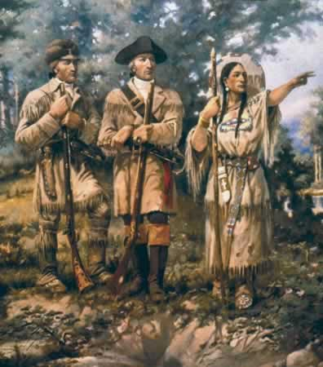
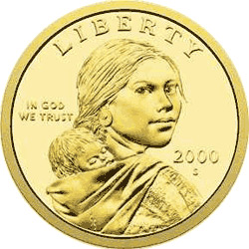

Slide 43
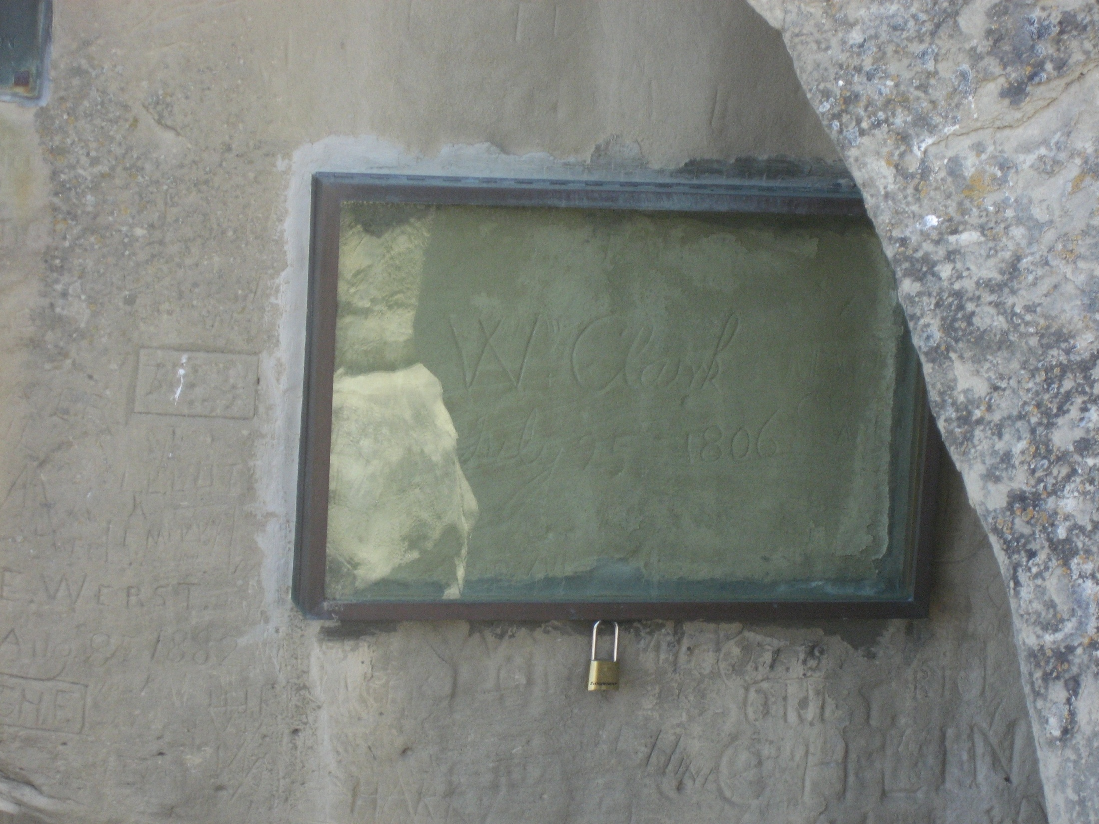

Slide 44
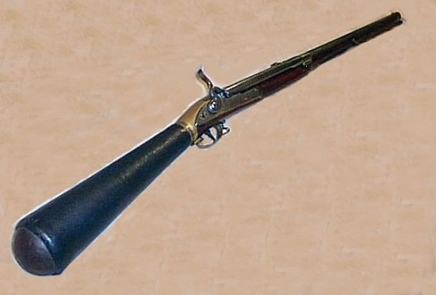

Slide 45
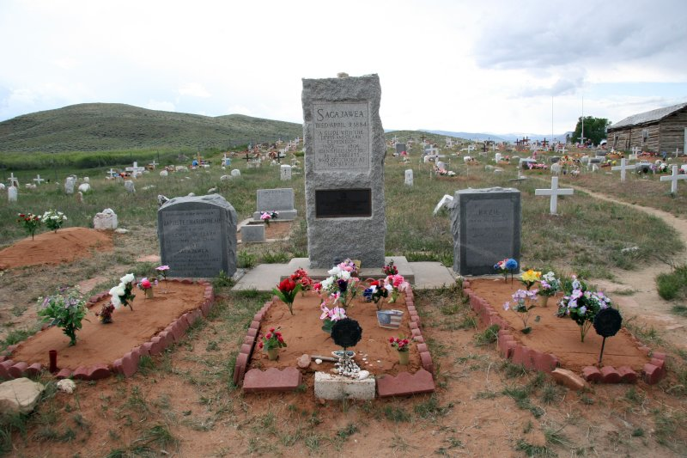

Slide 46
D. Chief Justice John Marshall
1. Strengthened the Judicial Branch
2. Marbury v. Madison (1803) = established power of judicial review
a. Supreme Court can declare laws “unconstitutional”
b. Judicial Branch can check the power of the other two branches

Slide 47
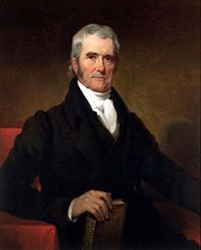

Slide 48
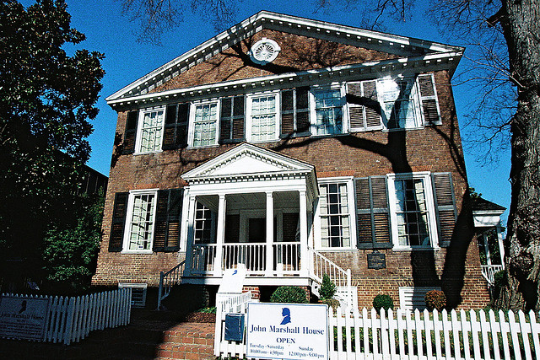

Slide 49
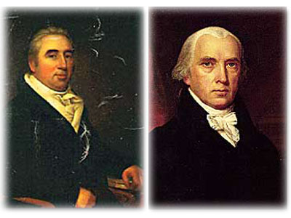

Slide 50
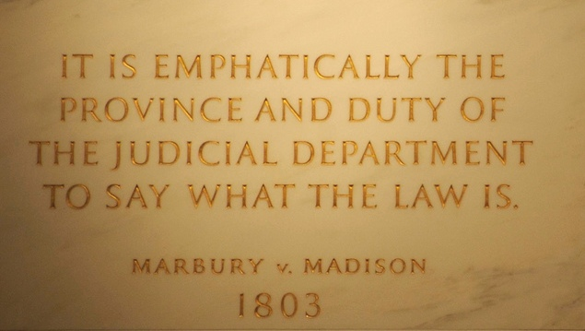

Slide 51
3. McCulloch v. Maryland (1819) = MD taxed the Baltimore branch of the BUS
a. Ruling – States can not tax the federal gov’t
b. Reinforced federal govt.’s implied power to create the bank

Slide 52
4. Gibbons v. Ogden (1824) = supremacy clause
Ogden had a boat license from NY & Gibbons’ license came from Congress
Ruling – federal gov’t has the power to regulate interstate commerce

Slide 53
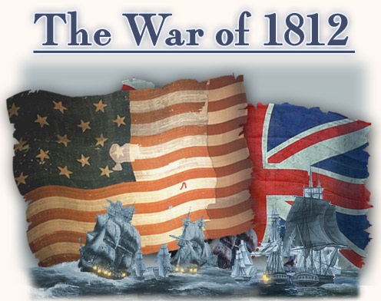
Madison & the War of 1812

Slide 54
A. Causes of the War
1. Britain and France were fighting again! – U.S. tried to stay neutral.
2. British interfered with U.S. shipping and western expansion

Slide 55
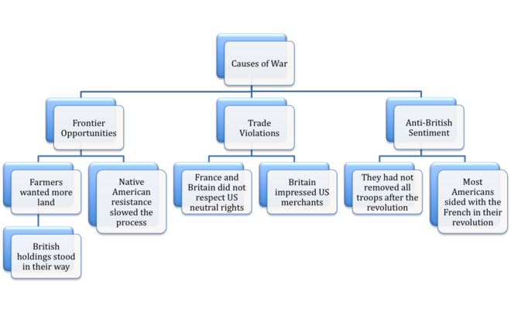

Slide 56
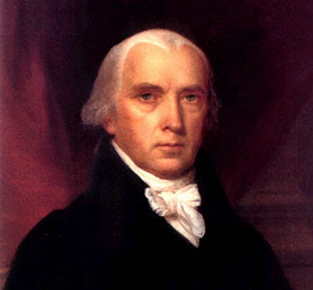
B. War Hawks (wanted to fight)
1. Canada = easy target
2. Federalists opposed b/c they traded w/ Britain – “Mr. Madison’s War”

Slide 57
C. The War
1. In 1814, British attacked key cities – DC, Baltimore, & New Orleans
July 20-21 – invaded Westmoreland Courthouse
Aug. 3 – burned Kinsale
2. Aug. 1814: Redcoats burned the Presidential Mansion & the Capitol
* “White House” = Presidential Mansion painted white to cover burn marks

Slide 58
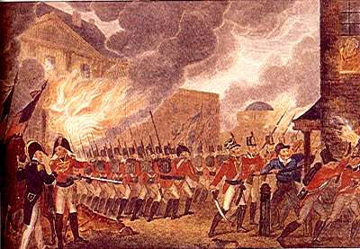

Slide 59
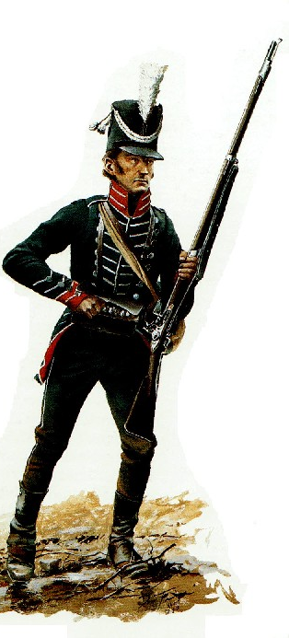
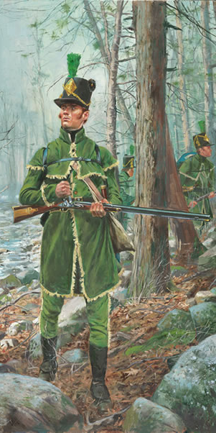

Slide 60
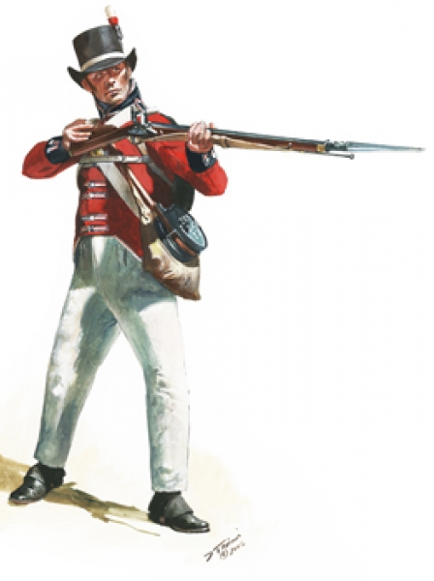

Slide 61
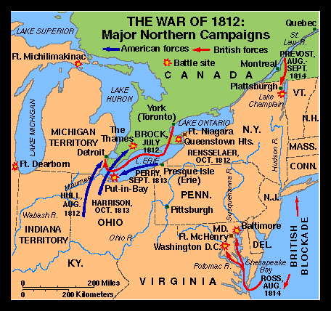

Slide 62
3. British were turned back at Baltimore
a. Ft. McHenry - Francis Scott Key wrote our national anthem, “The Star-Spangled Banner”
4. British failed to capture New Orleans in Jan. 1815
a. Andrew Jackson (TN) became a hero by defeating the British army

Slide 63
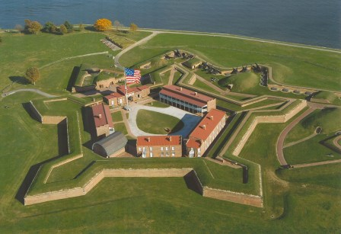

Slide 64
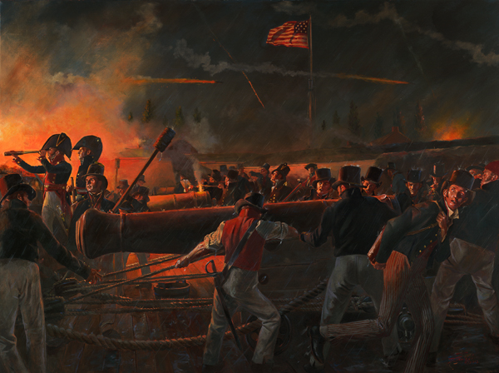

Slide 65
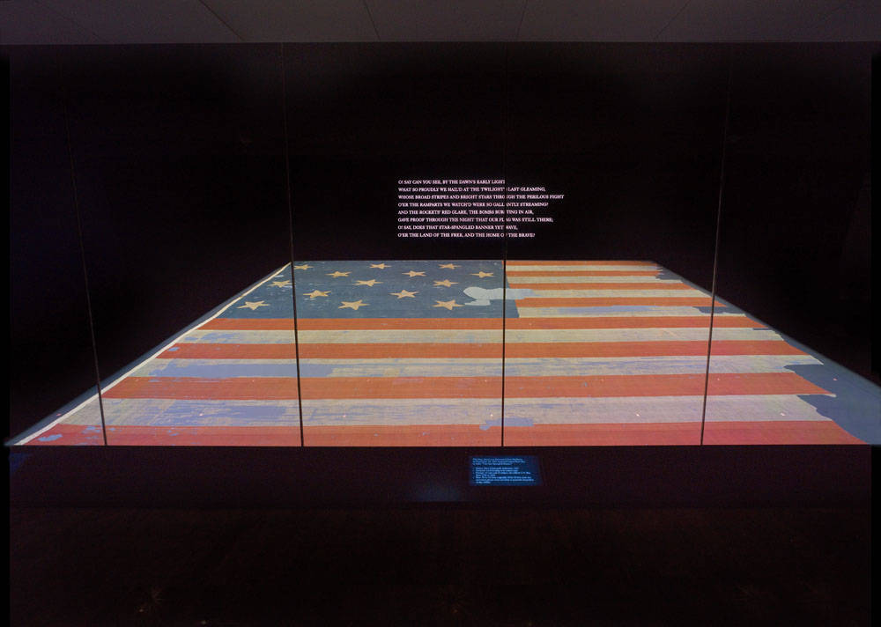

Slide 66
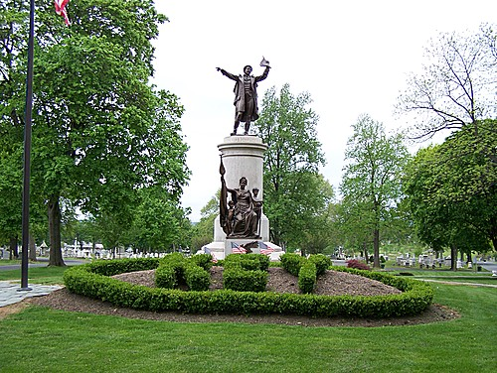

Slide 67
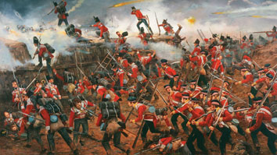

Slide 68
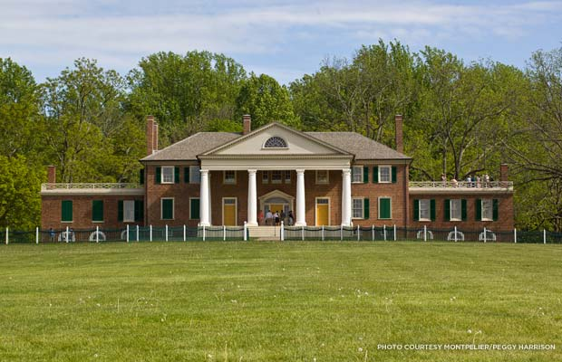

Slide 69
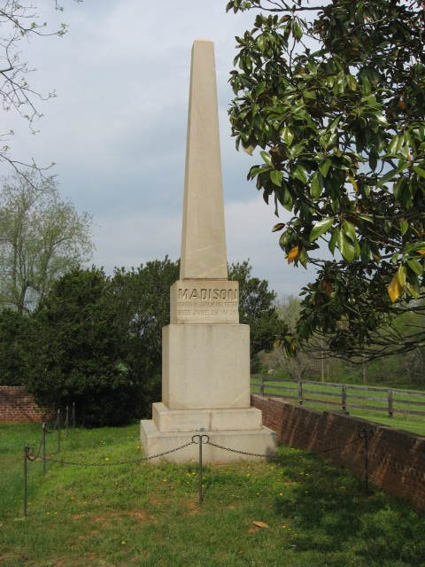

Slide 70
D. Results of the War of 1812:
1. Americans claimed the Oregon Territory
2. Americans migrated into Florida
- Spain ceded (gave up) Florida in a treaty.

Slide 72
Good Times 1816-1824

Slide 73
A. James Monroe:
5th President – Democratic-Republican from Westmoreland County
“Era of Good Feelings” = intense nationalism (patriotism) after the War of 1812

Slide 77
B. Improvements in Transportation
1. Roads = National Road built from MD to IL – helped settlers move west
2. Canals (1825-1850) = connect larger bodies of water
- Erie Canal = Lake Erie to NYC

Slide 82
3. Steamboats (1807) made travel faster & cheaper
4. Railroads = much faster
- Connected NE factories to farmers in the west

Slide 87
C. Monroe Doctrine (1823)
1. Latin American nations revolted against European rule
a. Americas should NOT be colonized by European powers
b. If Europe interferes with any free country in the Western Hemisphere, the US will regard it as a threat
c. U.S. will not interfere in European affairs

