Slide 1
Early American History

Slide 2
The Story Begins…
The “First Americans” were the Indians.
Migrated from Asia to America across a land bridge during the Ice Age.

Slide 3
Meso-American Civilizations
Three Native American powerful societies were the
Maya – Yucatan Peninsula
Made advancements in mathematics and astronomy
Aztec – central Mexico
Aggressive society - religion based on war
Inca – western South America - Andes Mts.
Build extensive road network
These people depended on the environment for food, clothing, and shelter.

Slide 4
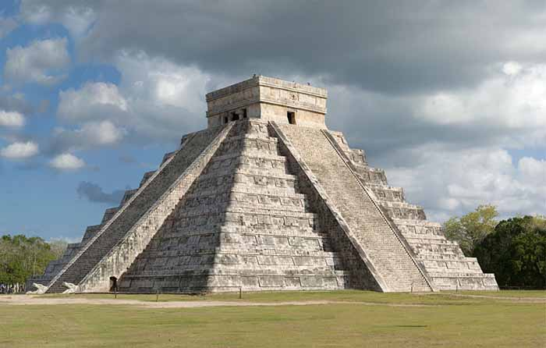

Slide 5
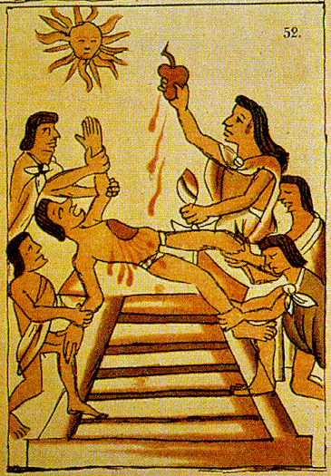

Slide 6
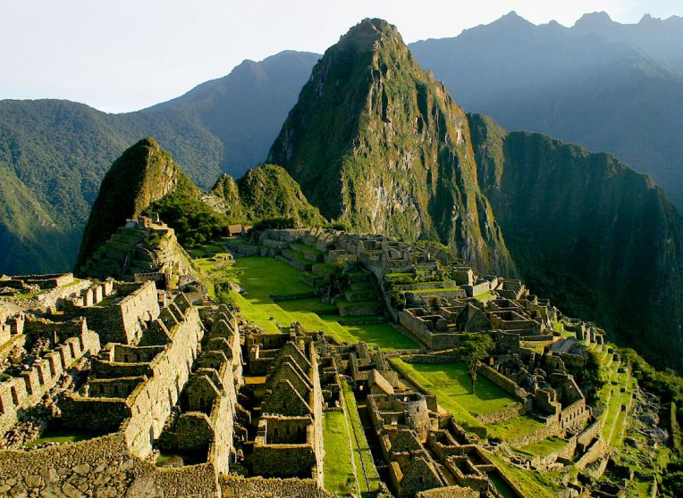

Slide 7
North American Indians
Eastern Woodlands – long houses built from wood and grass
Pueblos – building of sun-dried bricks
Many places and bodies of water in the NN reflect this Native American heritage, such as
Rappahannock
Chesapeake
Nomini

Slide 8
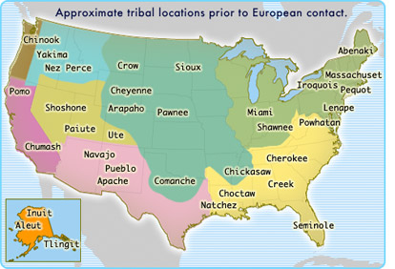

Slide 9
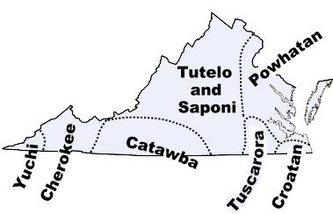

Slide 10
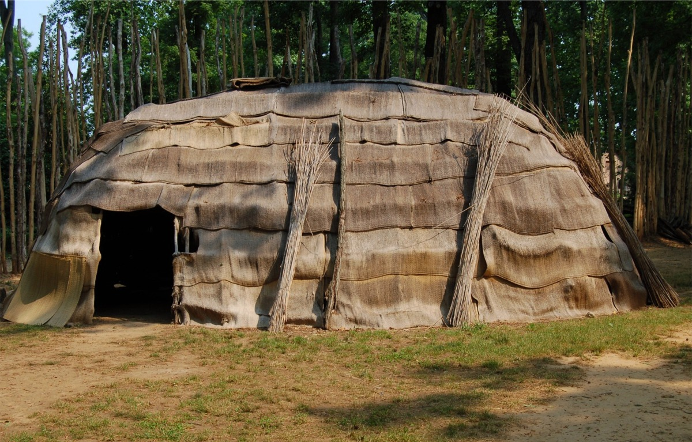

Slide 11
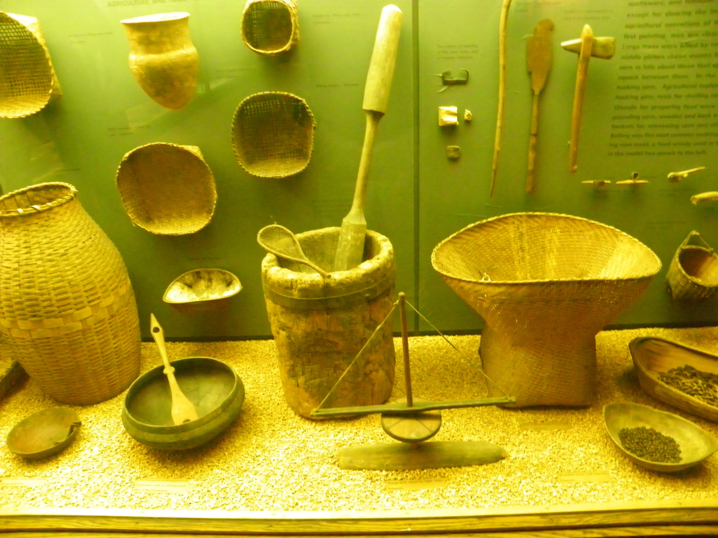

Slide 12
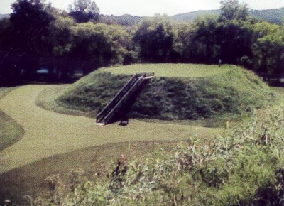

Slide 13
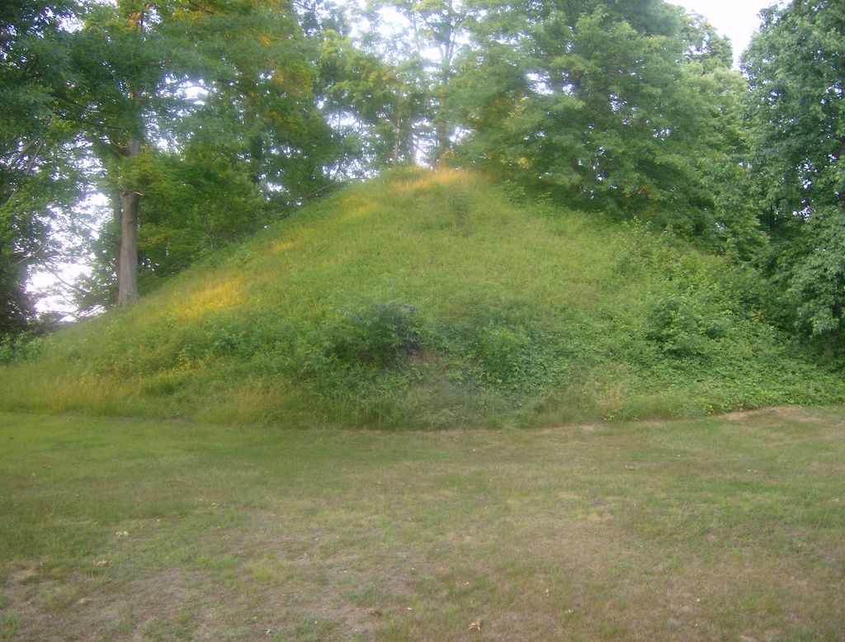

Slide 14
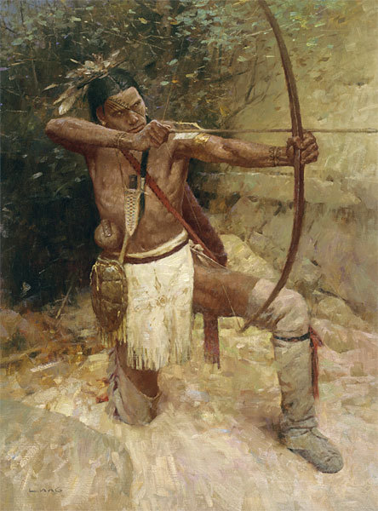
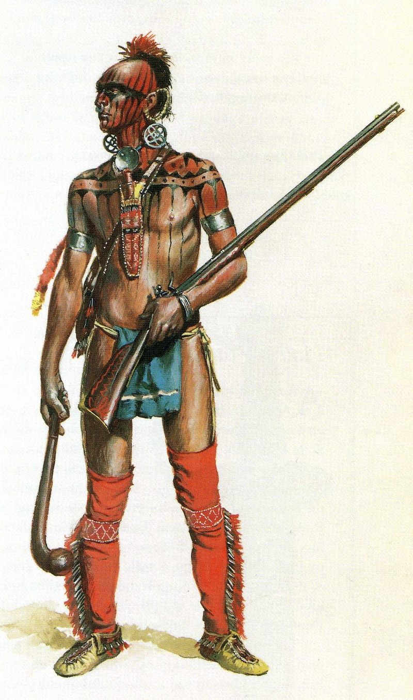

Slide 15
Age of Exploration
Europeans competed for luxury goods
New inventions allowed farther navigation
Did not know the Americas even existed
They thought there was a huge ocean between Europe and Asia
Europeans sought way to Asia for the wealth gained from spices

Slide 16
discovery
In 1492, Columbus gained support from the king and queen of Spain
He wanted to find a shortcut to Asia
Thought he could sail west across the Atlantic Ocean
Reached the Bahamas after two months at sea
Two worlds collided – The Old World, Europe, and The New World, the Americas.

Slide 17
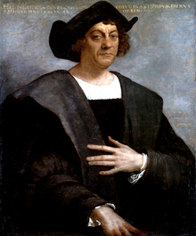

Slide 18
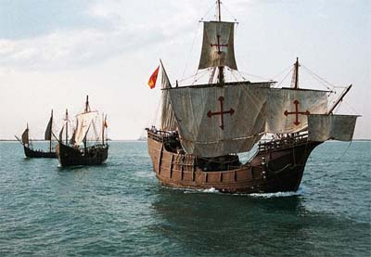

Slide 19
New Spain empire
1519-1521 – Hernando Cortes conquered the Aztec
1532 – Francisco Pizarro conquered the Inca
Spanish used superior weapons
Natives weakened by civil war and diseases
Spain became rich, super-power
Navy dominates the sea – rivalry with England

Slide 20
New Spain
Spanish began to form colonies in Mexico, South America, the Caribbean, and the southern U.S.
Tried to make the Indians slaves
Converted them to Christianity and built plantations

Slide 21
Exchange of culture is known as the Columbian Exchange
Products sent from Europe to America:
Citrus fruits, horses, coffee
Products sent from Americas to Europe:
Chocolate, tobacco, & corn, peanuts, potatoes.
Europeans brought new technology and diseases – devastated Indian diseases.

Slide 22
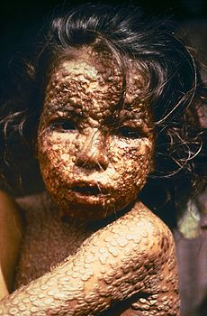

Slide 23
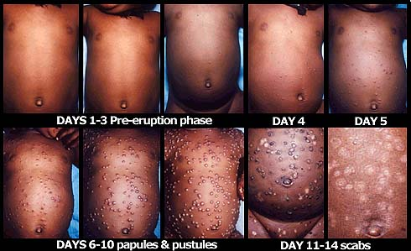

Slide 24
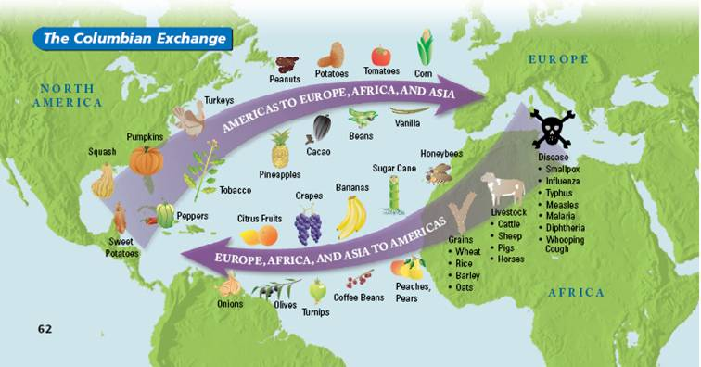

Slide 25
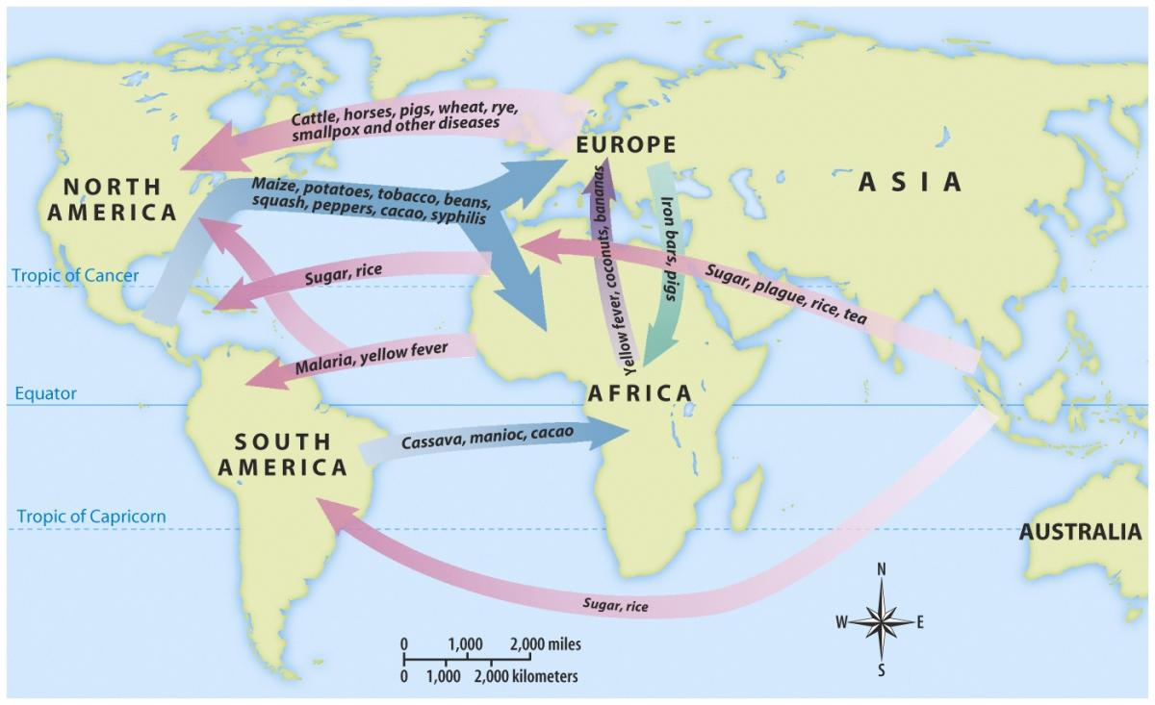

Slide 26
Europeans began to import slaves from Africa
An agricultural-based economy encouraged demand for cheap, manual labor

Slide 27
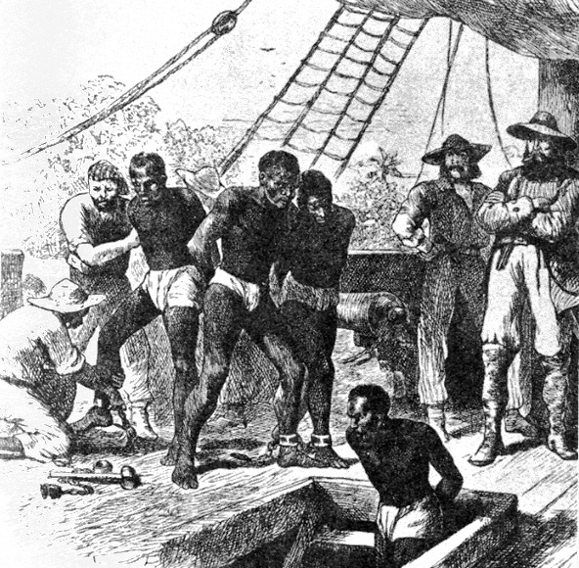

Slide 28
Rise of English Empire
1585-1604 – Anglo-Spanish War
English defeated the Spanish Armada (1588)
England won the war
Wanted to establish colonies in North America
England slowly became more powerful

Slide 29
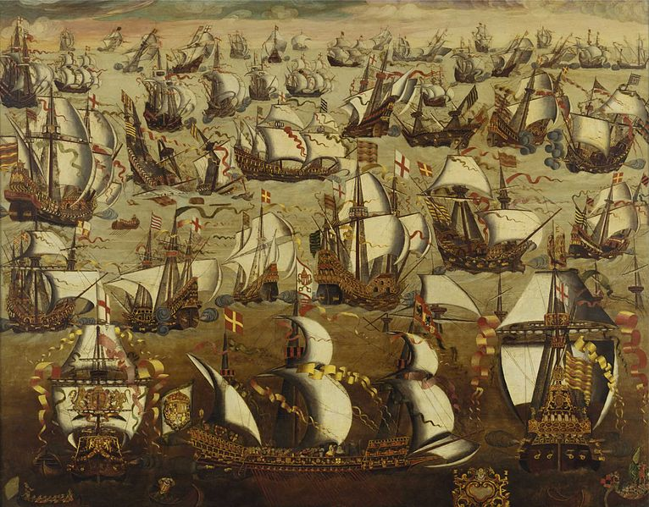

Slide 30
European Competition
Other European countries began to compete to create colonies in the New World
Colonies provided raw materials and markets for the mother country

Slide 31
Culture Clash
Europeans and Indians had differing ideas over land ownership
Indians – no one owned the land
Europeans – private property
Created hostilities and warfare
One exception: the French who treated Indians as equals and respected them
Wanted to develop a fur trading industry

Slide 32
The English settled 13 colonies along the Atlantic coast
Portuguese had possession of land in Brazil

Slide 33
