Slide 1
Contemporary U.S.

Slide 2
A. Society has changed over the past 50 years. WHY?
1. New waves of immigration
2. Scientific and technological advances

Slide 3
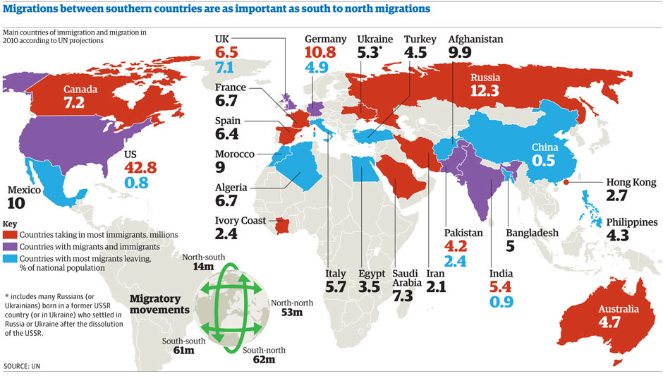

Slide 4
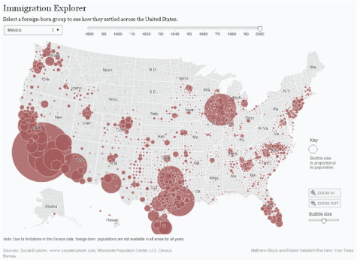

Slide 5
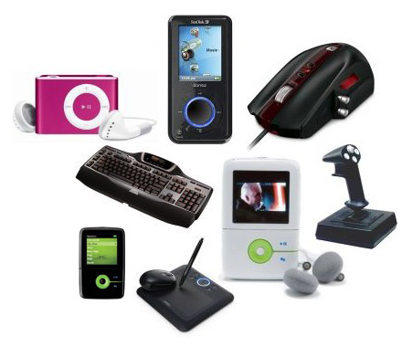

Slide 6
B. Immigration Issues
1. Since 1970, immigration has increased from Asia & Latin America
2. Political freedom & economic opportunities pull people to the U.S.
a. Cubans fled to Florida after Castro seized power in 1959
b. Mexicans came in search of jobs.

Slide 7
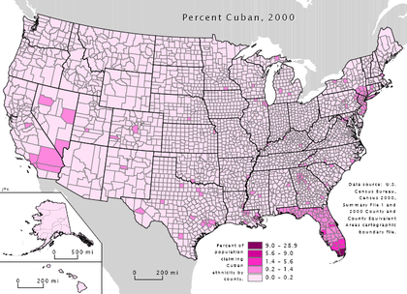

Slide 9
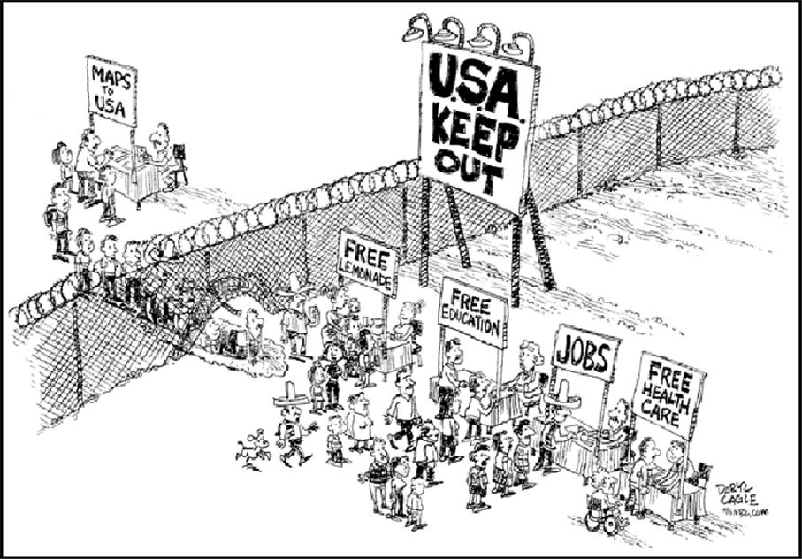

Slide 10
3. Effects of Immigration Policies:
a. Strain on govt services (ie schools, supported by tax dollars)
b. Offering bilingual education (expensive)
c. Policing the border in TX, AZ, & NM to prevent immigration
d. Debate over citizenship for illegal immigrants
e. Signs & instructions in Spanish

Slide 11
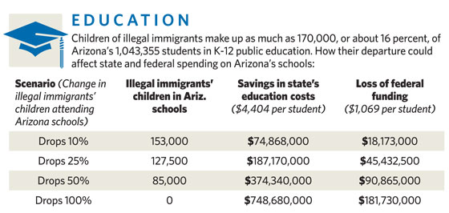

Slide 12
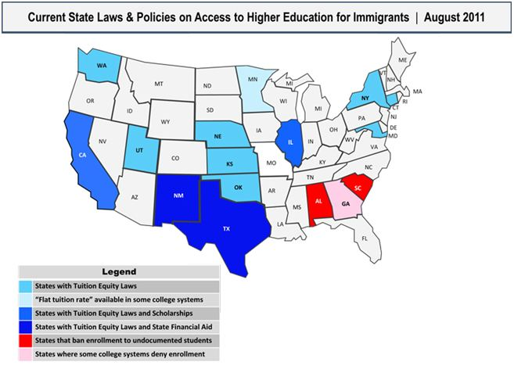

Slide 13
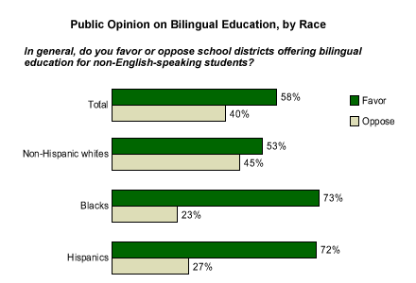

Slide 15
4. Contributions of Immigrants:
a. Diversity of music, the arts, and literature
b. Immigrants take low paying, manual labor jobs
c. Expanded source of engineers & scientists esp. from Asia & Eastern Europe

Slide 16
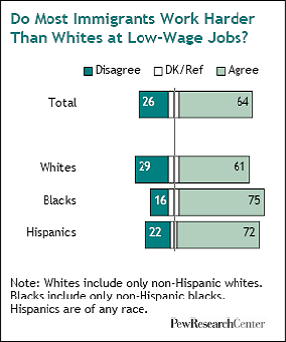

Slide 17
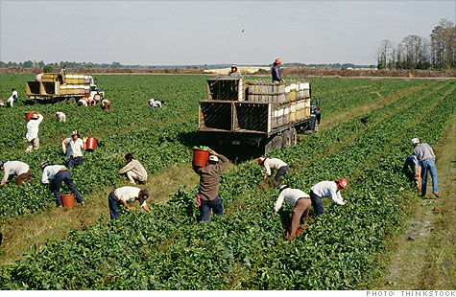

Slide 19
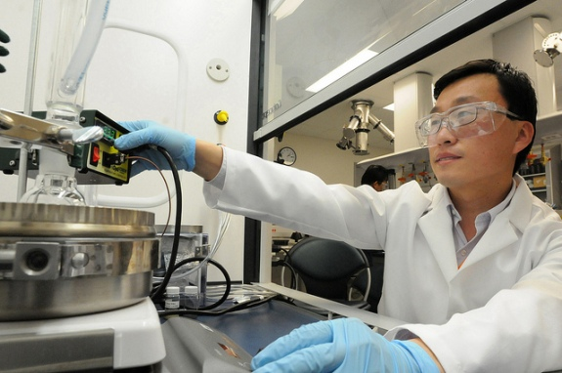

Slide 20
C. Advancements in Technology
1. The Space Program supported by JFK in the 1960s was a triumph.
a. John Glenn (1962) = 1st American to orbit in space
b. Neil Armstrong (1969) = 1st person to step on the moon – “That’s one small step for man, one giant leap for mankind.”
c. Sally Ride (1983) = 1st U.S. female astronaut to orbit in space.

Slide 21
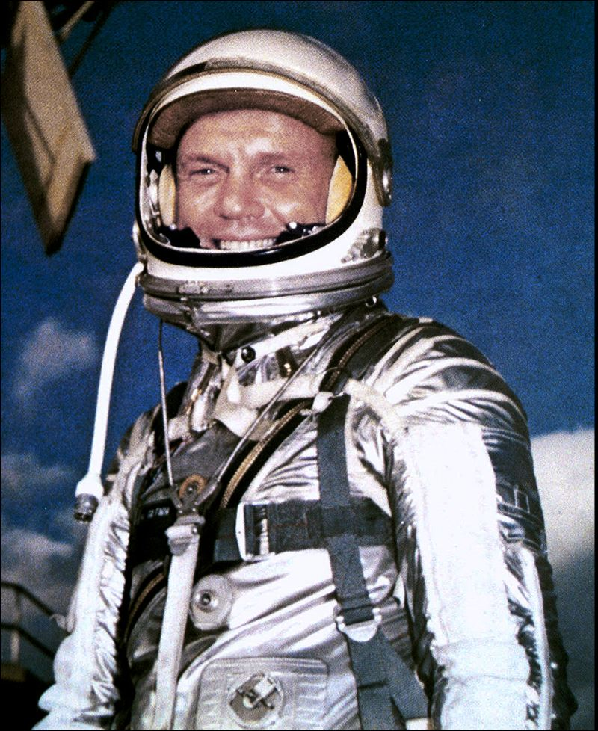
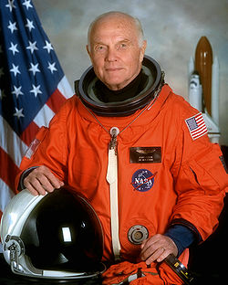

Slide 22
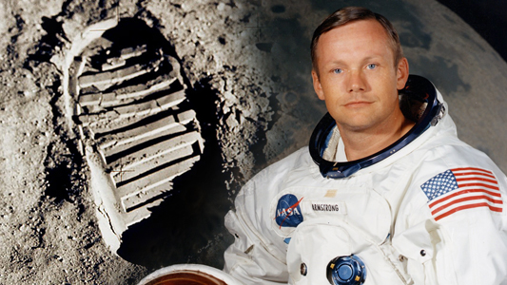

Slide 23
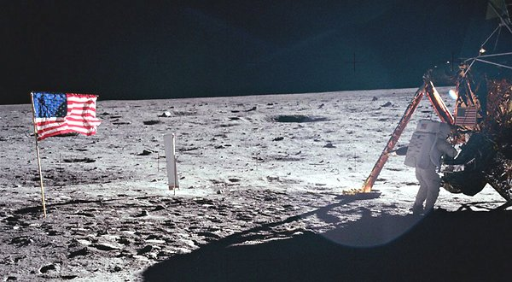

Slide 24
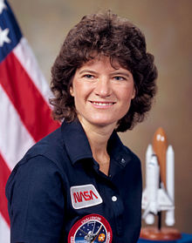

Slide 25
2. Improvements in technology and media = better access to global views and information for rural areas, businesses, and consumers
a. cable TV
b. 24 hour new programs (ie. CNN)
c. Cellular phones with GPS capability
d. World Wide Web

Slide 26
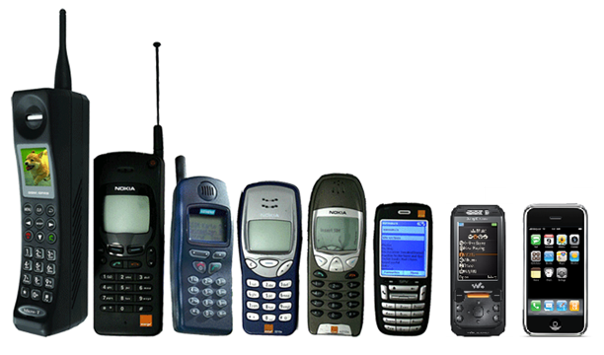

Slide 27
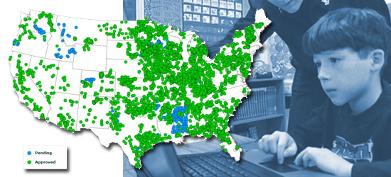

Slide 28
3. Changes in Work, School, and Health Care
a. Telecommuting – people work from home via the internet
b. Distance Learning = people can take online courses.
c. Rapid growth of service industries related to technology (computer repair, on-line sales, & costumer service)

Slide 29
d. Computer-controlled robotics reduced need for factory workers
e. Medical research including Dr. Jonas Salk (developed polio vaccine), artificial hearts, MRI, & organ transplants
f. Telecommunications enabled American companies to use outsourcing and offshoring to hire overseas employers for low wages.

Slide 30
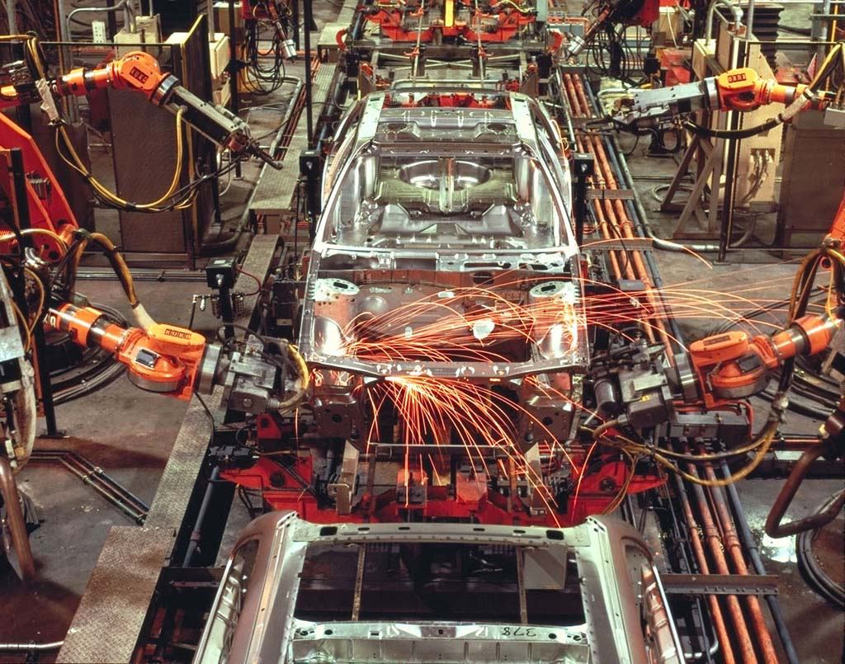

Slide 31
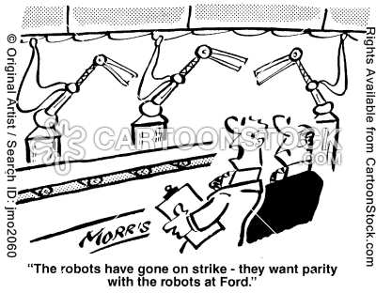

Slide 32
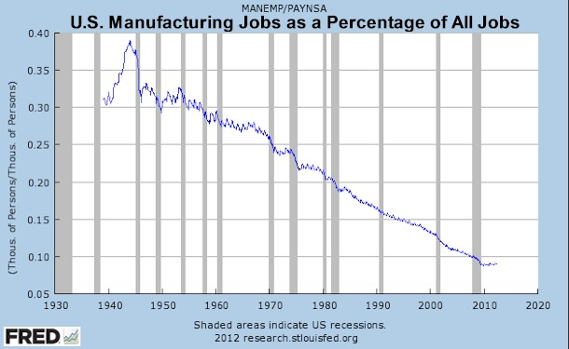

Slide 33
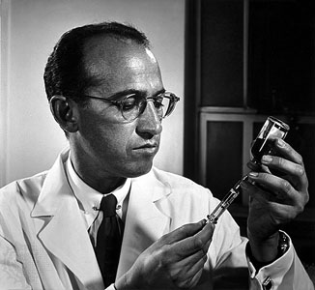

Slide 34
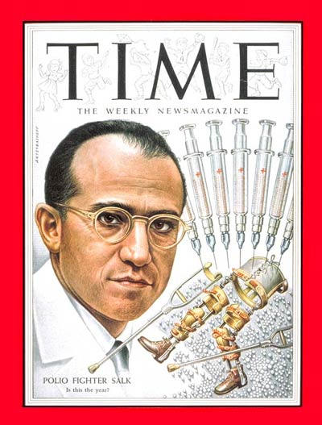

Slide 35
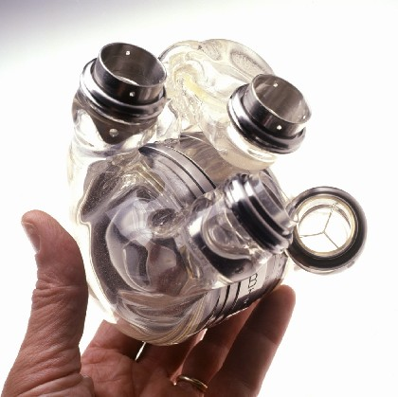

Slide 36
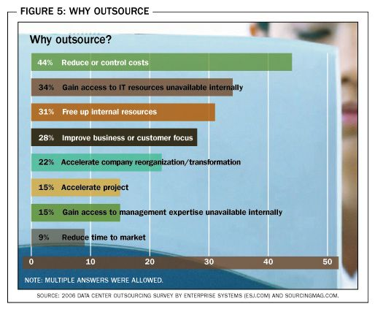

Slide 37
