Slide 1
Sectional Tensions

Slide 2
A. Compromise of 1850
1. 1849 - gold was discovered in California
a. Within a year, the population reached 90,000
b. Wanted to be a free state
2. Deal:
a. CA- free state
b. NM & UT allowed to decide if free or slave
c. Fugitive Slave Act – forced Northerners to return runaways
No more slave trade in D.C.

Slide 3
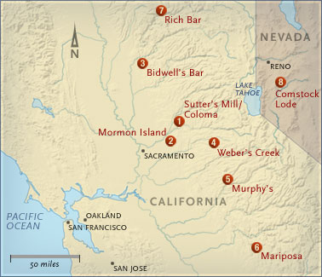

Slide 4
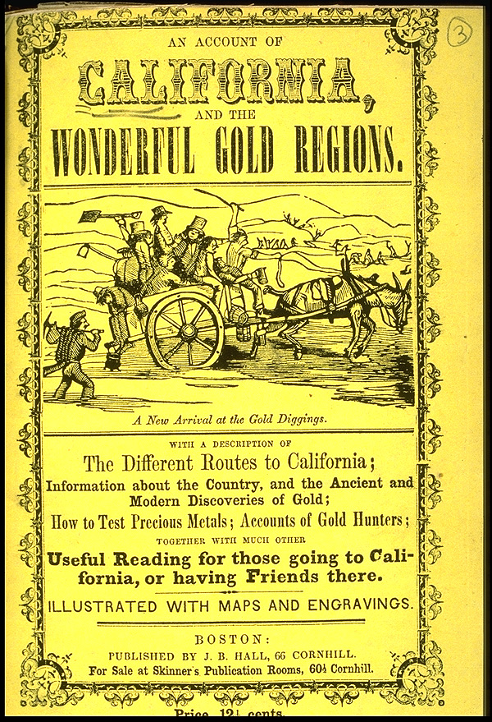

Slide 5
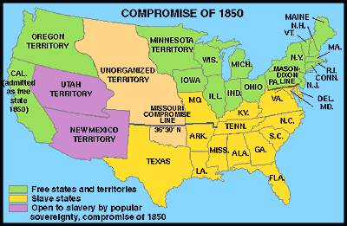

Slide 6
B. Uncle Tom’s Cabin (1852)
1. written by Harriet Beecher Stowe – abolitionist
- Fictional account of the brutality of slavery
2. South – very angry & defensive

Slide 7
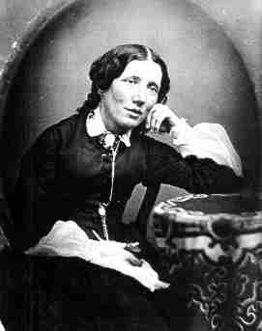
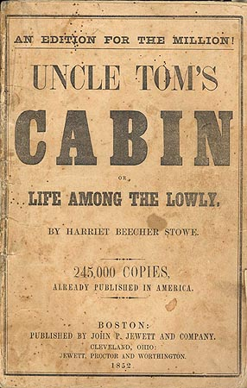

Slide 8
C. Kansas-Nebraska Act (1854)
Plans to build a transcontinental RR created problems
1. Sen. Stephen Douglas, (IL), proposed new territories - Kansas & Nebraska
- abolished the Missouri Compromise
-let the people vote on the slavery issue = popular sovereignty
2. Northerners formed the Republican Party – opposed expansion of slavery

Slide 9
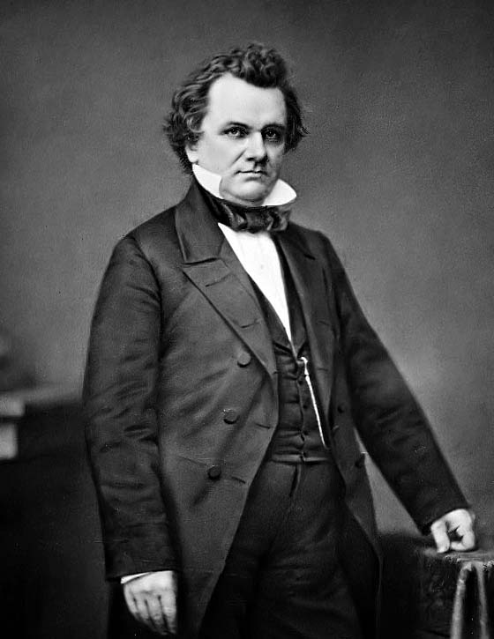
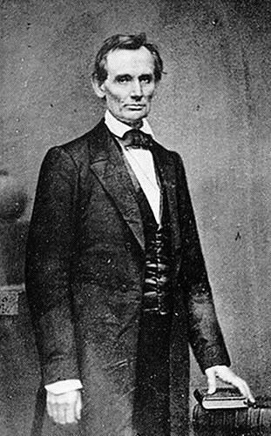

Slide 10
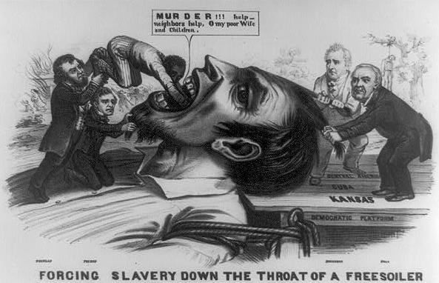

Slide 11
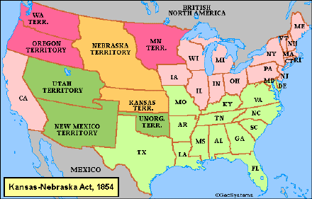

Slide 12
D. Bleeding Kansas (1856)
1. Because of popular sovereignty, there was a race by slave owners & abolitionists to populate Kansas
2. Violence left hundreds dead

Slide 13
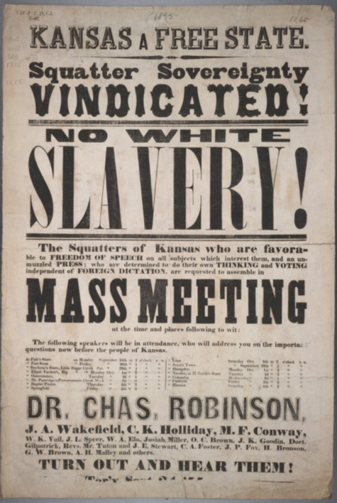

Slide 14
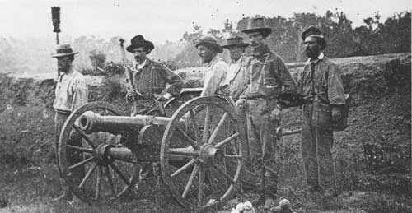

Slide 15
E. Dred Scott Decision (1857)
1. Scott sued for his freedom b/c he had lived in a free state
2. The Supreme Court ruled:
a. blacks were NOT citizens & could not sue
b. Congress could NOT forbid slavery
3. South loved decision; Northerners were outraged!

Slide 16
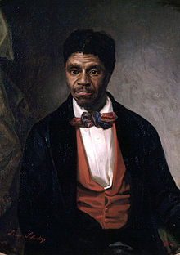

Slide 17
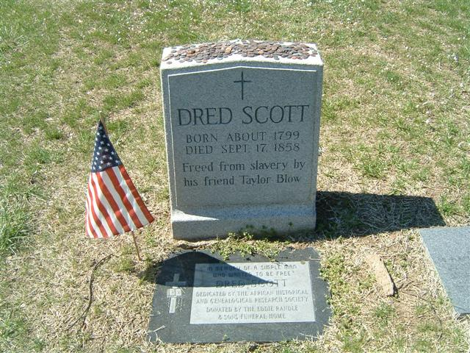

Slide 18
F. Election of 1860
Four candidates
1. Abraham Lincoln, a Republican, won the electoral majority; but only 40% of the popular vote
2. Southerners hated Lincoln – “A house divided against itself can not stand.”

Slide 19
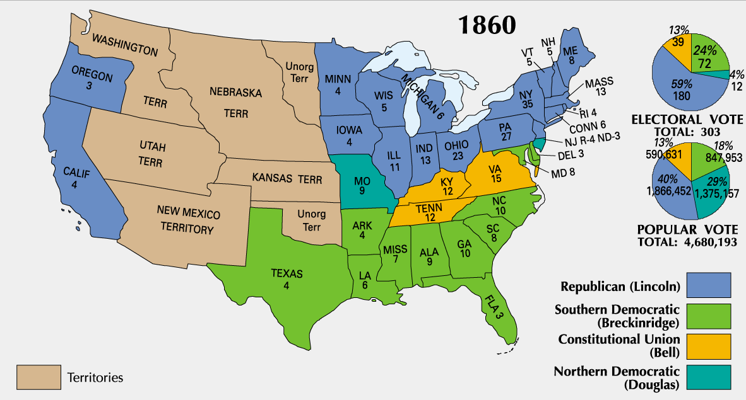

Slide 20
G. Secession & States Rights
1. Thinking President Lincoln would free all of the slaves – southern states began to secede (leave the Union)
2. Southerners believed in States’ Rights – states could leave the union if they wanted
- formed the Confederate States of America & Jefferson Davis (MS) elected President

Slide 21
3. Lincoln asserted: “No state may leave the union after it has joined”; “The United States is one nation, not a collection of states.”

Slide 22
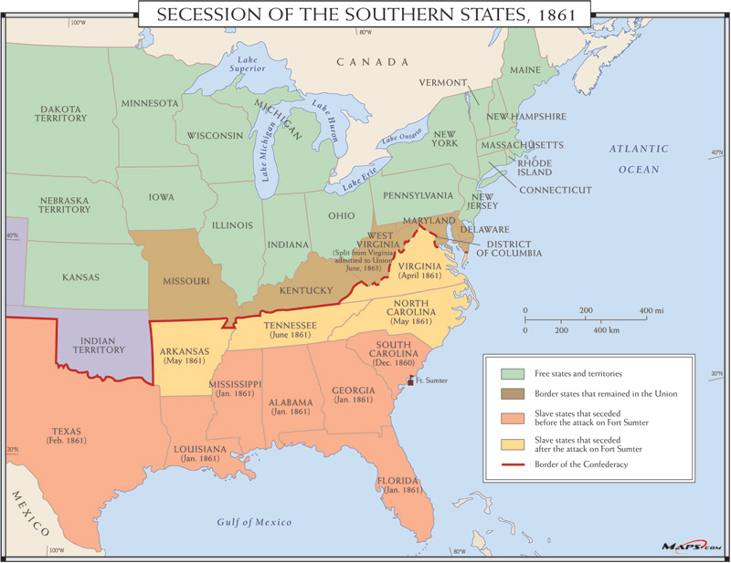

Slide 23
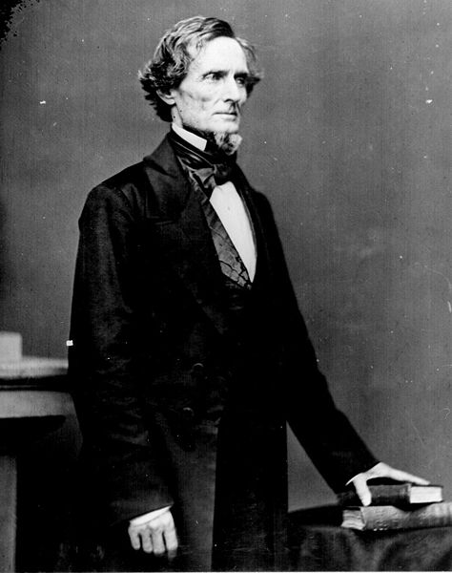

Slide 24
The War Begins (1861)

Slide 25
A. Opening Confrontation at Fort Sumter (Charleston, SC. – April 1861)
1. South fired on the fort & captured it
2. Event stirred nationalism in the North & the South
a. Lincoln called for 75,000 volunteers to put down the rebellion.
b. Davis called for 100,000 troops to defend the south
On both sides, men were eager to fight

Slide 26
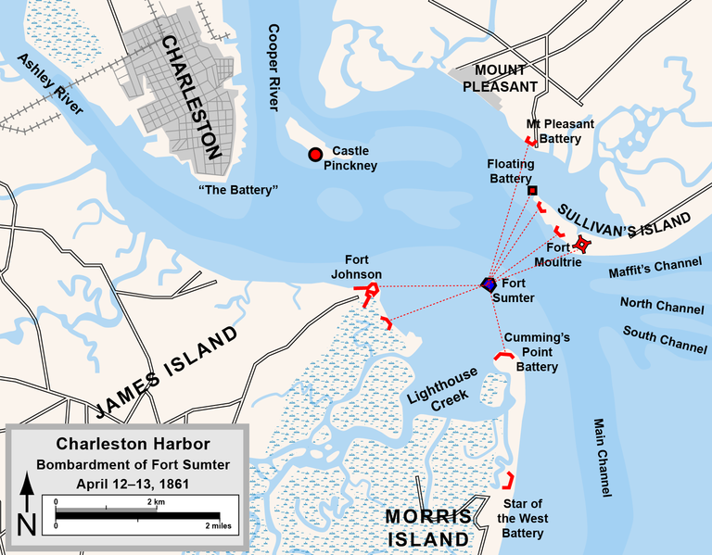

Slide 27
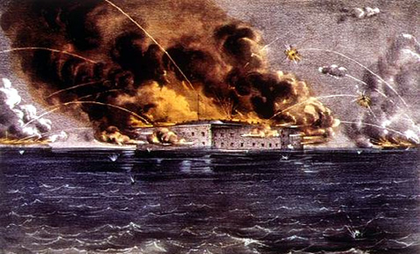

Slide 28
B. More Slave States Secede
1. Lincoln’s call for troops caused VA, NC, AR, and TN to secede (refused to fight against fellow southerners)
2. MD put under martial law by Lincoln b/c he needed to protect Washington, DC

Slide 29
3. Robert E. Lee = was asked to command Union army, but he rejected it
a. opposed secession
b. could not fight against his family & his beloved VA
c. Became Confederate general of the Army of Northern Virginia

Slide 30
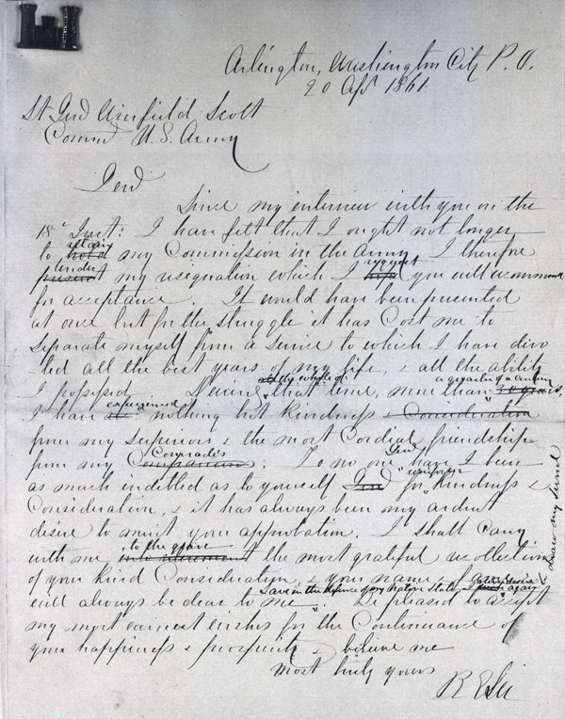

Slide 31
C. Comparing Resources
South
1. Fighting on their land
2. Better generals
3. Lack of supplies & $$
4. Lower population – would not use slaves
Confederacy, Rebels, Gray
North
1. Larger population
2. More money & factories
3. More RR to move supplies
4. Kept border states in Union
Union, Federals, Yankees, Blue

Slide 32
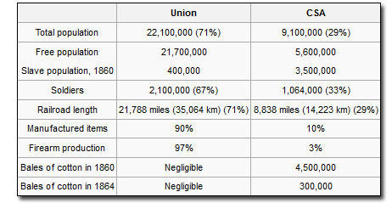

Slide 33
D. Realities of War
1. Old tactics with modern weapons = high casualties
a. kept diaries & wrote letters home to fight boredom
b. Poor medical practices led to amputations
c. 620,000 death - most were caused by diseases

Slide 34
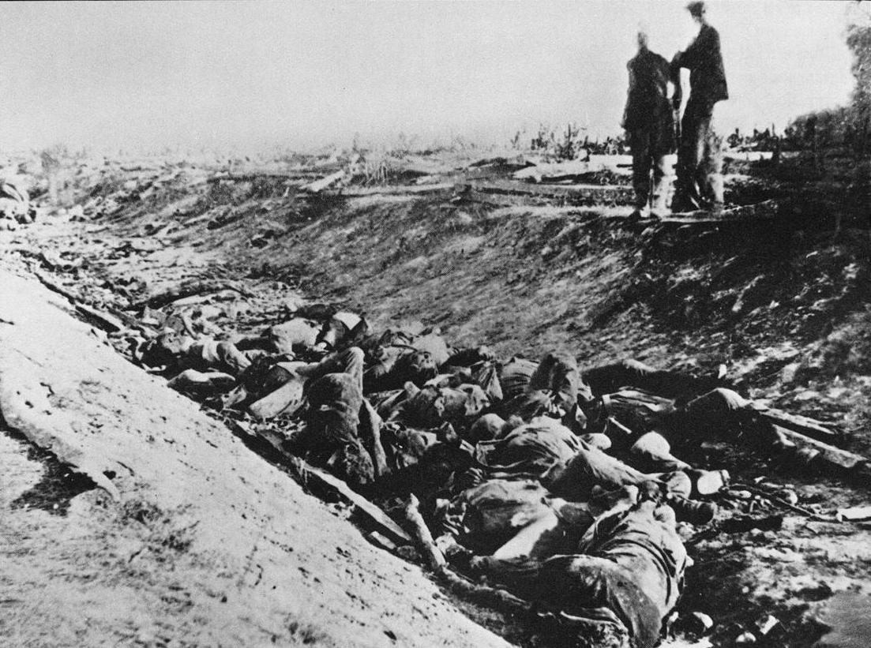

Slide 35
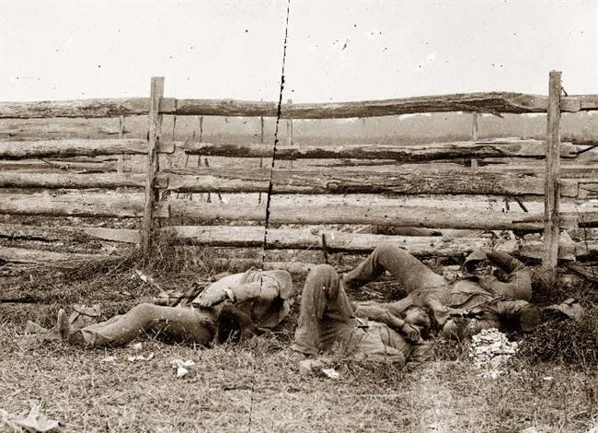

Slide 36
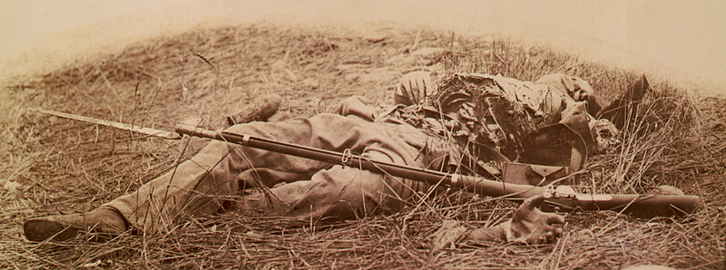

Slide 37
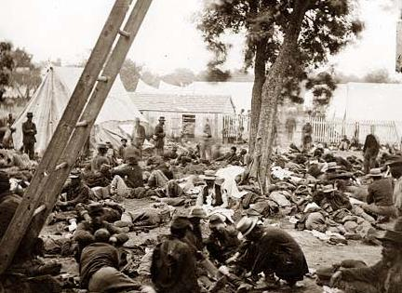

Slide 38
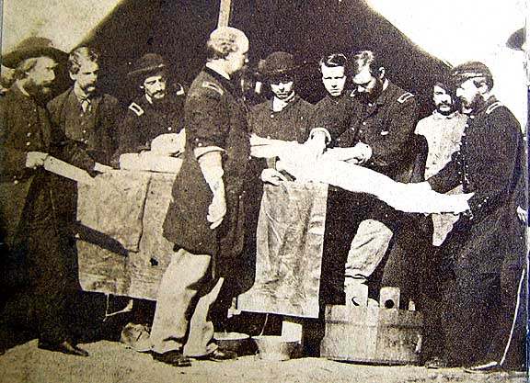

Slide 39
2. Women ran the farms, worked in factories, & managed the families
Often faced poverty and hunger
- Many became nurses to care for soldiers

Slide 40
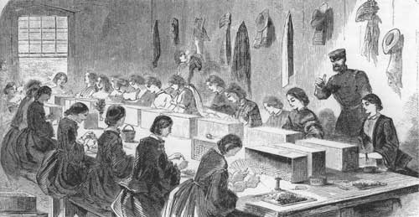

Slide 41
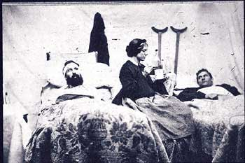

Slide 42
Key Events of the Civil War

Slide 43
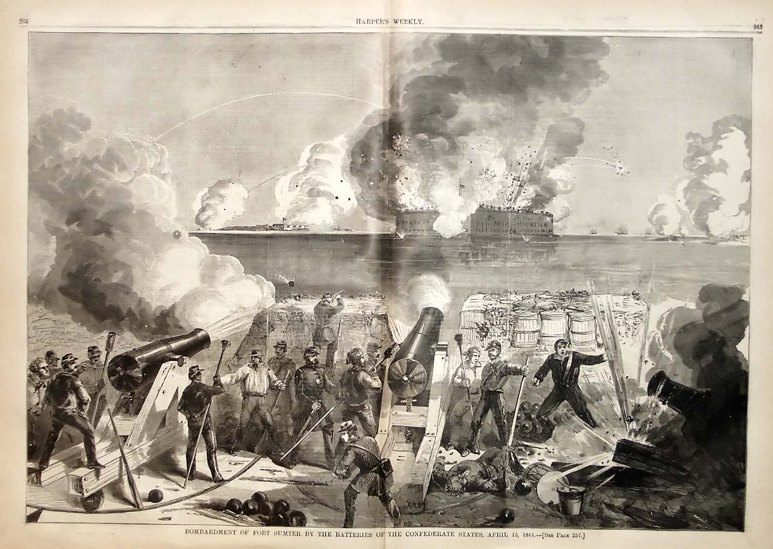
Apr. 1861: Ft. Sumter (SC)
Opening confrontation of the war

Slide 44
Sept. 1862: Antietam (MD)
Lee tried to invade the North
Single bloodiest day of the war (22,000 casualties)
Union victory = allowed Lincoln to pass the Emancipation Proclamation

Slide 45
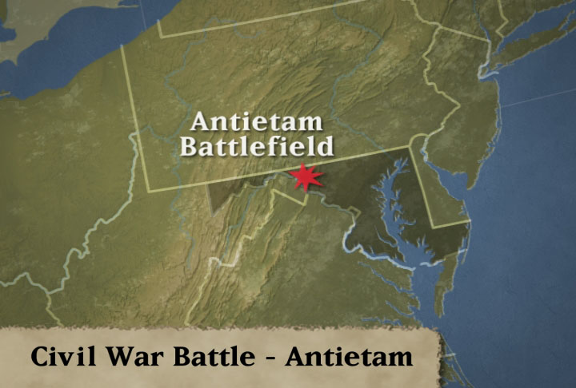

Slide 46
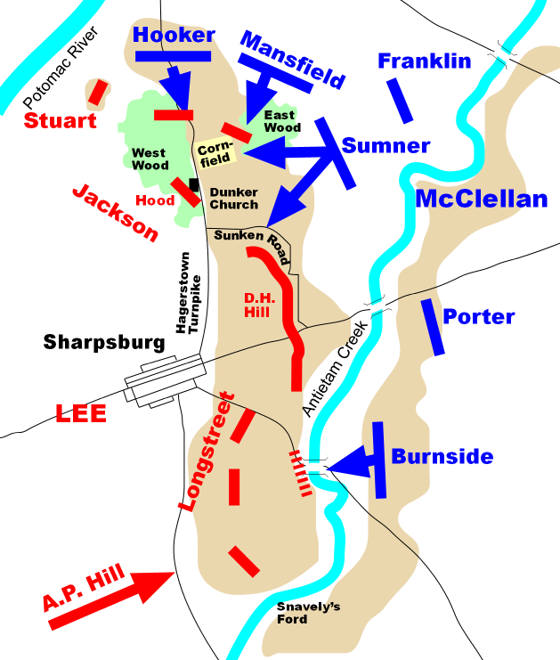

Slide 47
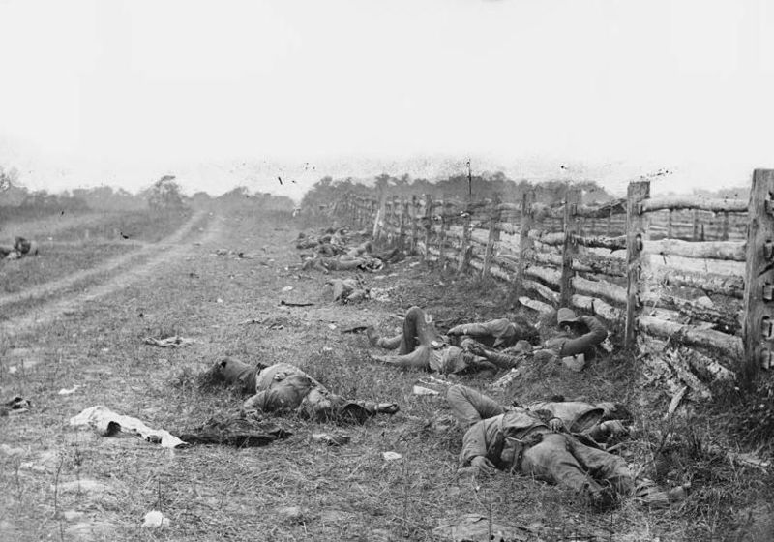

Slide 48
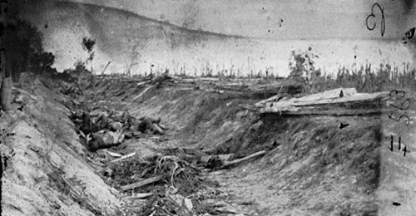

Slide 49
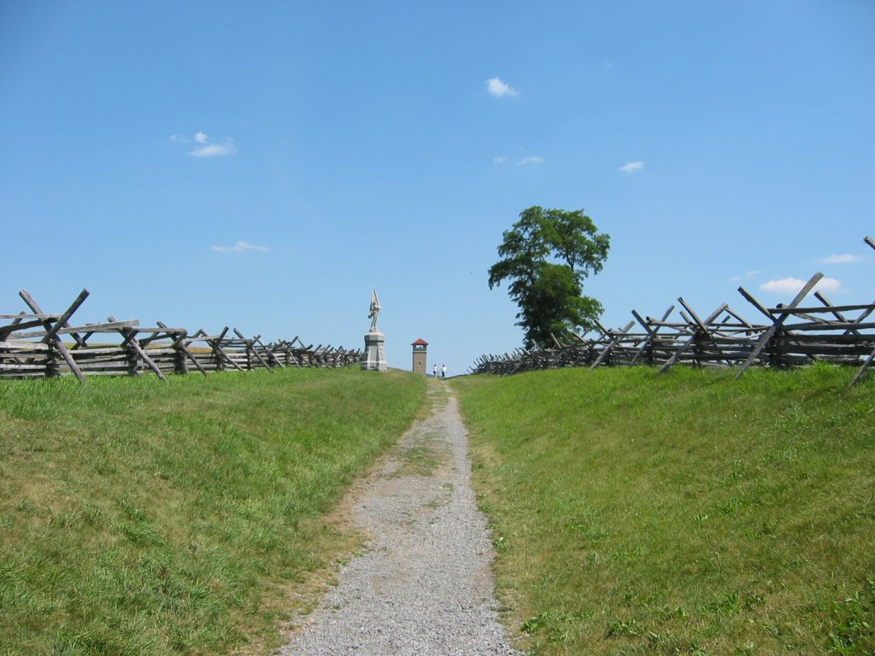

Slide 50
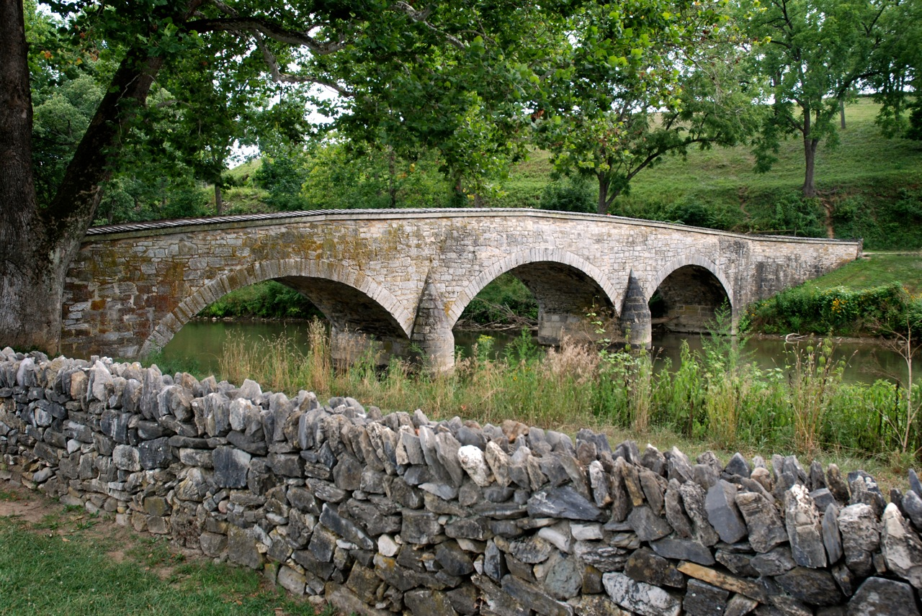

Slide 51
Emancipation Proclamation
Lincoln ordered all “slaves in rebelling states” be set free on Jan. 1, 1863
Made destruction of slavery a goal of the war
Discouraged foreign intervention

Slide 52
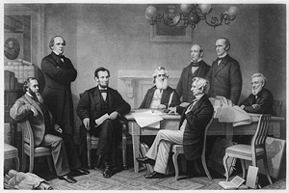

Slide 53
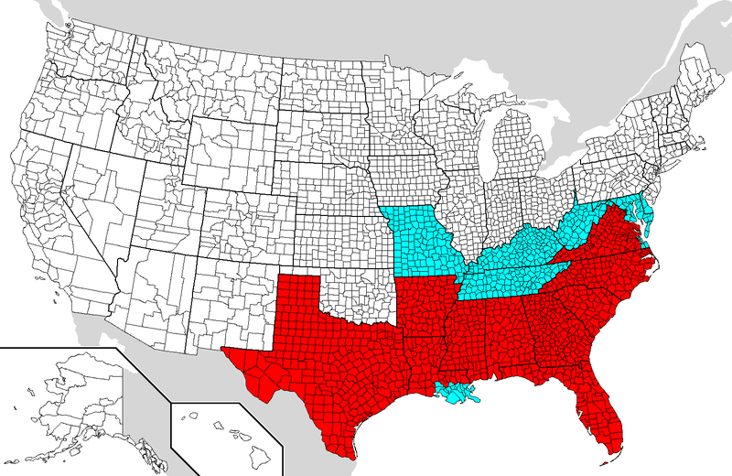

Slide 54
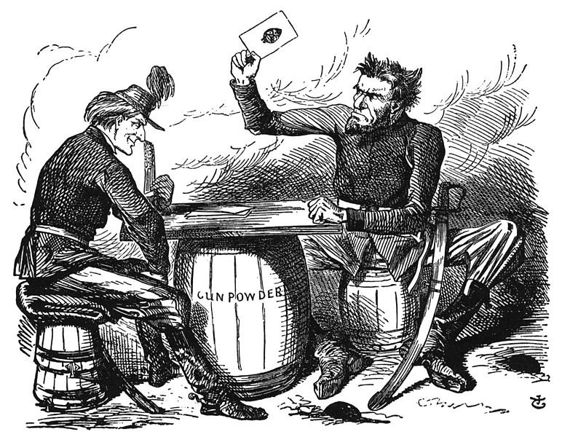

Slide 55
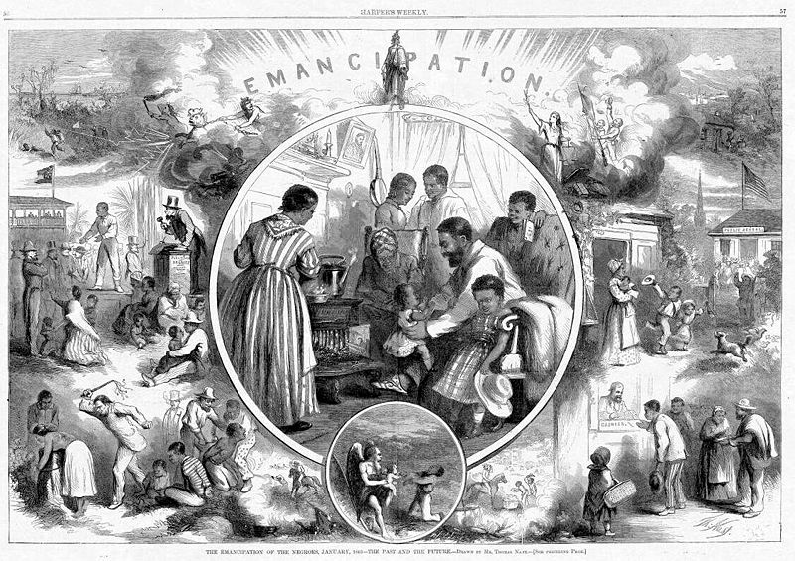

Slide 56
July 1863: Gettysburg (PA) – TURNING POINT!
Lee’s 2nd invasion of the North failed
After 3 days of fighting, Lee lost 1/3 of his army
Union army began winning the war.

Slide 57
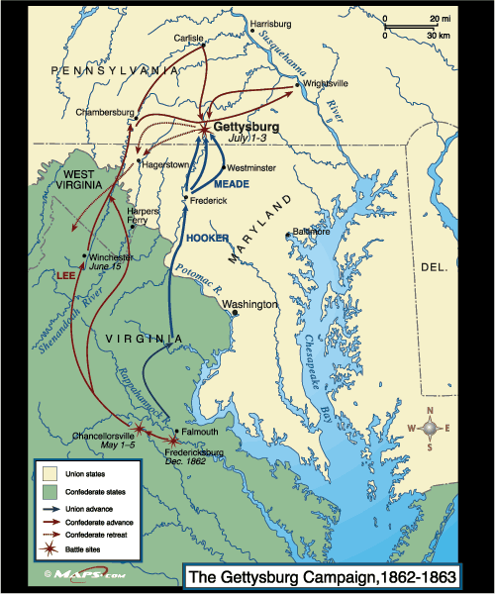

Slide 58
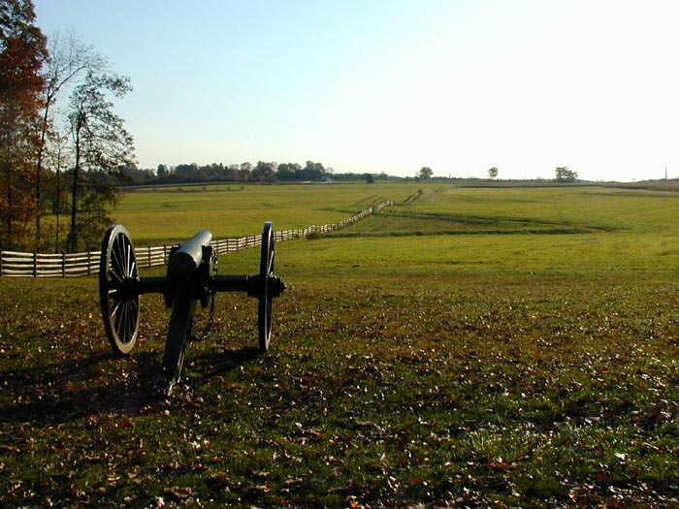

Slide 59
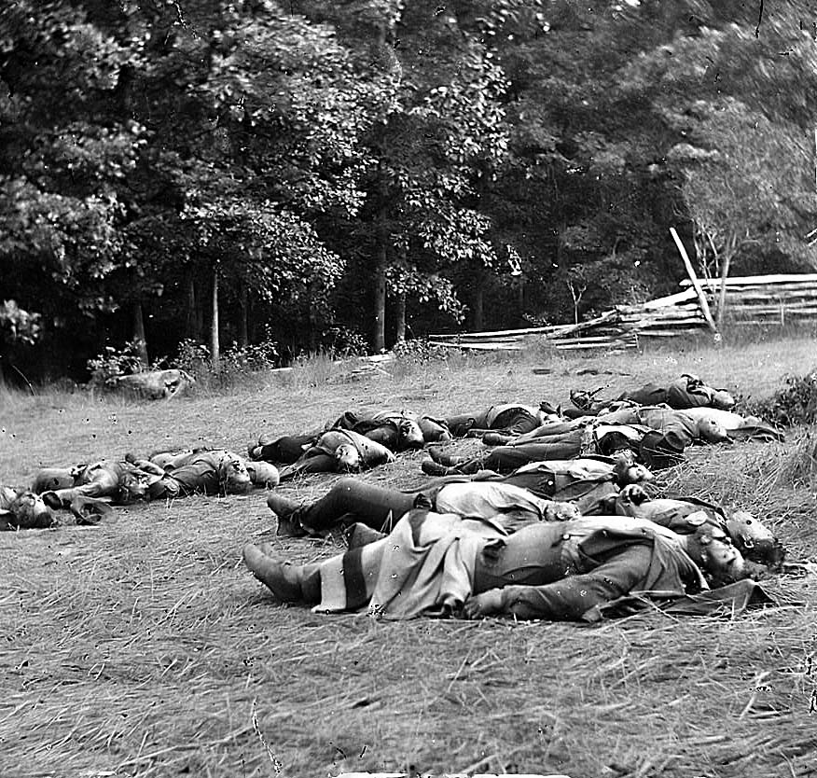

Slide 60
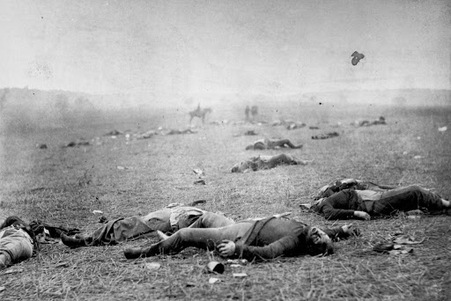

Slide 61
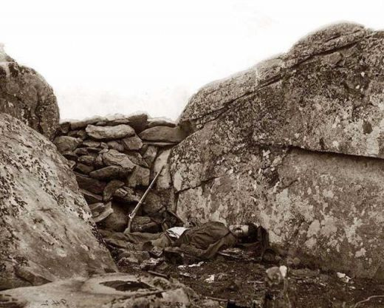

Slide 62
Gettysburg Address; Nov. 1863
Lincoln’s speech to dedicate the cemetery
Referred to the Declaration of Independence
Civil War is being fought t0:
1) preserve the nation (“…that government of the people, by the people, for the people…”)
2) end slavery (“…the proposition that all men are created equal...”)

Slide 63
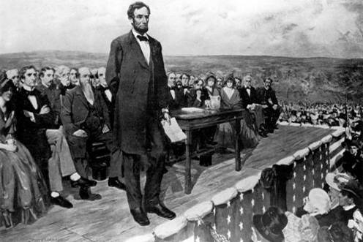

Slide 64
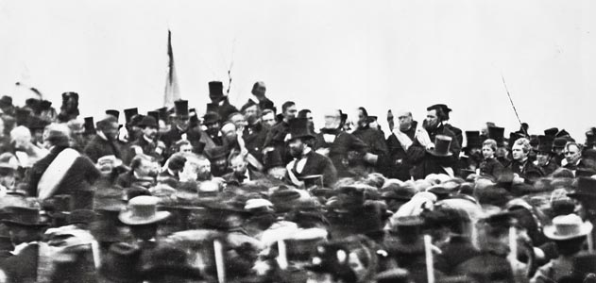

Slide 65
Apr. 1865: Appomattox (VA)
Lee surrendered to Grant, ending the war

Slide 66
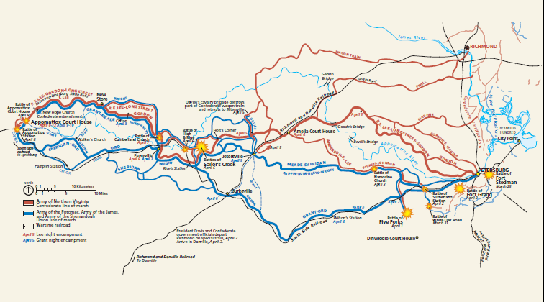

Slide 67
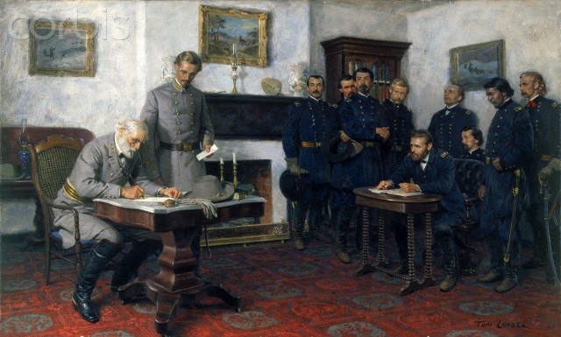

Slide 68
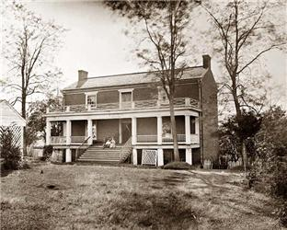

Slide 69
Hampton Roads
Battle of the Ironclads
CSS Virginia (Merrimac) destroyed the USS Congress and USS Cumberland, USS Minnesota ran aground
USS Monitor arrives and fights the Virginia the next day
Result: a draw

Slide 70
The War’s End (1865)

Slide 71
A. African-American Contributions
1. Emancipation Proclamation allowed blacks to serve in the Union army (188,000)
- were paid less & served in segregated units
2. Frederick Douglas urged Lincoln to use former slaves in the Army
3. The South refused to use slaves as soldiers

Slide 72
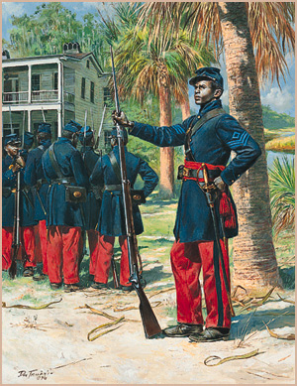

Slide 73
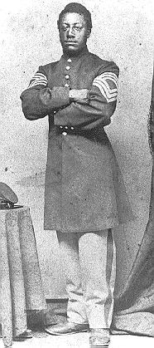

Slide 78
B. Grant Defeats Lee
1. Ulysses S. Grant was given command of the Union army after winning key battles in the West
2. The North engaged in “total war” - burning civilian property & crops

Slide 83
3. Grant did not allow the Confederates to retreat
4. After losing Richmond & Petersburg, Lee was cut off at Appomattox, VA
- Lee surrendered on April 9, 1865

Slide 85
C. Lincoln’s Death
1. Lincoln believed the country needed to be reunified
a. He did not want to punish the South
b. 2nd Inaugural Address – Lincoln said, “…with malice toward none, charity for all, let us….bind up the nation’s wounds”

Slide 88
2. April 14, 1865 - John Wilkes Booth shot Lincoln at Ford’s Theater
3. Andrew Johnson (TN) - became the 17th president

