Slide 1
Civil Rights Movement

Slide 2
1. Segregation is legal – “Separate, but equal”
2. Jim Crow laws
3. Goals of NAACP:
1) End Segregation
2) Protect voting right in the South

Slide 3
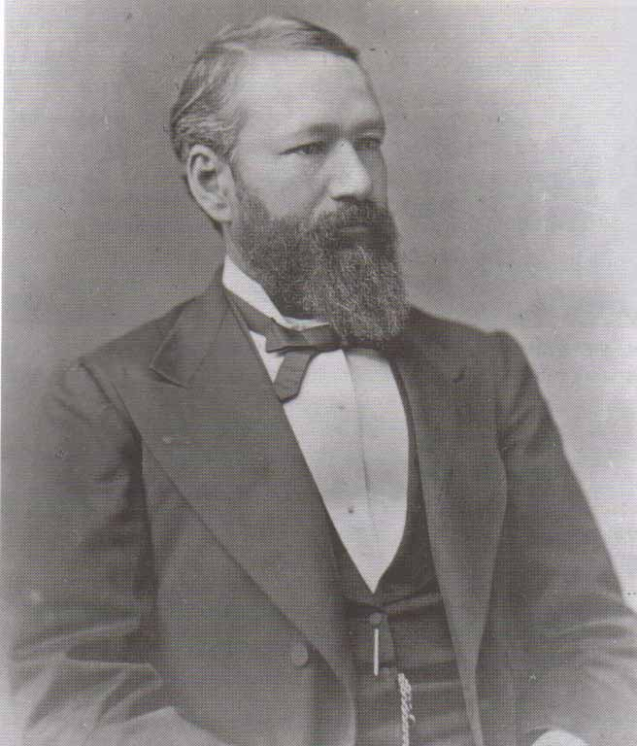

Slide 4
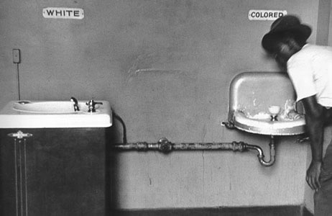

Slide 5
4. Thurgood Marshall – chief counsel for NAACP

Slide 6
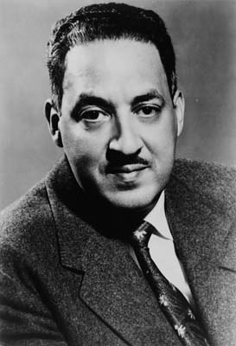
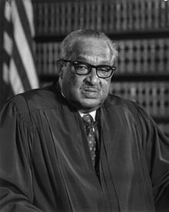

Slide 7
5. Oliver Hill – Richmond attorney who headed legal defense team in VA
6. Desegregation of Prince Edward County Schools

Slide 8
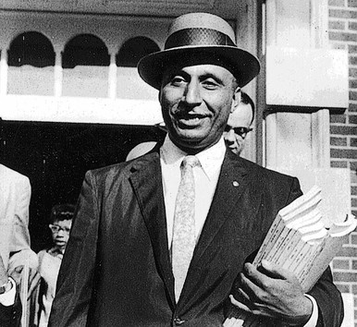

Slide 9
7. Brown v. Board of Ed. Of Topeka (1954)
Supreme Court case – segregation in public schools was unconstitutional & must integrate

Slide 10
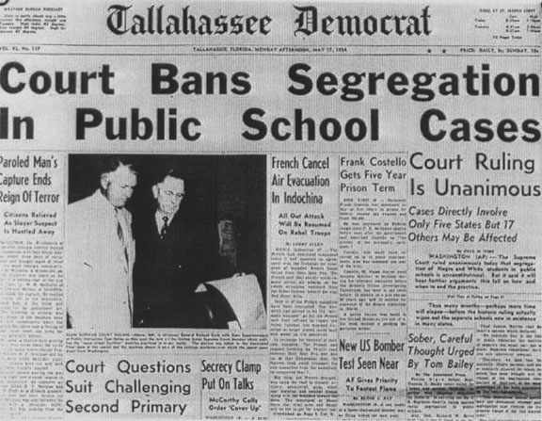

Slide 11
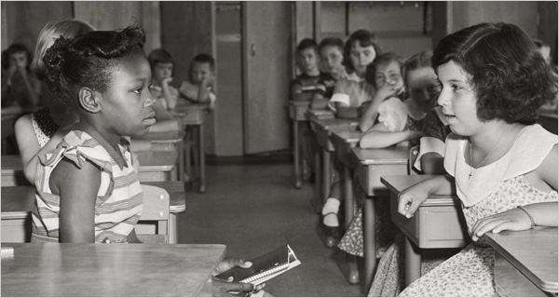

Slide 12
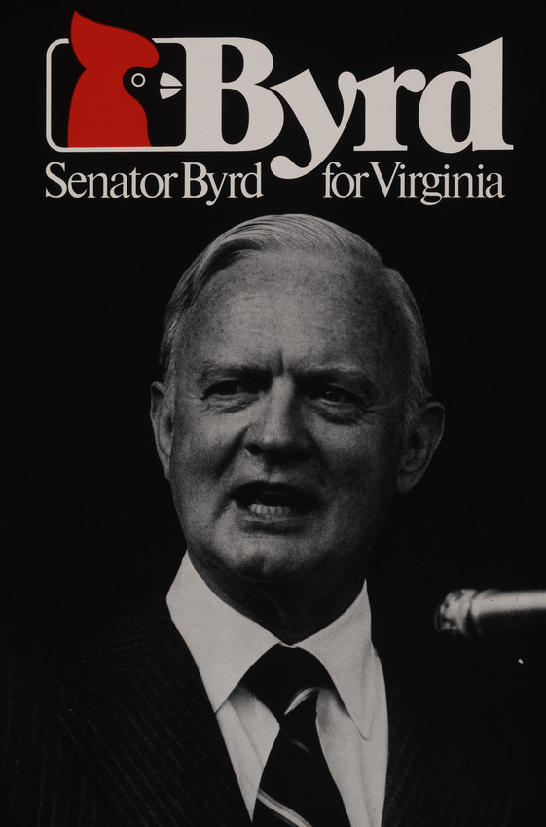
8. VA & other southern states adopted policy of Massive Resistance

Slide 13
9. Massive Resistance: closed schools rather than integrate
1) White parents formed private schools
2) “White Flight” from cities to the suburbs

Slide 14
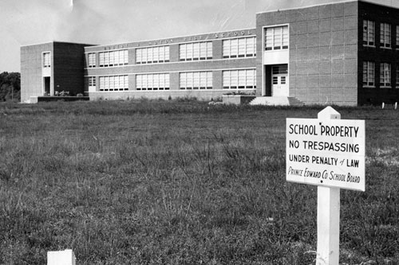

Slide 15
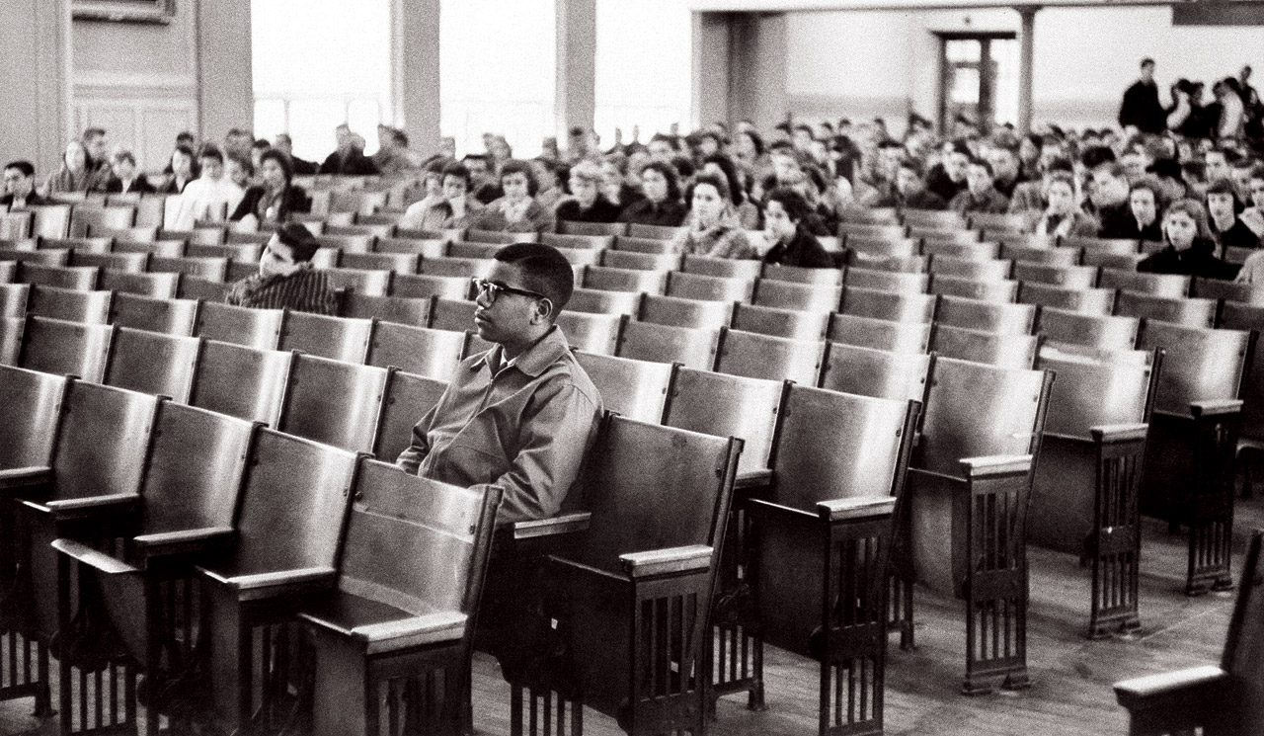

Slide 16
10. Desegregate and Integrate = black and white children go to school together
11. YES
12. W&L integrated in 1971.

Slide 17
Dr. King’s philosophy of non-violence (borrowed from Ghandi)
Protesters don’t fight back & don’t hate their attackers

Slide 18
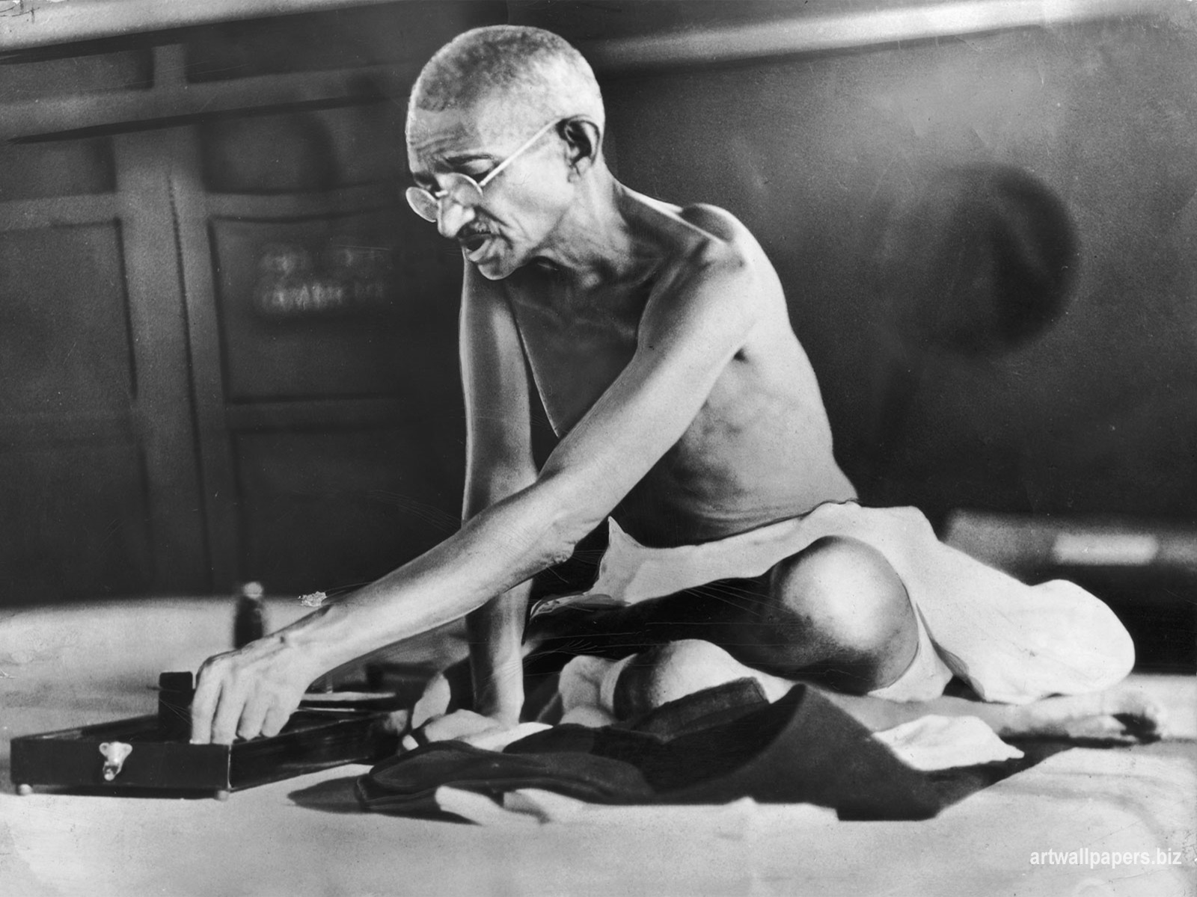

Slide 19
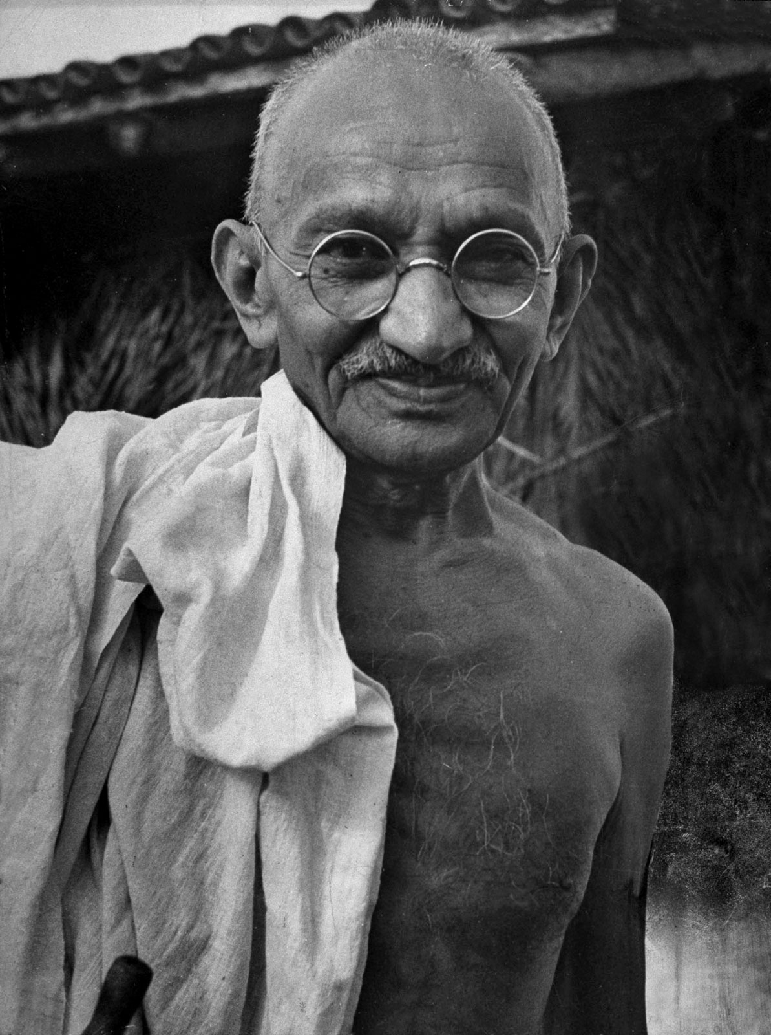

Slide 20
14. Montgomery Bus Boycott (Alabama, 1955)
1) Rosa Parks arrested for refusing to give up seat on a bus
2) Dr. King organized a boycott
3) Buses were desegregated

Slide 21
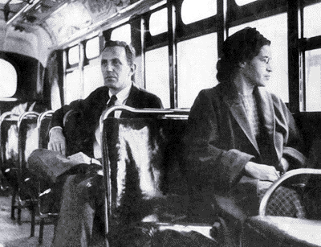

Slide 22
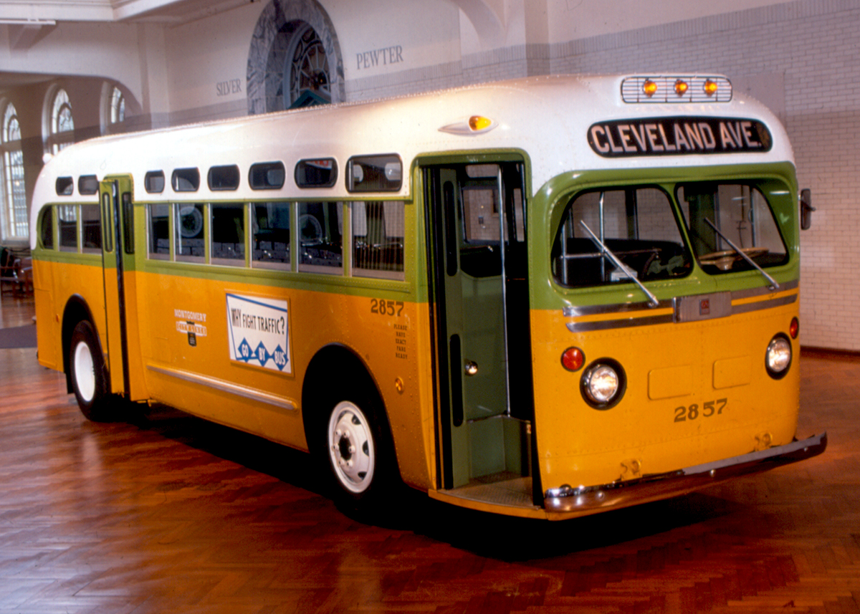

Slide 23
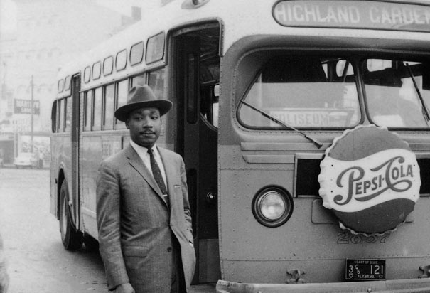

Slide 24
14. “Letter from a Birmingham Jail”
Blacks cannot wait any longer for rights

Slide 25
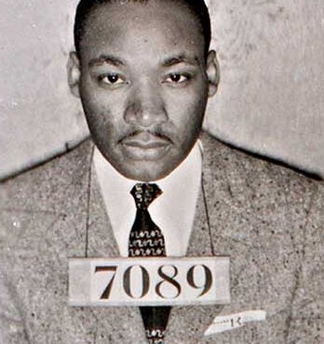

Slide 26
16. Civil disobedience = refuse to obey unjust laws
(Ex. Sit-ins)

Slide 27
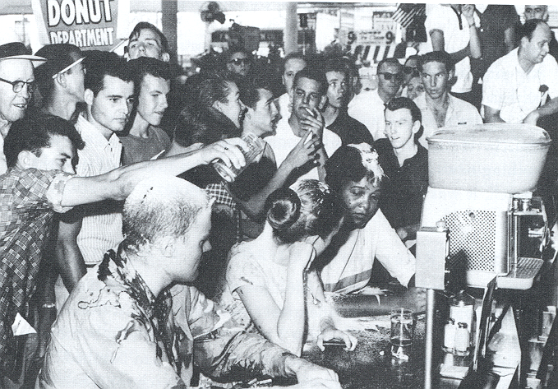

Slide 28
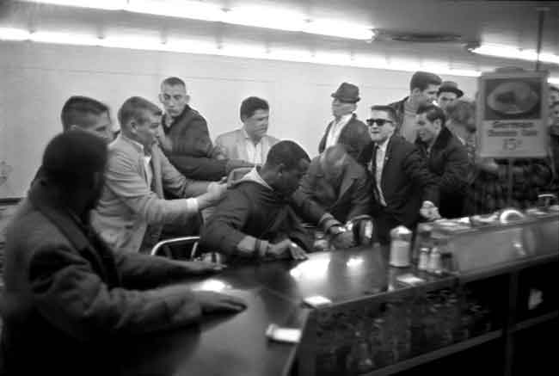

Slide 29
17. Dr. King organized the march
-pressure JFK for a civil rights bill
18. 250,000 at Lincoln Memorial
19. Dr. King = “I have a dream”

Slide 30
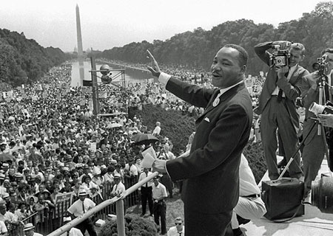

Slide 31
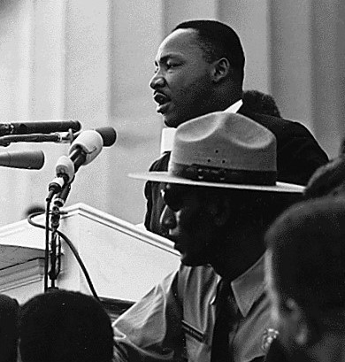

Slide 32
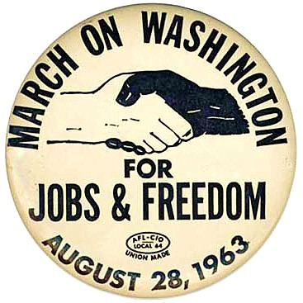

Slide 33
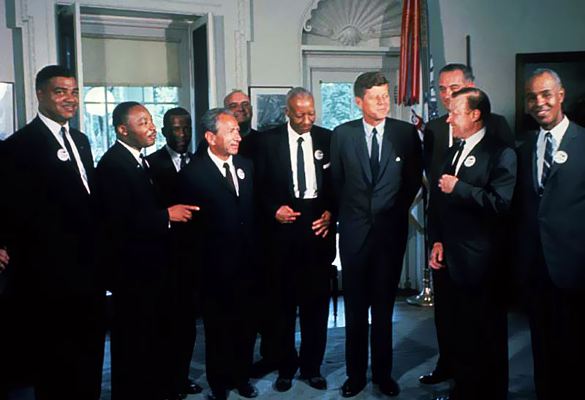

Slide 34
20. JFK was assassinated & LBJ became president
21. Lyndon B. Johnson helped pass civil rights laws.

Slide 35
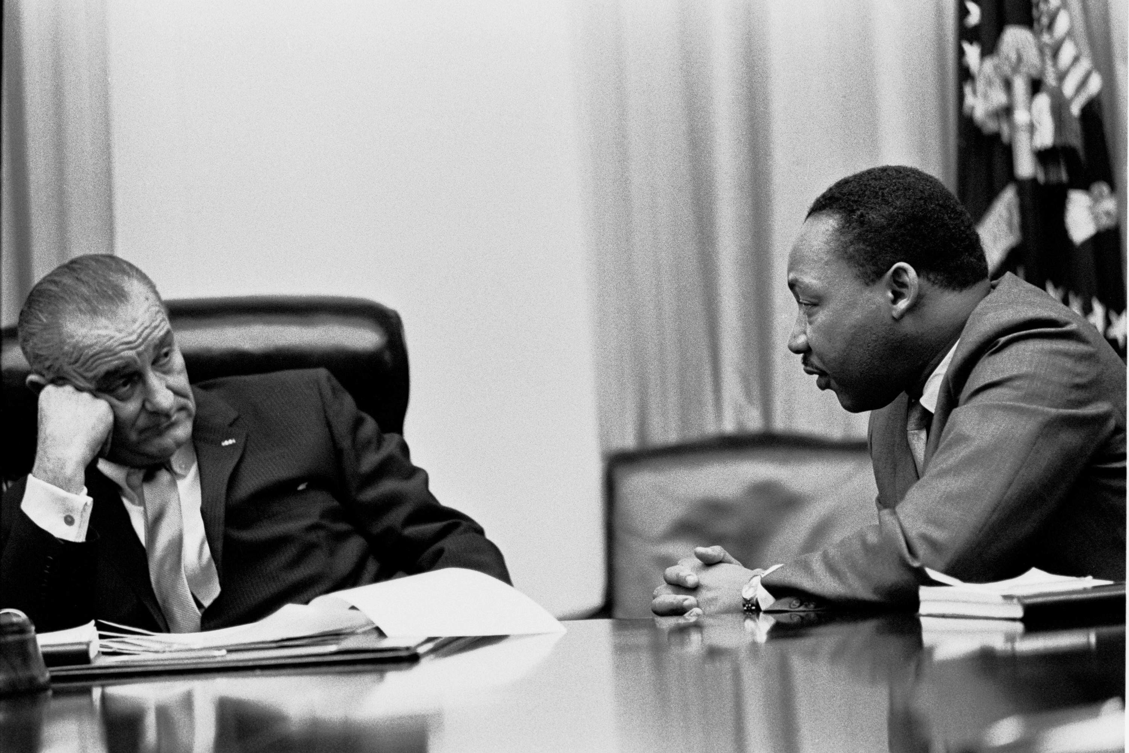

Slide 36
22. Civil Rights Act of 1964: Prohibits discrimination based on race, religion, national origin, or gender in public facilities
Killed Jim Crow laws

Slide 37
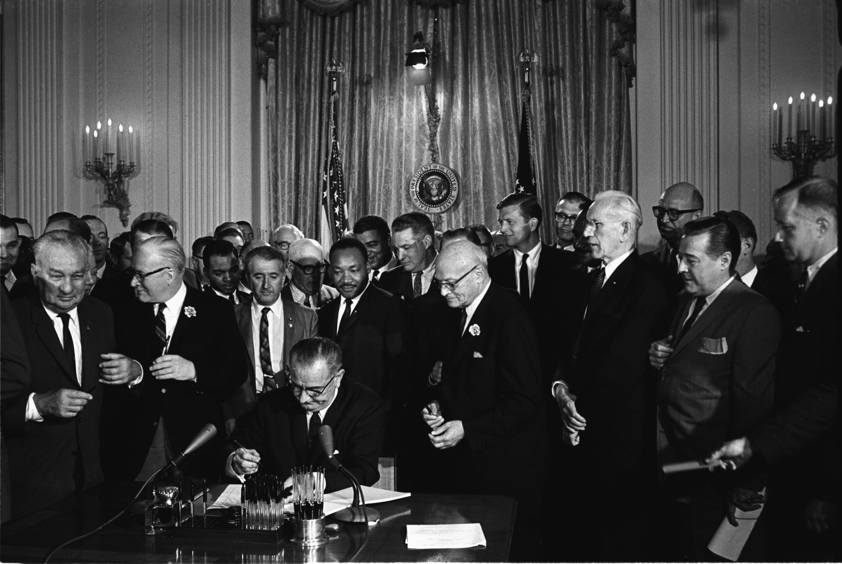

Slide 38
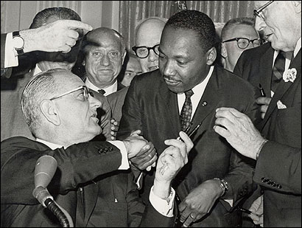

Slide 39
23. March in Selma drew attention to lack of voting rights
-Marchers attacked by policemen
-Footage horrified Americans

Slide 40
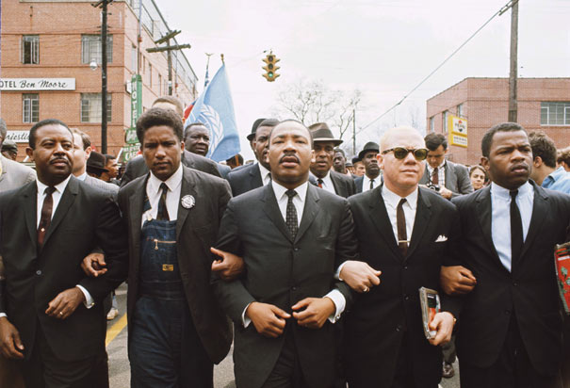

Slide 41
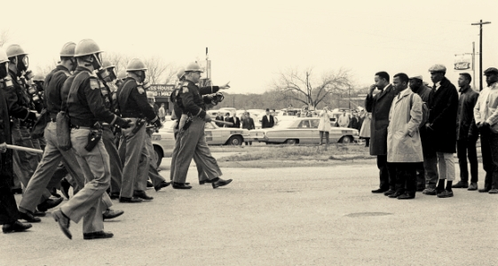

Slide 42
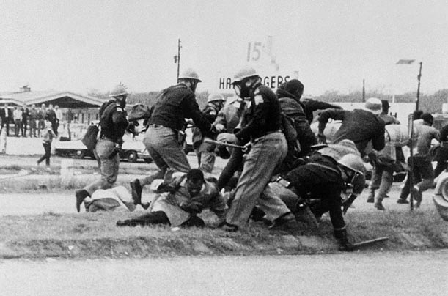

Slide 43
24. Voting Rights Act of 1965: Protected blacks’ voting rights (15th Amend.)
1) Outlawed literacy tests
2) Federal workers registered black voters
25. Result: percent of black voters increased dramatically

Slide 44
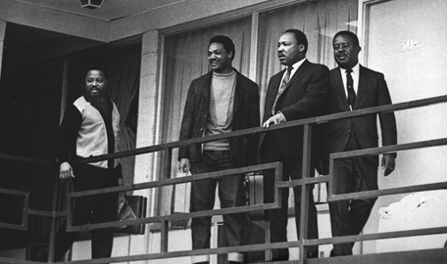

Slide 45
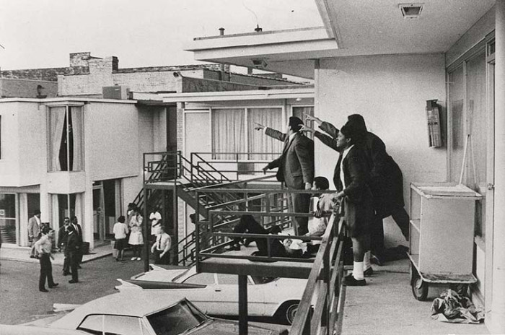

Slide 46
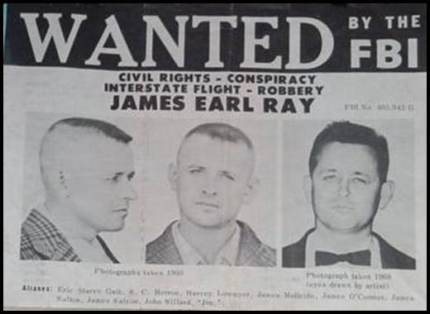

Slide 47
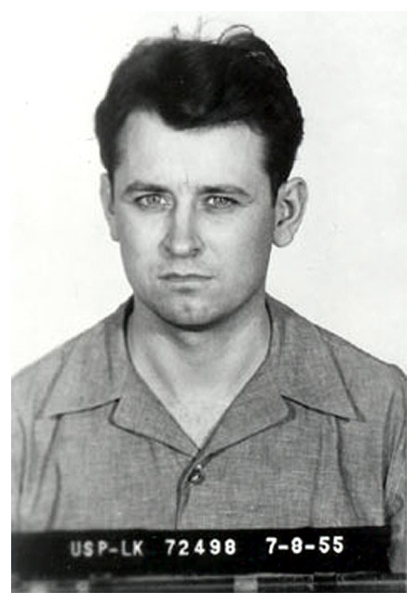

Slide 49
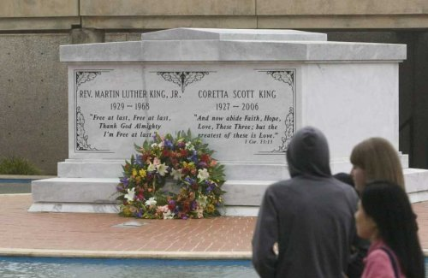

Slide 50
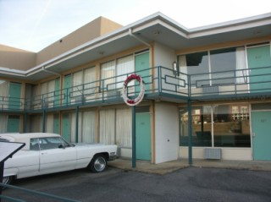

Slide 51
