Slide 1
A Failed Attempt

Slide 2
Americans wanted to ensure the NATIONAL govt did not have too much power. WHY?

Slide 3
A. During the war, Continental Congress served as the national govt.
1. The Articles of Confederation were adopted.
2. Under the plan, the national government had limited powers. WHY?
a. Leaders feared a powerful central government like England
b. Not much trust among the states

Slide 4
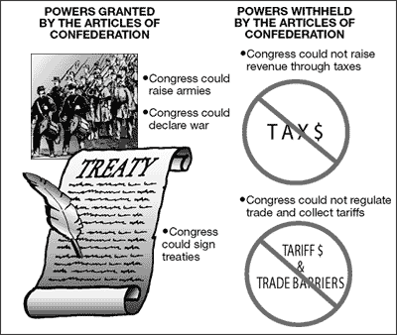

Slide 5
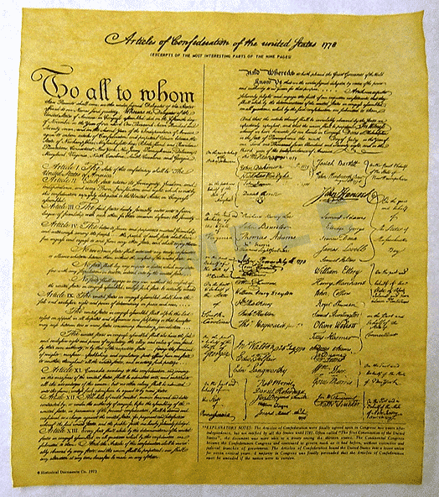

Slide 6
B. Weaknesses of the Articles of Confederation
1. No power to tax – had to beg states for money
2. No executive or judicial branch
3. No power to regulate trade
4. No common currency
5. Each state had one vote regardless of size

Slide 7
C. Problems caused by a weak central government
1. Delegates met in Philadelphia to revise the Articles of Confederation in 1787.
2. They decided to write a new, stronger plan of govt
3. Plan was called the Constitution

Slide 8
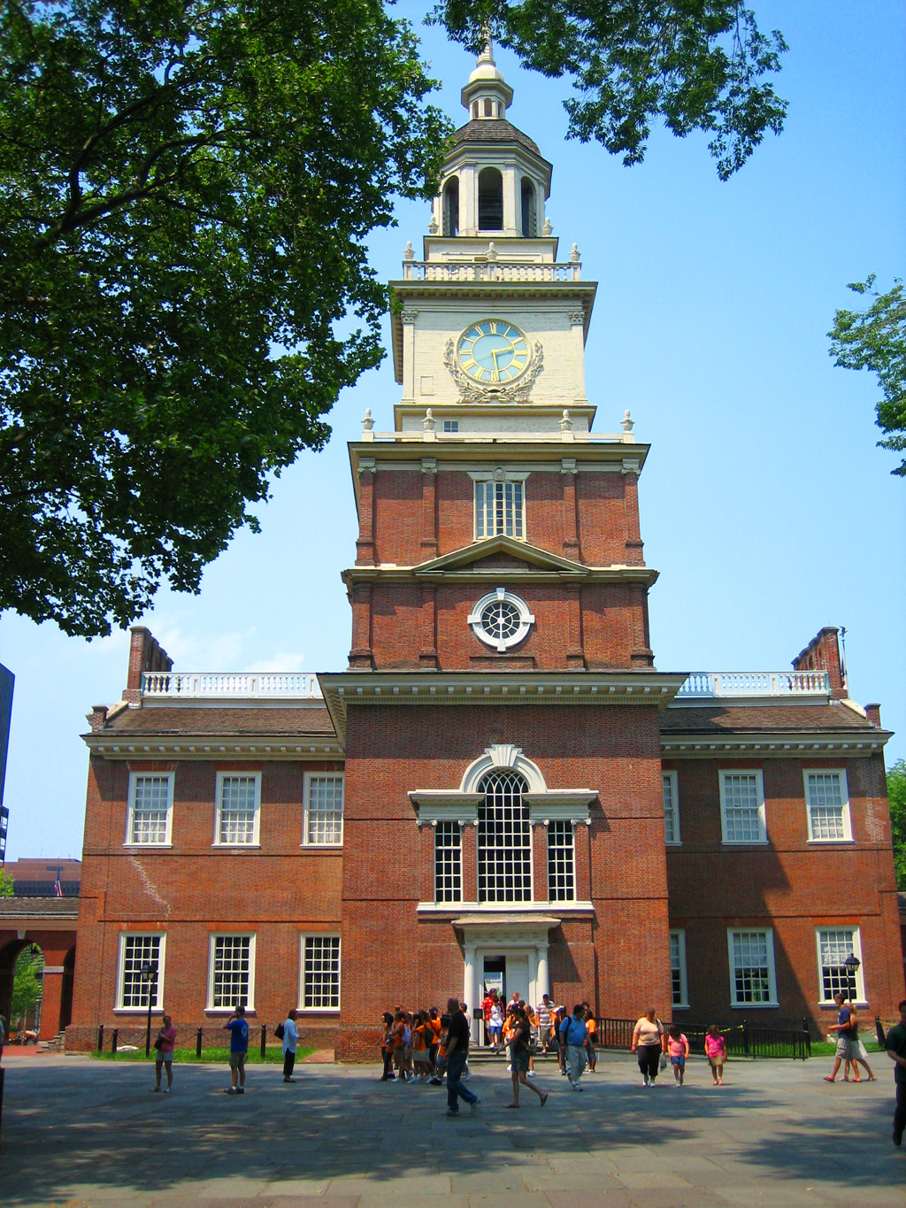

Slide 9
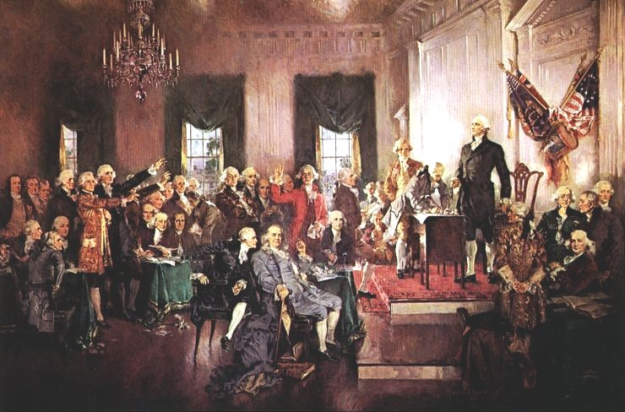

Slide 10
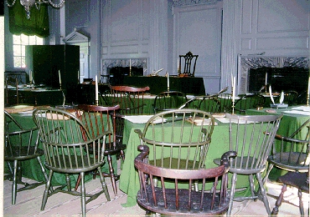

Slide 11
D. Key Individuals at the Constitutional Convention:
1. James Madison (VA) = “Father of the Constitution”
a. Kept copious (detailed) notes of debates
b. Authored the Virginia Plan & much of the Bill of Rights

Slide 12
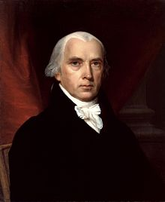

Slide 13
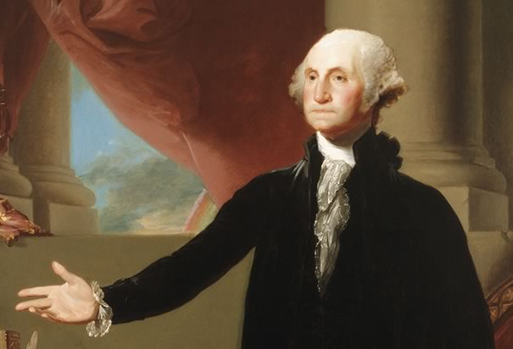
2. George Washington (VA) = elected President of the Convention
-Rarely participated, but his presence brought prestige to the convention.

Slide 14
Constitution Activities
Activity B

Slide 15
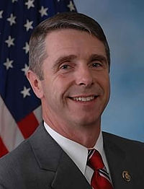
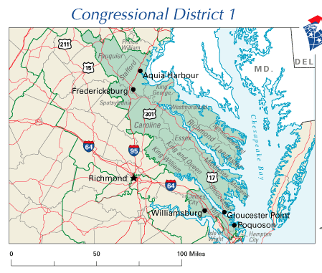
US Representative – Rob Wittman (R) - VA – 1st District

Slide 16
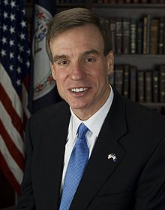
US Senators – Mark Warner (D) & Tim Kaine(D)

Slide 17
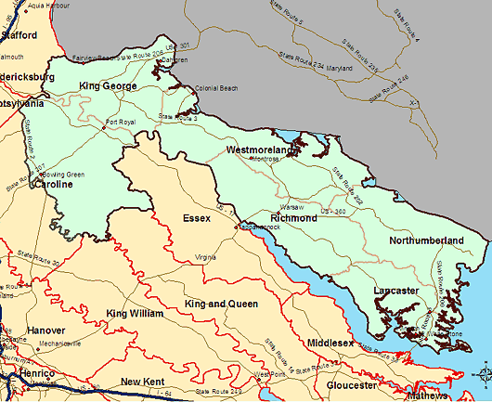
VA General Assembly – Margaret Ransone (R) – 99th District

Slide 18
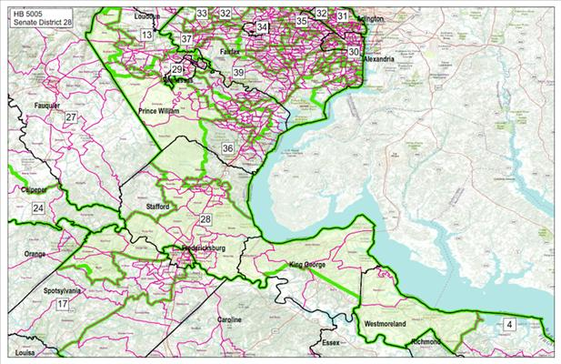
VA Senate – Richard Stuart (R) – 28th District

Slide 19
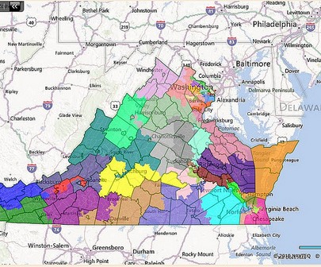
Ryan McDougle (R) – 4th District

Slide 20
The Power of Compromise
Deals made at the Constitutional Convention

Slide 21
A. James Madison suggested the Virginia Plan
1. Divided govt. into 3 branches – separated powers so no one branch became too powerful
2. bicameral legislative branch made up of 2-houses
3. Representation based on population of the state (favored large states like VA & NY)

Slide 22
B. States with smaller populations liked the New Jersey Plan
1. Each state = 1 vote
2. Representation would be equal (favored smaller state like DE & RI)

Slide 23
C. The Great Compromise solved the problem
1. House of Representatives – representation based on population
2. Senate – representation based on equality (2 senators per state)

Slide 24
D. Three-Fifths Compromise = solved the slave problem
1. South – wanted slaves to count toward population
2. North – wanted slaves taxed
3. Compromise: 5 slaves = 3 free people for representation and taxation

Slide 25
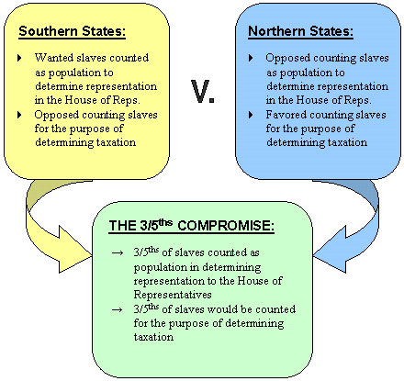

Slide 26
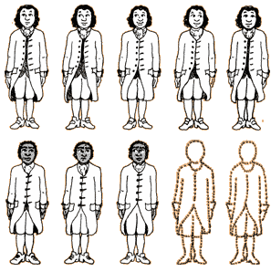

Slide 27
E. Legislative Branch given new powers!
1. Levy & collect taxes
2. Coin money
3. Regulate trade

Slide 28
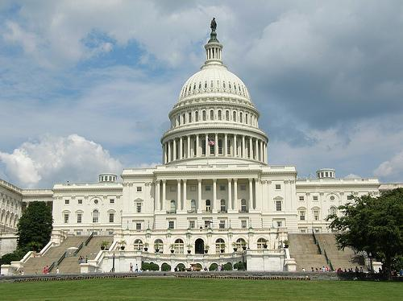

Slide 29
F. Executive Branch = to prevent one person from becoming too powerful:
1. The President serves 4-year terms & runs for re-election
2. Chosen by Electoral College

Slide 30
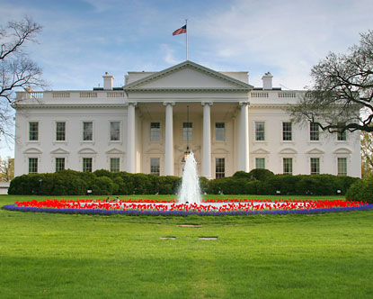

Slide 31
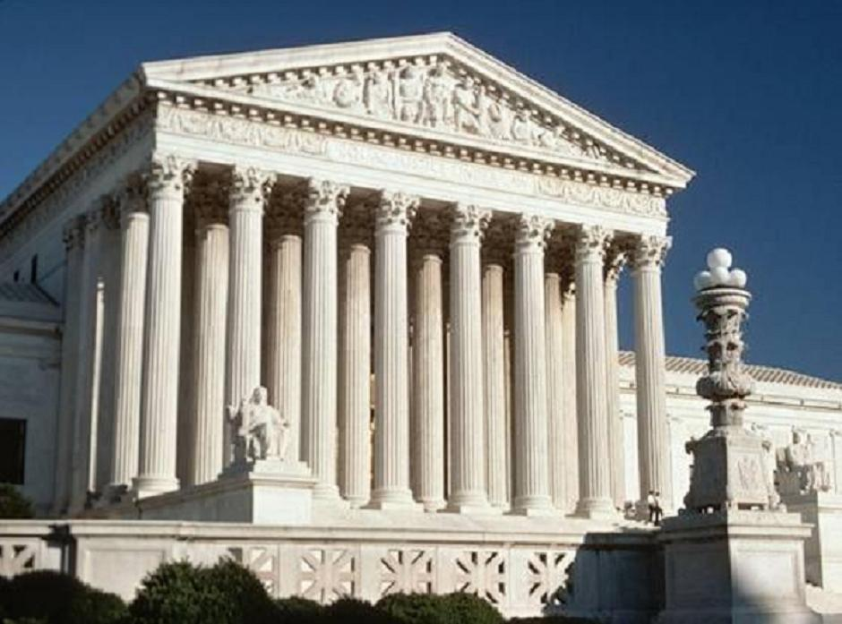
G. Judicial Branch = created the Supreme Court

Slide 32
H. Framework for Limited Government
1. Federalism = national government shares powers with the states
2. Checks & Balances = prevent too much power
3. Amendments = add or make changes to the Constitution
4. Supremacy Clause = the Constitution & federal law is the “supreme law of the land”

Slide 34
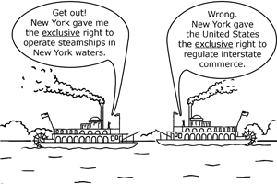

Slide 35
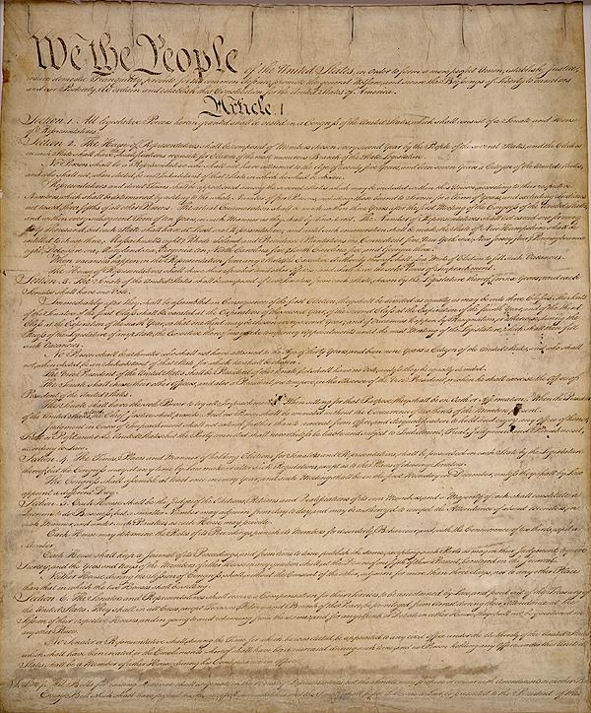

Slide 36
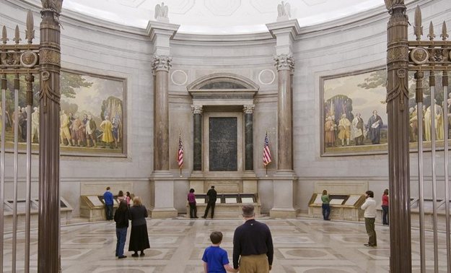

Slide 37
Ratification

Slide 38
Only required 9 out of 13 states to ratify (approve) the Constitution

Slide 39
Two groups argued for and against the Constitution:
Federalists
Ant-Federalists
For strong central gov’t
George Washington & James Madison
Strong gov’t necessary for economic development & public improvements
Today, Liberals think Federal gov’t should solve nation’s problem
Against strong central gov’t
Patrick Henry & George Mason
national gov’t would take power away from the states and infringe on people’s rights
Today, conservatives think individuals can solve their own problems

Slide 40
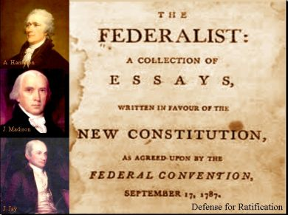

Slide 42
Compromise
Federalists added a Bill of Rights so the Anti-federalists would ratify the Constitution.
By 1791, all 13 states had ratified

Slide 43
Bill of Rights
Individual freedoms that protect citizens from gov’t abuses (first 10 Amendments)
Mainly written by James Madison who borrowed from other documents

Slide 44
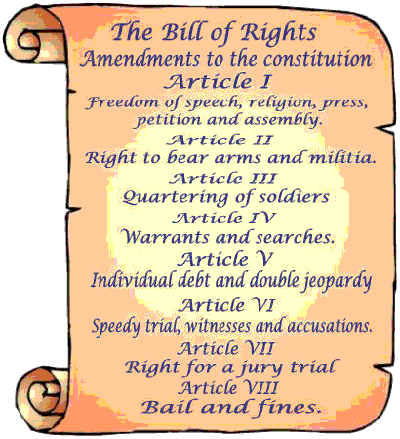

Slide 45
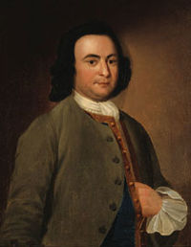
Virginia Declaration of Rights = list of fundamental rights
written by George Mason in 1776.

Slide 46
Virginia Statute of Religious Freedom = written by Thomas Jefferson
“separation of church and state”
Basis for 1st Amendment - freedom of religion

