Slide 1
Struggle for Empire

Slide 2
A. Understanding the Colonial Relationship:
Americans Colonists
Proud subjects of the King of England
Believed they had the same rights as any Englishmen
England
Authority to tax and to make laws for the colonies
Colonies needed to support the mother country

Slide 3
B. During the early colonial period, England did not enforce the rules. Why not?
1. Distance = 3,000 miles, difficult to control
2. Few British officers in America
3. Colonists smuggled goods
4. England had to deal with King George III

Slide 4
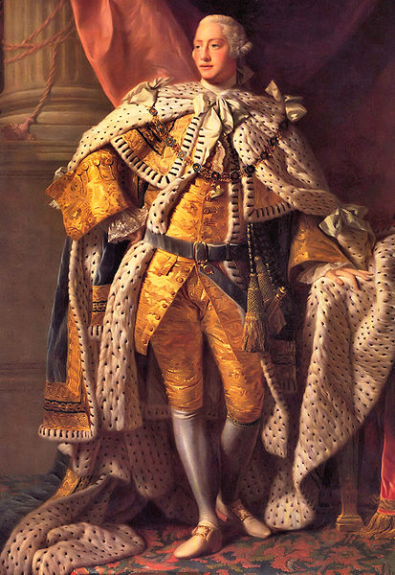

Slide 5
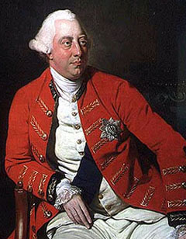

Slide 6
c. Anglo-French Rivalry led to the French & Indian War (1754-1763)
- Great Britain & France fought for control of North America
French built forts located in territories of VA & PA
Washington told the French to leave – They refused
- Britain won and got all of Canada & lands east of the Mississippi River.
French upset – 150 yrs of colonization down the drain

Slide 7
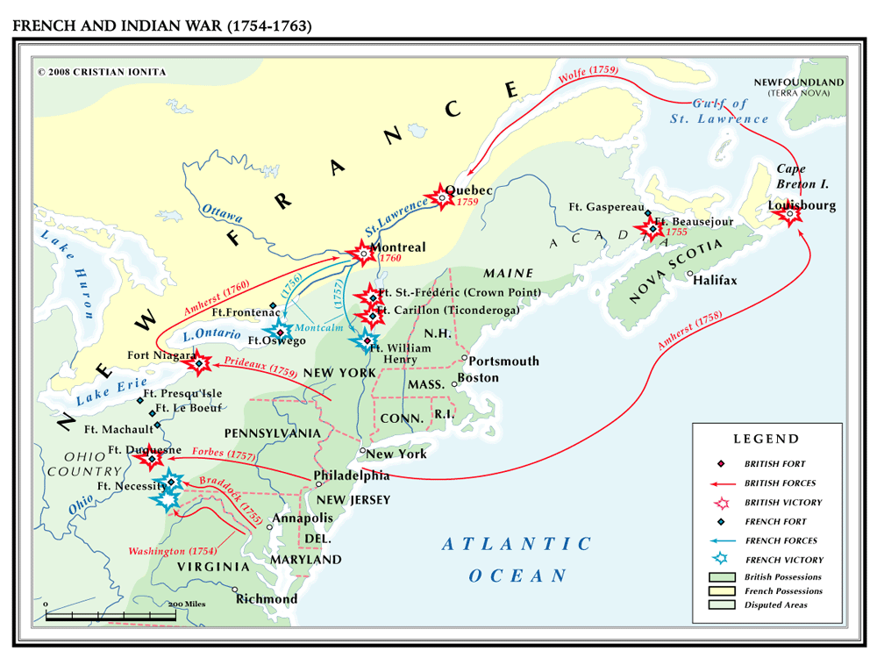

Slide 8
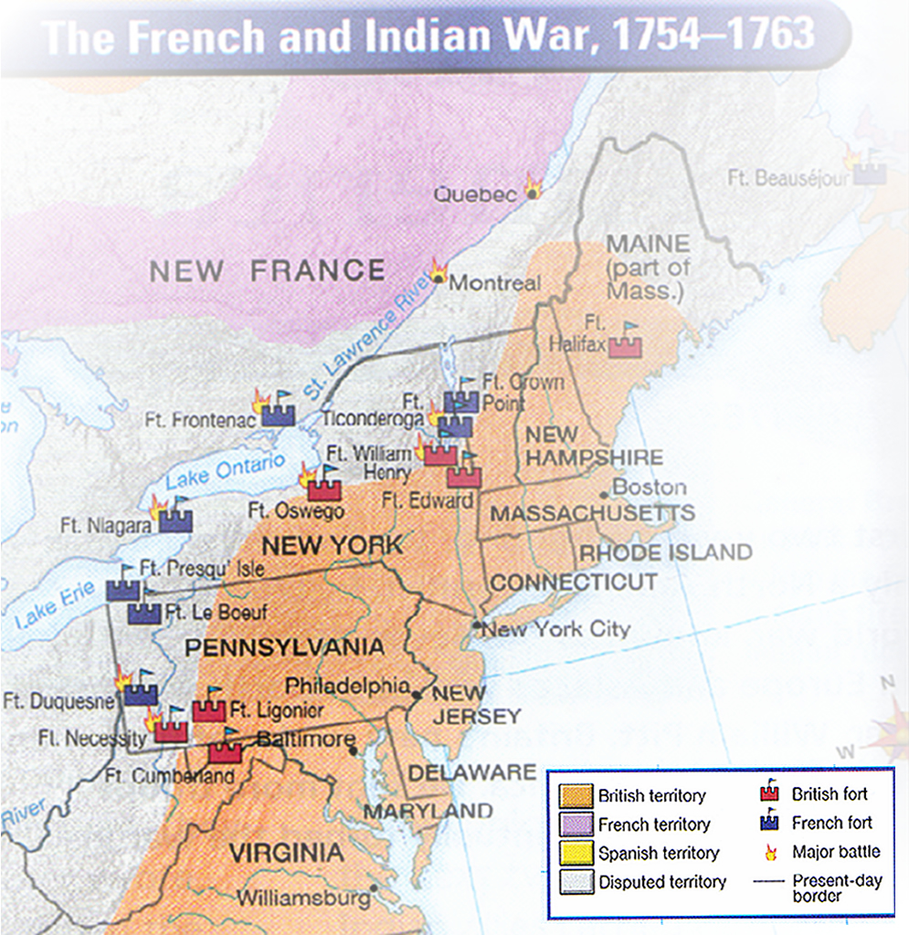

Slide 9
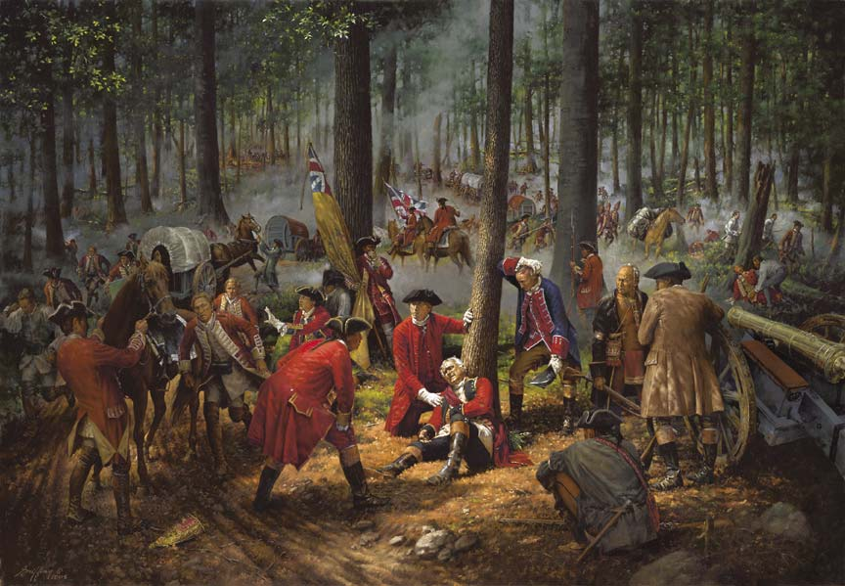

Slide 10
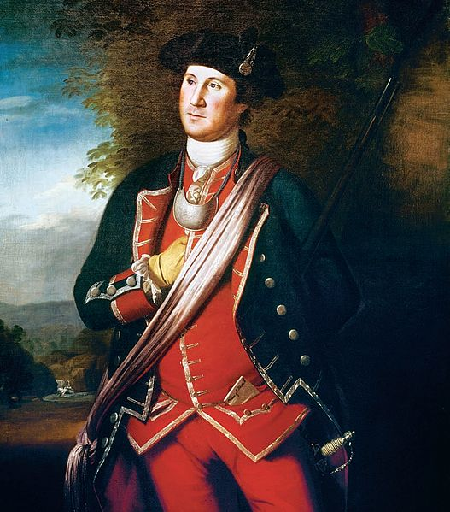

Slide 11
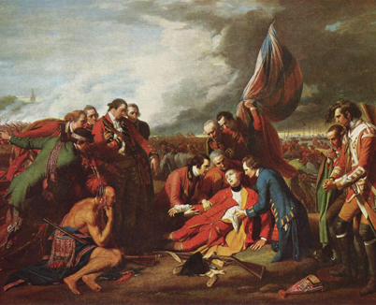

Slide 12
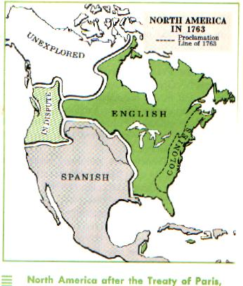

Slide 13
D. Problems After F & I War
1. Huge debt for England (wars are expensive)
2. More territory to control
3. Indian revolts in the Ohio River Valley

Slide 14
E. Proclamation of 1763
-No colonists were allowed west of the Appalachian Mts.
-Colonists were MAD – deprived of land they had fought for during the war

Slide 15
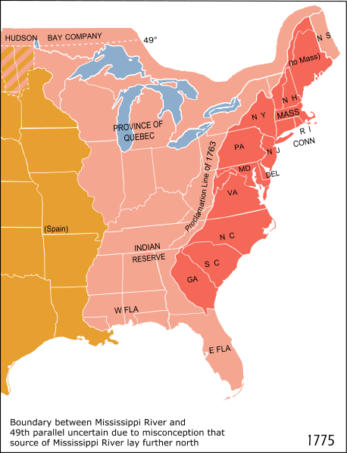

Slide 16
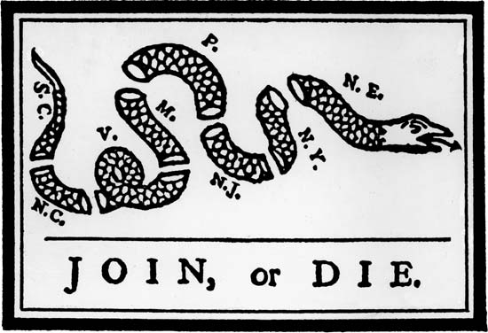
Control & Protest

Slide 17
A. England gets tough on the colonies – Why? Needed colonies to help pay costs
British agents given a warrant to search for smuggled goods
Eliminated jury trials (basic rights of all Englishmen)

Slide 18
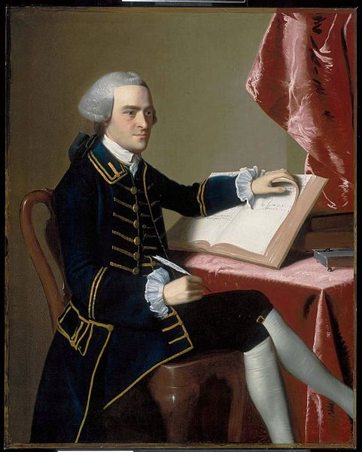

Slide 19
B. British felt the Colonists should pay for their defense.
1. Stamp Act (1765): required stamps to be placed on any printed or legal documents.
a. Colonists boycotted (refused to buy British goods)
b. Parliament repealed tax in 1766

Slide 20
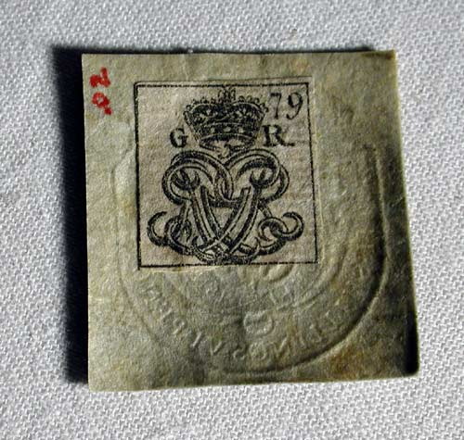

Slide 21
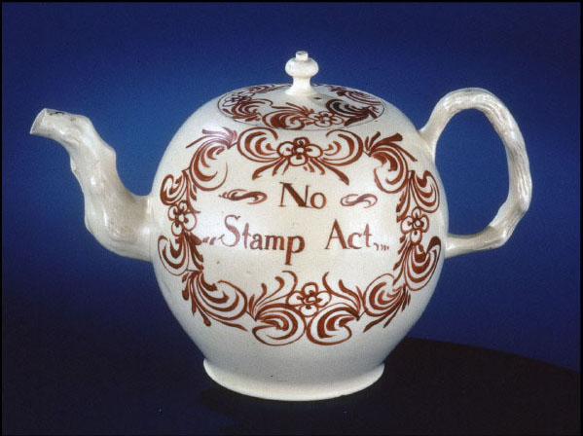

Slide 22
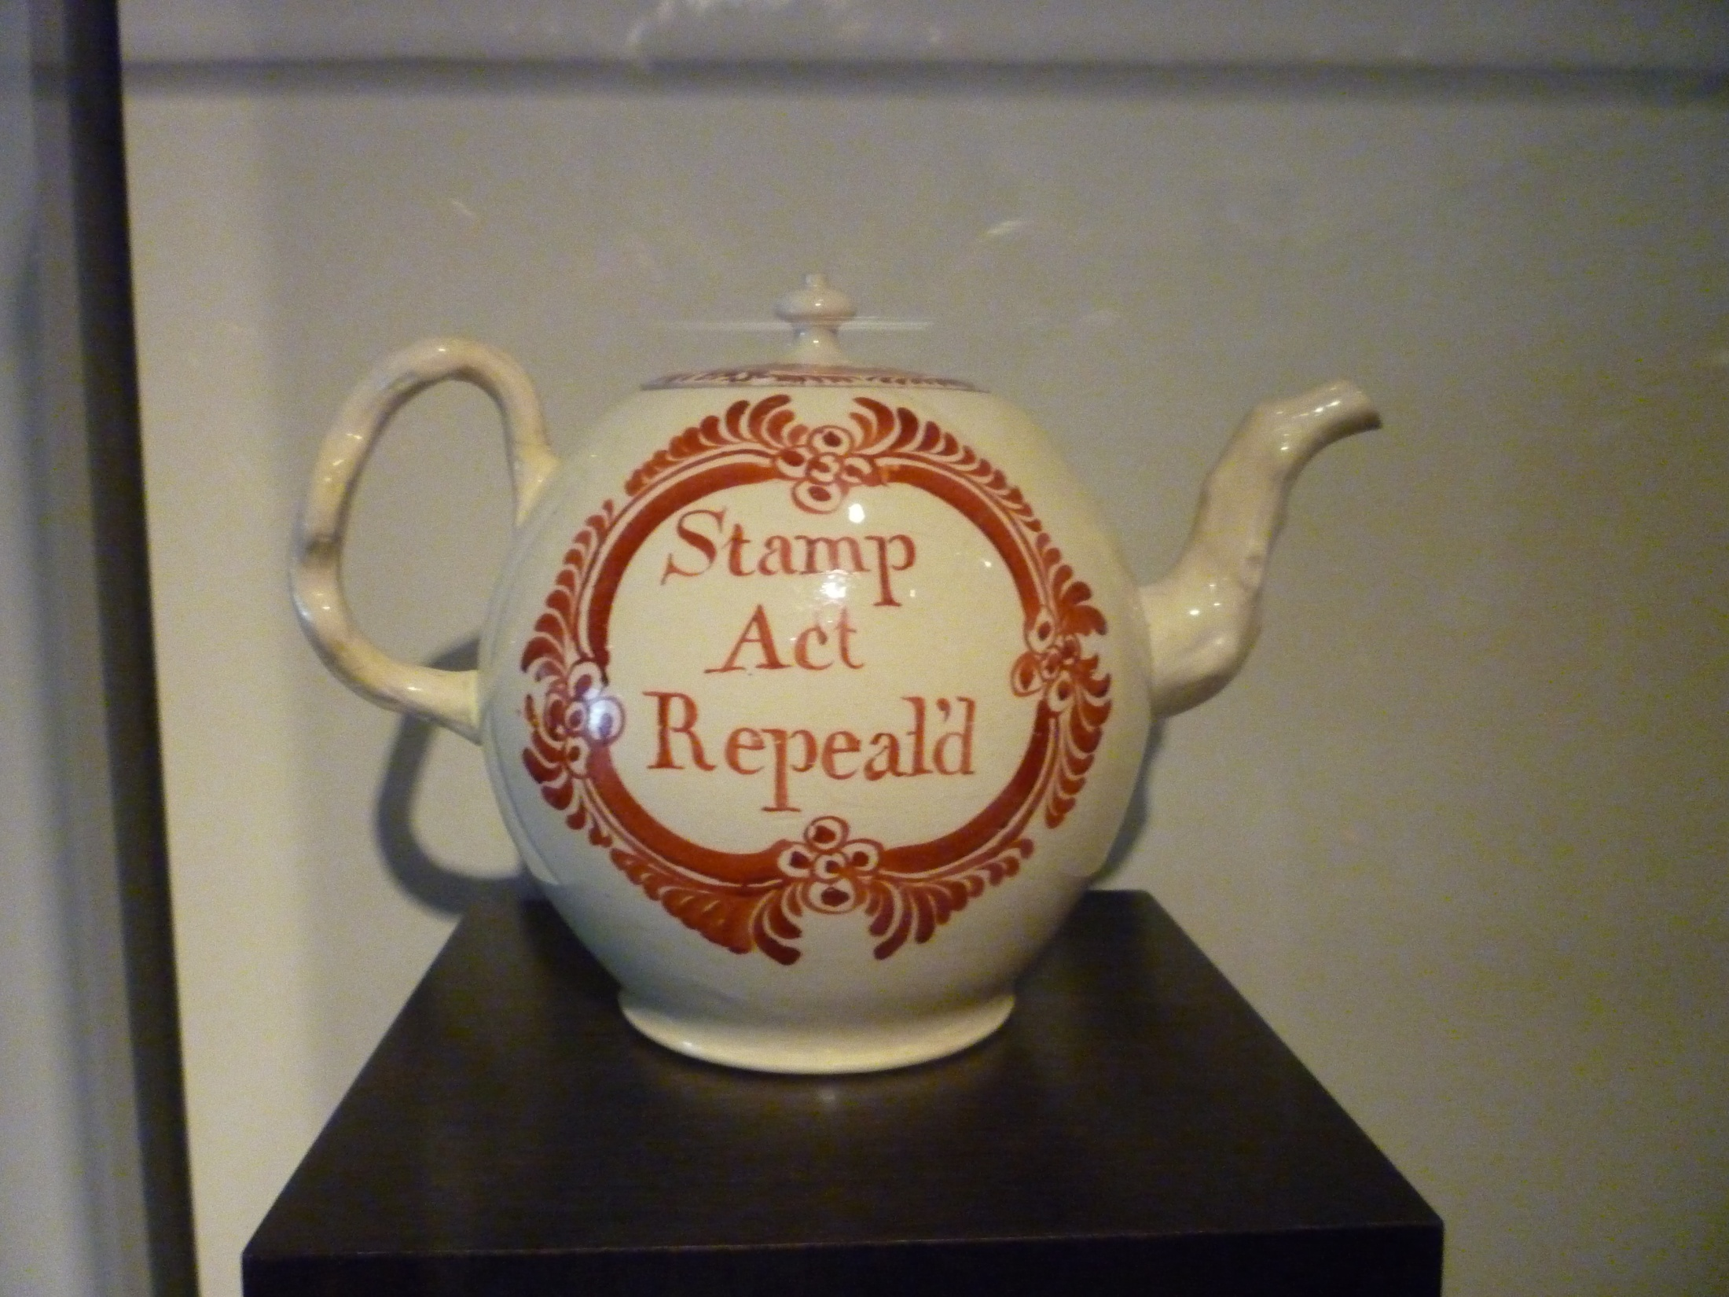

Slide 23
2. Colonial Leaders from Virginia:
a. Patrick Henry protested Stamp Act: “How can Britain tax the colonies if the colonies have no representation in Parliament?”
b. Richard Henry Lee wrote the Leedstown Resolutions to protest the Stamp Act in Westmoreland Co.

Slide 24
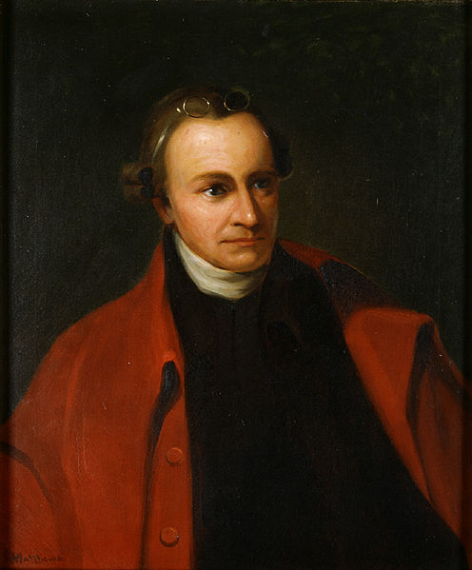

Slide 25
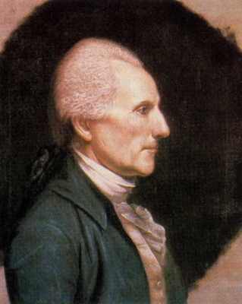

Slide 26
C. Stronger British Presence in the American Colonies
Redcoats stationed in cities to assist tax collectors
Boston Massacre (Mar. 5, 1770): colonists taunted a redcoat
a. Soldiers fired into the crowd (5 dead)
b. John Adams defended the soldiers in court

Slide 27
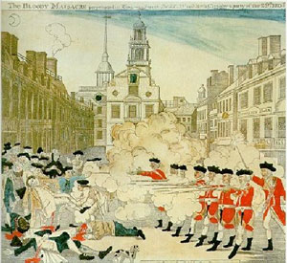

Slide 28
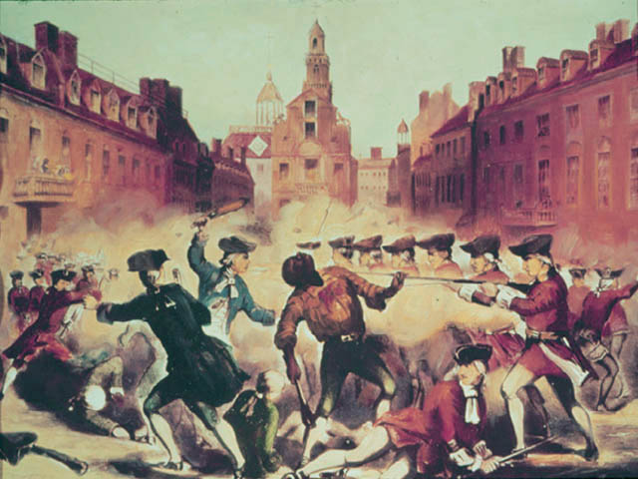

Slide 29
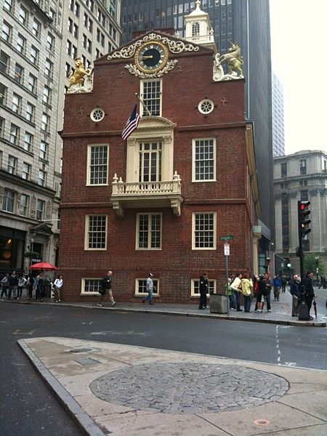

Slide 30
D. Boston Tea Party (Dec. 16, 1773): British had tea monopoly in the colonies
1. Disguised as Indians, colonists boarded the ships & dumped 342 crates of tea in the harbor
2. England closed the port of Boston & limited town meetings

Slide 31
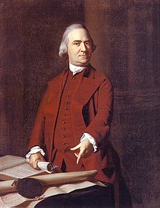

Slide 32
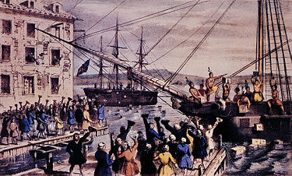

Slide 33
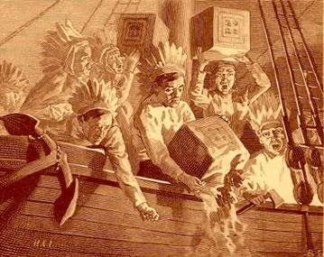

Slide 34
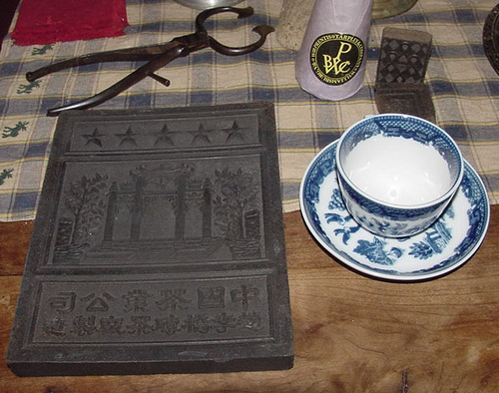

Slide 35
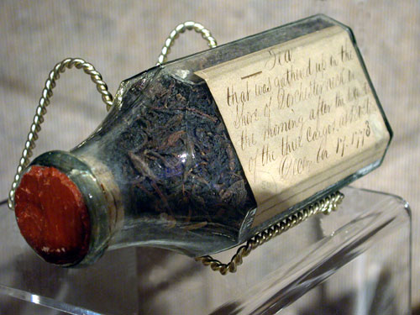

Slide 36
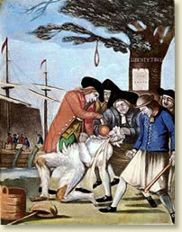

Slide 37
E. First Continental Congress (Sept. 1774)
- 56 delegates from all of the colonies EXCEPT Georgia met in Philadelphia & began to work together
1. Asked King George III for relief
2. Vowed to boycott English goods
3. Organized minutemen and militias (citizen armies)

Slide 38
F. “The Shot Heard ‘Round the World” (Apr. 19, 1775)
Redcoats marched to Concord, MA to seize colonial powder & ammunition
Paul Revere & 200 riders alarmed minutemen
1. At Lexington, 70 minutemen vs. 700 redcoats – someone fired & the Revolutionary War began
2. Other colonies around the world will follow the United States’ example!

Slide 39
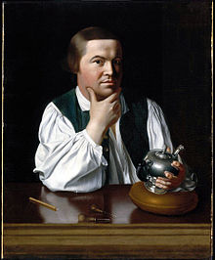

Slide 40
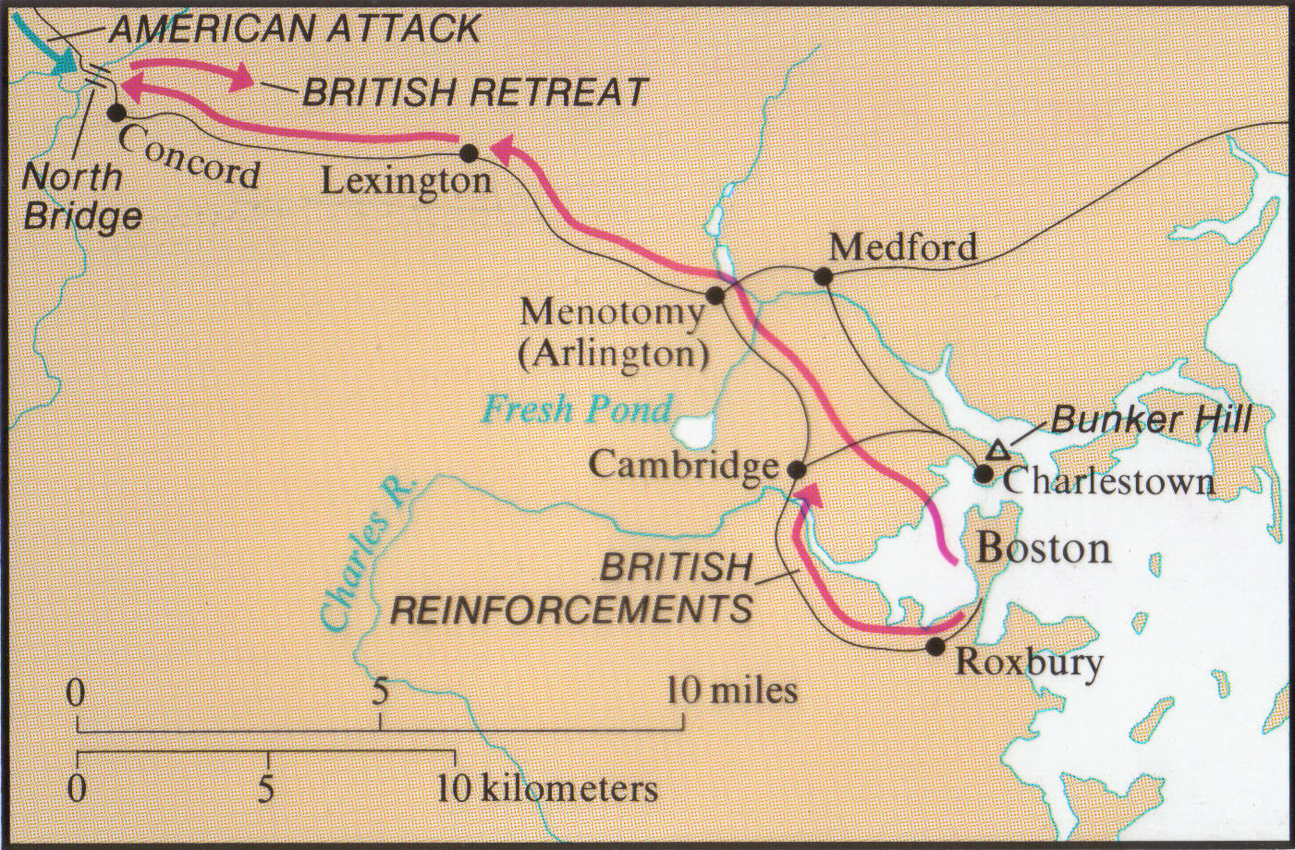

Slide 41
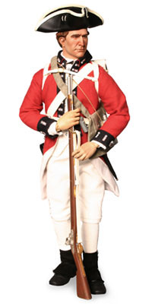

Slide 42
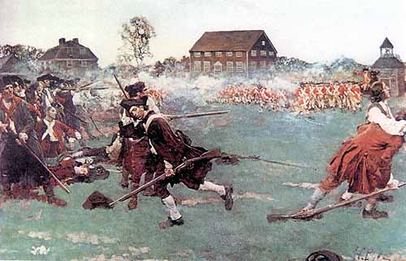

Slide 43
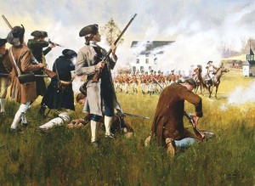

Slide 44
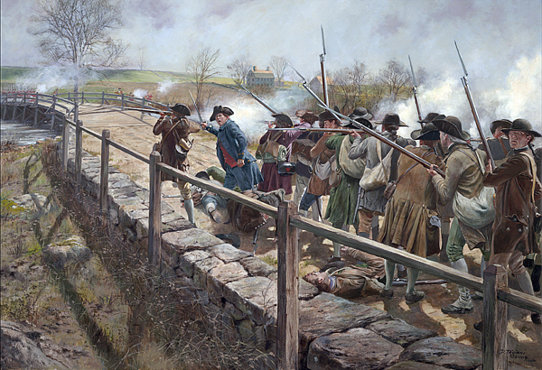

Slide 45
G. Colonial representatives met in Philadelphia in May 1775
1. Assumed the role of a central government
2. Chose George Washington (VA) to lead the Continental Army
– hoped to gain support of southern colonies.

Slide 46
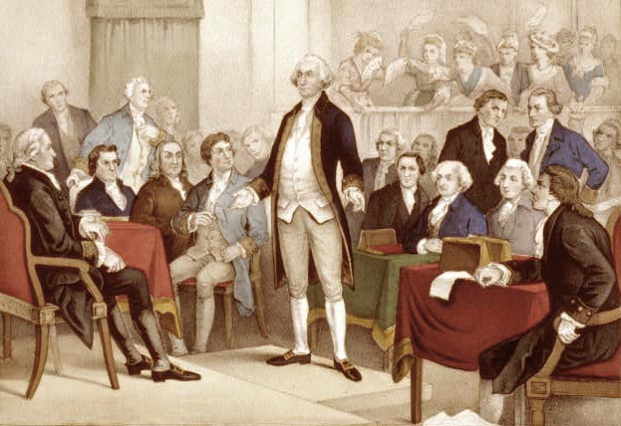

Slide 47
Freedom Writers

Slide 48
A. In Jan. 1776, Thomas Paine wrote a pamphlet called “Common Sense”
He argued the colonies should become independent
1. Colonists were divided over Paine’s idea of independence

Slide 49
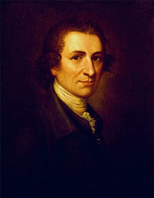

Slide 50
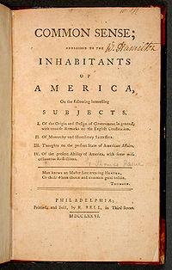

Slide 51
a. Patriots (1/3) wanted independence – inspired by Patrick Henry’s speech: “Give me liberty or give me death.”
b. Loyalists (Tories) (1/3) remain loyal to England b/c of cultural & economic ties
c. Neutrals = stay uninvolved in the war

Slide 52
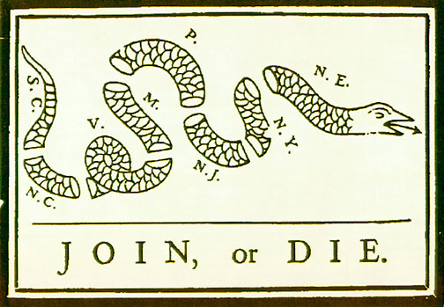

Slide 53
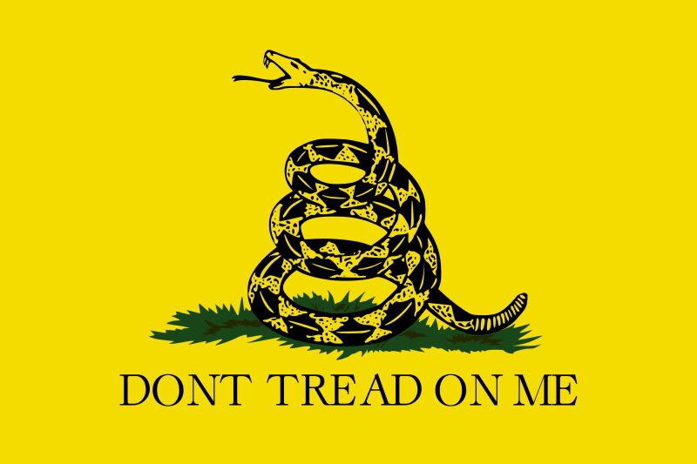

Slide 54
B. Declaring Independence – Continental Congress … Philadelphia
1. Declaration of Independence written by Thomas Jefferson to explain reasons for independence –approved on July 4, 1776
a. Borrowed from Enlightened philosopher, John Locke

Slide 55
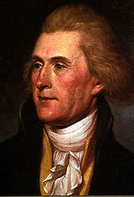

Slide 56
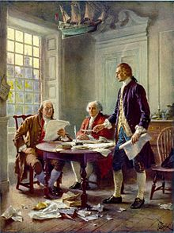

Slide 57
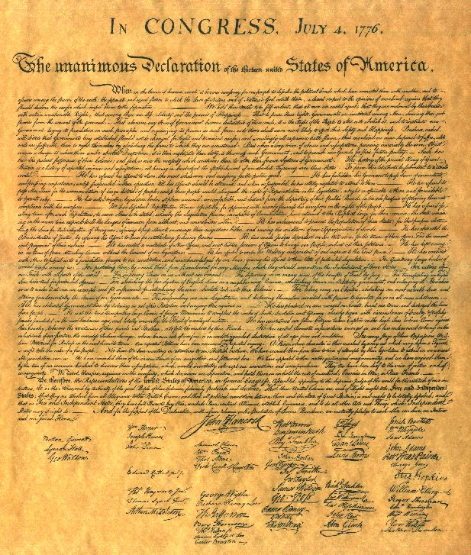

Slide 58
(1) Natural Rights: rights that can’t be taken away
- “unalienable rights; Life, Liberty, and the Pursuit of Happiness.”

Slide 59
(2) Social-contract theory: “Government derives their just powers from the consent of the governed.”
- People form govts to protect their rights and in return they agree to obey the laws (ordered liberty).
- When govt threatens these rights, it has broken the contract & the people have the right to “alter or abolish it”

Slide 60
b. Ideas challenged the practice of dictatorial rule
c. Jefferson listed grievances against the King of England (described earlier by Thomas Paine in Common Sense)
d. key ideas included:
political participation = voting
social participation = equality
economic rights = pursuit of happiness

Slide 61
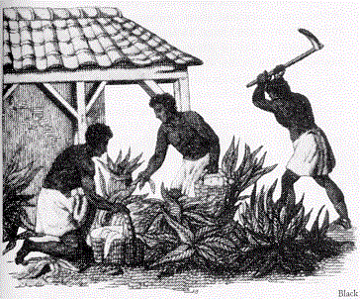
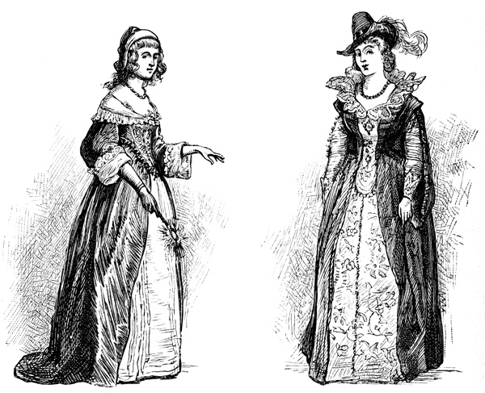
e. Declaration of Independence contradicted the realities of slavery and the undemocratic nature of political participation (women).

Slide 62
The Revolutionary War
1775 - 1783

Slide 63
In the early years of the war, defeat for the Americans seemed inevitable
A. Washington’s leadership kept the Continental Army together
avoided situations that threatened the destruction of his army

Slide 64
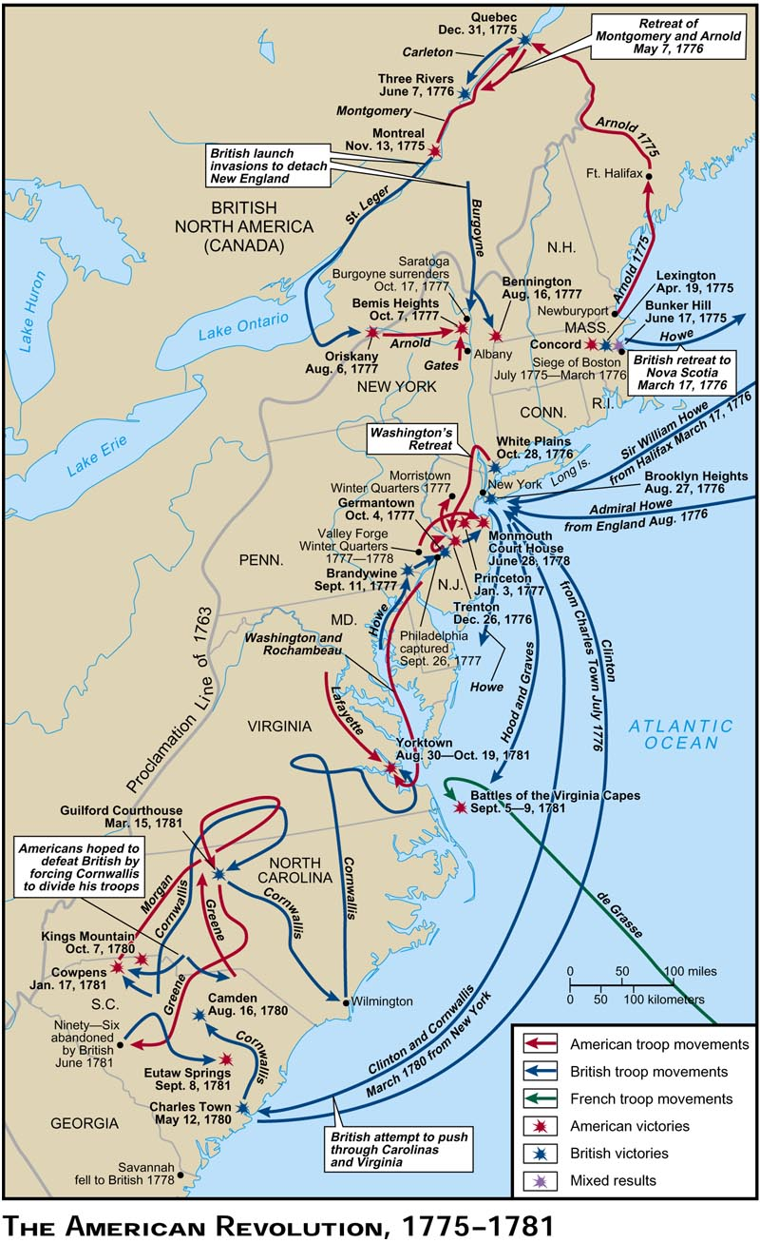

Slide 65
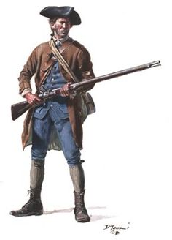
B. Analyzing Armies - Patriots
Disadvantages
Small , untrained army
Lacked money and supplies
Advantages
Leadership of George Washington
Fought for their homes
Knew the territory

Slide 66
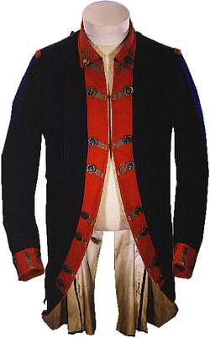
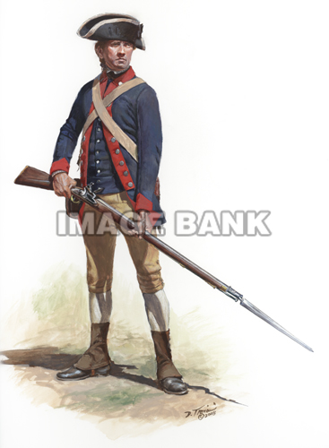

Slide 67
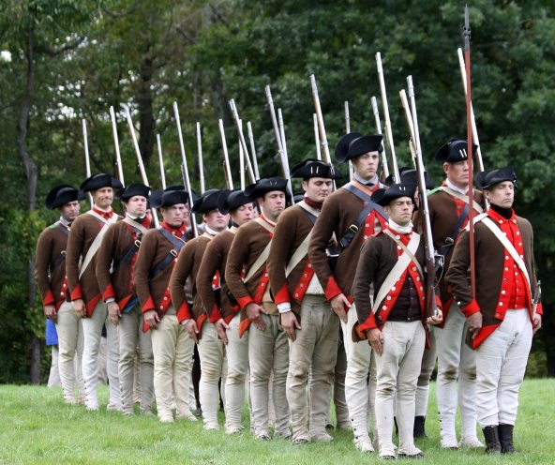

Slide 68
-Redcoats
Advantages
Large, well-trained army & navy
Lots of money for supplies
Helped by Tories
Disadvantages
Unpopular war in Britain
Did not understand causes of war
Defending against hit-and-run tactics

Slide 69
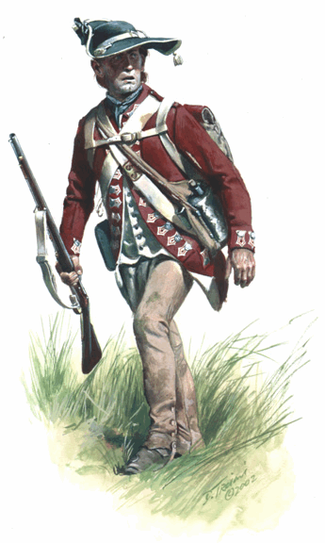
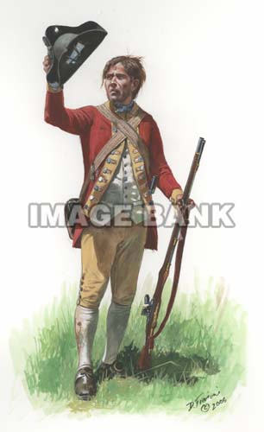

Slide 70
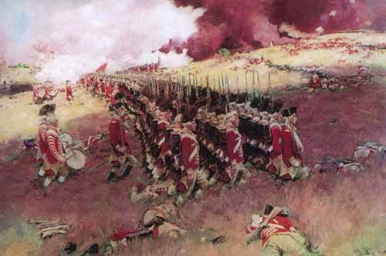

Slide 71
C. Alliance with France
1. Benjamin Franklin was popular in France & worked to form alliance
2. France wanted signs of success before supporting Americans
3. In Oct. 1777, the colonists won a major battle in NY – France agreed to help

Slide 72
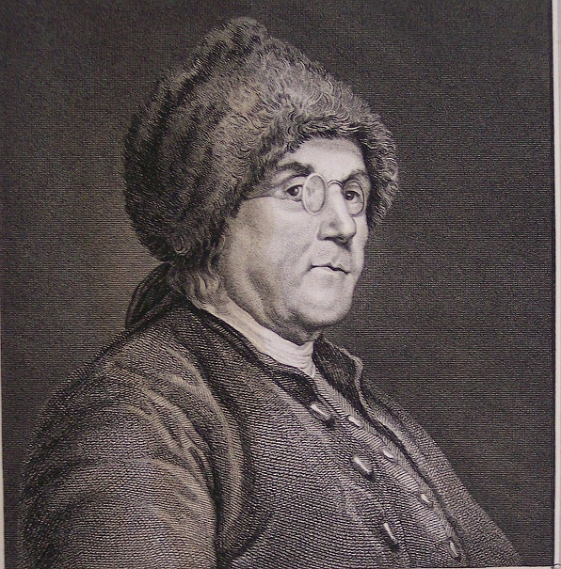

Slide 75
Winter at Valley Forge (PA, 1777-1778): Continental Army suffered through a harsh winter
1. Before French aid could arrive – American troops lacked food, shoes, and coats
2. 25% of Washington’s men (2,500) died or deserted
3. By spring, France & other European countries lent money & military support

Slide 77
D. End of the War
1. Gen. Cornwallis fought north from GA to VA
2. Battle of Yorktown (VA, 1781):
a. French navy blocked the Chesapeake Bay & prevented British naval support
b. French & American surrounded Yorktown & trapped Cornwallis
3. Cornwallis’ army surrendered on Oct. 19, 1781 – Americans had won.

Slide 81
F. Treaty of Paris (1783)
1. United States became an independent nation
2. Given lands from the Atlantic to the Mississippi River, north to Canada, and south to Florida
3. U.S. doubled in size from the original 13 colonies

